Slide 1
Coupled Semi-Supervised Learning for Information Extraction
Carlson et al.
Proceedings of WSDM 2010

Slide 2
Summary
What’s the Point?
Bootstrapping review
Coupling constraints
CPL, CSEAL, and MBL
Results and Discussion

Slide 3
What’s the Point?
Learn new information from the web
Specifically, find new instances of known categories and relations
Notes:
First question to ask about this paper: what is the point of the learning methods being researched? To learn new information from the web. Specifically, given a set of categories and relationships within a particular domain, to learn new instances of those categories and relationships.

Slide 4
Bootstrapping
<Mark Twain, Elmira> Seed tuple
Grep (google) for the environments of the seed tuple
“Mark Twain is buried in Elmira, NY.”
X is buried in Y
“The grave of Mark Twain is in Elmira”
The grave of X is in Y
“Elmira is Mark Twain’s final resting place”
Y is X’s final resting place.
Use those patterns to grep for new tuples
Iterate
Notes:
Quick refresher on bootstrapping, or semi-supervised learning - Start with small seed set of categories and relations and large unlabeled corpus
Find new information that conforms with seed data
Evaluate and incorporate good information into KB

Slide 5
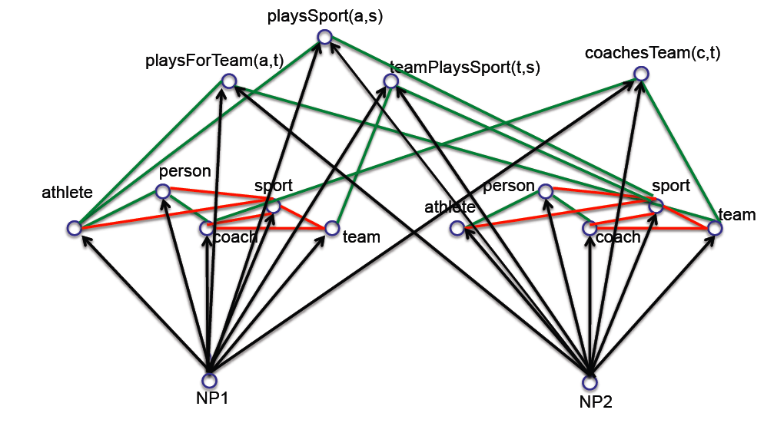
Key Idea 1: Coupled semi-supervised training of many functions
person
noun phrase
hard (underconstrained) semi-supervised learning problem
much easier (more constrained)
semi-supervised learning problem
Tom Mitchell
Notes:
Main idea of paper part 1: coupled training via multiple functions; using the output of one classification function to compare to another and vice versa in order to avoid semantic drift

Slide 6
Type 1 Coupling: Co-Training, Multi-View Learning
[Blum & Mitchell; 98]
[Dasgupta et al; 01 ]
[Ganchev et al., 08]
[Sridharan & Kakade, 08]
[Wang & Zhou, ICML10]
person
f₁(NP)
f₃(NP)
f₂(NP)
NP context distribution
NP morphology
NP HTML contexts
NP:
__ is a friend
rang the __
…
__ walked in
capitalized?
ends with ‘...ski’?
…
contains “univ.”?
www.celebrities.com:
<li> __ </li>
…
Tom Mitchell
Notes:
Main idea of paper part 2: coupled training via multiple data views; using classification on different types of data as checks against one another’s results

Slide 7
Coupling Constraints
Types of Constraints
Output constraints :: Mutual exclusion
Compositional constraints :: Argument type-checking
Multi-view-agreement constraints :: Unstructured and semi-structured comparison
Notes:
The authors consider three abstract types of coupling constraints, which roughly correspond to the three specific constraints leveraged in the paper.
Questions?

Slide 8
Coupled Semi-Supervised Learning
Coupled Pattern Learning (CPL)
Extracts patterns from unstructured text
Coupled SEAL (CSEAL)
Extracts patterns from semi-structured text (e.g. URLs)
Meta-Bootstrap Learner (MBL)
Cross-checks results from CPL and CSEAL
Notes:
The overall structure proposed in the paper looks something like this: functional coupling is used at the first level in independent runs of CPL and CSEAL, and the second level then uses multi-view coupling to combine the results from the first runs into the MBL. A complete iteration of the learner requires running through both steps.

Slide 9
Coupled Pattern Learner
Extract new candidate instances/patterns using promoted info
Filter candidates using coupling constraints
Rank filtered candidates
Promote top-ranked candidates
Rinse and repeat
Babe Ruth broke the home run record
Category
Baseball Player
NP
Pattern
Associated Promoted Patterns
- arg1 played baseball for
- arg1 broke the home run record
Associated Promoted Instances
- Lou Gehrig
- Babe Ruth
=> arg1 broke the home run record is new Baseball Player category
=> Babe Ruth is new Baseball Player instance
Notes:
More detail on how the Coupled Pattern Learner works. This is a method for pattern-based learning on unstructured text, so what we’re looking for is literal, unstructured, string patterns. Step 1 is to use all of the promoted category and relation instances and patterns (in the first run, this is the seed data) in order to find new candidate instances and patterns, by looking for string matches. So, if we’re using the category “Baseball Player” and we have a promoted instance of “Babe Ruth”, any pattern found around “Babe Ruth”, as long as it obeys certain syntactic constraints, is considered a candidate pattern for Baseball Player. Similarly, if the pattern “broke the home run record” is promoted, then the NP “Babe Ruth”, found in the arg1 position, is considered a candidate instance.
Step 2 is to filter the candidates using the two coupling constraints that apply at this stage: namely, mutual-exclusion and type-checking. Mutual-exclusion (and possibly type-checking) constraints are specified in the input ontology—there is no mechanism for extracting these from observed data.
Step 3 is to rank candidates; instances are preferred based on the number of distinct promoted patterns they co-occur with, and patterns are preferred based on how commonly they appear with a promoted instance compared to how commonly they appear in the entire corpus.
-> I take some issue with both of these rankings; the first seems like it should suffer from not ranking instances that can only appear with very few patterns, and the second from not ranking patterns that are common English constructs.
Step 4 is straightforward—take the highly-ranked candidates and promote them,
And then continue apace.
See illustration of candidate extraction below.

Slide 10
Coupled Pattern Learner
Extract new candidate instances/patterns using promoted info
Filter candidates using coupling constraints
Rank filtered candidates
Promote top-ranked candidates
Rinse and repeat
Candidate Instance
Sears Tower
Sears Tower is promoted instance of Building
Building != Baseball Player
=> Sears Tower != Baseball Player
Category
Baseball Player
Notes:
More detail on how the Coupled Pattern Learner works. This is a method for pattern-based learning on unstructured text, so what we’re looking for is literal, unstructured, string patterns. Step 1 is to use all of the promoted category and relation instances and patterns (in the first run, this is the seed data) in order to find new candidate instances and patterns, by looking for string matches. So, if we’re using the category “Baseball Player” and we have a promoted instance of “Babe Ruth”, any pattern found around “Babe Ruth”, as long as it obeys certain syntactic constraints, is considered a candidate pattern for Baseball Player. Similarly, if the pattern “broke the home run record” is promoted, then the NP “Babe Ruth”, found in the arg1 position, is considered a candidate instance.
Step 2 is to filter the candidates using the two coupling constraints that apply at this stage: namely, mutual-exclusion and type-checking. Mutual-exclusion (and possibly type-checking) constraints are specified in the input ontology—there is no mechanism for extracting these from observed data.
Step 3 is to rank candidates; instances are preferred based on the number of distinct promoted patterns they co-occur with, and patterns are preferred based on how commonly they appear with a promoted instance compared to how commonly they appear in the entire corpus.
-> I take some issue with both of these rankings; the first seems like it should suffer from not ranking instances that can only appear with very few patterns, and the second from not ranking patterns that are common English constructs.
Step 4 is straightforward—take the highly-ranked candidates and promote them,
And then continue apace.
See illustration of candidate extraction below.

Slide 11
Coupled Pattern Learner
Extract new candidate instances/patterns using promoted info
Filter candidates using coupling constraints
Rank filtered candidates
Promote top-ranked candidates
Rinse and repeat
Candidate Instances
Babe Ruth -> 3
Lou Gehrig -> 2
Hank Aaron -> 22
Candidate Patterns
arg1 broke the home run record -> .98
arg1 hit a fly ball -> .7
tagged arg1 out -> .3
Candidate Instances
Babe Ruth -> 3
Lou Gehrig -> 2
Hank Aaron -> 22 Promoted!
Candidate Patterns
arg1 broke the home run record -> .98 Promoted!
arg1 hit a fly ball -> .7
tagged arg1 out -> .3
Notes:
More detail on how the Coupled Pattern Learner works. This is a method for pattern-based learning on unstructured text, so what we’re looking for is literal, unstructured, string patterns. Step 1 is to use all of the promoted category and relation instances and patterns (in the first run, this is the seed data) in order to find new candidate instances and patterns, by looking for string matches. So, if we’re using the category “Baseball Player” and we have a promoted instance of “Babe Ruth”, any pattern found around “Babe Ruth”, as long as it obeys certain syntactic constraints, is considered a candidate pattern for Baseball Player. Similarly, if the pattern “broke the home run record” is promoted, then the NP “Babe Ruth”, found in the arg1 position, is considered a candidate instance.
Step 2 is to filter the candidates using the two coupling constraints that apply at this stage: namely, mutual-exclusion and type-checking. Mutual-exclusion (and possibly type-checking) constraints are specified in the input ontology—there is no mechanism for extracting these from observed data.
Step 3 is to rank candidates; instances are preferred based on the number of distinct promoted patterns they co-occur with, and patterns are preferred based on how commonly they appear with a promoted instance compared to how commonly they appear in the entire corpus.
-> I take some issue with both of these rankings; the first seems like it should suffer from not ranking instances that can only appear with very few patterns, and the second from not ranking patterns that are common English constructs.
Step 4 is straightforward—take the highly-ranked candidates and promote them,
And then continue apace.
See illustration of candidate extraction below.

Slide 12
Coupled SEAL
Run SEAL to extract new candidates and their wrappers
Filter wrappers/candidates using coupling constraints
Rank filtered candidates
Promote top-ranked candidates
Rinse and repeat
<a class=“car”>Audi</a>
Category
CarMake
Pattern
NP
Associated Promoted Patterns
- <p class=“auto”>arg1</p>
- <a href=“car”>arg1</a>
Associated Promoted Instances
- Ford
- Audi
=> <a class=“car”>arg1</a> is new CarMake category
=> Audi is new CarMake instance
Notes:
CSEAL follows a similar pattern. There are no direct modifications to the SEAL algorithm, so it is treated as a black box that extracts candidates and wrappers from HTML. Filtering here is the same as in CPL, using mutual-exclusion and type-checking constraints.
Candidate ranking is performed based solely on the unfiltered count of wrappers that extracted the candidate. The top-ranked 100 candidate instances are then promoted and we move on.
See example at bottom.
From what I understood, CSEAL does not rank/promote wrapper patterns—however, all the information to do so appears to be provided by SEAL’s output, so I’m not sure why this is the case.

Slide 13
Meta-Bootstrap Learner
Run CPL, store results in X₁
Run CSEAL, store results in X₂
Compare results from X₁ and X₂
Filter for all x_{i} such that x ∈ X₁ and x ∈ X₂
Filter for all x_{i} such that x_{i} satisfies coupling constraints
Promote remaining candidates
Notes:
The Meta-Bootstrap Learner is relatively simple—CPL and CSEAL are run independently, with the one modification that instead of promoting candidates themselves, they report top candidates to MBL. The results from both runs are compared, and candidates that A) were found as candidates for the same category by both algorithms and B) do not violate coupling constraints are promoted. CPL and CSEAL are then re-run with the new promoted candidates, and so on.

Slide 14
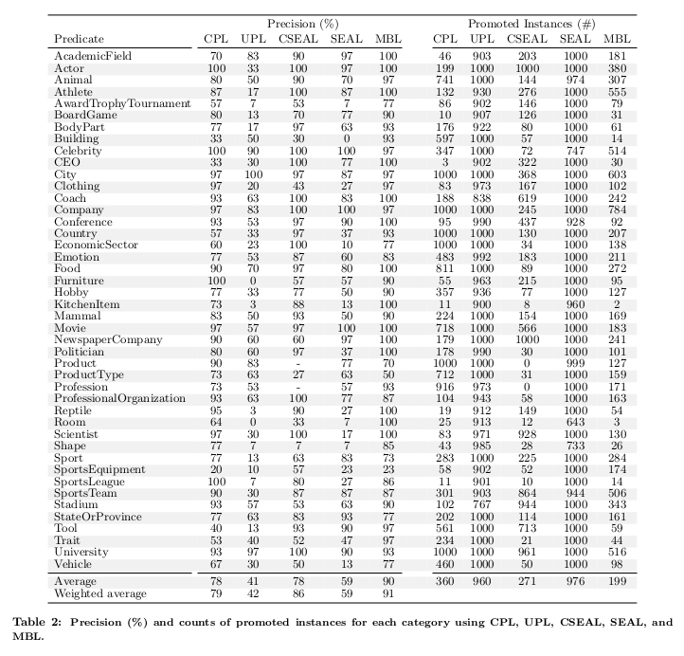
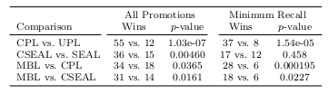
From Carlson et al. (2010)
Notes:
Three

Slide 15
Discussion Points
Corpus differences
CPL: 514m sentences from web crawl
CSEAL: Google web index
Evaluation procedure
Sample size N = 30 instances from each predicate
Resulting 10717 instances evaluated 3x by Mechanical Turk
96% correct in 100-instance sample of MT results
Relations more difficult than categories
Where to go from here?
Learning categories and constraints - NELL

