Slide 1
Undirected Probabilistic Graphical Models (Markov Nets)
(Slides from Sam Roweis)

Slide 2
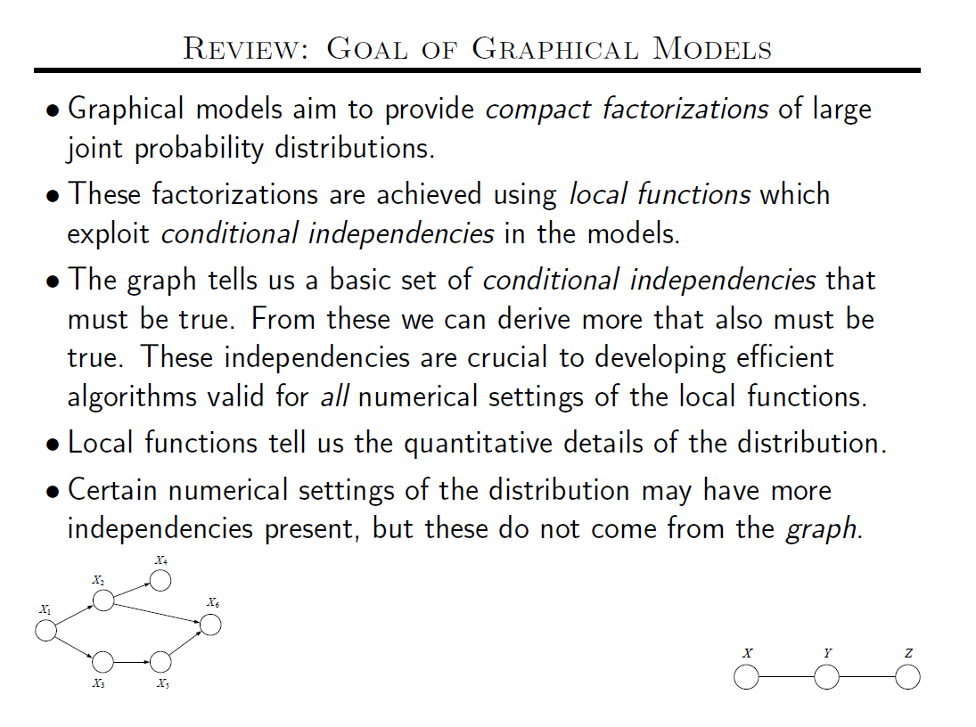

Slide 3
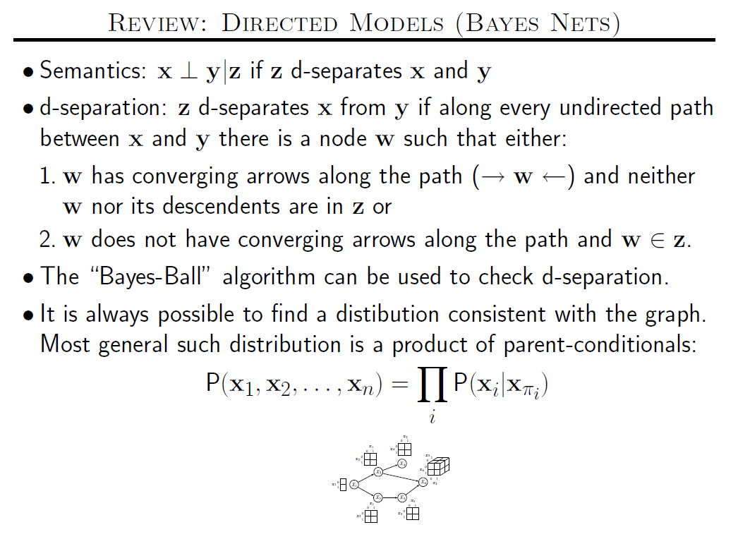

Slide 4
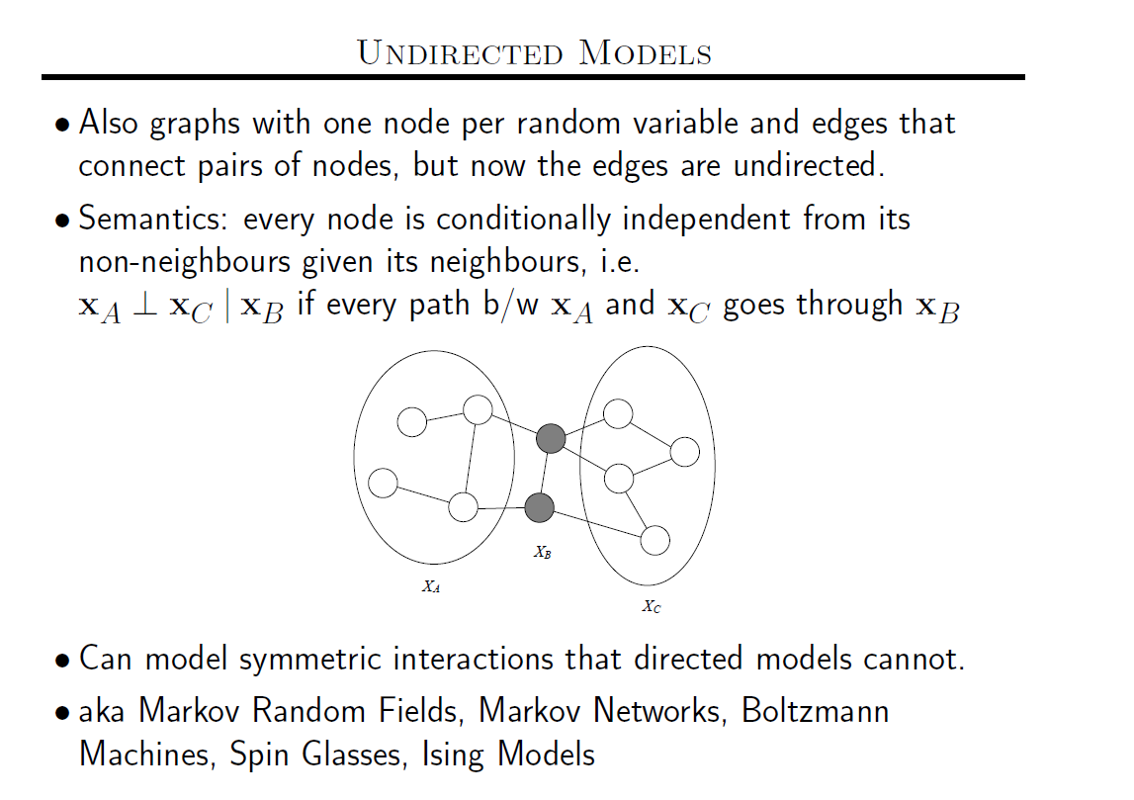

Slide 5
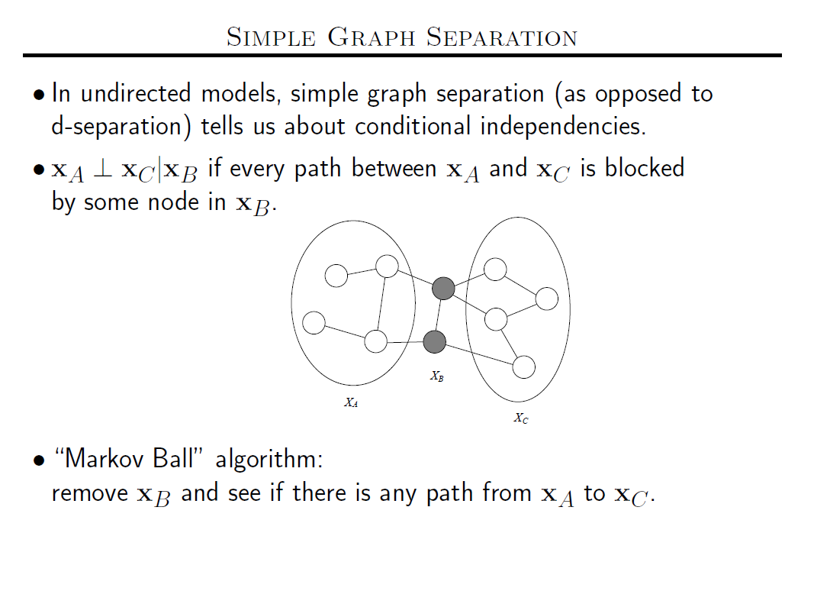

Slide 6
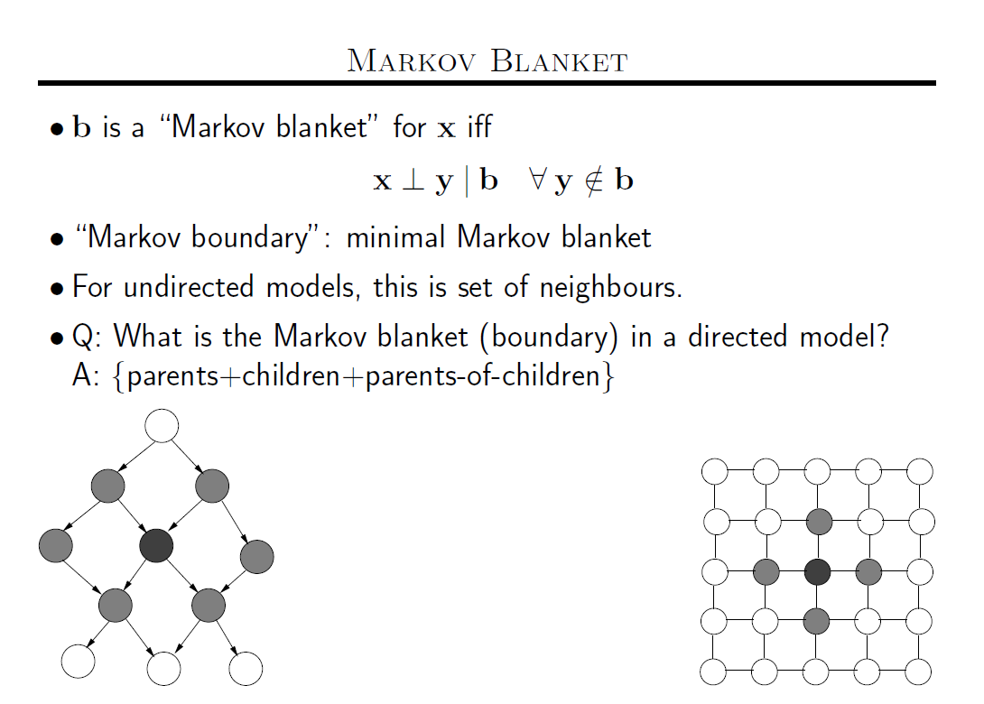
Connection to MCMC:
→MCMC requires sampling a node given its markov blanket
→Need to use P(x|MB(x)). For Bayes nets MB(x) contains more
nodes than are mentioned in the local distribution CPT(x)
→ For Markov nets,

Slide 7
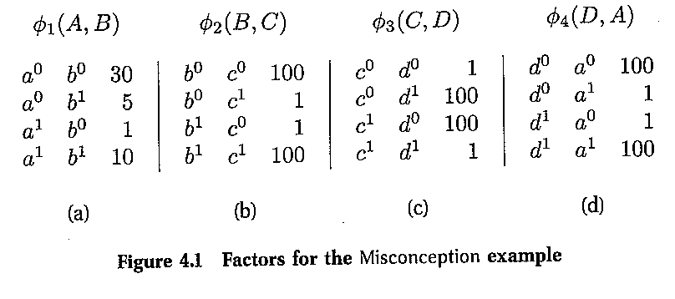
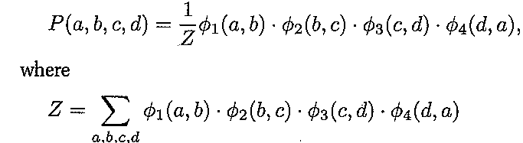
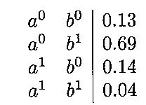
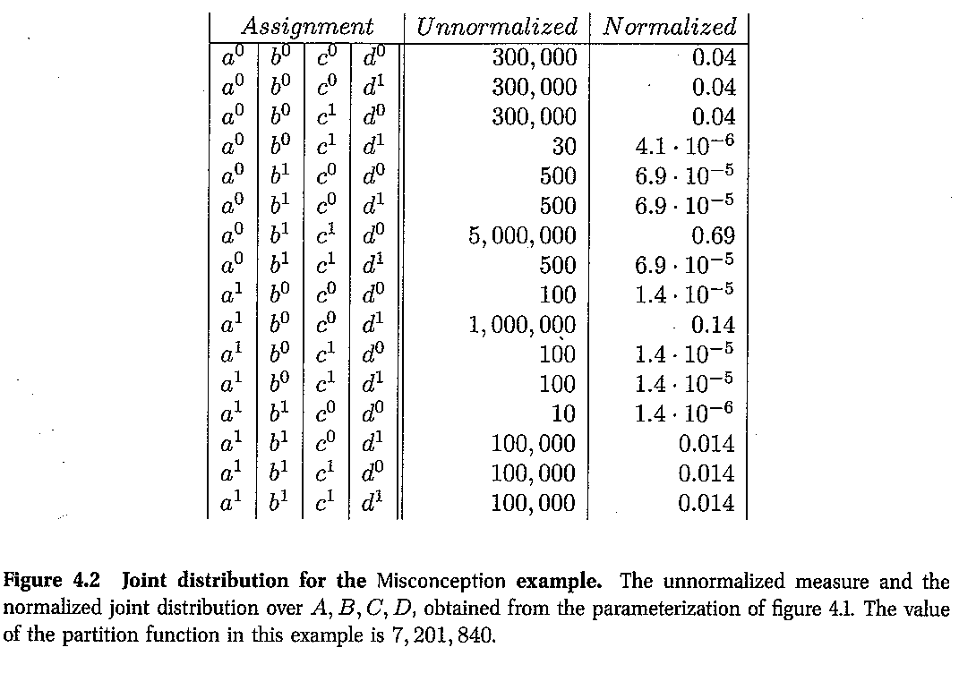
We can have potentials
on any cliques—not just
the maximal ones.
So, for example we can
have a potential on A
in addition to the other
four pairwise potentials
A
Factor says a=b=0
B
D
Qn: What is the
most likely
configuration of A&B?
C
But, marginal says
a=0;b=1!
Okay, you convinced me
that given any potentials
we will have a consistent
Joint. But given any joint,
will there be a potentials
I can provide?
→Hammersley-Clifford
theorem…
Although A,B would
Like to agree, B&C
Need to agree,
C&D need to disagree
And D&A need to agree
.and the latter three have
Higher weights!
Moral: Factors
are not marginals!

Slide 8
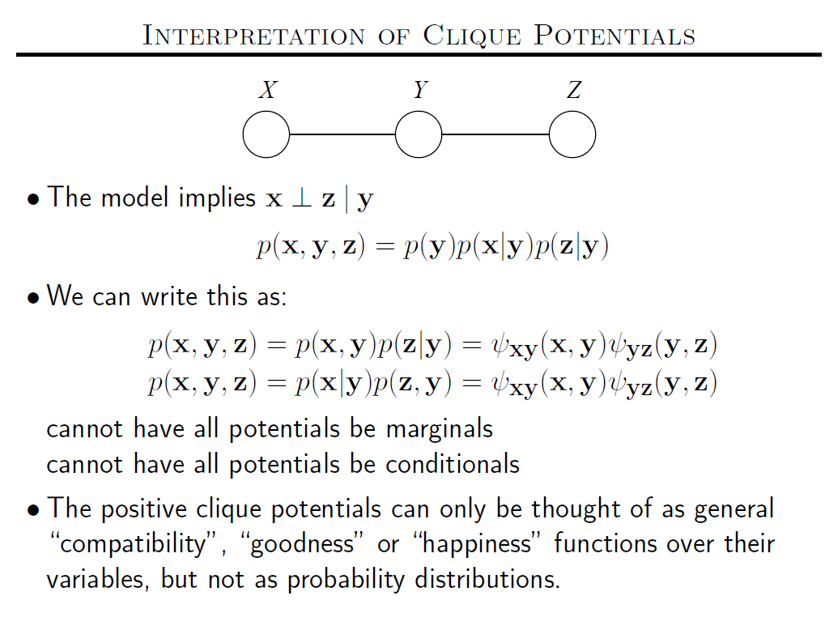

Slide 9
Markov Networks
Undirected graphical models
Smoking
Cancer
Asthma
Cough
Potential functions defined over cliques
Smoking | Cancer | Ф(S,C)
False | False | 4.5
False | True | 4.5
True | False | 2.7
True | True | 4.5

Slide 10
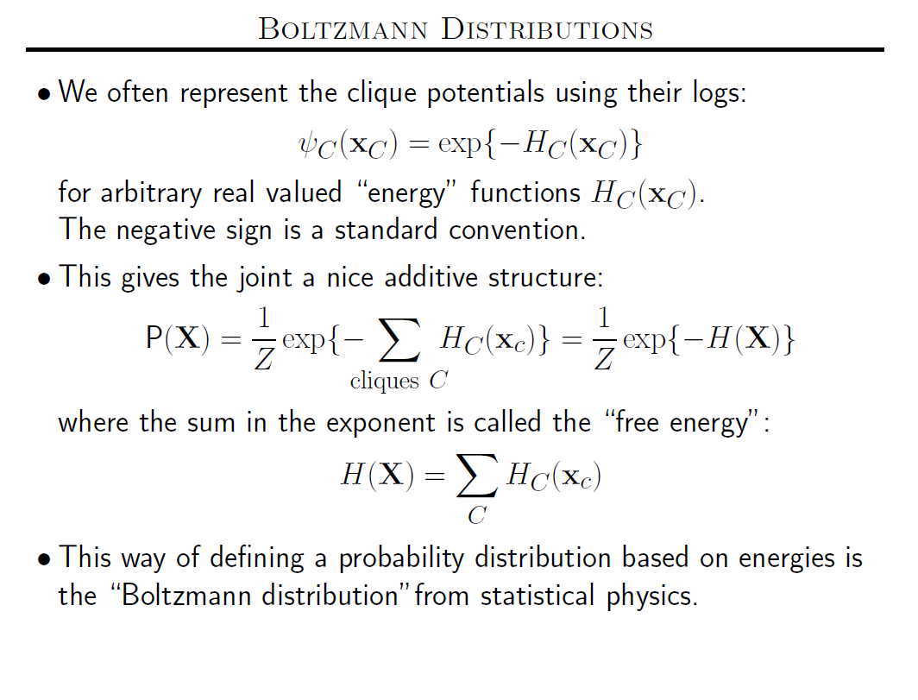

Slide 11



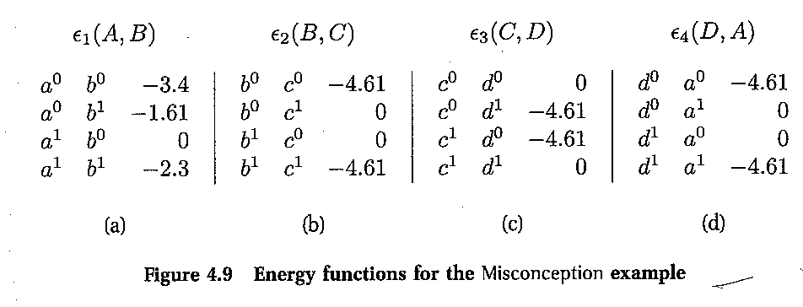
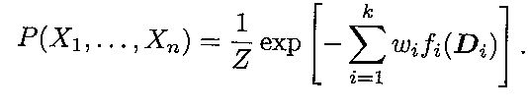
Log-Linear models for Markov Nets
A
B
D
Without loss of generality!
C
Factors are “functions” over their domains
Log linear model consists of
→ Features f_{i} (D_{i} ) (functions over domains)
→Weights w_{i} for features s.t.

Slide 12
Markov Networks
Undirected graphical models
Smoking
Cancer
Asthma
Cough
Log-linear model:
Weight of Feature i
Feature i

Slide 13
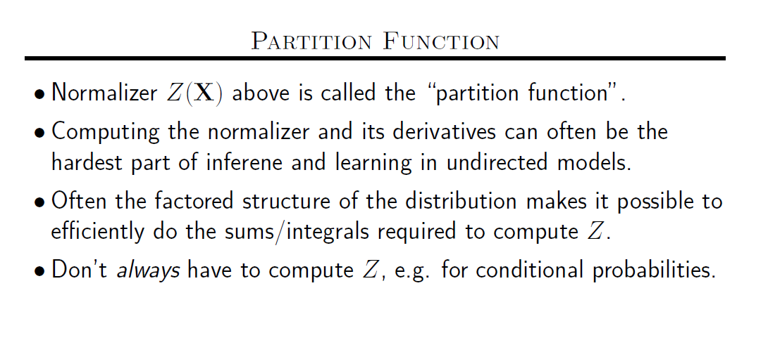

Slide 14
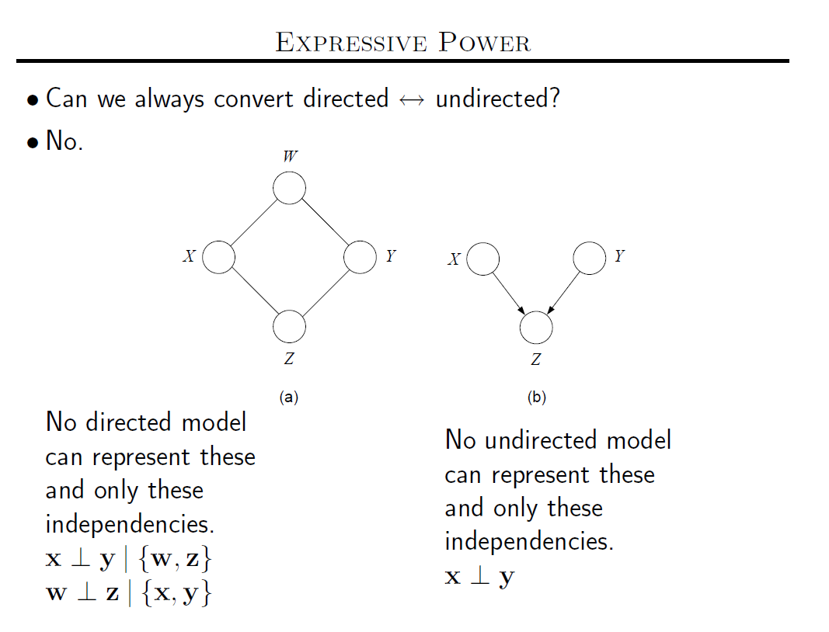

Slide 15
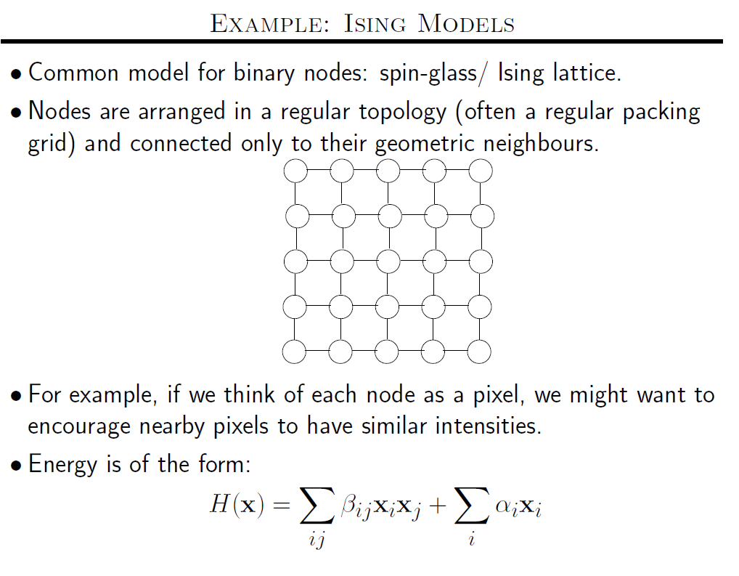

Slide 16
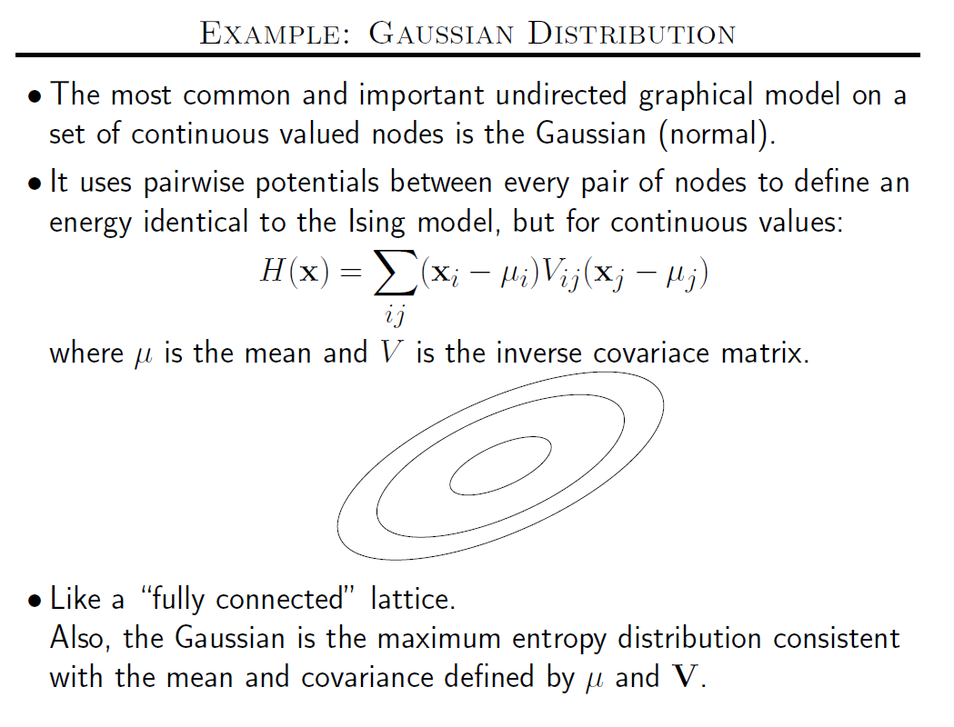

Slide 17
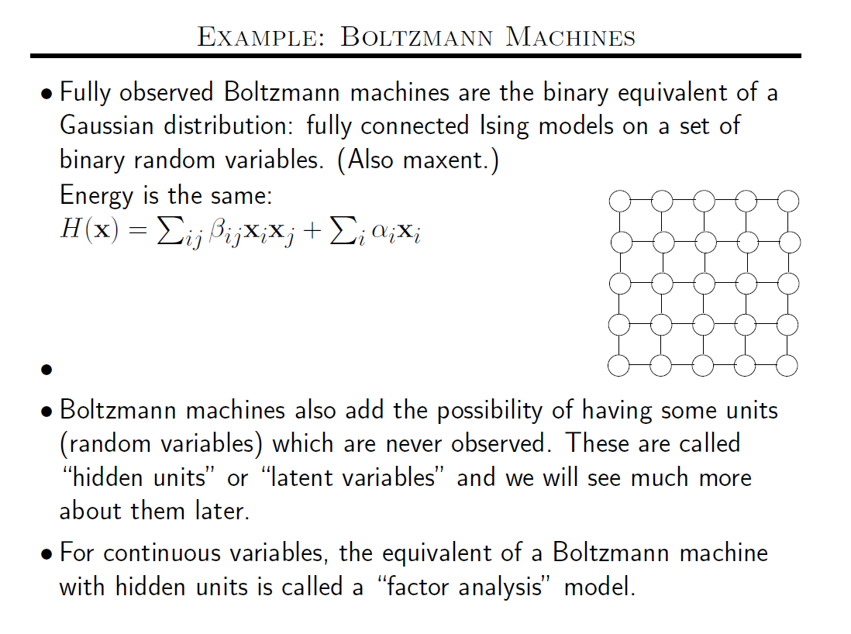

Slide 18
Markov Nets vs. Bayes Nets
Property | Markov Nets | Bayes Nets
Form | Prod. potentials | Prod. potentials
Potentials | Arbitrary | Cond. probabilities
Cycles | Allowed | Forbidden
Partition func. | Z = ? global | Z = 1 local
Indep. check | Graph separation | D-separation
Indep. props. | Some | Some
Inference | MCMC, BP, etc. | Convert to Markov

Slide 19
Inference in Markov Networks
Goal: Compute marginals & conditionals of
Exact inference is #P-complete
Most BN inference approaches work for MNs too
Variable Elimination used factor multiplication—and should work without change..
Conditioning on Markov blanket is easy:
Gibbs sampling exploits this

Slide 20
MCMC: Gibbs Sampling
state ← random truth assignment
for i ← 1 to num-samples do
for each variable x
sample x according to P(x|neighbors(x))
state ← state with new value of x
P(F) ← fraction of states in which F is true

Slide 21
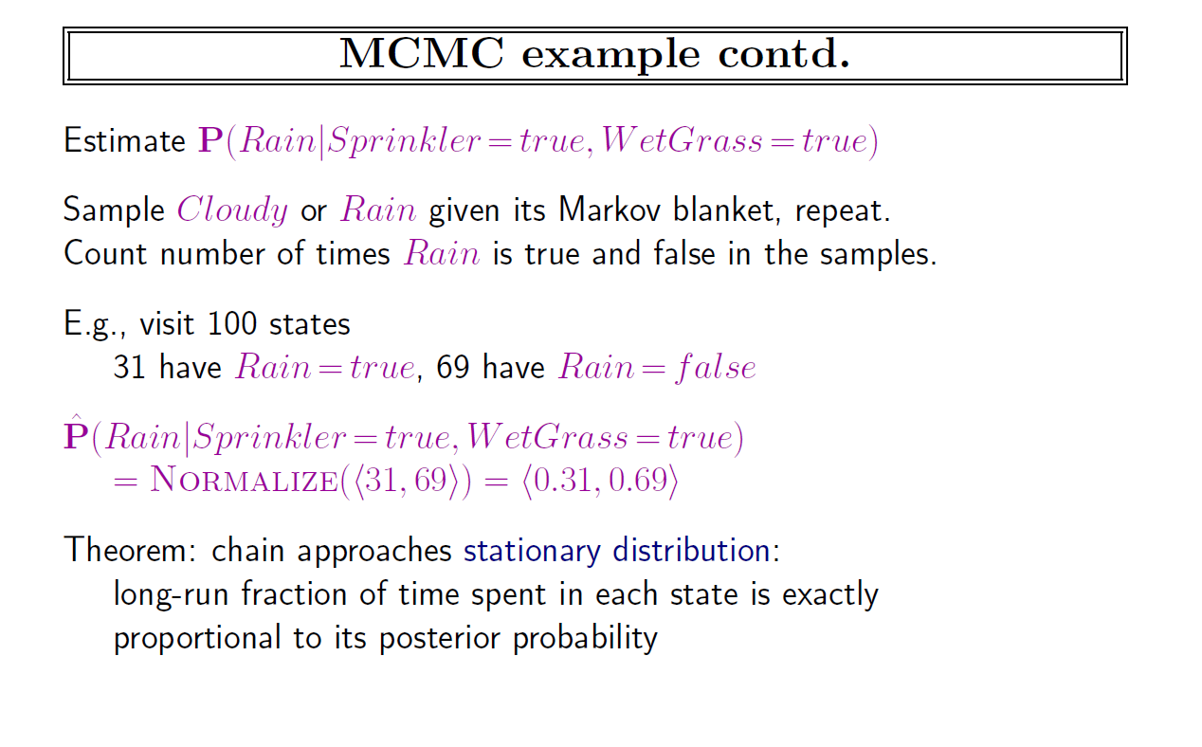

Slide 22
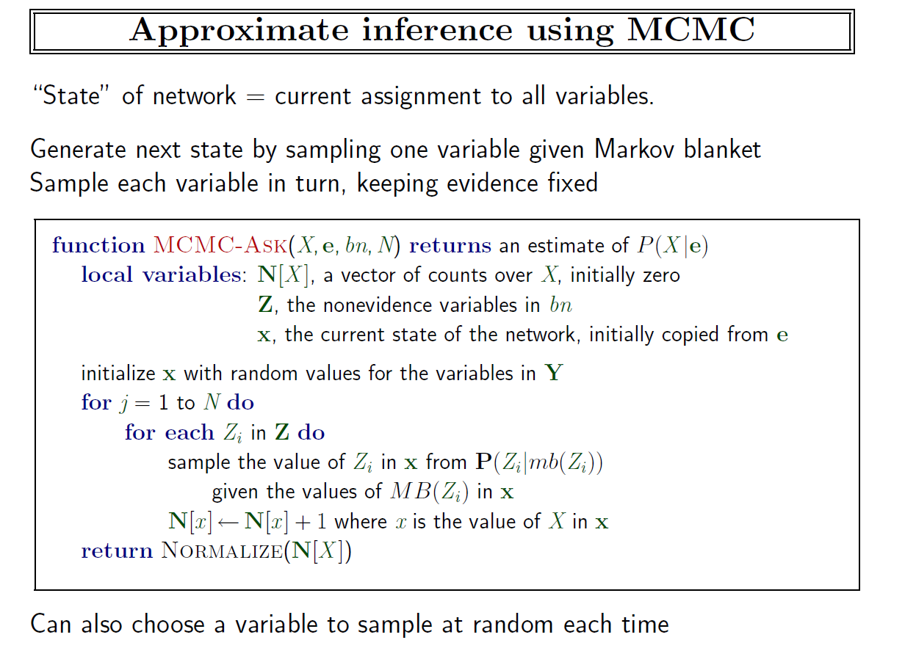

Slide 23
Other Inference Methods
Many variations of MCMC
Belief propagation (sum-product)
Variational approximation
Exact methods

Slide 24
Overview
Motivation
Foundational areas
Probabilistic inference
Statistical learning
Logical inference
Inductive logic programming
Putting the pieces together
Applications

Slide 25
Learning Markov Networks
Learning parameters (weights)
Generatively
Discriminatively
Learning structure (features)
Easy Case: Assume complete data (If not: EM versions of algorithms)

Slide 26

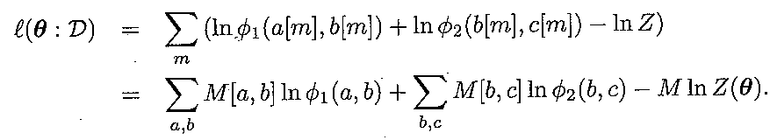

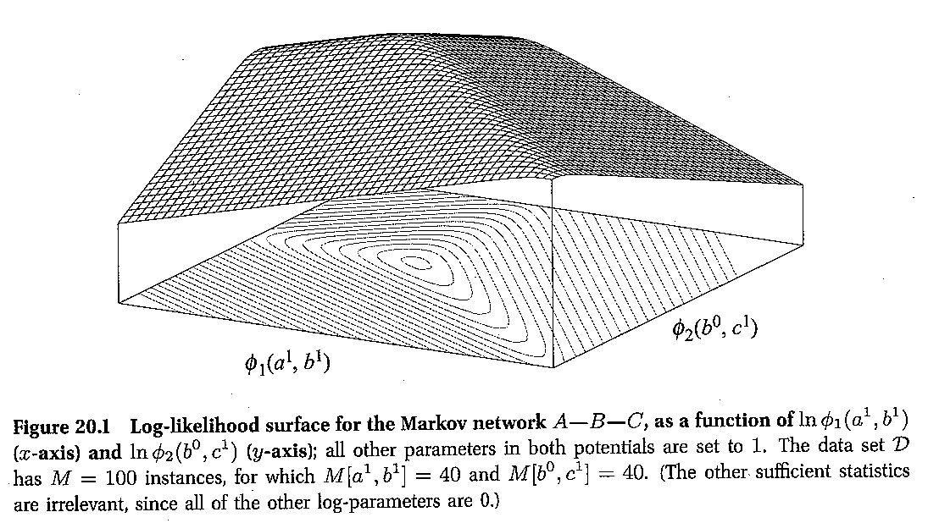
Entanglement in log likelihood…
a
b
c

Slide 27
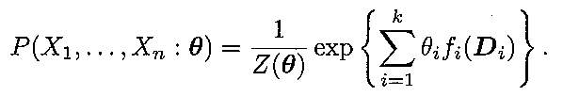

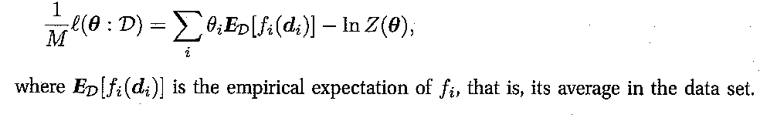
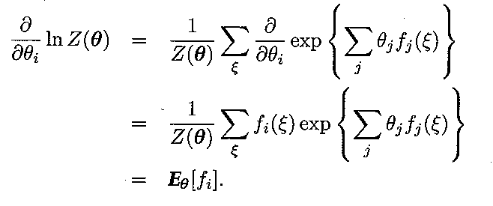

Learning for log-linear formulation
What is the expected
Value of the feature
given the current
parameterization
of the network?
Requires inference to answer
(inference at every iteration—
sort of like EM ☹)
Use gradient ascent
Unimodal, because Hessian is
Co-variance matrix over features

Slide 28
Why should we spend so much time computing gradient?
Given that gradient is being used only in doing the gradient ascent iteration, it might look as if we should just be able to approximate it in any which way
Afterall, we are going to take a step with some arbitrary step size anyway..
..But the thing to keep in mind is that the gradient is a vector. We are talking not just of magnitude but direction. A mistake in magnitude can change the direction of the vector and push the search into a completely wrong direction…

Slide 29
Generative Weight Learning
Maximize likelihood or posterior probability
Numerical optimization (gradient or 2nd order)
No local maxima
Requires inference at each step (slow!)
No. of times feature i is true in data
Expected no. times feature i is true according to model

Slide 30
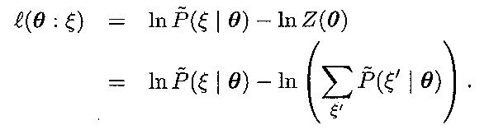
Alternative Objectives to maximize..
Given a single data instance ξ log-likelihood is
Since log-likelihood requires network inference to compute the derivative, we might want to focus on other objectives whose gradients are easier to compute (and which also –hopefully—have optima at the same parameter values).
Two options:
Pseudo Likelihood
Contrastive Divergence
Log prob of data
Log prob of all other possible
data instances (w.r.t. current θ)
Maximize the distance
(“increase the divergence”)
Compute likelihood of
each possible data instance
just using markov blanket
(approximate chain rule)
Pick a sample of
typical other instances
(need to sample from P_{θ}
Run MCMC initializing with
the data..)

Slide 31
Pseudo-Likelihood
Likelihood of each variable given its neighbors in the data
Does not require inference at each step
Consistent estimator
Widely used in vision, spatial statistics, etc.
But PL parameters may not work well for long inference chains
[Which can lead to disasterous results]

Slide 32
Discriminative Weight Learning
Maximize conditional likelihood of query (y) given evidence (x)
Approximate expected counts by counts in MAP state of y given x
No. of true groundings of clause i in data
Expected no. true groundings according to model

Slide 33
Structure Learning
How to learn the structure of a Markov network?
… not too different from learning structure for a Bayes network: discrete search through space of possible graphs, trying to maximize data probability….

