Slide 1




Modeling Missing Data in Distant Supervision for Information Extraction
Alan Ritter
Luke Zettlemoyer
Mausam
Oren Etzioni

Slide 2
Distant Supervision For Information Extraction
[Bunescu and Mooney, 2007]
[Snyder and Barzilay, 2007]
[Wu and Weld, 2007]
[Mintz et al., 2009]
[Hoffmann et. al., 2011]
[Surdeanu et. al. 2012]
[Takamatsu et al. 2012]
[Riedel et. al. 2013]
…
Input: Text + Database
Output: relation extractor
Motivation:
Domain Independence
Doesn’t rely on annotations
Leverage lots of data
Large existing text corpora + databases
Scale to lots of relations
Notes:
Distant supervision is the task of learning to extract information from text given only unlabeled corpora, and populated databases.
This is in contrast to the more traditional approach to information extraction which relies on manually annotated corpora.
There has been a lot of recent work in this area, some of which I’ve listed here…
The motivation for this approach is that it’s more domain independent, since it doesn’t rely on manually labeled data in a fixed domain, and it’s able to scale up to large unlabeled text corpora.
Also this approach has the potential to scale up to many relations.

Slide 3

Heuristics for Labeling Training Data
e.g. [Mintz et. al. 2009]
(Albert Einstein, Ulm)
(Mitt Romney, Detroit)
(Barack Obama, Honolulu)
Person | Birth Location
Barack Obama | Honolulu
Mitt Romney | Detroit
Albert Einstein | Ulm
Nikola Tesla | Smiljan
… | …
“Barack Obama was born on August 4, 1961 at … in the city of Honolulu ...”
“Birth notices for Barack Obama were published in the Honolulu Advertiser…”
“Born in Honolulu, Barack Obama went on to become…”
…
Notes:
OK, so in distant supervision for binary relations we have access to a large number of instances of a target relation.
Then we gather a bunch of sentences which mention pairs of entities from the realtion.
Now we can extract features from these sentences and treat them like positive examples of the relation.
But what happens if some data is missing here?
Now all these sentences are effectively negative training examples which is clearly problematic.
This is a pretty common situation. These databases are incomplete and there is a lot of missing data.
********************************************************
***PROBLEM-AREA****
In distant supervision we have access to both a database and a large text corpus.
For example Freebase contains large lists of people and their birth locations.
And if we search the web for pairs of these entities, we can find lots of sentences which mention them.
For example here are a few sentences which mention Barack Obama and Honolulu.
OK, so each of these entity pairs become positive examples for the relation we’re trying to extract (in this case birth-location), we extract features from these sentences and train a supervised classifier to recognize instances of the relation for new pairs of entities.
********************************************************************
In Distant supervision we have access to a structured database, for example Freebase contains a list of birth locations for many individuals.
Then we look through a large text collection and find all the sentences which mention people and their birth locations, for example all the sentences that contain Barack Obama and Honolulu.
Then features are extracted from each group of sentences, and these entity pairs are treated as positive examples of the relation for a supervised classifier.
-Negative instances are just random pairs of entities.

Slide 4
Problem: Missing Data
Most previous work assumes no missing data during training
Closed world assumption
All propositions not in the DB are false
Leads to errors in the training data
Missing in DB -> false negatives
Missing in Text -> false positives
Let’s treat these as missing (hidden) variables
[Xu et. al. 2013]
[Min et. al. 2013]
Notes:
Most of the previous work assumes that there is no missing data in the database.
This is corresponds to the closed world assumption, which states that all propositions missing from the DB are false.
In the case of missing data this leads to errors in the training data, both false negatives like I just illustrated on the previous slide, and false positives if there is information missing in the text.
There has been a bit of recent work which has aimed at addressing the problem of false negatives.
Basically the idea here is that we’d like to treat these missing propositions as hidden variables, but there is a bit of a problem here, because they aren’t missing at random.

Slide 5

NMAR Example: Flipping a bent coin
[Little & Rubin 1986]
Flip a bent coin 1000 times
Goal: estimate
But!
Heads => hide the result
Tails => hide with probability 0.2
Need to model missing data to get an unbiased estimate of
Notes:
To show why data which is not missing at random can be a problem, I’d like to start out with a simple example.
Let’s suppose we’re going to do an experiment where we flip a coin 1000 times and our goal is to estimate the probability it comes up heads.
But, I’m going to look at the result first, and every time the coin comes up heads I’ll hide the result. If the coin comes up tails, I’ll hide the result with some probability.
I think you can see that in order to get an accurate, unbiased estimate of \theta{h}, we need to know something about the process by which I’m deciding when to hide the coin.
This is a case where data is not missing at random, because whether an observation is missing depends on the value of the variable we are trying to observe.

Slide 6
Distant Supervision: Not missing at random (NMAR)
[Little & Rubin 1986]
Prop is False => hide the result
Prop is True => hide with some probability
Distant supervision heuristic during learning:
Missing propositions are false
Better idea: Treat as hidden variables
Problem: not missing at random
Solution: Jointly model Missing Data + Information Extraction
Notes:
OK, so we have pretty much the same problem in distant supervision for information extraction.
If a proposition is true, we have some chance to observe it in the database
If it’s false, we will never get to observe it’s truth value.
Most of the previous work has heuristically assumed that all propositions not mentioned in the database are missing
Instead we’d really like to treat missing propositions like hidden variables.
But like I just mentioned, this is a problem because they aren’t missing at random, whether we observe them depends on their truth value.
So in order to get an unbiased estimate of the parameters of the information extraction model, we need to jointly model information extraction along with the missing data mechanism.

Slide 7

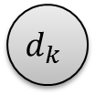



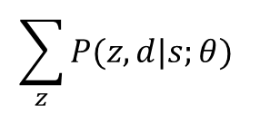
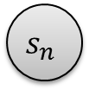
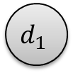





Distant Supervision (Binary Relations)
[Hoffmann et. al. 2011]
(Barack Obama, Honolulu)
$$s_{1}$$
$$s_{2}$$
$$s_{3}$$
…
$$s_{n}$$
Sentences
Local Extractors
$$P\left(z_{i}=r | s_{i}\right)∝exp⁡(θ⋅f\left(s_{i},r\right))$$
$$z_{1}$$
$$z_{2}$$
$$z_{3}$$
…
$$z_{n}$$
Relation mentions
Deterministic OR
$$d_{1}$$
$$d_{2}$$
…
$$d_{k}$$
Aggregate Relations
Maximize
Conditional
Likelihood
(Born-In, Lived-In, children, etc…)
$$\sum_{z}{P(z,d|s;θ) }$$
Notes:
Before I get into the details of how we’re going to deal with missing data, I’d like to walk through a model for distant supervision in the context of extracting binary relations.

Slide 8
Learning
Structured Perceptron (gradient based update)
MAP-based learning
Online Learning
$\frac{∂{log⁡O}_{i}(θ)}{∂θ}=E_{p\left(z | s,d;θ\right)}\left(\sum_{j}{f(s_{j},z_{j}) }\right)$ - $E_{p\left(d,z | s;θ\right)}\left(\sum_{j}{f(s_{j},z_{j}) }\right)$
$\frac{∂{log⁡O}_{i}(θ)}{∂θ}≈\max_{p\left(z | s,d;θ\right)}\left(\sum_{j}{f(s_{j},z_{j}) }\right)$ - $\max_{p\left(d,z | s;θ\right)}\left(\sum_{j}{f(s_{j}, z_{j}) }\right)$
Max assignment to Z’s (conditioned on Freebase)
Weighted Edge Cover Problem
(can be solved exactly)
Max assignment to Z’s (unconstrained)
Trivial
Notes:
PROBLEM AREA
For learning, we’re using an approach based on the Structured Perceptron which is an iterative gradient-based update.
Additionally, we take an online approach to learning, which just means that we update the parameters after each entity pair rather than going through them all and doing batch updates.
So here is what the gradient looks like. It’s just the difference between these two expectations over the features.
In practice these expectations are too difficult to compute, so instead we approximate them with maximizations.
Basically what we do here is to find the best assignment to the sentence-level varaibles, both conditioned on the facts observed in Freebase, and unconstrained.
If the two predictions agree with eachother then we don’t make any changes, otherwise we update the parameters by the difference between these terms.
The unconstrained inference problem is trivial, we just find the max-scoring relation for each sentence independently.
And the constrained inference problem can be viewed as an instance of a weighted edge-cover problem which can be efficently solved exactly.
*********************************************
To do this we use an iterative gradient descent method based on the structured perceptron
Additionally we use an online approach to learning (we iterate through each entity pair updating parameters after each).
The gradient is the difference between these two expectations over the features
This is to expensive to compute in practice, so instead we approximate the expectations with maximizations
Basically what happens here is that we find the best assignment to the hidden sentence-level variables constrained by Freebase and unconstrained.
If the two predictions agree, then we don’t make any changes to the weights.
If they disagree, we update the parameters based on the difference between the features.
**********************************************************************
-STRUCTURED PERCEPTRON
-ONLINE Learning
-Latent variables
-Find max prob. assignment to hidden variables
-Update parameters (Feature expectations…)
-So what happens during training is that we get to observe the aggregate variables, which we treat as constraints.
-Then we search for the highest scoring assignment to the hidden variables which satisfy these constraints, and use this to update the parameters of the local extractors.

Slide 9
Missing Data Problems…
2 Assumptions Drive learning:
Not in DB -> not mentioned in text
In DB -> must be mentioned at least once
Leads to errors in training data:
False positives
False negatives
Notes:
OK, so there are two assumptions driving the learning here.
If a fact is not mentioned in the DB it can’t be mentioned in the text.
If a fact is mentioned in the DB we have to extract it at least once from the text.
These assumptions are good, because they drive the learning, but if there is missing data in either the text or the database the lead to errors in the training data.

Slide 10

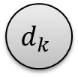


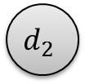






Changes
$$s_{1}$$
$$s_{2}$$
$$s_{3}$$
…
$$s_{n}$$
$$z_{1}$$
$$z_{2}$$
$$z_{3}$$
…
$$z_{n}$$
$$d_{1}$$
$$d_{2}$$
…
$$d_{k}$$
Notes:
OK, so how can we deal more gracefully with missing data?
**************************************
So how can we more gracefully deal with missing data?

Slide 11


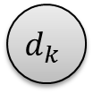



Modeling Missing Data
[Ritter et. al. TACL 2013]
$$s_{1}$$
$$s_{2}$$
$$s_{3}$$
…
$$s_{n}$$
$$z_{1}$$
$$z_{2}$$
$$z_{3}$$
…
$$z_{n}$$
Mentioned in Text
$$t_{1}$$
$$t_{2}$$
…
$$t_{k}$$
Encourage Agreement
Mentioned in DB
$$d_{1}$$
$$d_{2}$$
…
$$d_{k}$$
Notes:
Our proposed solution is to split these aggregate variables into two parts, one which represents whether each fact is mentioned in the text.
Another which represents whether it is mentioned in the database.
These factors between the two variables just encourage, but don’t require that they agree with eachother.
So now you can see that the facts in FB will act like soft constraints instead of hard constraints as they did previously.
So for example, it’s possible to extract facts not in FB if the local extractors are very confident, but of course we have to pay some penalty for doing that.
********************************************************
We’re proposing to split these aggregate-level variables into two parts.
One which represents whether each fact is mentioned in the text
And another which represents whether it is mentioned in the database.
Then these factors encourage, but don’t require that they agree.
As you can see, the facts in freebase now act like soft rather than hard constraints.
It’s possible to extract facts not in Freebase, if the sentence-level extractors are very confident though you have to pay some penalty for doing it.
******************************************************
And split the aggregate variables into two parts.
-One which is true if a fact is mentioned in the text, and another variable which is true if the fact is mentioned in the database.
-The factors between these two variables encourage, but don’t require agreement; so that it’s possible to violate these constraints, but you have to pay a penalty.

Slide 12
Learning
Old parameter updates:
$\frac{∂{log⁡O}_{i}(θ)}{∂θ}=\max_{p\left(z | s,d;θ\right)}\left(\sum_{j}{f(s_{j},z_{j}) }\right)$ - $\max_{p\left(d,z | s;θ\right)}\left(\sum_{j}{f(s_{j}, z_{j}) }\right)$
Doesn’t make much difference…
New parameter updates (Missing Data Model):
$\frac{∂{log⁡O}_{i}(θ)}{∂θ}=\max_{p\left(t,z | s,d;θ\right)}\left(\sum_{j}{f(s_{j},z_{j}) }\right)$ - $\max_{p\left(t,d,z | s;θ\right)}\left(\sum_{j}{f(s_{j}, z_{j}) }\right)$
This is the difficult part!
soft constraints
No longer weighted edge-cover
Notes:
Learning proceeds in much the same way as before.
Basically the only difference is that we’re also maximizing over these new aggregate hidden variables.
This doesn’t end up making much difference in the unconstrained optimization.
But for the constrained case it makes the inference harder than before (no longer simple bipartite graph matching problem).
******************************************************************
Learning proceeds in much the same way as before, except now we optimize over these additional aggregate level hidden variables.
This doesn’t end up making any difference for the unconstrained inference problem.
It does make the inference problem which is constrained by the freebase facts more difficult.
*********************************************************
The difference here is that we’re also maximizing over these additional hidden variables, but they are deterministically determined by the sentence-level hidden variables, so the real difference is that the Freebase relations act like soft constraints as opposed to hard constraints as before.
*********************************************************
Now we’re optimizing over the t’s in addition to z’s
Effectively this means now we have soft constraints whereas before we had hard constraints.

Slide 13

MAP Inference
Aggregate “mentioned in text”
Sentence level hidden variables
Sentences
Database
Find z that maximizes
Optimization with soft constraints
Exact Inference
A* Search
Slow, memory intensive
Approximate Inference
Local Search
With Carefully Chosen Search operators
$$P\left(t,z | s,d;θ\right)$$
Only missed an optimal solution in 3 out of > 100,000 cases
Notes:
So the question here is: how to find the best assignment to the sentence level hidden variables given the observed sentences and facts in freebase.
This is just an optimization problem with soft constraints.
We looked at two different methods for solving this; the first is A* search, which is slow and memory intensive, but is guaranteed to find an optimal solution, because we’re using an admissible heuristic.
The second approach is an approximate inference approach based on A* search which is fast and doesn’t require much memory, so scales up to the larger problem sizes which are found in our data.
We found that using a carefully chosen set of search operators, local search almost always finds an exact solution, which we can verify by comparing it’s results to optimal solutions found using A*.
Using this approach we only missed an optimal solution in 3 out of 100000 problems from our actual data.

Slide 14
Exact Inference: A* Search
Hypothesis
Partial assignment to z
Heuristic
Upper bound on the best score with partial assignment
Pick relation mentions independently
For each aggregate factor:
check if we can improve the overall score by flipping each
can lead to inconsistencies, but
gives good upper bound

Slide 15
Approximate Inference Local Search
Almost always finds exact solution!
Start with full (random) assignment to
Search operators define neighboring states
At each step pick the highest scoring neighbor
Until there are none better
Basic Search Operators:
Change each
Aggregate Search Operators:
Change all ‘s assigned to relation to

Slide 16
Aggregate Search Operator: Intuition
Allows for global moves in the search space
Not as likely to get stuck in local optima
Type-level MCMC [Liang et. al. 2010]
Notes:
TODO: add figure to explain this with more detailed example?
-> e.g. fact not in freebase, many sentences mention, may have to transition through many low-scoring states to gain enough benefit to outweight the peanlty for extracting something not in FB

Slide 17
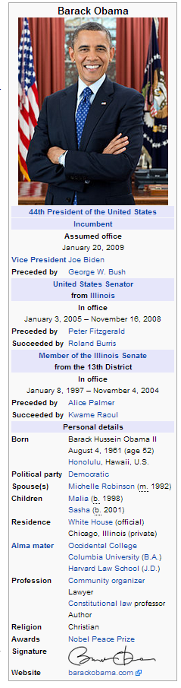
Side Information
Entity coverage in database
Popular entities
Good coverage in Freebase Wikipedia
Unlikely to extract new facts
$$s_{1}$$
$$s_{2}$$
$$s_{3}$$
…
$$s_{n}$$
$$z_{1}$$
$$z_{2}$$
$$z_{3}$$
…
$$z_{n}$$
$$t_{1}$$
$$t_{2}$$
…
$$t_{k}$$
$$d_{1}$$
$$d_{2}$$
…
$$d_{k}$$
Notes:
Another nice feature of this model is that it provides a natural way to incorporate side information in the form of a missing data model.
One example of this is to take into account an entity’s coverage in the database.
The idea is that popular entities like Barack Obama, tend to have very good coverage in databases like Freebase, so it’s unlikely we will extract new facts about them which are missing. We can encode this intuition in a pretty natural way using the disagreement penalties in this model, basically we just set a higher penalty for extracting new facts for popular entities.

Slide 18
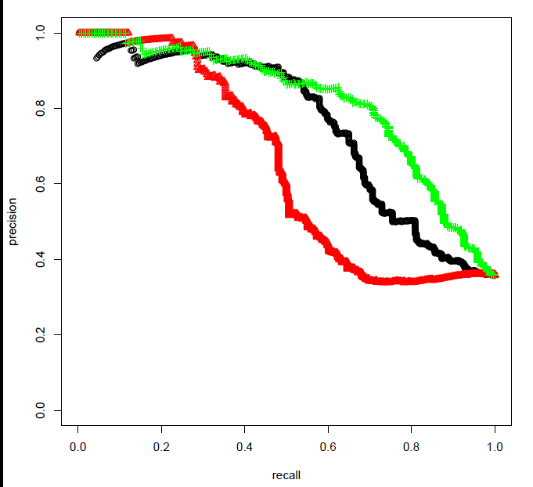
Experiments
Red: MultiR
Black: Soft Constraints
Green: Missing Data Model
[Hoffmann et. al. 2011]
Notes:
Of course the real question is, how does modeling missing data during learning affect performance in terms of precision and recall.
The answer is that it actually makes a big difference.
Here I’m showing P/R curves on the sentence-level relation extraction task comparing against human judgements.
The red curve here is the system using hard constraints, which you can think of as the baseline.
By simply relaxing these as soft constraints and setting two parameters by hand we get the black curve which is a huge improvement.
Finally, by incorporating additional side information in the form of a missing data model, we get the green curve.
-------------------------------------------------------------------
OK, so how much difference does explicitly modeling missing data make in practice?
Here I’m showing precision-recall curves on the sentence-level extraction task compared against human judgments.
The red curve is the original system which uses Freebase as hard constraints.
In the black curve we’re using soft constraints with two hand-set parameters, one is the penalty for extracting facts not in FB, the other is the penalty for not extracting facts in FB.
In the green curve we’re incorporating additional information in the form of a missing data model.
By explicitly modeling missing data we’re doing much better. I think we knew these distant supervision models were making some bad assumptions, but I was surprised that there is this much room for improvement.
**********************************************************
-The precision and recall using this approach is much better than the original model
-

Slide 19
Automatic Evaluation
Hold out facts from freebase
Evaluate precision and recall
Problems:
Extractions often missing from Freebase
Marked as precision errors
These are the extractions we really care about!
New facts, not contained in Freebase
Notes:
OK, so we also did an automatic evaluation, which has been used in a bunch of the previous work.
The idea is to test how well our model can predict held-out facts in Freebase
There are a number of problems with this evaluation.
Facts extracted by our model are often correct, but missing from Freebase, in which case they are marked as precision errors.
In my opinion, these are really the facts we should really care about the most: the whole point of this exercise should be to extract new facts not already in the database!

Slide 20
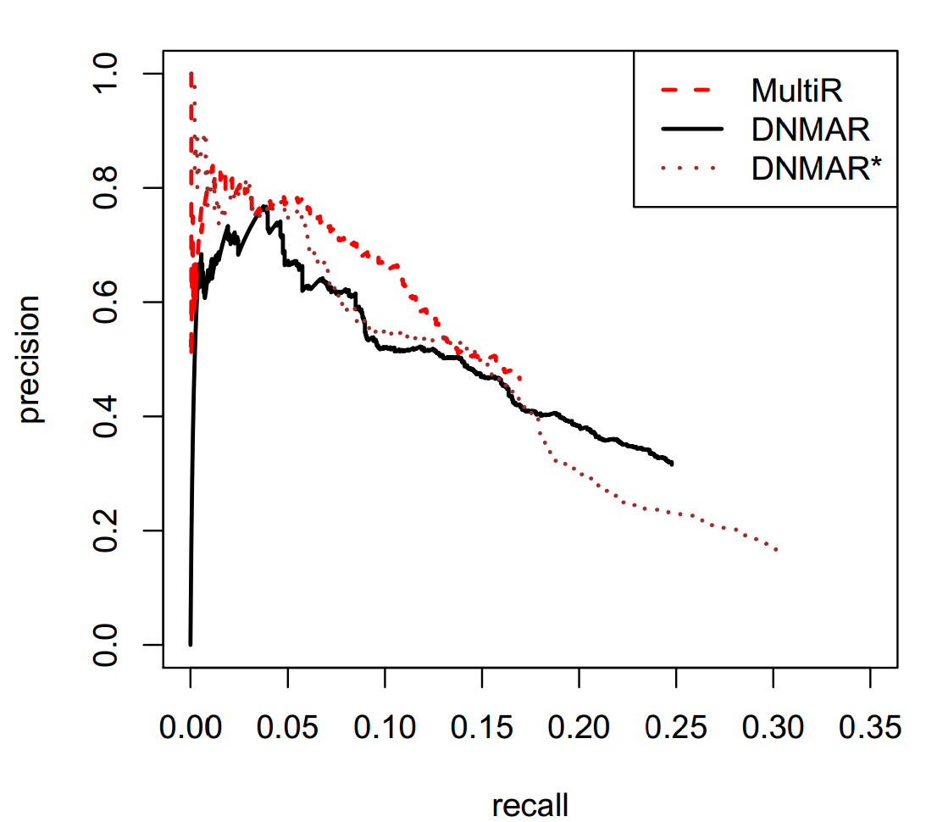
Automatic Evaluation
Notes:
OK, so here I’m showing our results on the aggregate evaluation. In general we’re doing worse in terms of precision than the system trained using hard constraints, though we are able to get much higher recall.

Slide 21
Automatic Evaluation: Discussion
Correct predictions will be missing form DB
Underestimates precision
This evaluation is biased
Systems which make predictions for more frequent entity pairs will do better.
Hard constraints => explicitly trained to predict facts already in Freebase
[Riedel et. al. 2013]
Notes:
Like I mentioned correct extractions are often missing from the database, so this evaluation is underestimating precision.
This is true for all the models, but I think the bigger problem is that this evaluation is biased towards systems that make predictions for more frequent entities which are likely to appear in Freebase.
Also, I’d like to point out that the system trained using hard constraints is explicitly tuned to extract only those facts in Freebase, whereas our system which is modeling missing data is more likely to predict facts missing from freebase, but which are mentioned in the text.

Slide 22
Distant Supervision for Twitter NER
[Ritter et. al. 2011]
Macbook Pro
iPhone
Lumina 925
PRODUCT
Lumina 925
iPhone
Macbook pro
Nexus 7
…
Nokia parodies Apple’s “Every Day” iPhone ad to promote their Lumia 925 smartphone
new LUMIA 925 phone is already running the next WINDOWS P...
@harlemS Buy the Lumina 925 :)
…
Notes:
OK, so we also did an evaluation on a weakly supervised named entity categorization task which is a pretty straightforward generalization of distant supervision from binary to unary relations.
Here we have a similar setup, for example we have a NE category we want to predict, for example products
And Freebase gives us a large list of products.
For each NP in this list, we can search a big text corpus to find sentences which mention it, and assume they contain mentions to products.
But again we run into the same problem if there are entities missing from the database.

Slide 23
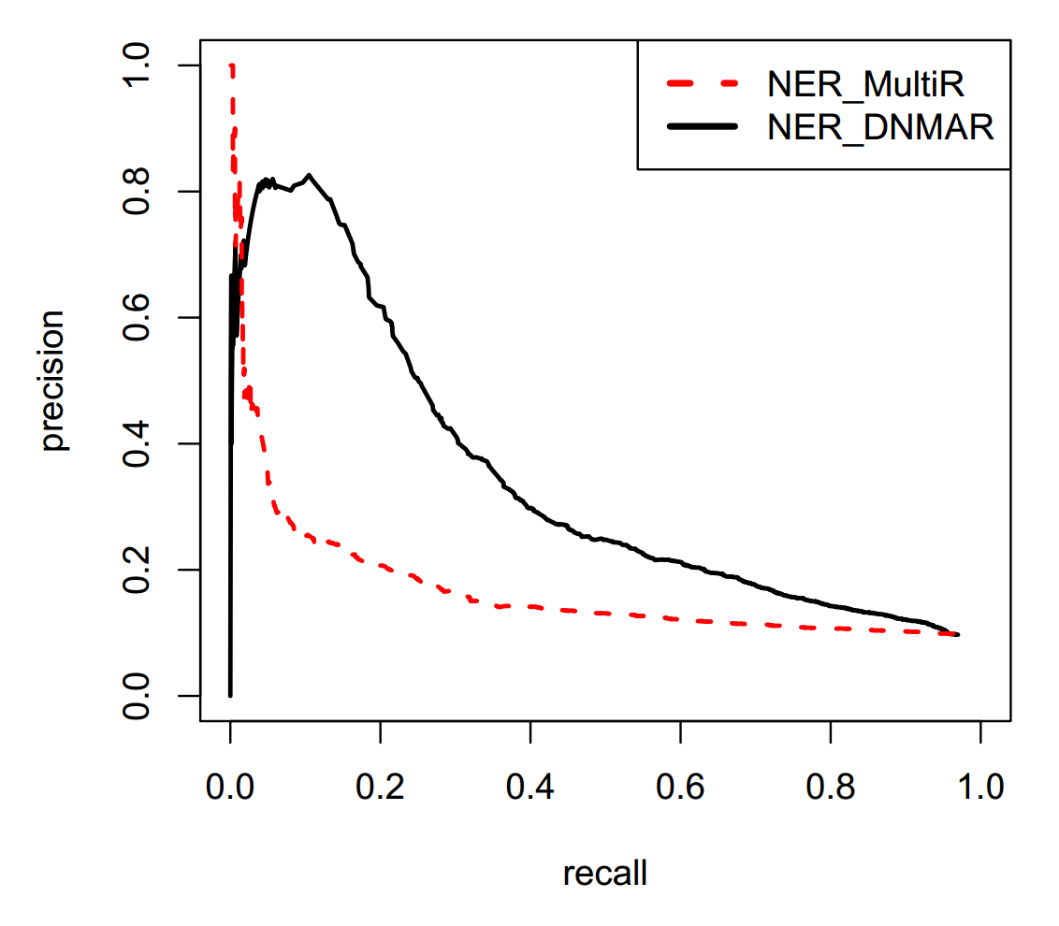
Weakly Supervised Named Entity Classification
Notes:
Here I’m showing P/R curves on the named entity classification evaluation, again comparing against human annotations.
You can see that by explicitly modeling missing data, we’re able to do much better, though I should mention that we aren’t getting state of the art results here.

Slide 24
Experiments: Summary
Big improvement in sentence-level evaluation compared against human judgments
We do worse on aggregate evaluation
Constrained system is explicitly trained to predict only those things in Freebase
Using (soft) constraints we are more likely to extract infrequent facts missing from Freebase
GOAL: extract new things that aren’t already contained in the database
Notes:
OK, so to summarize the experiments, we see a big improvement in the sentence level relation-extraction task comparing against human judgments.
We do worse on the aggregate evaluation, though I would argue this is a flawed evaluation metric, especially for evaluating systems modeling missing data.
The constrained system is explicitly trained to predict only things which appear in freebase, whereas by using soft constraints we’re more likely to predict facts which are mentioned in the text, but not in the database.
In my opinion, our goal should really be to extract new facts from text which aren’t already in the database!

Slide 25
Contributions
New model which explicitly allows for missing data
Missing in text
Missing in database
Inference becomes more difficult
Exact inference: A* search
Approximate inference: local search
with carefully chose search operators
Results:
Big improvement by allowing for missing data
Side information -> Even Better
Lots of room for better missing data models
THANKS!
Notes:
OK, so to wrap up, I would argue that we shouldn’t just train distant supervision models to predict facts we already know.
We showed that by explicitly modeling the possibility of missing data during learning, we get a big improvement on the sentence-level relation extraction task.
And by incorporating side information in the form of a missing data model, we do even better.
I think there is a lot of room for better missing data models here.

