Slide 1
Coupled Semi-Supervised Learning for Information Extraction
Carlson et al.
Proceedings of WSDM 2010

Slide 2
What’s the Point?
Learn new information from the web
Specifically, find new instances of known categories and relations
Notes:
First question to ask about this paper: what is the point of the learning methods being researched? To learn new information from the web. Specifically, given a set of categories and relationships within a particular domain, to learn new instances of those categories and relationships.

Slide 3
Bootstrapping
<Mark Twain, Elmira> Seed tuple
Grep (google) for the environments of the seed tuple
“Mark Twain is buried in Elmira, NY.”
X is buried in Y
“The grave of Mark Twain is in Elmira”
The grave of X is in Y
“Elmira is Mark Twain’s final resting place”
Y is X’s final resting place.
Use those patterns to grep for new tuples
Iterate
Notes:
Quick refresher on bootstrapping, or semi-supervised learning - Start with small seed set of categories and relations and large unlabeled corpus
Find new information that conforms with seed data
Evaluate and incorporate good information into KB

Slide 4
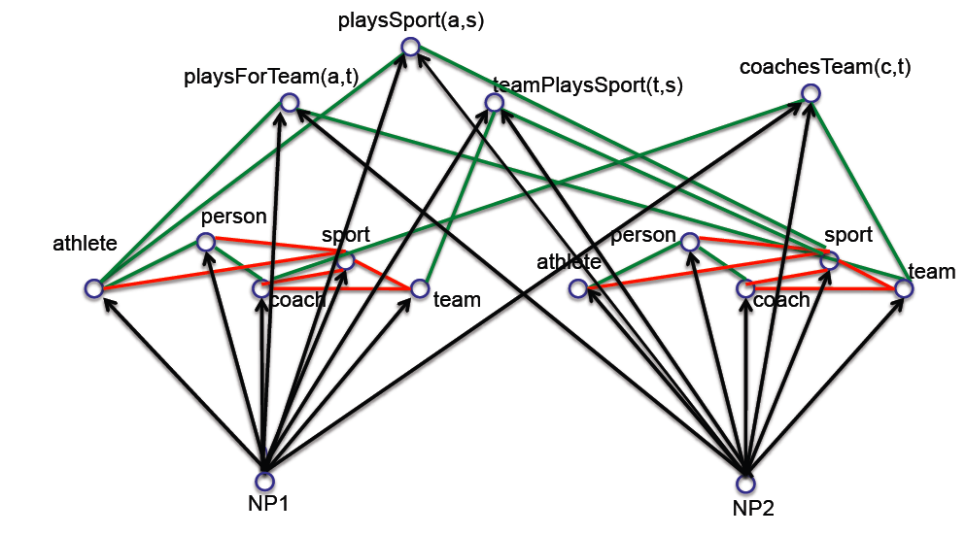
Key Idea 1: Coupled semi-supervised training of many functions
person
noun phrase
hard (underconstrained) semi-supervised learning problem
much easier (more constrained)
semi-supervised learning problem
Tom Mitchell
Notes:
Main idea of paper part 1: coupled training via multiple functions; using the output of one classification function to compare to another and vice versa in order to avoid semantic drift

Slide 5
Type 1 Coupling: Co-Training, Multi-View Learning
[Blum & Mitchell; 98]
[Dasgupta et al; 01 ]
[Ganchev et al., 08]
[Sridharan & Kakade, 08]
[Wang & Zhou, ICML10]
person
f₁(NP)
f₃(NP)
f₂(NP)
NP context distribution
NP morphology
NP HTML contexts
NP:
__ is a friend
rang the __
…
__ walked in
capitalized?
ends with ‘...ski’?
…
contains “univ.”?
www.celebrities.com:
<li> __ </li>
…
Tom Mitchell
Notes:
Main idea of paper part 2: coupled training via multiple data views; using classification on different types of data as checks against one another’s results

Slide 6
Coupling Constraints
Types of Constraints
Output constraints
Compositional constraints
Multi-view-agreement constraints
Specific Constraints
Mutual exclusion
Argument type-checking
Unstructured and Semi-structured comparison
Notes:
The authors consider three abstract types of coupling constraints, which roughly correspond to the three specific constraints leveraged in the paper.

Slide 7
Coupled Semi-Supervised Learning
Coupled Pattern Learning (CPL)
Extracts patterns from unstructured text
Coupled SEAL (CSEAL)
Extracts patterns from semi-structured text (e.g. URLs)
MPL
Cross-checks results from CPL and CSEAL

Slide 8
Coupled Pattern Learner
Extract new candidate instances/patterns using promoted info
Filter candidates using coupling constraints
Rank filtered candidates
Promote top-ranked candidates
Rinse and repeat
Babe Ruth broke the home run record
Category
Baseball Player
NP
Pattern
Associated Promoted Patterns
- arg1 played baseball for
- arg1 broke the home run record
Associated Promoted Instances
- Lou Gehrig
- Babe Ruth
=> arg1 broke the home run record is new Baseball Player category
=> Babe Ruth is new Baseball Player instance

Slide 9
Coupled SEAL
Run SEAL to extract new candidates and their wrappers
Filter wrappers/candidates using coupling constraints
Rank filtered candidates
Promote top-ranked candidates
Rinse and repeat
<a class=“car”>Audi</a>
Category
CarMake
Pattern
NP
Associated Promoted Patterns
- <p class=“auto”>arg1</p>
- <a href=“car”>arg1</a>
Associated Promoted Instances
- Ford
- Audi
=> <a class=“car”>arg1</a> is new CarMake category
=> Audi is new CarMake instance

Slide 10
Meta-Bootstrap Learner
Run CPL, store results in X₁
Run CSEAL, store results in X₂
Compare results from X₁ and X₂
Filter for all x_{i} such that x ∈ X₁ and x ∈ X₂
Filter for all x_{i} such that x_{i} satisfies coupling constraints
Promote remaining candidates

Slide 11
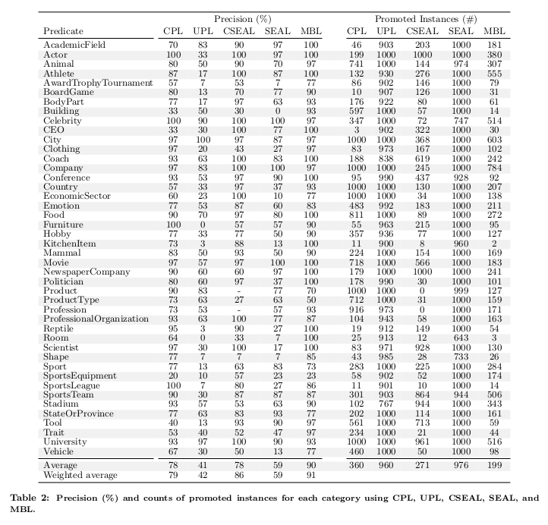
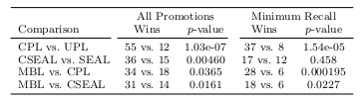
From Carlson et al. (2010)

Slide 12
Discussion Points
Corpus differences
CPL: 514m sentences from web crawl
CSEAL: Google web index
Evaluation procedure
Sample size N = 30 instances from each predicate
Resulting 10717 instances evaluated 3x by Mechanical Turk
96% correct in 100-instance sample of MT results
Relations more difficult than categories

