Slide 1
WELCOME
Mr. Sandesh Ravindra Padwal

Slide 2
In this PPT We Cover following Topic:
Information About Selenium Web Driver
Project: Book Airline ticket
In project which method use
Test cases and Scenario

Slide 3

Selenium Web Driver
Selenium is a browser automation library. Most often used for testing web-applications, Selenium may be used for any task that requires automating interaction with the browser.
Selenium WebDriver is a web framework that permits you to execute cross-browser tests.
This tool is used for automating web-based application testing to verify that it performs expectedly.

Slide 4
Project Book Airline Ticket
We see that In this Project
In this project I have tested How user can book airline ticket
I use following link for book airline ticket
https://blazedemo.com/
In this project some difficulties faced while using selenium web driver
Test cases and test scenario

Slide 5
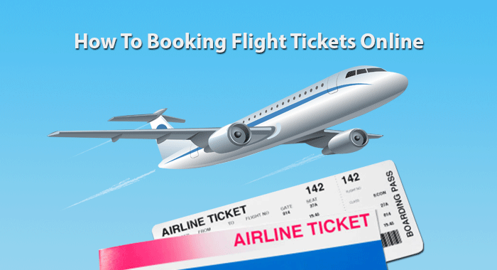
Book Airline Tickets Online

Slide 6
Modules Used in project
Departure and Destination Module :
To check user choose departure and destination city.
Choose the flight:
To check user choose the flight by suitable time, price and flight.
To fill the form for purchasing the flight:
To check user fill the form by putting some credentials information.

Slide 7
Types of Methods
Browser Commands:
All the command associated with browser
Opening browser : get()
Closing browser : close()
Title of page: getTitle()
Navigation Commands:
Check the browser moments
Forward()
Back()
Refresh() or Reload()

Slide 8
Types of Methods
Web Elements Commands:
List of action that can be performed on various web elements
Drop Down Commands:
1.Select By Index : It is used to select an option based on its index, beginning with 0.
dropdown.selectByIndex();
2.Select By Value: It is used to select an option based on its ‘Value’ attributes.
dropdown.selectByValue();
3.Select By Visible Text : It is used to select an option based on the text over the option.
dropdown.selectByVisble();

Slide 9
Types of Methods
Find Element:
This Method used to identify a web element with locators like id ,name , xpath etc
driver.findElement(By.id(“ “));
SendKeys:
Identify input field using locators and entering value in input box . Ex. Email,password
driver.findElement(By.id(“ “)).sendKeys(“ “);
Clear:
Clear input Field
driver.findElement(By.id(“ “)).clear(“ “);

Slide 10
Types of Locators
Locators: locating elements in web page by using findElement() method.
Types:
Id
Name
ClassName
cssSelector
Xpath
Link text

Slide 11
Locators
Method | Syntax | Description
By.id | driver.findElement(By.id(<id>)); | Locates an element using the ID attributes
By.Name | driver.findElement(By.name(<name>)); | Locates an element using the Name attributes
By.className | driver.findElement(By.className(<class>)); | Locates an element using the class attributes
By.cssSelector | driver.findElement(By.cssSelector(<cssSelector>)); | Locates an element using the css attributes
By.xpath | driver.findElement(By.xpath(<xpath>)); | Locates an element using the xpath attributes
By.linktext | driver.findElement(By.linktext(<linktext>)); | Locates an element using the linktext attributes

Slide 12
Test Cases and Test Scenario
Test Case:
It is a detailed document, which provides information about the testing strategy,
testing process, preconditions and expected output.
Test Scenario:
It is derived from the use case and give the one-line information about what to test.
Test cases and test scenario perform in excel sheet.

Slide 13
Bug Report
Bug Name: Application crashes upon clicking the login and register button.
Severity: HIGH
Priority: HIGH
Assigned: Developer-XYZ
Reported By: Sandesh Padwal
Reported on: 28/11/2022
Environment: Windows
Description: Application crashes upon clicking the login and Register button, hence unable to create a new user in the application.

Slide 14
Bug Report
Steps to Reproduce:
Open the application.
Filled out all the user information in fields into the login and Register page.
Clicked on the login and Register button.
Seen an error page 419| page Expired.
Expected Result: On clicking the login and Register button, you should be on next page a successful message “Login successful” and “New user has been created successfully”.

Slide 15
Thank You

