Slide 1
PIP4004: UNIVERSITY PROJECT Review-2 Presentation ONLINE CHATBOT BASED TICKETING SYSTEM
Batch Number: CSE - G15
Under the Supervision of,
Dr. Jothish C
Associate Professor
School of Computer Science and Engineering
Presidency University
Roll Number | Student Name
20211CSE0364 | Sandesh W D
20211CSE0352 | Darshan A R
20211CSE0365 | Dhriteshree M R
20211CSE0359 | Mohammed Zahid Hasan
Name of the Program: B TECH
Name of the HoD: Dr. Asif Mohamed H B
Name of the Program Project Coordinator:
Name of the School Project Coordinators: Dr. Sampath A K / Dr. Abdul Khadar A / Mr. Md Ziaur Rahman

Slide 2
Introduction
The Online Chatbot-Based Ticketing System is a software solution designed to streamline the ticket booking process for museums by replacing traditional manual systems with a responsive, multilingual chatbot. Visitors often face challenges such as long queues, booking errors, and language barriers, which negatively impact their experience and the museum's reputation. This project aims to provide a user-friendly and efficient booking system that supports ticket reservations for general entry and special exhibitions, integrated with a secure payment gateway to ensure smooth, error-free transactions. Additionally, the system incorporates analytics tools to provide valuable insights for improving decision-making and enhancing customer service. By implementing this solution, museums can significantly enhance visitor satisfaction, reduce operational costs, and improve accessibility.

Slide 3
Literature Review
Recent advancements in artificial intelligence (AI) and natural language processing (NLP) have significantly improved the capabilities of chatbots in handling complex tasks, including online ticket booking. Liu et al. [1] proposed an intelligent chatbot system for ticket booking using NLP, highlighting its efficiency in processing large volumes of requests with minimal errors. Similarly, Gupta and Sharma [2] developed a multilingual chatbot for museum ticketing, emphasizing enhanced user accessibility and satisfaction. Their work demonstrated that chatbot integration could reduce waiting times and provide personalized user experiences.
Das et al. [3] introduced a conversational AI model tailored for museum ticketing, showcasing its ability to automate various booking-related tasks effectively. The system integrated payment gateways to achieve complete automation, a critical aspect for enhancing operational efficiency. Furthermore, Lee et al. [4] reviewed chatbot technologies in customer service, identifying essential trends like machine learning-driven personalization and sentiment analysis.

Slide 4
Objectives
To develop an efficient and user-friendly ticketing system
To implement multilingual support in the chatbot
To integrate a secure payment gateway
To provide real-time data analytics and reporting tools
To reduce operational costs and minimize human errors

Slide 5
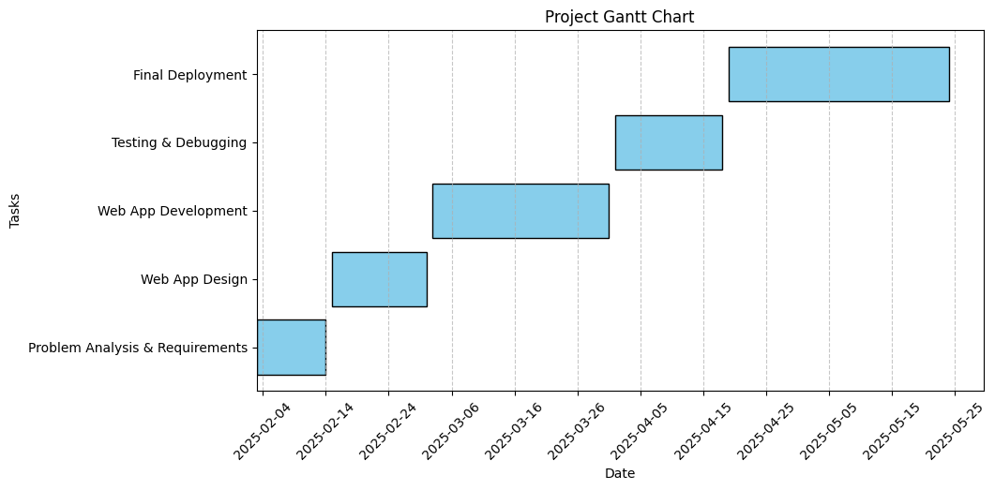
Timeline of the Project (Gantt Chart)

Slide 6
Expected Outcomes
Improved User Experience
Operational Efficiency
Scalable Solution
Automated Payment Handling
Data-Driven Insights

Slide 7
Conclusion
The Online Chatbot-Based Ticketing System presents a promising solution for enhancing the efficiency and user experience of museum ticketing operations. By integrating a responsive, multilingual chatbot with a secure payment gateway, the system ensures streamlined booking processes and improved accessibility. Furthermore, the inclusion of real-time analytics enables museum administrators to make data-driven decisions, optimize resources, and enhance marketing strategies. The proposed system not only minimizes operational costs and human errors but also enhances visitor satisfaction, thereby positively impacting the museum's reputation and profitability.

Slide 8
References (IEEE Paper format)
[1] Y. Liu, M. Zhou, and J. Zhao, "Intelligent Chatbot for Online Ticket Booking Using Natural Language Processing," IEEE Transactions on Computational Social Systems, vol. 9, no. 2, pp. 210-220, Apr. 2023, doi: 10.1109/TCSS.2023.3265489.
[2] R. K. Gupta and A. Sharma, "AI-Based Chatbot for Museum Ticketing: Enhancing User Experience with Multilingual Support," in Proceedings of the IEEE International Conference on Artificial Intelligence and Smart Systems (ICAISS), Chennai, India, 2022, pp. 45-52, doi: 10.1109/ICAISS54655.2022.9784556.
[3] P. Das, S. Roy, and N. Banerjee, "Automated Ticket Booking System for Museums Using Conversational AI," in Proceedings of the IEEE International Conference on Smart Computing and Communications (ICSCC), Kuala Lumpur, Malaysia, 2021, pp. 167-172, doi: 10.1109/ICSCC51209.2021.9672568.
[4] S. J. Lee, H. Kim, and K. W. Lee, "A Review of Chatbot Technologies for Online Customer Service: Applications and Future Trends," IEEE Access, vol. 10, pp. 34567-34582, 2022, doi: 10.1109/ACCESS.2022.3145678.
[5] T. K. Patel and M. J. Singh, "Integration of Payment Gateway with AI Chatbots for Seamless E-Ticketing in Cultural Institutions," in Proceedings of the IEEE International Conference on Digital Transformation and Artificial Intelligence (ICDTAI), Dubai, UAE, 2023, pp. 299-305, doi: 10.1109/ICDTAI56829.2023.10074568.

Slide 9


