Slide 1
Data Types in Python

Slide 2
Numeric
There are basically three different numerical data types in Python.
int (plain integers): It stores positive or negative whole numbers.
float(floating point real values): This stores real numbers and are written with a decimal point showing the integer and fractional parts of a number. They may also be represented in scientific notation with “e” indicating the power of 10.

Slide 3
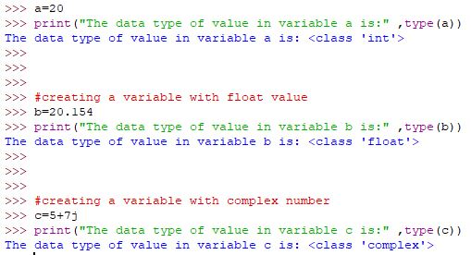
complex(complex numbers): They are in the form of a+bj, where a and b and j represents the square root of -1 i.e imaginary number. a and b represents the real and the imaginary part of complex number respectively.

Slide 4
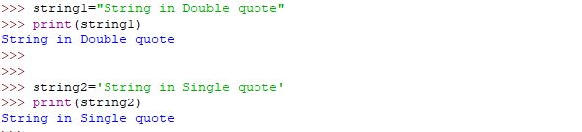
String
A string is a basically a sequence of characters. It is usually represented by single or double quotes.

Slide 5
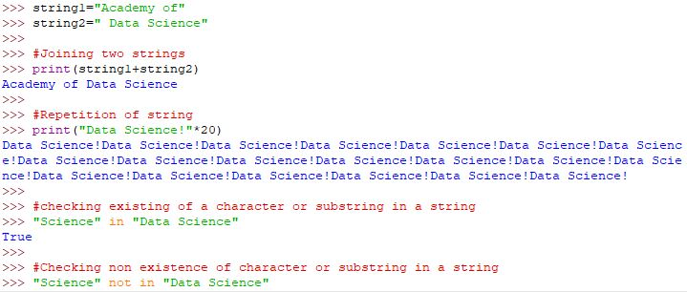
Some Basic Operations on String

Slide 6
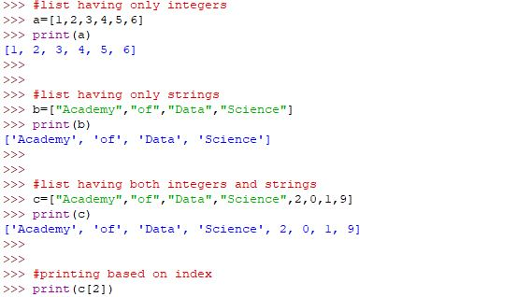
Lists
List in python are simply ordered collection of data. A list can concurrently hold different types of data in it. It is created using [] and commas.

Slide 7
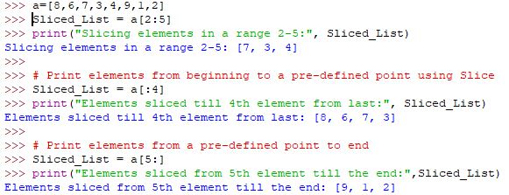
Slicing operations in Lists

Slide 8
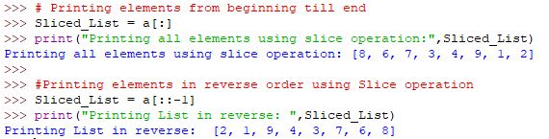

Slide 9
Tuples
Tuples are basically lists which are immutable i.e once created the data in the tuples cannot be changed.

Slide 10
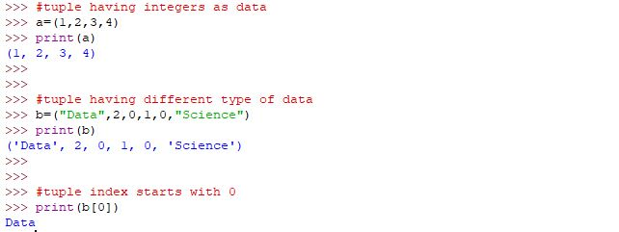

Slide 11
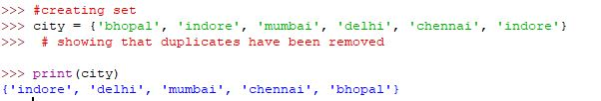
Sets
Sets are unordered collection of data. One important aspect of sets is that it doesn’t store redundant data. Set objects also support mathematical operations like union, intersection, difference, and symmetric difference. Sets can be created by set() or {} curly braces.

Slide 12
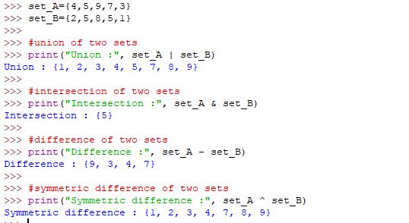
There are various operations that can be performed on sets such as join, intersection, difference and symmetric difference. Below are some examples for the above operation.

Slide 13
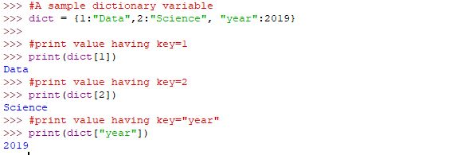
Dictionary
Python dictionary is an unordered sequence of key value with data form. It is quite similar to hash tables in C++. Dictionary are indexed by keys which can be any immutable data types. Tuples can be used as keys unless it doesn’t contain any mutable object. The main operations on dictionary is storing values with some key and retrieving the value given the string.

