Slide 1


CrimeAnalysis
India Crime Analytics — 12 years of NCRB IPC crime data, end-to-end pipeline
MYSQL → PANDAS → POWER QUERY → DAX → POWER BI

Slide 2
Dataset at a Glance
12
35
806
Years
States / UTs
Districts
2001–2012
29
23.9M
Categories
Total Cases

Slide 3






The Analytics Pipeline
MySQL
Source data
Python / pandas
Validation
Power Query (M)
ETL / reshape
Star Schema
Data model
DAX
Measures
Power BI
Dashboard
Raw MySQL source — not a pre-cleaned CSV — demonstrating the full real-world analyst pipeline.

Slide 4

Validation: Catching the 4M Gap
Raw Sum
TOTAL_IPC_CRIMES
28,037,178 cases
23,940,654 cases
Root Cause
6 sub-category columns double-counted inside parent categories

Slide 5
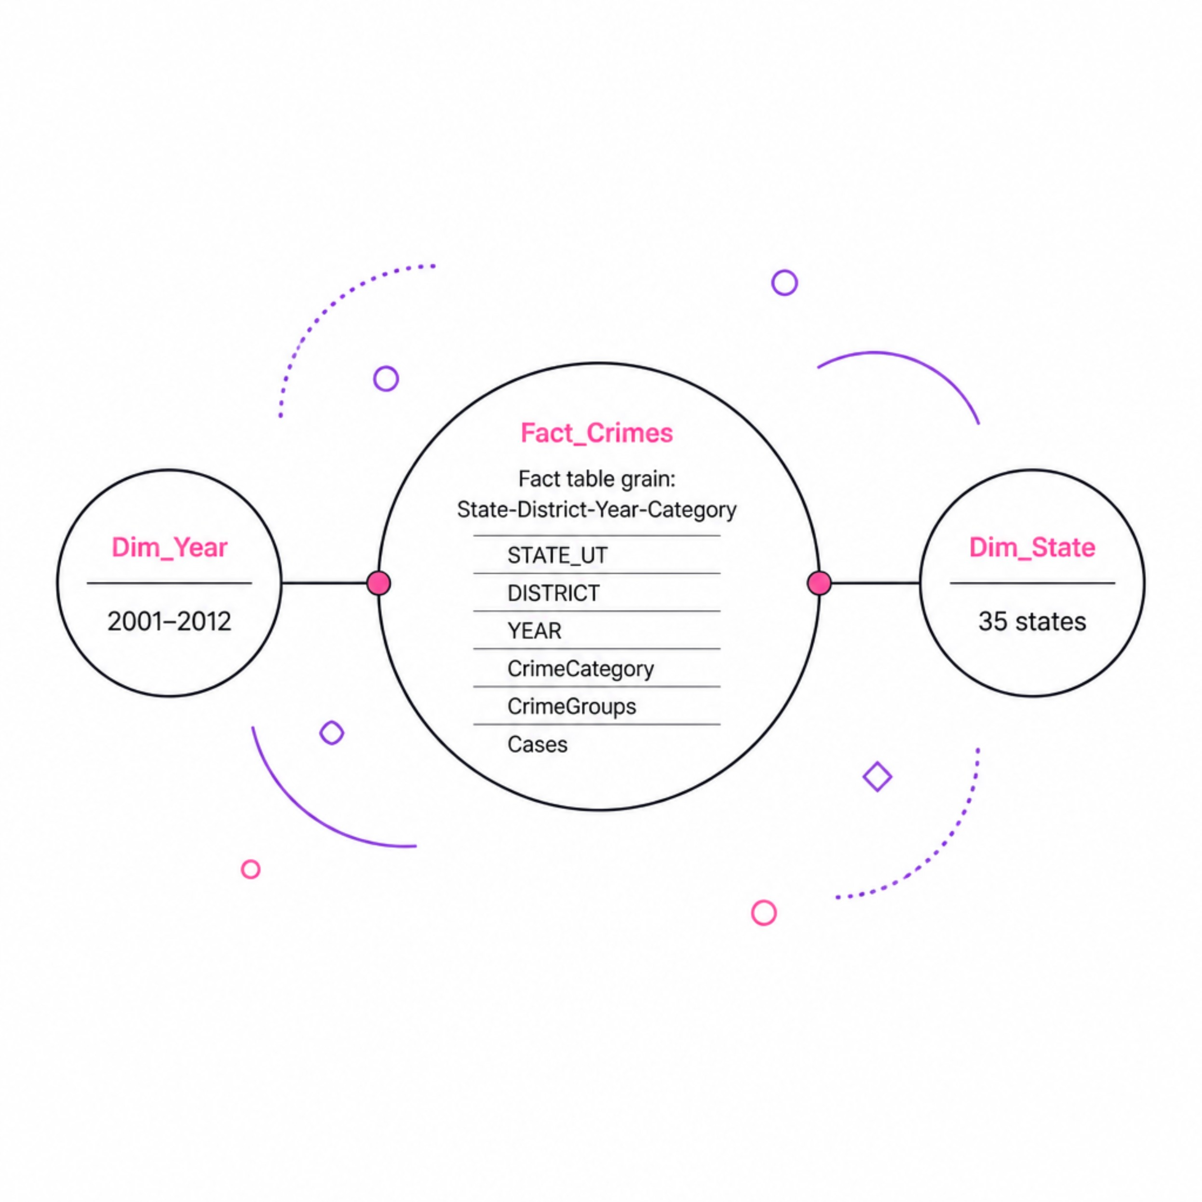

Data Modelling: Star Schema
Fact_Crimes
Grain: State–District–Year–Category
Dim_Year
2001–2012
Dim_State
35 distinct states / UTs
CrimeGroups bucket 23 categories into 5 analytical groups: Violent, Property, Women, Kidnapping, Other.

Slide 6
Headline KPIs
23.9M
2.65%
Total Crimes
YoY Change
2001–2012
2011 → 2012
2.76%
8.33%
CAGR
Violent Crime %
2001–2012
Share of total IPC
All measures validated against independent pandas calculations — not just DAX output.

Slide 7

Dashboard Design
Page 1 — National
Page 2 — State
KPIs, trend line, category breakdown, state heat matrix
State rank, district charts, State × CrimeGroup matrix
Page 3 — District
District rank, funnel, gauge vs state average

Slide 8
Debugging Log
Issue
Root Cause
Fix
Total inflated to 28M+
6 sub-columns double-counted
Excluded in Power Query
YoY showing 929.5%
No Year filter context
Explicit Latest/Prior-Year measures
CAGR = 0
General Number format
Set to Percentage
Rank always 1
RANKX no single-value context
HASONEVALUE + COUNTROWS
District Rank = 190,864
Ranked raw fact rows
Ranked over VALUES(DISTRICT)
Gauge no gap
State avg filtered by district
CALCULATE(..., ALL(DISTRICT))
Map visuals disabled
Tenant policy blocking Bing Maps
Replaced with Matrix

Slide 9

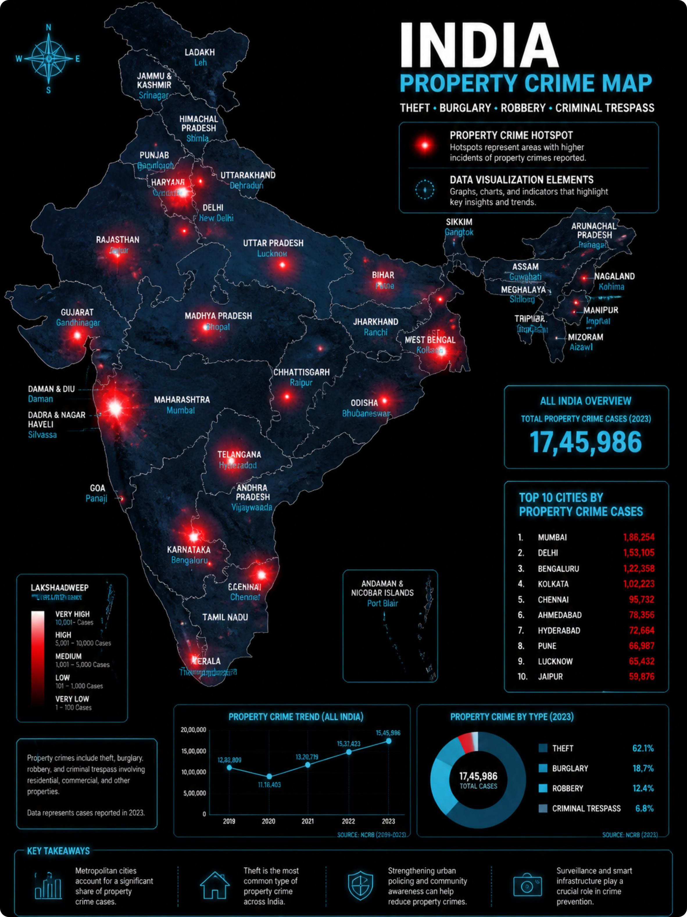

Key Insights
Property Crime Dominates
Largest, fastest-growing category — highest-leverage for policy focus
2.76% CAGR, Accelerating Post-2007
Steady national growth over 12 years
Madhya Pradesh Leads
2,413,770 cases — narrowly ahead of Maharashtra (2,273,436)
Violent Crime: Only 8.33%
Bulk falls under property and "other" IPC categories

Slide 10





Skills Demonstrated
Data Engineering
Analysis
Modelling
SQL, Power Query (M), cleaning, schema design
pandas profiling, aggregation, root-cause analysis
Star schema, DAX, CALCULATE/FILTER, ranking
Visualisation
Analytical Thinking
Power BI design, KPIs, conditional formatting
Reconciling totals, debugging context bugs, defensible insights

