Slide 1
Education Consultancy System
Mentor : Suramya Biswas
Presented By:
Sandhesh S
Mongal Das
Gangadhara Shravya

Slide 2
Agenda
Introduction
Technology and tools
Modules to be Implemented
Outputs
Future Enhancements
Conclusion

Slide 3

Introduction
In today’s fast-paced world, students and parents often struggle with choosing the right academic path. Education Consultancy Systems play a crucial role in bridging this gap by providing structured guidance. This project provides guidance to students, parents.

Slide 4
Technology and Tools
Backend: Java 17, Spring Boot 3(Spring Data JPA , Spring Security)
Frontend: Boot Strap , ReactJS , HTML, CSS, JavaScript
Database: MySQL-8.0
Build tool: Maven
Code editor and tool : Eclipse IDE , Visual Studio Code

Slide 5
Modules to be Implemented
User Authentication and Registration
Admin Dashboard
Student Dashboard
Course
Subscription Management
Payment Management

Slide 6
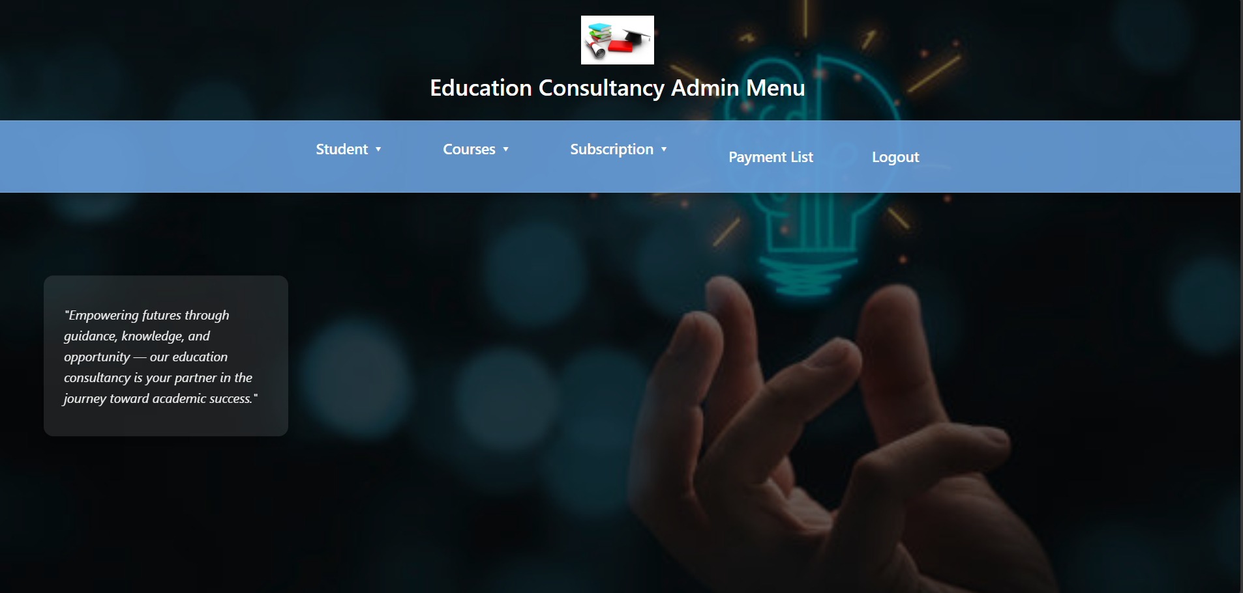
Outputs
Admin Dashboard
The Admin Panel in the Edu Consultancy System serves as a central dashboard for managing students, courses, subscriptions, and payments. It provides an intuitive interface with navigation options for viewing and updating student records, tracking subscriptions, and handling payments securely. Admins can efficiently oversee the system, ensuring smooth operations and transparency. The panel also includes a logout option for secure access control, making it a user-friendly and essential tool for effective administration.

Slide 7

Outputs:
Student Dashboard
The Student Dashboard in the Edu Consultancy System provides students with an intuitive interface to access courses, manage subscriptions, and track payments. With a simple navigation menu, students can explore available courses, view their enrollment details, and make secure payments. The dashboard enhances the learning experience by offering easy access to essential academic resources while ensuring a seamless and user-friendly experience.

Slide 8
Conclusion and Future Enhancements
The Education Consultancy System provides an efficient platform for students, parents, and consultants. Future enhancements may include AI-driven recommendations, chatbot integration for instant support, and expansion of course offerings.

Slide 9
Conclusion
The Education Consultancy System provides an efficient platform for students, parents, and consultants. It helps in educational planning, ensuring a smooth experience for all stakeholders.

Slide 10
Thank You

