Slide 1



IOT SMART HOME (Firebot and Device Automation)
FARID , Zarin, KENTON, MIHIR

Slide 2

Stand out Features
Visualization and control of the temperature, pressure and humidity of the home from a remote place.
Sending of an email if the temperature, pressure or humidity goes above a certain set value.
Sensing a fire if there is one and sending a text message via twilio to the home owner.
Putting out the fire by splashing water to the fire affected areas in the given proximity.
Making a high pitched sound in case of fire which can warn the nearby people.
Controlling the AC, fans, lights via one button build in MIT app inventor application.
Economic and cost effective design for a safe environment at home.

Slide 3
Flow Diagram Hardware Flow Software Flow
Sensor Tag
Raspberry Pi
Database
Firebot
Mobile Phone
Sensor data
Node-red
Firebase/ Thingspeak
MIT App inventor
Text msg (twilio)/ emails

Slide 4
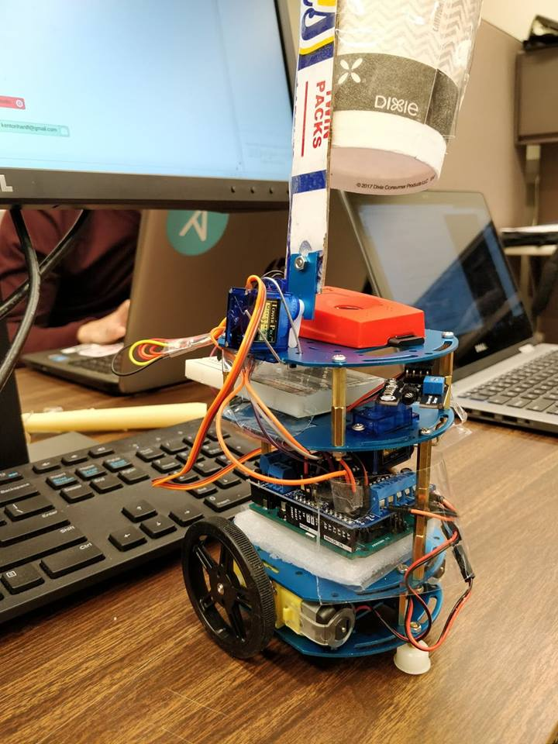
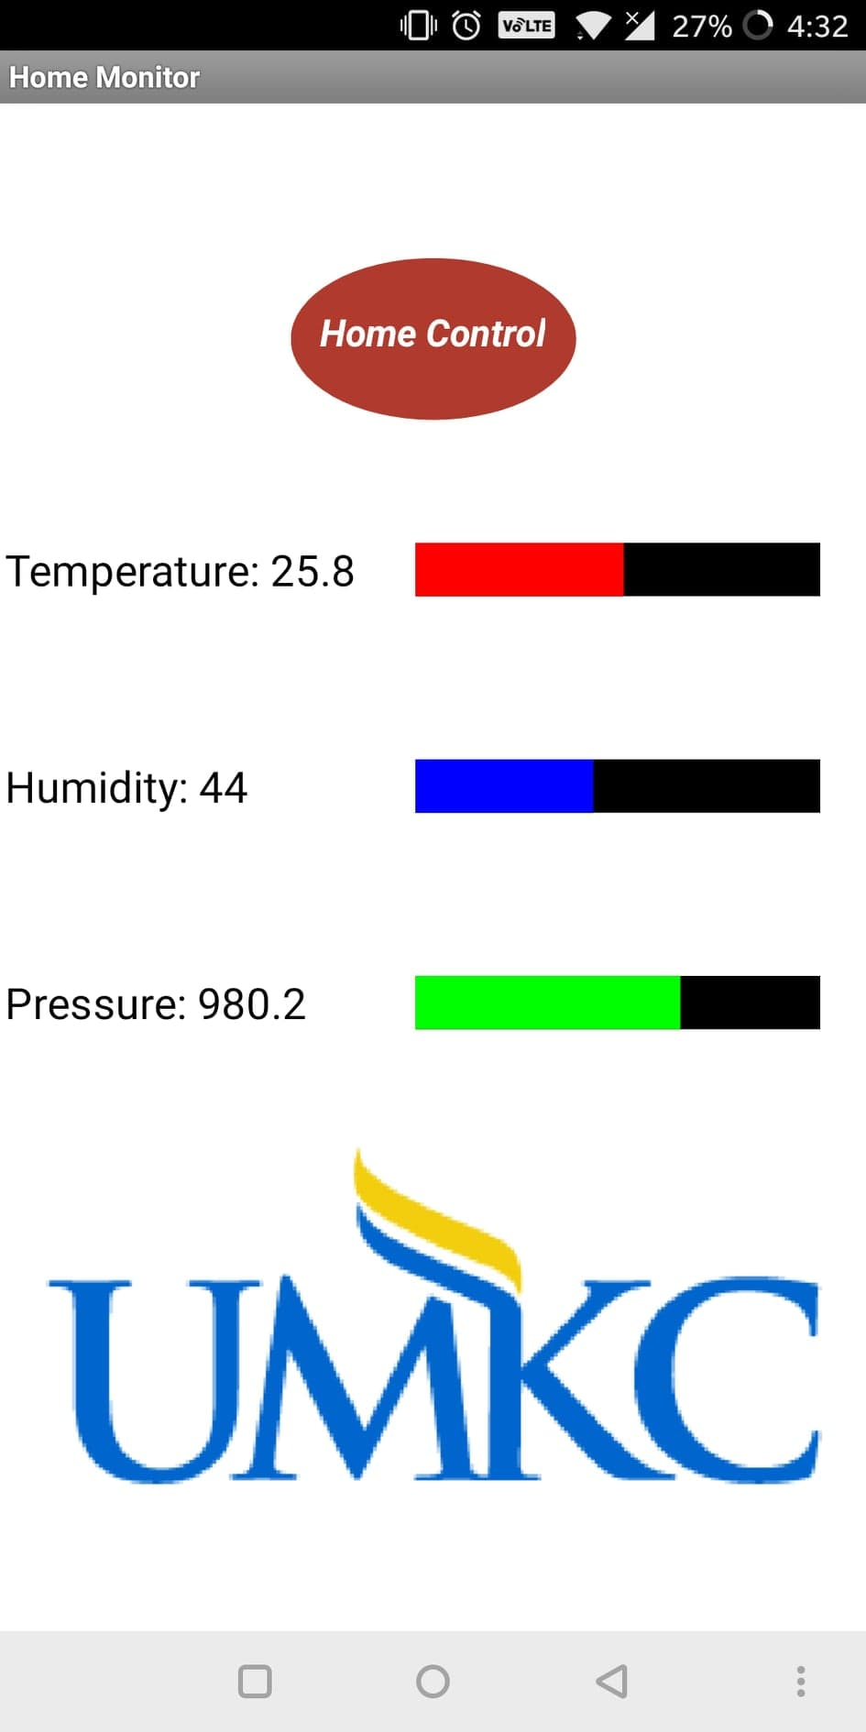
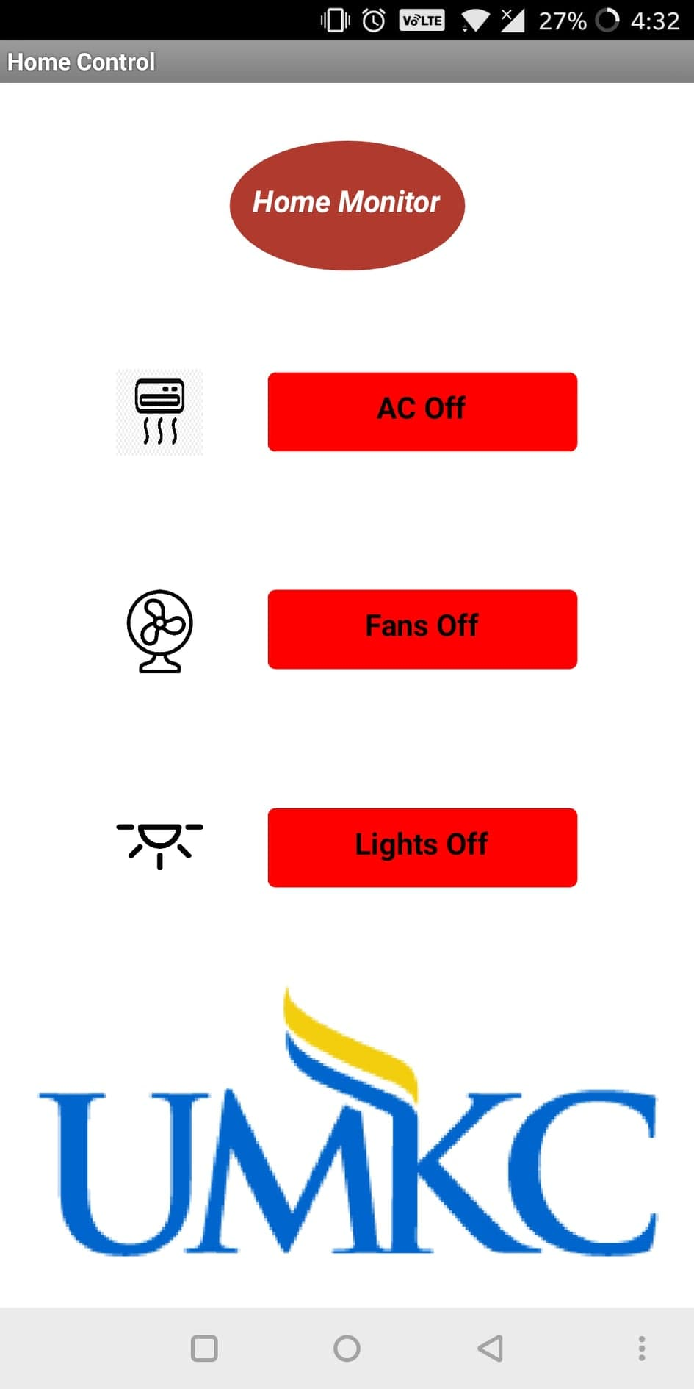
Fire Fighting Robot & User Interface on MIT App Inventor

Slide 5

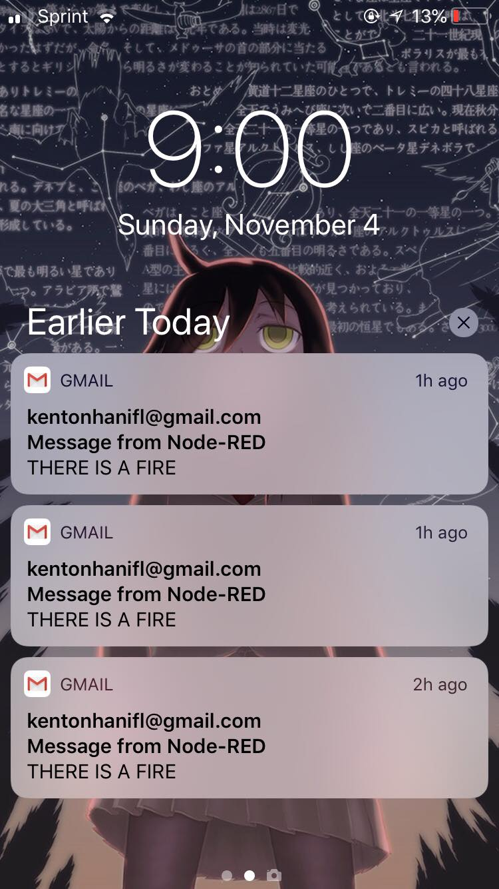
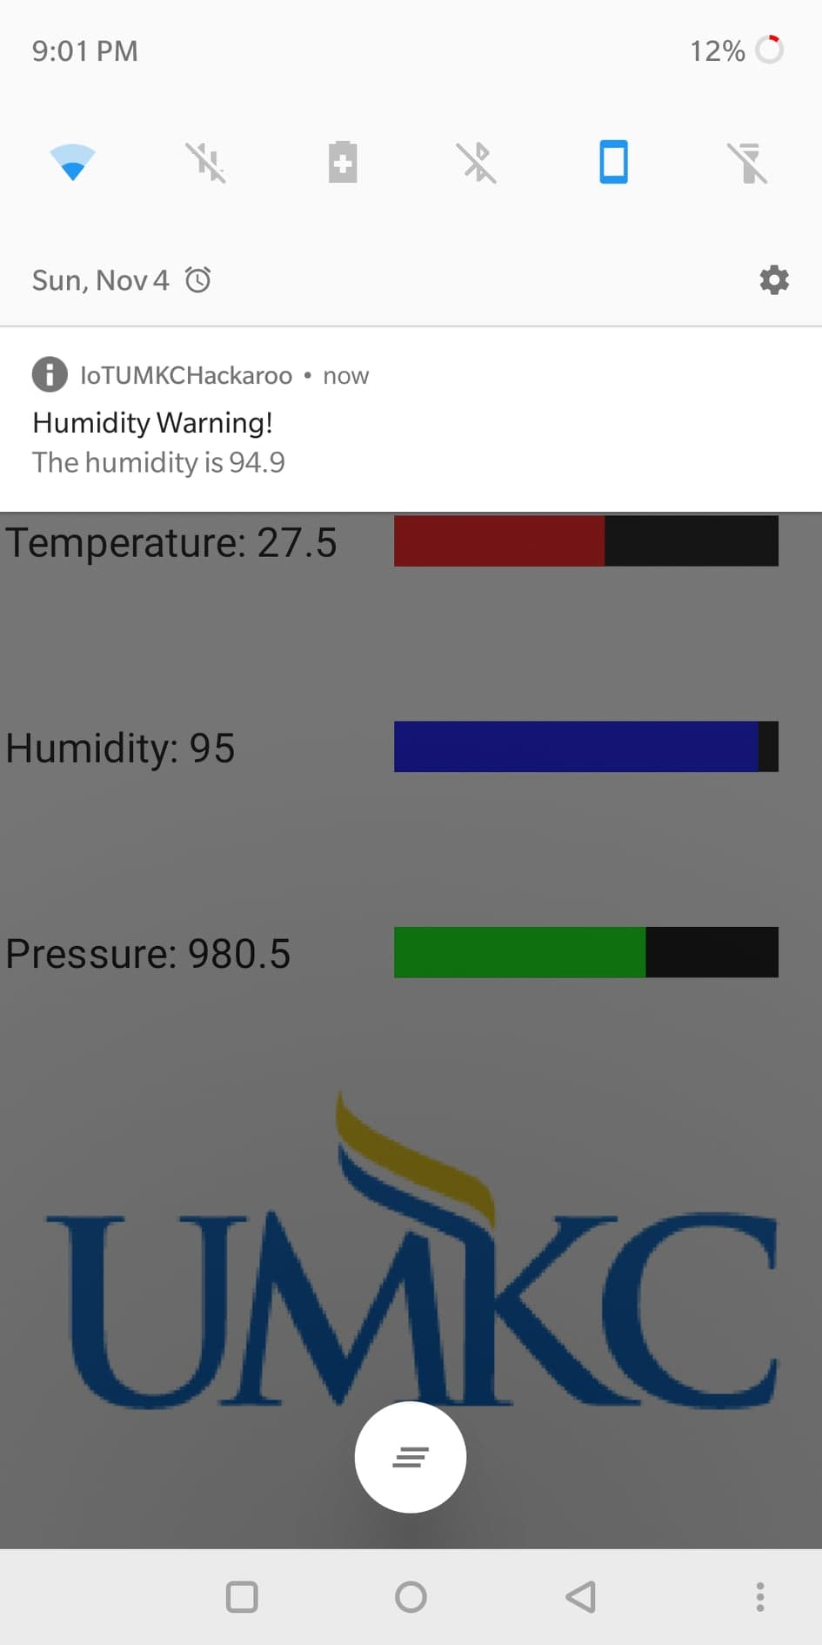

Advantages
Easy to deploy and cost effective product (around $80) for smart home.
A low-power design which covers all aspects of a safe home.
Reachability of the fire fighting robot to remote location to put out fire.
Possibility of sending text message/ making a call to 911 via node-red.
Interaction with user using all kinds of communication techniques.

