Slide 1


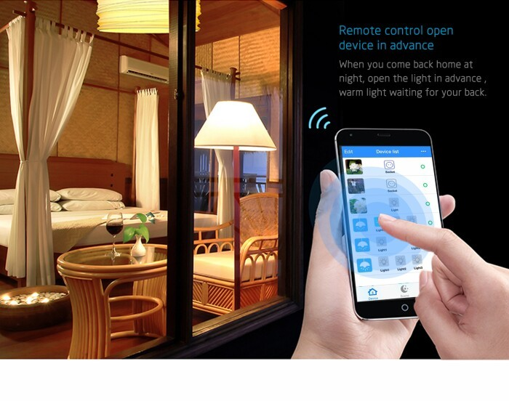
IOT SMART HOME (Firebot and light automation)
FARID ,Zarin, KENTON, MIHIR

Slide 2

Stand out Features
Visualizes and controls the temperature, pressure and humidity of the home from a remote place
Sends an email if the temperature, pressure or humidity goes above a certain set value
Sends a text message via twilio to the home user when a firefighting bot detects fire
Splashes water to the fire affected areas in the given proximity
Controls the ac, fans, lights via one button build in MIT app inventor application.
Economic and cost effective design for a safe environment at home

Slide 3
Features Hardware flow Software flow
Sensor Tag
Raspberry Pi
Database
Fire-bot
Mobile phone
Sensor data
Node-red
Firebase/ Thingspeak
MIT App inventor
Text msg (twilio)/ emails

Slide 4
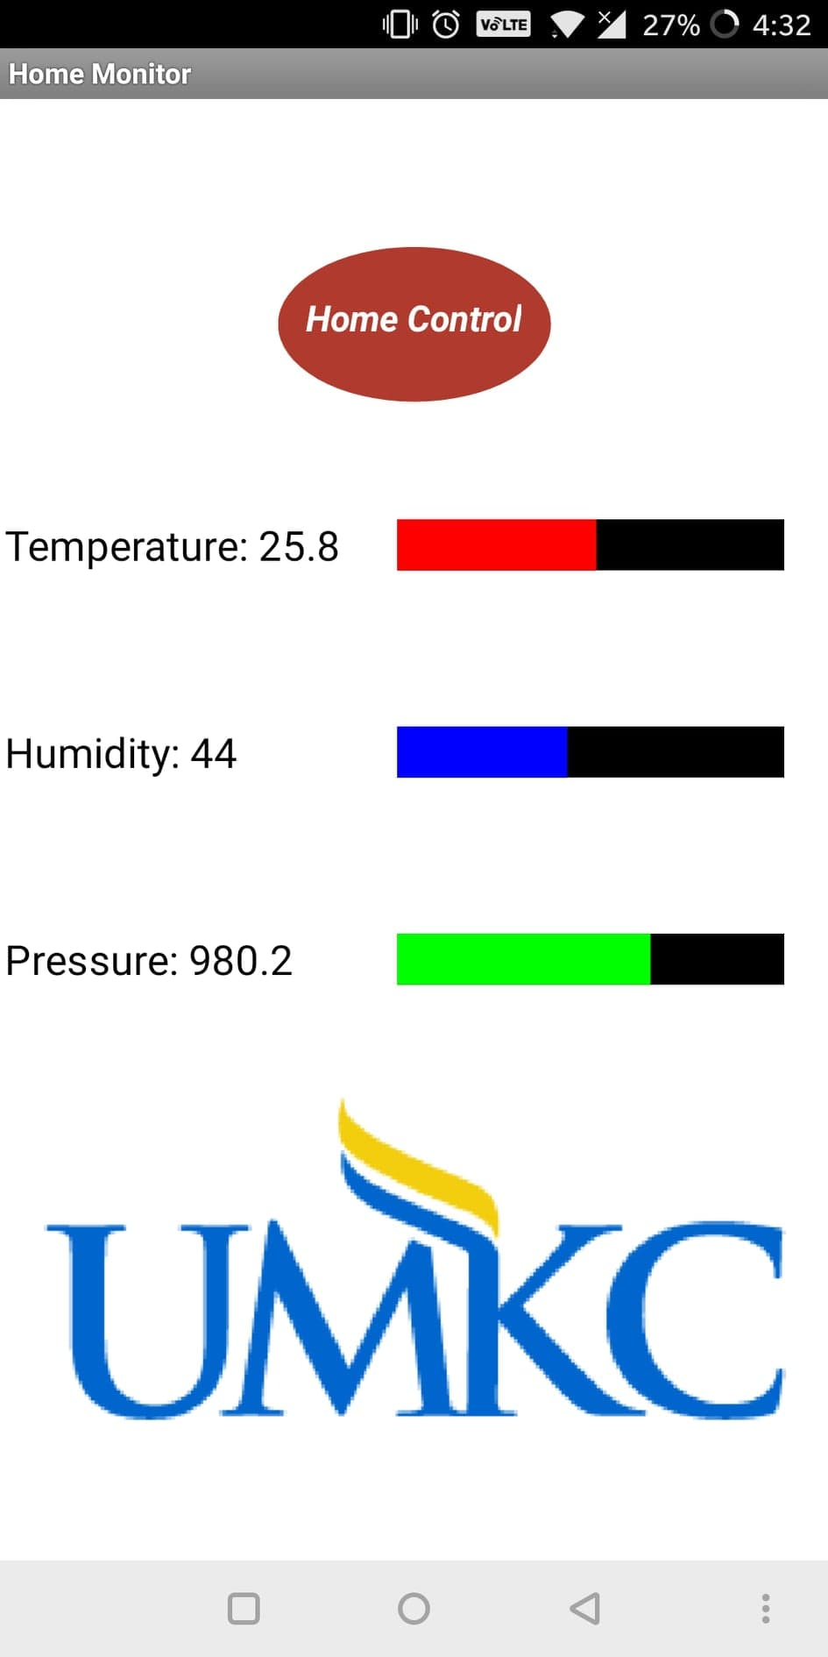
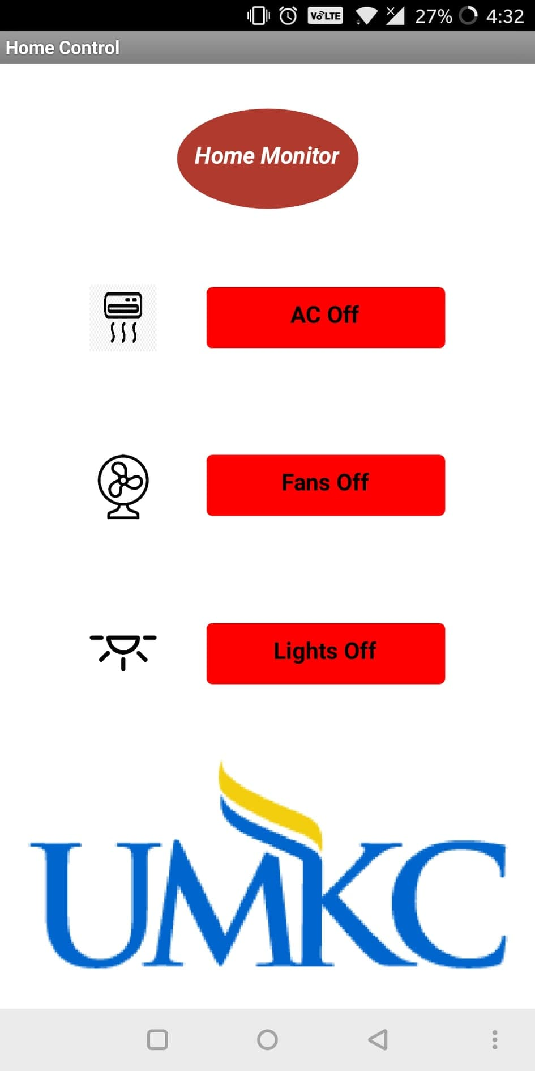
User Interface on MIT app Inventor

Slide 5
Advantages and Demo
Easy to deploy and cost effective product for smart home
Alert reachability to your remote location
Jbkbkj
Csvsdvvs
Demo
Video link

