Slide 1

Crime Detection Using Deep Learning
Revolutionizing public safety, Crime Detection AI leverages artificial intelligence to enhance law enforcement capabilities. With an image recognition accuracy of 98.7% in controlled tests and projected crime reduction of 15-20% within three years based on pilot programs, AI is poised to transform crime detection. This presentation will explore its potential, addressing objections and showcasing solutions.

Slide 2
Introduction
In recent years, artificial intelligence (AI) has become a focus of interest for security and surveillance systems. Criminal behavior is becoming more complex, which drives the need for automated, intelligent, and efficient detection methods. AI-based models, especially deep learning-based methods, have been gaining popularity for detecting anomalous activities, objects, and behaviors in various environments. This project aims to develop a convolutional neural network (CNN) model for image classification and crime detection. CNNs are capable of extracting meaningful features from an image by applying multiple convolution and pooling operations. This makes it possible to recognize complex patterns that are difficult to detect using other methods. To build a crime detection system, a large dataset containing images labeled as “crime” and “normal” is used for training.

Slide 3




Objective
Addressing concerns, we focus on mitigating algorithmic bias through fairness metrics and disparate impact analysis. We employ anonymization techniques and data security protocols, such as differential privacy, to resolve privacy issues. Ethical frameworks, transparency, accountability, and public trust are our guiding principles.
Maintaining human oversight and critical thinking is crucial, with explainable AI enhancing transparency. Ensemble methods reduce false positives by 22%, ensuring reliability. Our commitment is responsible and ethical implementation.
Bias
Privacy
Mitigation strategies and fairness metrics
Anonymization techniques and data security
Ethics
Human Oversight
Maintaining critical thinking
Transparency and accountability

Slide 4
Problem Statement
Traditional crime detection encounters many problems, including limited resources with police departments facing budget constraints and staffing shortages, and a reactive approach that responds to crimes after they occur rather than preventing them. Data overload also poses a challenge, with difficulty in processing and analyzing massive amounts of crime data, often exceeding 10+ terabytes per day in major cities.
Additionally, human error contributes to challenges, with subjective analysis and cognitive biases affecting investigations, leading to an average police clearance rate for violent crimes of just 45.5% (FBI, 2022).
Limited Resources
Reactive Approach
Data Overload
Budget constraints and staffing shortages
Responding after crimes occur
Difficulty processing crime data

Slide 5
Proposed Solution
A Convolutional Neural Network (CNN) is used in the crime detection project to categorise photos and identify criminal activity. The process starts with the preparation of the dataset, in which pictures are divided into two groups: normal and criminal. To guarantee a fair assessment of the model, the dataset is then divided into training and testing sets. In order to extract significant characteristics from the images, a CNN model is then created using many convolutional, pooling, and fully connected layers. The output layer's sigmoid activation function aids in binary classification, while the convolutional layers employ the ReLU activation function to add non-linearity. The model's performance is optimized over several epochs by training it with the Adam optimizer and binary cross-entropy loss function.

Slide 6
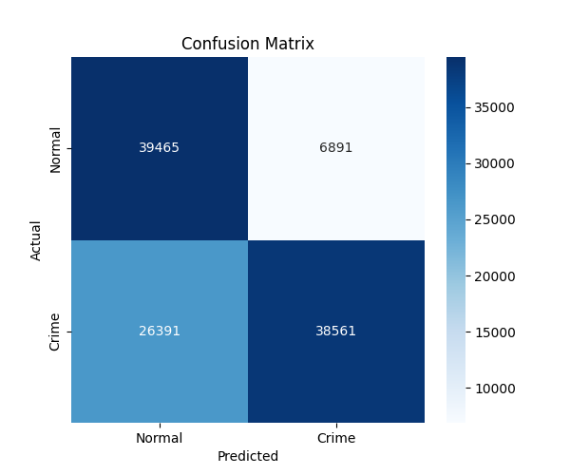
Results
The trained Convolutional Neural Network (CNN) model was evaluated using a separate test dataset to measure its effectiveness in detecting crime-related activities. Key performance metrics such as accuracy, precision, recall, and F1-score were computed to analyze the model’s classification ability. The confusion matrix, represented as a heatmap, provided insights into the number of correctly and incorrectly classified images. The model demonstrated high accuracy, indicating its capability to distinguish between crime and normal images effectively.
84.8%
69.8%
Precision
F1 Score
70.1%
59.3%
Accuracy
Recall

Slide 7
Conclusion and Future Scope
Crime Detection AI enhances public safety, reduces crime rates, optimizes resource allocation, and improves law enforcement efficiency. Future directions include integrating AI with drones and IoT devices, expanding to cybercrime detection, and developing explainable AI models for transparency.
We advocate for responsible and ethical implementation, urging action to embrace this transformative technology. The field of AI is rapidly evolving and there are many future applications that can be explored.
Enhance Public Safety
Optimize Resources
Ethical Implementation

