Slide 1

REINFORCEMENT PROJECT
Netflix Analysis

Slide 2
Overview
Generate the dataset
Analyze the dataset
Creating dashboard
Creating story
Insights

Slide 3
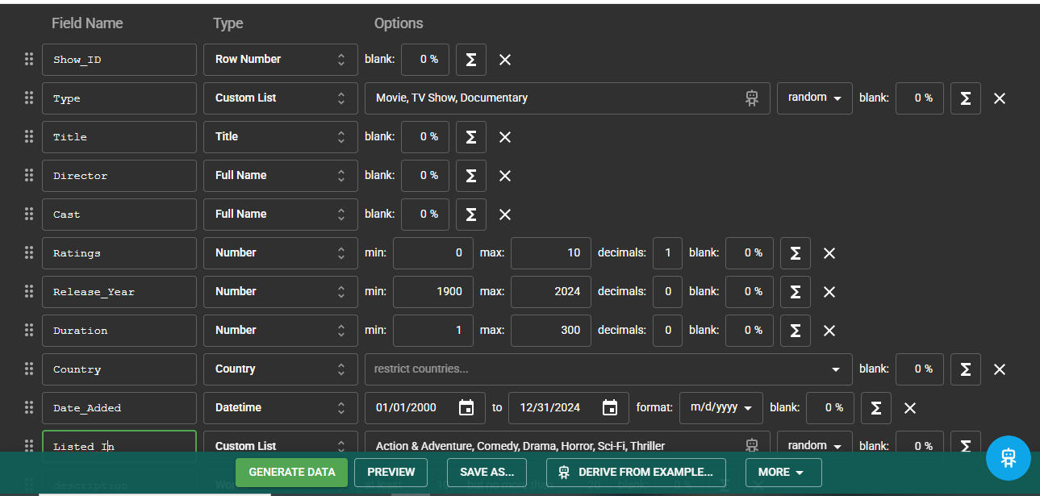
Generating Dataset

Slide 4
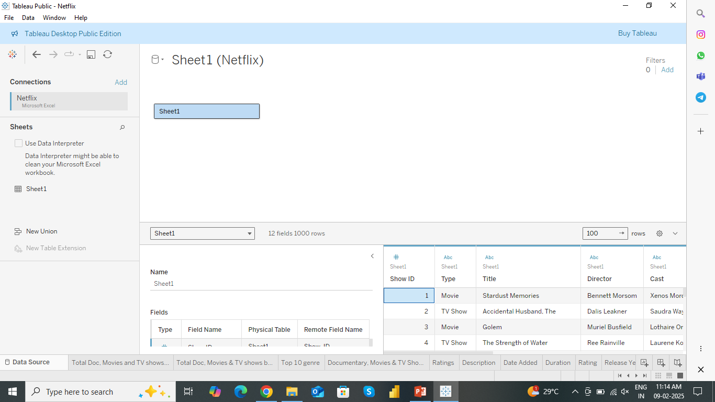
Data Sourcing

Slide 5
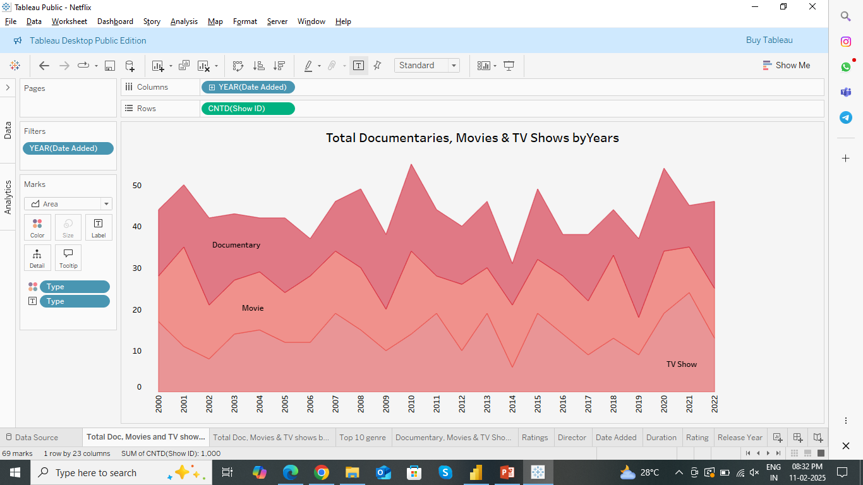
Visualization

Slide 6
List of Visuals
Total Documentaries, Movies & TV Shows by Year
Total Documentaries, Movies & TV Shows by Country
Genre list movie count
Documentary, Movies & TV Shows Distribution
Ratings by Movies count
Description
Date Added
Duration
Rating
Release Year

Slide 7
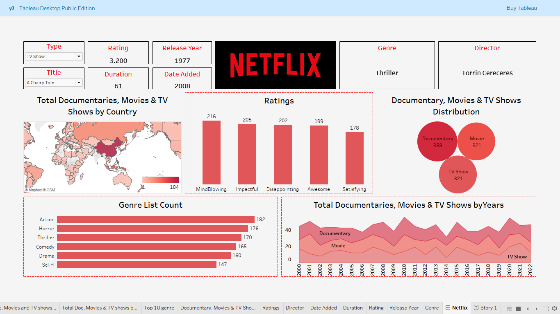
Dashboard

Slide 8
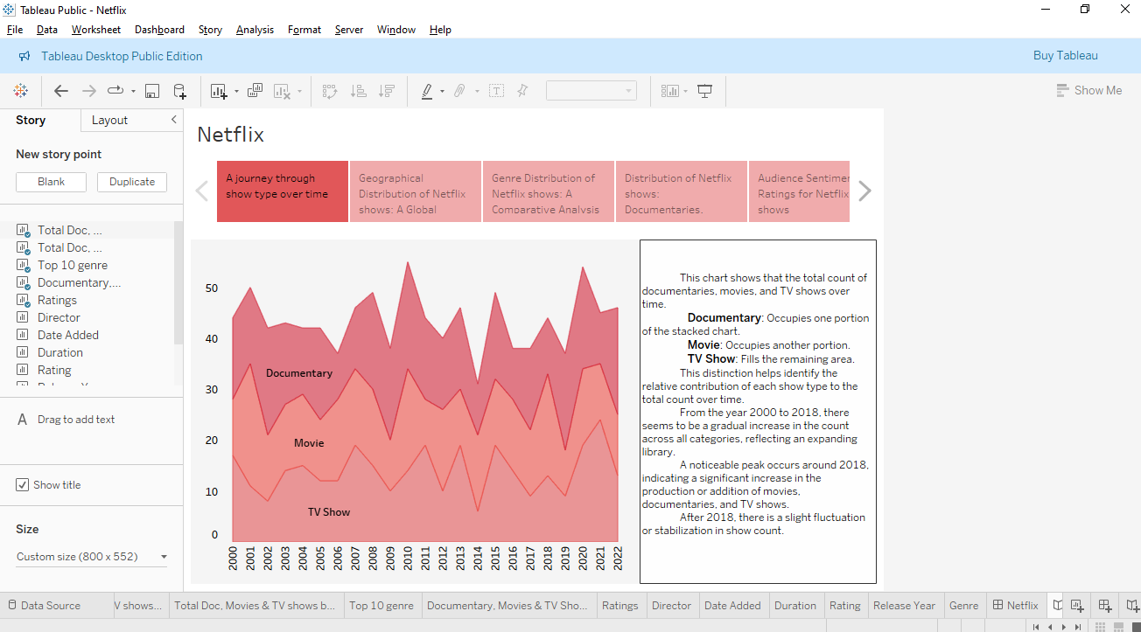
Story

Slide 9
Insights and Conclusion
Country
China - 184
Saudi Arabia,..-1
Genre
Action - 182
Sci-Fi - 147
Type
Documentary - 358
Movies, TV Shows - 321
Year
Before 2018
After 2018
Ratings
Mindblowing- 216
Satisfying - 178

Slide 10


