Slide 1

Student Management System
SUBMITTED BY:
SANDHIYA.S (192221086)
Dr. K. Jayasakthi Velmurugan
COURSE FACULTY
Department of Deep Learning.
Saveetha School of Engineering,
SIMATS, Chennai - 602105

Slide 2

Overview
1
Streamlining Processes
2
Improved Communication
Automates administrative tasks, freeing up staff time for more impactful activities.
Facilitates efficient communication between students, teachers, parents, and administrators.
3
Enhanced Collaboration
4
Data-Driven Insights
Creates a platform for seamless collaboration between all stakeholders in the educational process.
Provides valuable data analytics for informed decision-making and continuous improvement.

Slide 3
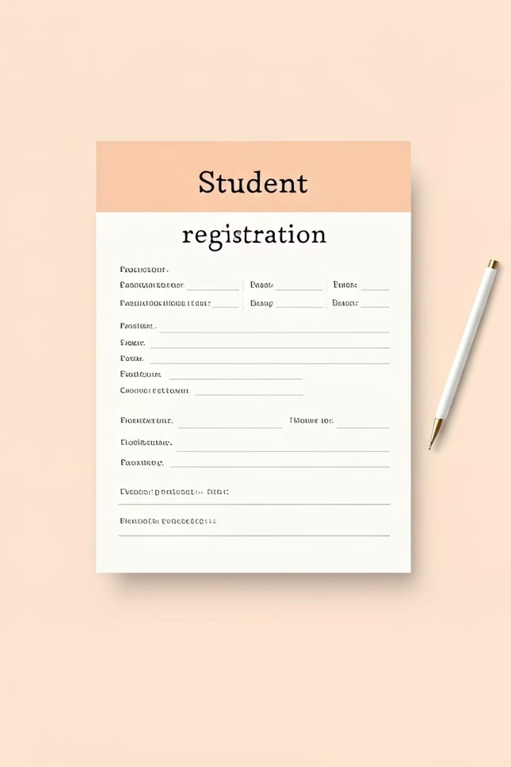
Student Registration
Online Forms
Automated Verification
Streamlines the registration process with easy-to-use online forms.
Ensures accuracy and reduces errors with automated verification of submitted information.
Secure Data Storage
Protects sensitive student data with secure storage and access controls.

Slide 4
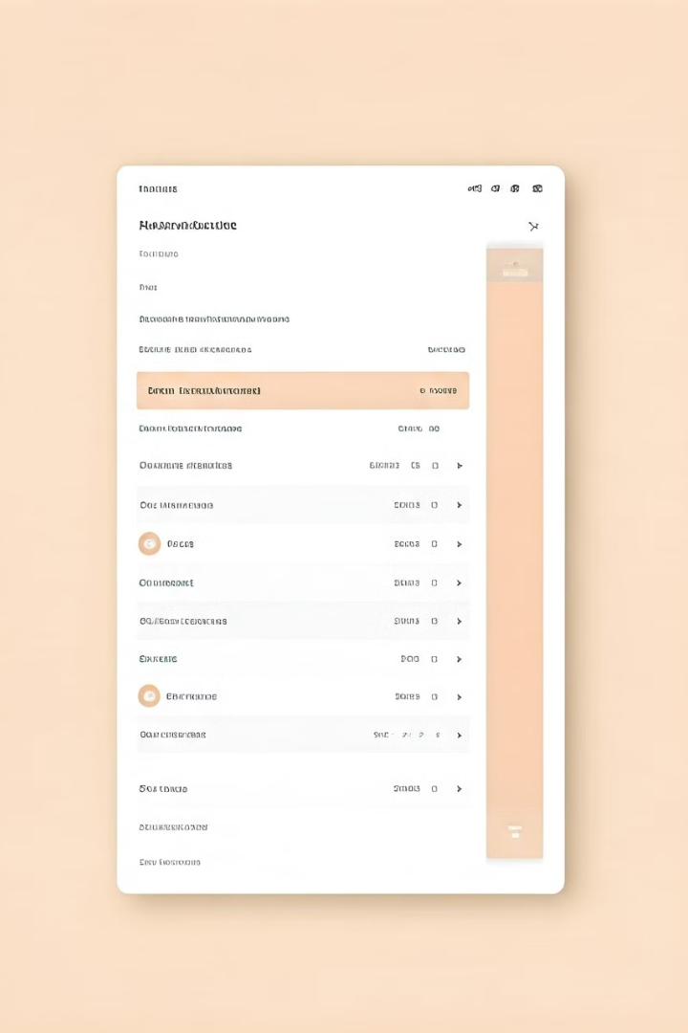
Student Records
Personal Information
Academic Records
Attendance
Extracurriculars
Name, Address, Contact Details
Grades, Transcripts, Coursework
Attendance Records, Absences
Clubs, Teams, Activities

Slide 5

Attendance Tracking
1
Real-time Tracking
Provides real-time updates on student attendance, allowing for proactive intervention.
2
Automated Reports
Generates automated reports for attendance patterns, identifying potential issues and areas for improvement.
3
Parental Notifications
Sends timely notifications to parents about student absences, promoting open communication.

Slide 6
Grading and Reporting
Automated Grading
Performance Analysis
Progress Reports
Simplifies the grading process, reducing manual effort and ensuring consistency.
Provides detailed analytics on student performance, identifying strengths and areas for development.
Generates comprehensive progress reports for students and parents, promoting transparency and engagement.

Slide 7
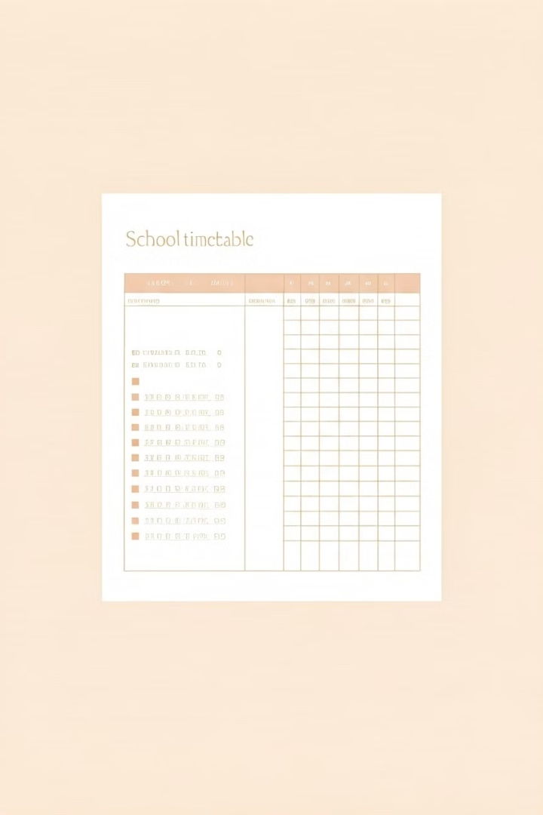



Scheduling and Timetabling
Class Scheduling
Creates and manages class schedules, ensuring optimal utilization of classroom resources.
Teacher Assignments
Assigns teachers to classes based on qualifications and availability, streamlining the scheduling process.
Room Allocations
Allocates classrooms for classes, taking into account capacity and suitability, ensuring efficient use of space.

Slide 8





Communication and Notifications
Messaging
Announcements
Enables secure and efficient communication between students, teachers, and parents.
Disseminates important information and updates to the entire school community.
Reminders
Notifications
Sends timely reminders about assignments, deadlines, and events, minimizing missed opportunities.
Provides alerts about important updates, ensuring that everyone stays informed.

Slide 9
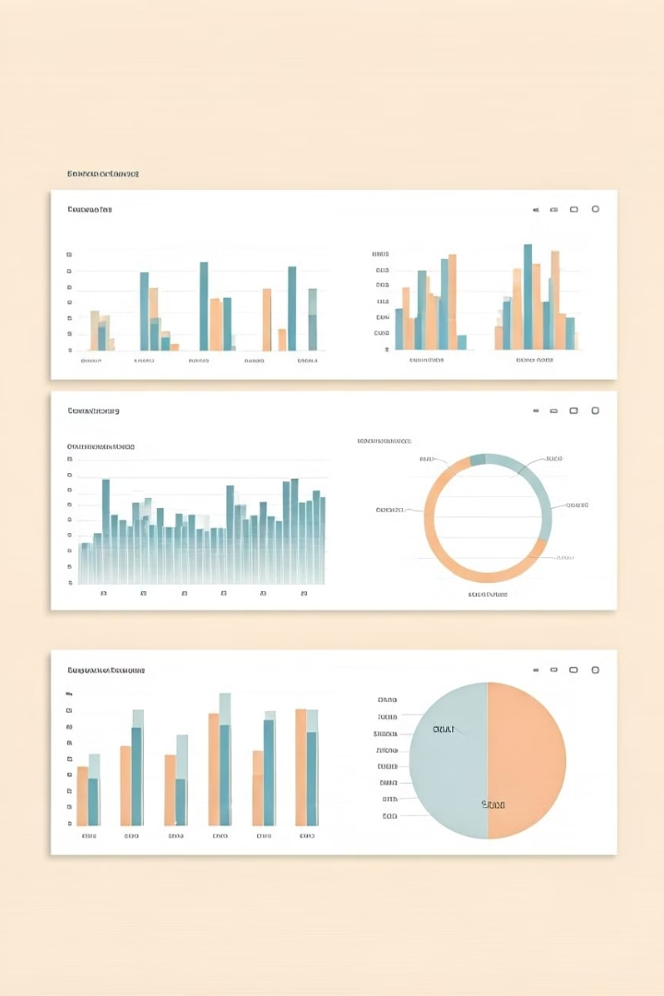
Analytics and Reporting
Student Performance
Attendance Trends
Identifies patterns in attendance, allowing for early intervention and proactive support.
Tracks and analyzes student academic performance, identifying areas for improvement.
Resource Utilization
Provides insights into the use of school resources, optimizing allocation and efficiency.

Slide 10

User Roles and Permissions
Role
Permissions
Student
Access to personal information, grades, attendance, assignments
Teacher
Manage classes, assign grades, track attendance, communicate with students
Administrator
Manage user accounts, system settings, access control, generate reports
Parent
View student information, attendance, grades, communicate with teachers

