Slide 1
FLIPKART
By
Sandhiya J

Slide 2
Requirement / User Story: As A user I should be able to search for a product, verify its discount and add it to cart, so that I can eventually buy the product.
Scenario / Test Case to Automate
1. Navigate to Flipkart.com
2. Close the popup - Use Xpath and the text() method in xpath to close
3. Search for text "fitbit" and click on search icon
4. Verify that there are more than 900 results shown
5. Click on the first result link. A new tab will open for the product details page
6. Take screenshot of this page (details page) and store it under project folder inside screenshots folder with filename productdetails.jpg
7. On this page, capture the original price and final price. Then calculate the discount percentage and verify that the % displayed on the page is correct.
8. Click on Add to Cart button. This will open the MyCart Page in the same window
9. Verify that the total amount is equal to the amount captured on Step 6 (final price)
10. Close the new window
11. Quit the drive

Slide 3
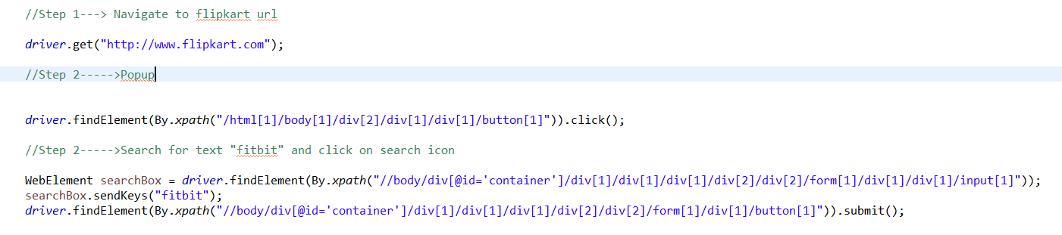
Step 1. Navigate to Flipkart.com Step 2. Close the popup - Use Xpath and the text() method in xpath to close Step 3. Search for text "fitbit" and click on search icon

Slide 4
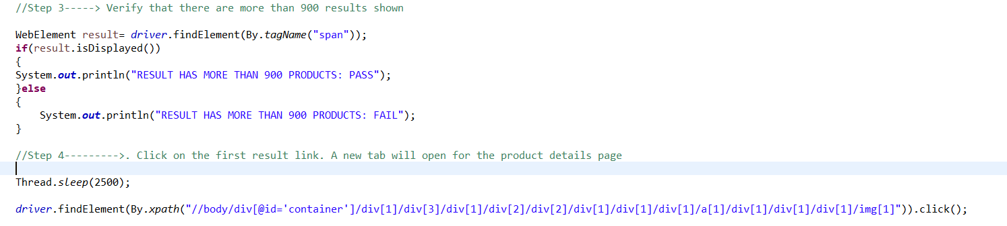
Step 4. Verify that there are more than 900 results shown Step 5. Click on the first result link. A new tab will open for the product details page

Slide 5
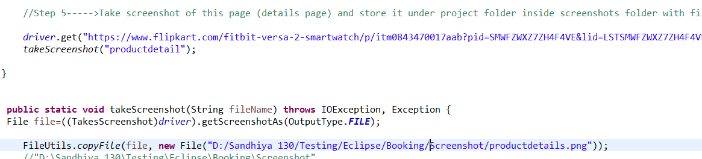
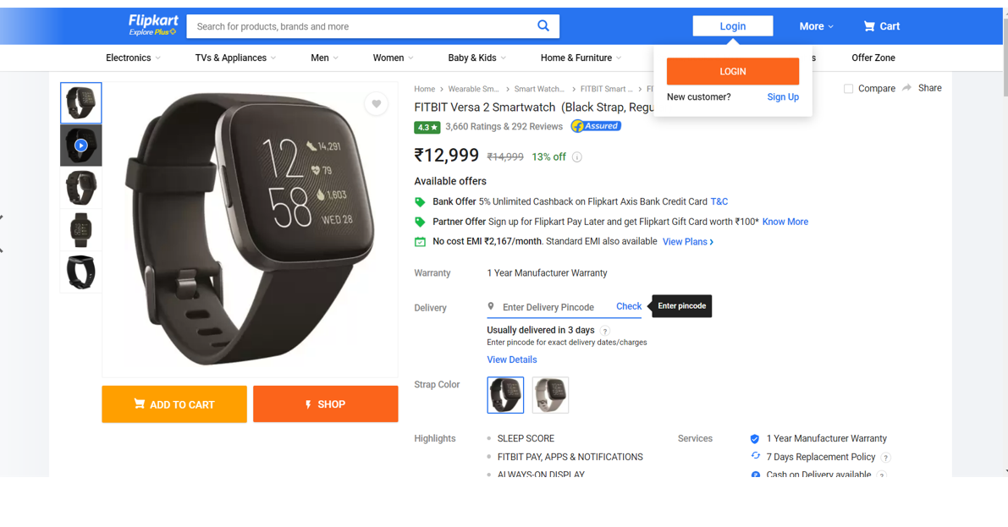
Step 6. Take screenshot of this page (details page) and store it under project folder inside screenshots folder with filename productdetails.jpg

Slide 6
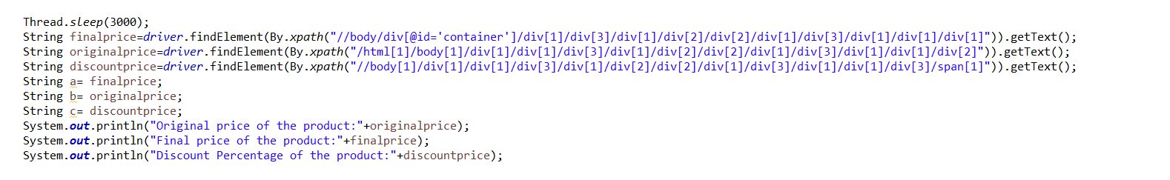
Step 7. On this page, capture the original price and final price. Then calculate the discount percentage and verify that the % displayed on the page is correct.

Slide 7
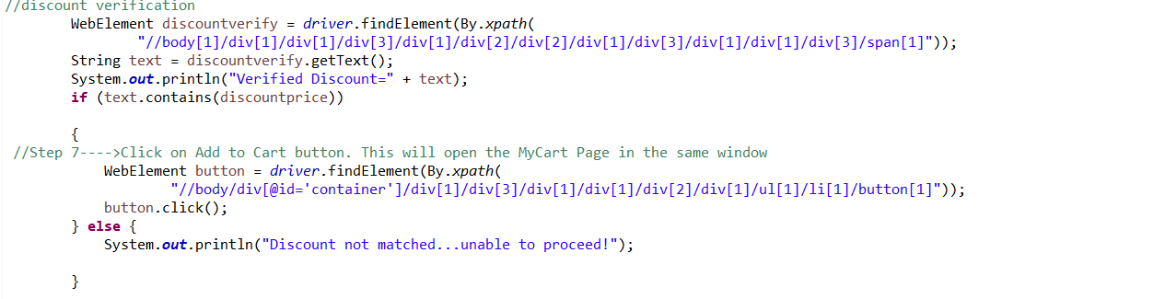
Step 8: Verify discount Step 9:. Click on Add to Cart button. This will open the MyCart Page in the same window

Slide 8
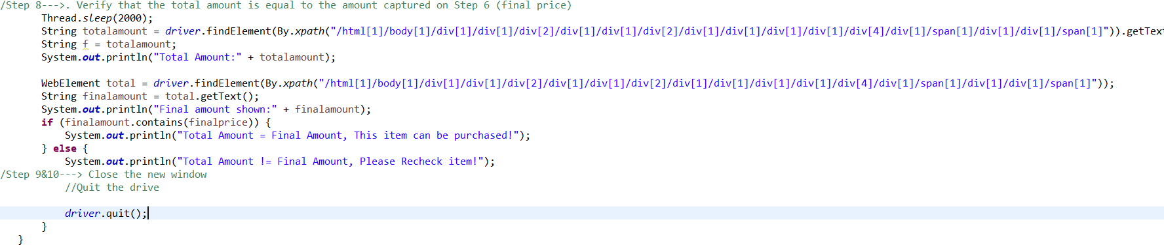
Step 10: Verify that the total amount is equal to the amount captured on Step 6 (final price)

Slide 9
Thank you

