Slide 1
RAUSHBYTE TECHNOLOGIES
AI/ML Internship Program
AI/ML Internship — Final Project Presentation
Projects, Technical Implementation & Learning Outcomes
PREPARED BY
ORGANIZATION
Sandhiya
RaushByte Technologies

Slide 2
Journey & Structure
Internship Overview & Progression
LEVEL 1
LEVEL 2
LEVEL 3
Foundations & Research
Interactive Systems
Advanced Applications
AI Research, Rule-Based Chatbot, and Core AI Concepts & Ecosystem Study.
Face Detection, Voice Assistant, and Python-based Task Automation.
Smart AI Assistant with tools & memory, and Computer Vision Object Detection.
Total 8 Completed Tasks Across 3 Progressive Levels
Structured Hands-On Curriculum

Slide 3


Tech Stack
Technologies & Tools Used
Python Language
OpenCV Library
Core programming for all project implementations.
Image processing, face detection & object detection.
Speech Processing
Task Automation
Voice command input and audio response execution.
Scripted file organization and workspace automation.
LLM & Tool Concepts
Research & Documentation
Rule-based logic, conversational memory, and tools integration.
Technical reporting, requirement tracking, and diagramming.

Slide 4

Level 1 — Task 1
Artificial Intelligence Research
Healthcare Applications
Diagnostic support, clinical workflow enhancement, and patient monitoring.
Research Deliverables
Education & Learning
Comprehensive AI research report in PDF
Personalized tutoring systems, automated assessment, and smart content delivery.
Structural AI workflow and area diagrams
Business & Daily Life
Complete source documentation & references
Process automation, customer service assistants, and smart home integration.

Slide 5
Level 1 — Task 2
Basic Rule-Based Chatbot
Developed a foundational rule-based conversational agent in Python (`chatbot/chatbot.py`) to demonstrate pattern matching and response generation.
> User: Hello
1
User Input Capture & Sanitization
> Bot: Hello! How can I assist you today?
> User: What can you do?
> Bot: I am a rule-based AI chatbot ready to help!
2
Rule-Based Keyword Matching Logic
Demonstrated via chatbot_demo.png
3
Predefined Response & Conversational Flow

Slide 6
Level 1 — Task 3
AI Concepts, Tools & Future Scope
AI Hierarchy & Workflow
Responsible AI & Lifecycle
Future AI Ecosystem
Explored AI, Machine Learning, and Deep Learning distinctions alongside standard development workflows.
Studied model evaluation, ethical AI guidelines, and the full AI development lifecycle phases.
Examined generative AI trends, intelligent tasks, and scalable enterprise integration strategies.

Slide 7
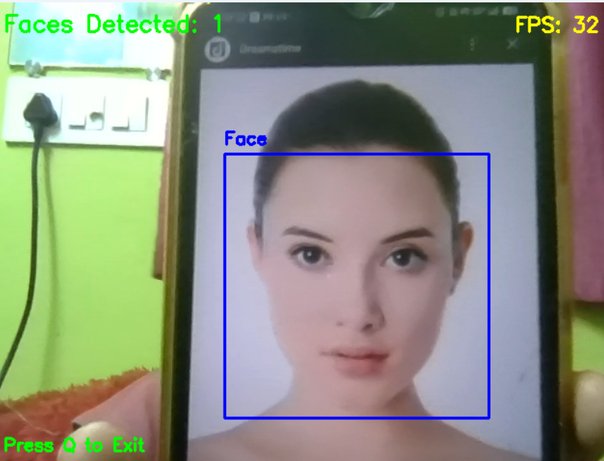
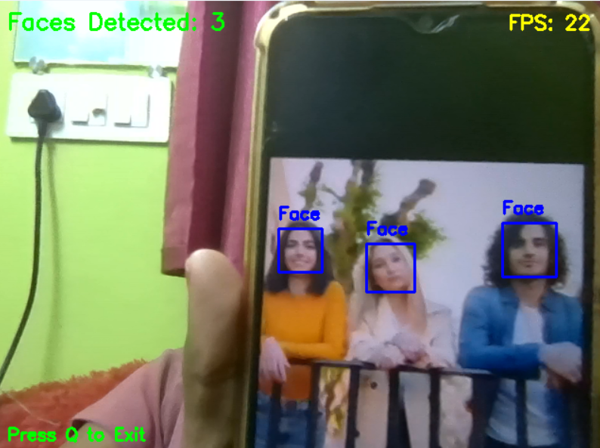
Level 2 — Task 1
Face Detection Project
Built a Python and OpenCV-powered face detection system (src/face_detection.py) to process visual inputs and identify faces.
[OpenCV Face Detection Feed]
Processing Workflow
Input Image / Video → OpenCV Processing → Face Detection → Detection Output & Bounding Boxes
Verified via project demo screenshots & requirements.txt

Slide 8
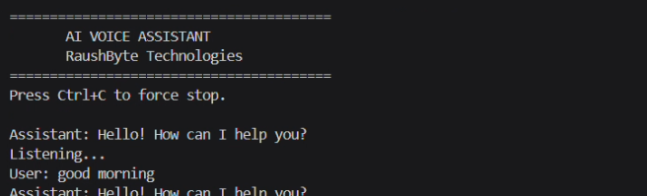
Level 2 — Task 2
Voice Assistant
Developed an interactive voice assistant (src/voice_assistant.py) capable of capturing audio commands and executing automated tasks.
[Voice Command Active & Executing]
Voice Input & Speech Recognition
Command Processing & Task Execution
Demonstrated via voice assistant demo screenshot
Voice Response & User Feedback

Slide 9
Level 2 — Task 3
AI Automation Assistant
Created an automation assistant (src/automation_assistant.py) to handle repetitive computer and file management tasks using Python.
[Automation Menu]
1. File Organization
2. Workspace Cleanup
Status: Action Executed Successfully
Automation Flow
User → Automation Menu → Selected Action → Automated Task → Result
Demonstrated via automation_menu.png & file_organization_demo.png

Slide 10
Level 3 — Task 1
Smart AI Assistant Capabilities
Advanced Question Answering
User Input
Context-aware processing for user queries.
Tool-Based Task Execution
AI Assistant & LLM Processing
Executing external actions via modular tools.
Conversation Memory Management
Maintaining contextual history across sessions.
Tools & Task Execution + Memory

Slide 11
Level 3 — Architecture
Smart AI Assistant Architecture
app.py
assistant.py
llm.py
tools.py
config.py
Application entry point & interface handler.
Core assistant logic & orchestration.
LLM integration & prompt processing.
External tool execution modules.
Configuration and environment setup.

Slide 12
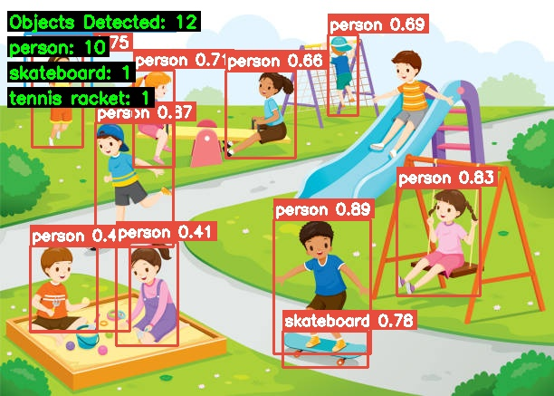
Level 3 — Task 2
Computer Vision Object Detection
Built an advanced object detection system (object_detection.py, detector.py) supporting multiple input sources.
[Input] → [Object Detector] → [Bounding Boxes & Labels] → [Output]
Static Image Object Detection
Video Stream Processing
Verified via image, video, and webcam detection outputs
Real-Time Webcam Detection

Slide 13
Milestone Timeline
Project Progression & Evolution
PHASE 1
PHASE 2
PHASE 3
PHASE 4
Research & Chatbot
Face Detection
Voice & Automation
Smart Assistant & CV
Systematic progression from basic AI concepts and rule-based logic to advanced computer vision and intelligent assistant architectures.

Slide 14
Skill Acquisition
Key Learning Outcomes
Python-Based AI Development
Computer Vision & OpenCV Workflows
Voice Interaction & Speech Processing
Task Automation & Scripting
AI Assistant Architecture & Tooling
Technical Documentation & Reporting

Slide 15
Engineering Insights
Practical Experience & Challenges
Component Integration
Workflow & Debugging
Structured Documentation
Successfully integrating multi-module Python scripts, config files, and external tools into unified projects.
Refining user input handling, debugging Python applications, and ensuring reliable computer vision output.
Maintaining rigorous project organization, requirements tracking, and professional technical presentations.

Slide 16
INTERNSHIP CONCLUSION
Thank You
Hands-on exposure to AI concepts, Python development, computer vision, and practical project engineering at RaushByte Technologies.
Sandhiya
AI/ML Intern — RaushByte Technologies

