Slide 1
AI/ML INTERNSHIP • LEVEL 1, TASK 1 • RAUSHBYTE TECHNOLOGIES
Applications of Artificial Intelligence in Healthcare, Education, Business & Daily Life
Prepared by: Sandhiya

Slide 2
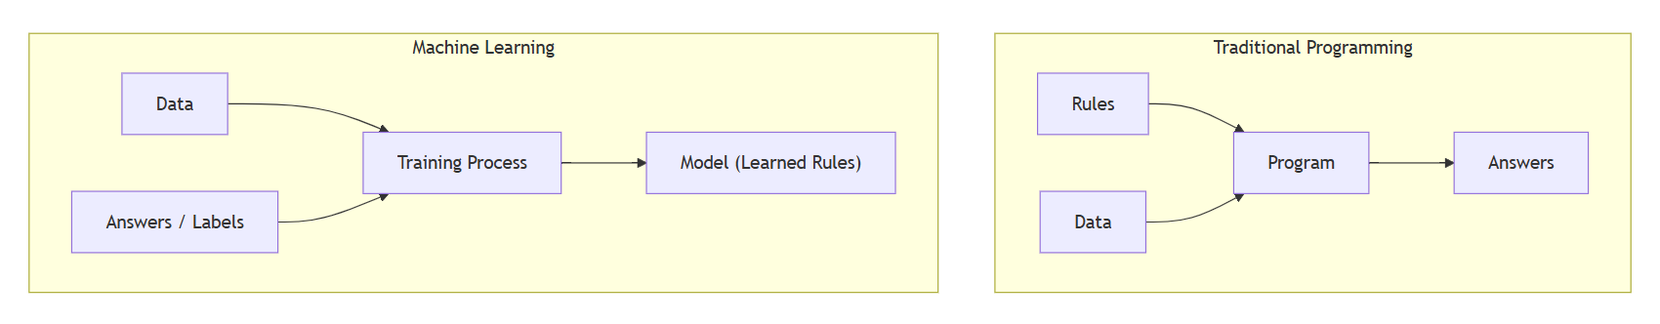
What is Artificial Intelligence?
Systems that perform tasks normally requiring human intelligence
"The science and engineering of making intelligent machines" — John McCarthy (1956)
Traditional Programming Rules + Data → Answers
Modern AI learns from data instead of following rigid hand-written rules.
Machine Learning Data + Answers → Rules

Slide 3
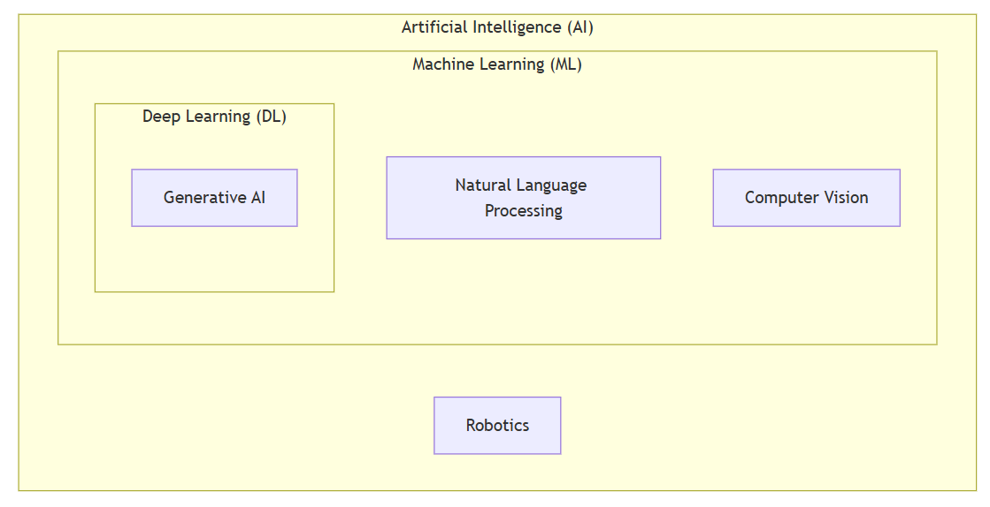
Major Areas of Artificial Intelligence
Machine Learning
Deep Learning
NLP
spam filters
speech-to-text
Google Translate, ChatGPT
Computer Vision
Generative AI
Robotics
face unlock
GitHub Copilot
warehouse robots
Hierarchical Relationship
AI is the umbrella; ML is a subset; deep learning is a subset of ML; generative AI is built on deep learning.

Slide 4
AI Applications in Healthcare
Enhancing diagnostic precision and clinical workflow efficiency
Medical imaging — IDx-DR: first FDA-authorized autonomous AI diagnostic (2018)
Drug discovery — AlphaFold: 200M+ protein structures, freely available
Early warning — TREWS sepsis system (Johns Hopkins, Nature Medicine 2022)
Monitoring — Apple Watch irregular-rhythm alerts (FDA-cleared)
Key point: AI assists clinicians — it does not replace them.

Slide 5
AI Applications in Education
Transforming classrooms with scalable personalized learning
Personalized Learning
AI Tutors
Duolingo's adaptive exercises adjusting difficulty based on performance.
Khanmigo (Socratic guidance, helping students think rather than just giving answers).
Auto-Grading
Accessibility
ETS e-rater used alongside human raters for consistent essay assessment.
Live speech-to-text captions and Immersive Reader for diverse learners.
Watch-outs: Academic integrity, over-reliance, and privacy of minors.

Slide 6
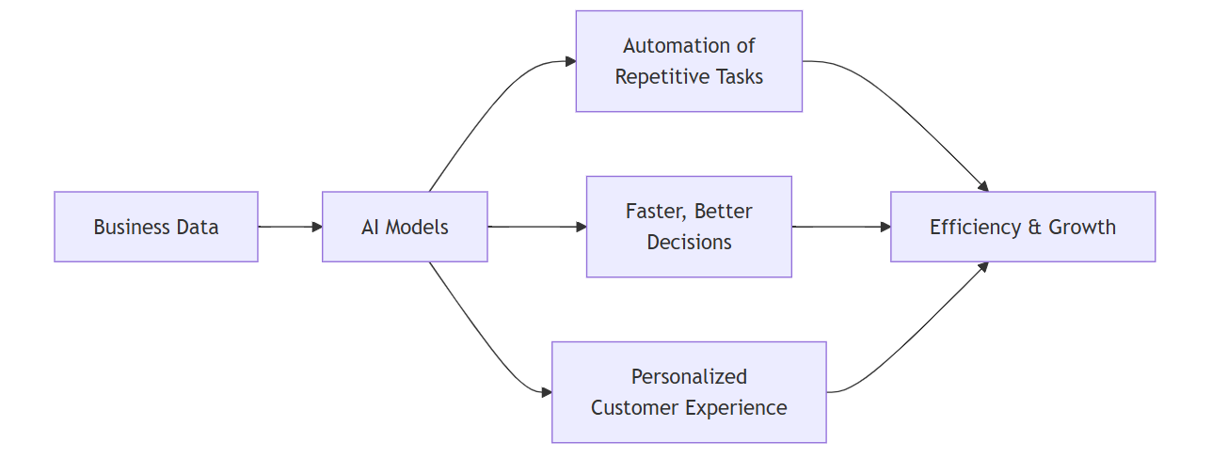
AI Applications in Business
Driving operational efficiency and data-backed decision making
Chatbots — 24/7 customer support automation
Recommendations — Drive the majority of Netflix viewing
Fraud Detection — Real-time scoring (Mastercard)
Route Optimization — UPS ORION saves ~100M miles/year
Cautionary Tale — Amazon scrapped a biased recruiting AI (2018)

Slide 7
AI in Daily Life
Ambient technologies integrated seamlessly into everyday routines
Voice Assistants
Search Engines
Social Feeds
Siri, Alexa, Google Assistant
Semantic ranking & intent
Algorithmic discovery loops
Streaming Picks
Maps & Navigation
Face Unlock & Spam
Personalized recommendations
Live traffic re-routing
Biometrics & email filters

Slide 8
Real-World Case Studies
Problem → Solution → Impact → Limitation
DeepMind Retinal Screening
AlphaFold Protein Folding
Problem/Solution: Specialist-level detection where doctors are scarce.
Problem/Solution: Years of lab work → minutes of computation.
Impact & Limit: Accelerated biology; computational models still need physical lab testing.
Impact & Limit: Early care enabled; requires rigorous localized clinical validation.
Khanmigo AI Tutoring
UPS ORION Routing
Problem/Solution: Affordable, scalable Socratic tutoring.
Problem/Solution: Complex logistics routing automation.
Impact & Limit: Personalized student guidance; models can still occasionally hallucinate.
Impact & Limit: Millions of miles saved; required years and massive infrastructure investment.

Slide 9
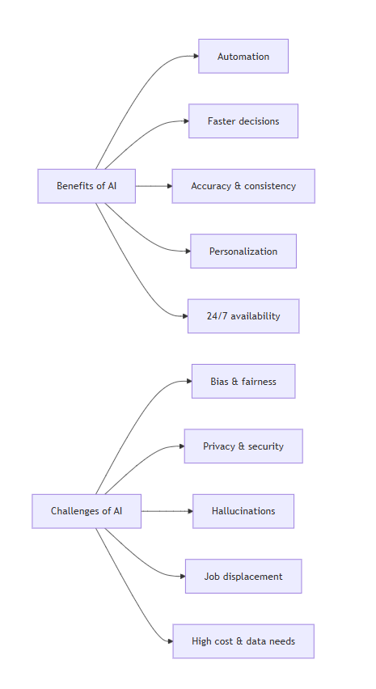
Benefits, Challenges & Ethics
Evaluating the trade-offs of modern AI deployment
Benefits
Challenges
•
•
Automation & speed
Bias & fairness
•
•
Accuracy & consistency
Privacy & security
•
•
Personalization
Hallucinations
•
•
24/7 availability
Job displacement
Ethics & Frameworks:
Fairness • Transparency • Accountability • Human oversight (OECD AI Principles, EU AI Act)

Slide 10
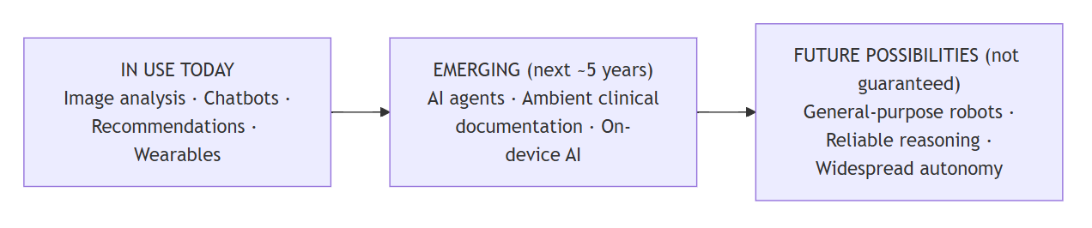
Conclusion & Future Scope
Humans + AI outperform either working alone. Responsible AI development is non-negotiable.
Full report & sources available in repository • Thank You!

