Slide 1
Machine Learning-Based Fault Detection and Classification in Power Systems
CAPSTONE PROJECT
Presented By:
1. Sandhiya R-SRM Madurai College For Engineering And Technology-B.E CSE(CYBER SECURITY)

Slide 2
OUTLINE
Problem Statement (Should not include solution)
Proposed System/Solution
System Development Approach (Technology Used)
Algorithm & Deployment
Result (Output Image)
Conclusion
Future Scope
References

Slide 3
Problem Statement
The increasing complexity of power distribution systems has made fault detection and classification a critical task for ensuring grid stability and operational safety. Faults such as line-to-ground, line-to-line, and three-phase faults can severely disrupt the power supply. The challenge lies in accurately detecting and classifying these faults in real time using electrical measurement data like voltage and current phasors. The goal is to create an automated, intelligent system that can promptly recognize fault conditions, thus improving system reliability and minimizing downtime.

Slide 4
Proposed Solution
To ensure rapid and reliable detection of faults in the power grid, the proposed solution uses machine learning techniques combined with cloud-based deployment for real-time analysis. The system aims to automatically detect and classify fault types with high accuracy to support grid stability and operational safety
1. Smart Data Acquisition
Collect electrical phasor data (voltage and current) from the power system.
Utilize a labeled dataset containing examples of various fault types (Line-to-Ground, Line-to-Line, Three-Phase, etc.) and normal conditions.
2. Efficient Data Preprocessing
Perform cleaning, normalization, and transformation of raw measurement data.
Extract meaningful features that highlight changes in current/voltage during fault events.
Encode fault labels for classification.
3. Machine Learning-Based Fault Classification
Train ML models such as Random Forest, Support Vector Machines (SVM), and Neural Networks.
Models learn to distinguish between different fault types and normal states.
Optionally include other grid parameters (load, frequency) to enhance prediction accuracy.
4. Cloud-Based Model Deployment (IBM Cloud)
Deploy the trained model using IBM Watson Studio and IBM Watson Machine Learning.
Enable real-time access through REST API endpoints.
Integrate with a web-based dashboard for live monitoring and fault alerts.
Outcome: A scalable, intelligent fault detection system capable of real-time classification, reducing outage durations and ensuring better protection for modern power distribution systems.

Slide 5
System Approach
The "System Approach" section outlines the overall strategy and methodology for developing and implementing the power system fault detection and classification. Here's a suggested structure for this section:
System requirements:
IBM Cloud(mandatory)
IBM Watson studio for model development and deployment
IBM cloud object storage for dataset handling

Slide 6
Algorithm & Deployment
Algorithm Selection:
Random Forest Classifier (or SVM based on performance)
Data Input:
Voltage, current, and phasor measurements from the dataset
Training Process:
Supervised learning using labeled fault types
Prediction Process:
Model deployed on IBM Watson Studio with API endpoint for real-time predictions

Slide 7
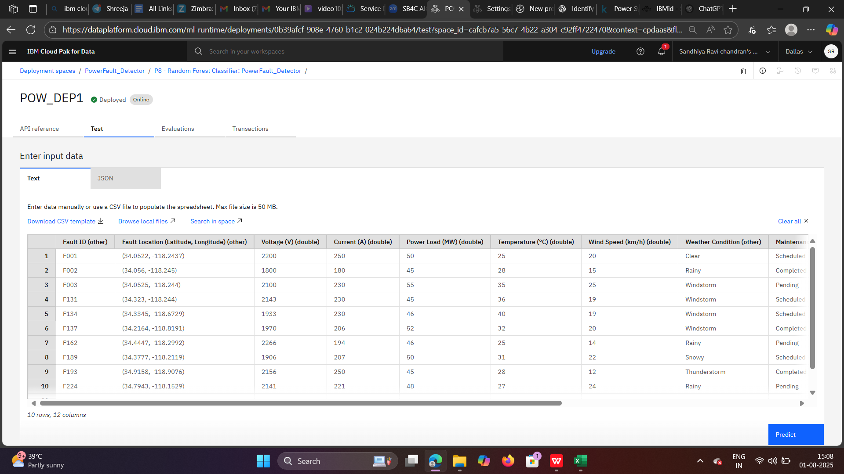
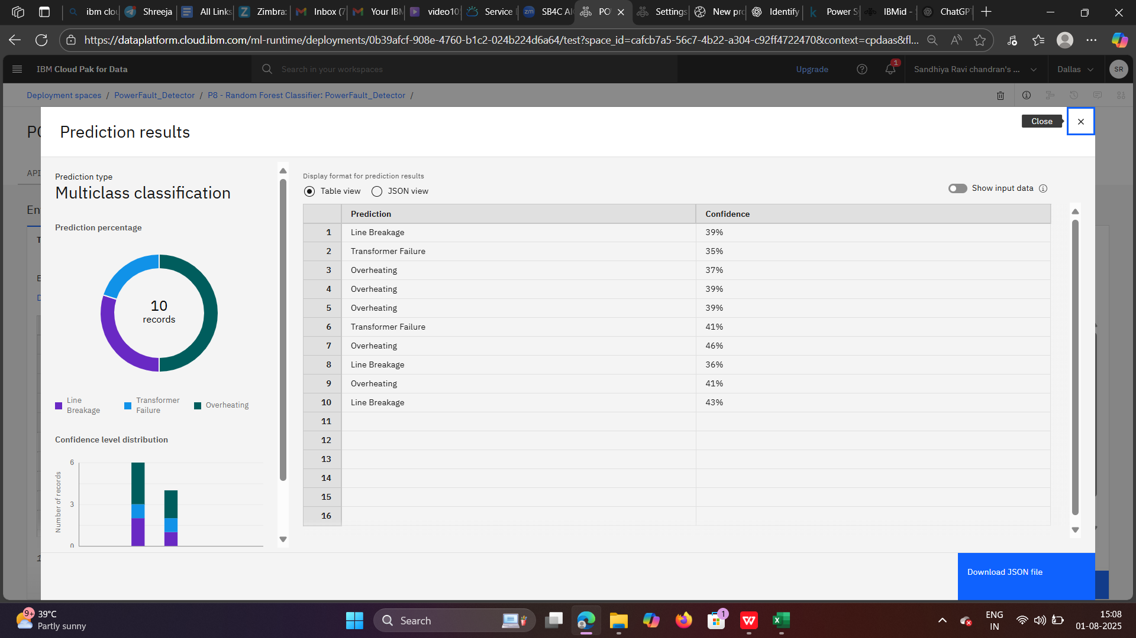
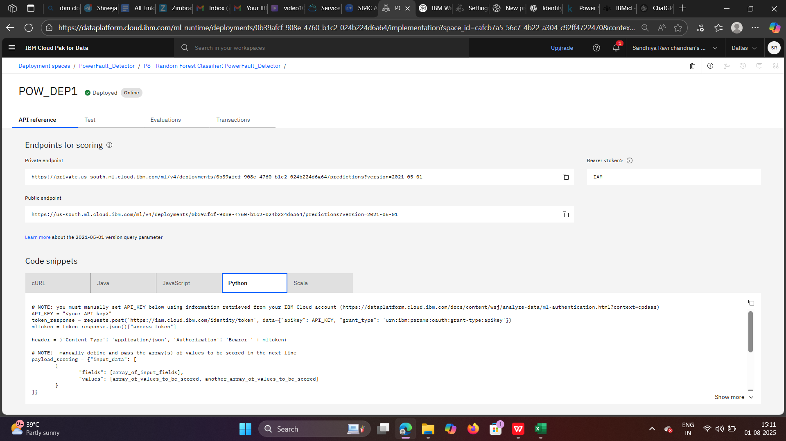
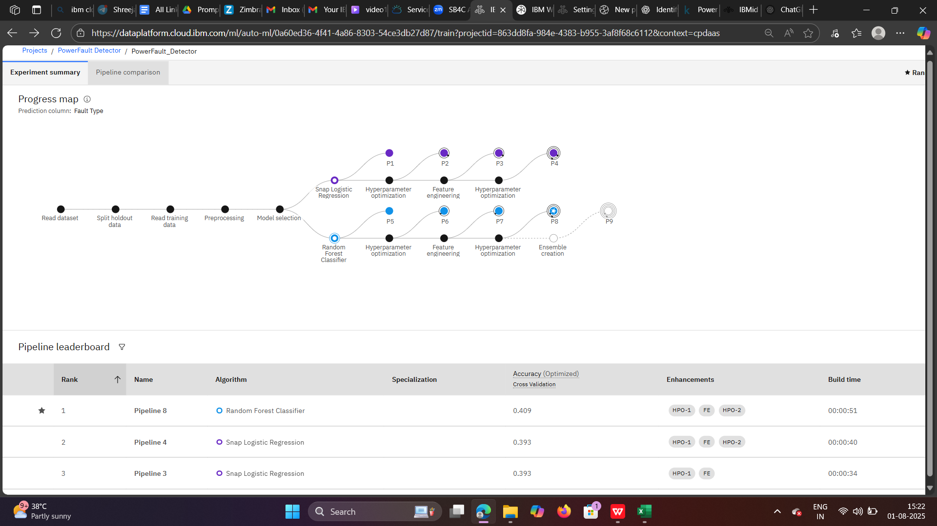
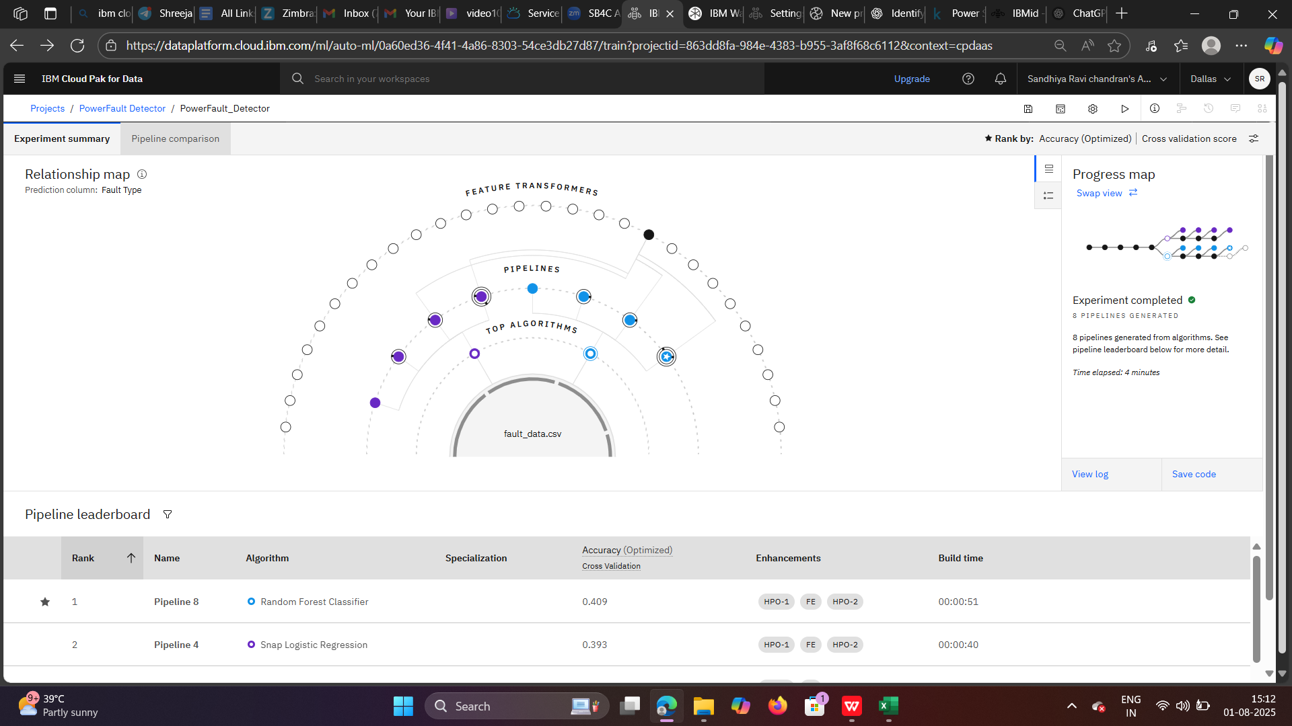
Result

Slide 8
Conclusion
This project demonstrates the potential of machine learning in real-time power system monitoring. By accurately detecting and classifying power faults, the model enhances the reliability and efficiency of grid operations. Integrating the solution with IBM Cloud services ensures seamless deployment and scalability for real-world applications in smart grids and industrial power systems.

Slide 9
Future scope
Extend the model to include real-time streaming data from IoT devices.
Integrate with SCADA systems for live fault monitoring and control.
Use deep learning techniques (like LSTM or CNN) for more complex signal patterns.
Add a mobile/web dashboard for fault alerts and analytics.
Scale the system to support multi-region power grids using distributed cloud architecture.

Slide 10
References
Kaggle Dataset – Power System Faults Dataset
IBM Cloud Docs – https://cloud.ibm.com/docs
Scikit-learn Documentation – https://scikit-learn.org/
IEEE Papers on Fault Classification in Power Systems
Pandas Documentation – https://pandas.pydata.org/docs/

Slide 11
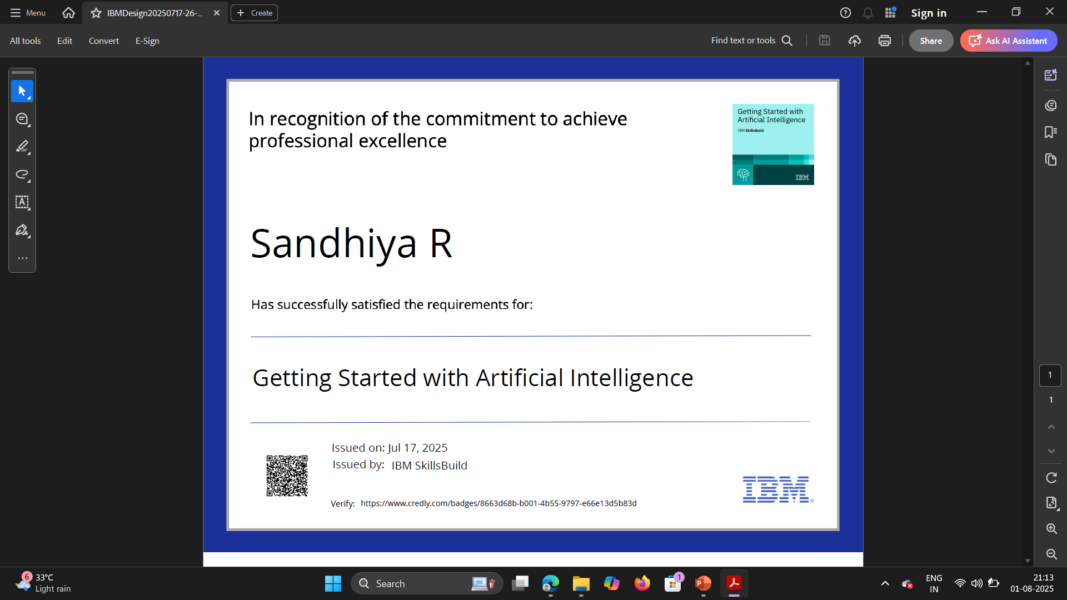
IBM Certifications

Slide 12
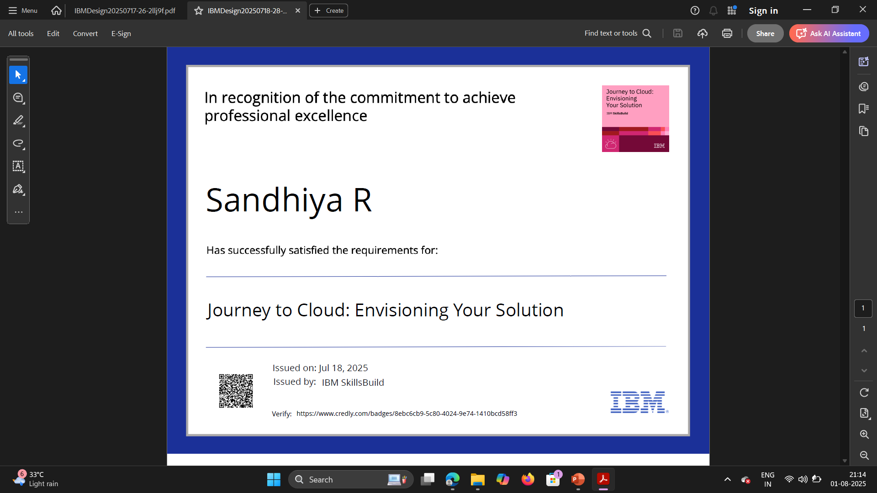
IBM Certifications

Slide 13
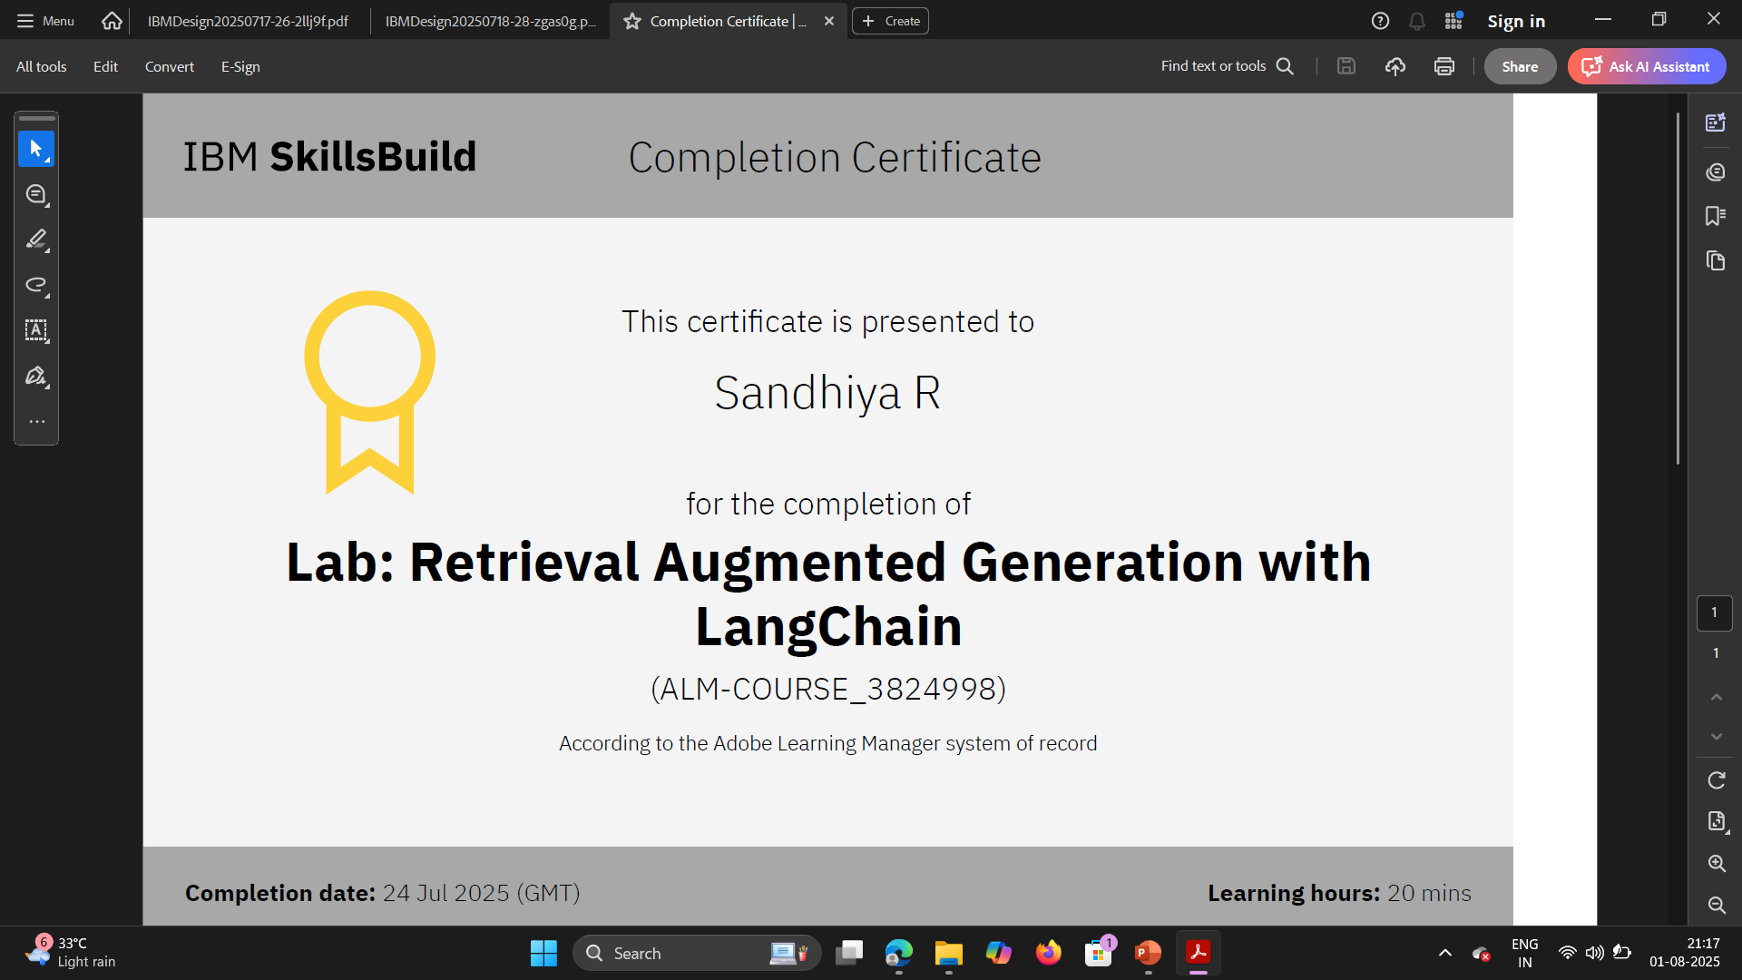
IBM Certifications

Slide 14
THANK YOU

