Slide 1

MYSQL PROJECT
BY
.
S.SANDHIYA DEVI
Notes:
null

Slide 2
What is Database?
A database is a vast collection of data that is stored and retrieved electronically system.
This structured data stored in the database is processed manipulated and updated to perform various operations.
.
Notes:
null

Slide 3
What is SQL?
Structured query language(SQL),is a programming
language for storing , manipulating and retrieving
data in database.
SQL is the standard language for relation database system. All relational database management systems like “MySQL, MS Access,
oracle, Sybase, Informix, Postgres and SQL server” use SQL as standard database language.
.
Notes:
null

Slide 4
What is DBMS?
Database Management Systems (DBMS) are software systems used to store, retrieve, and run queries on data.
A DBMS serves as an interface between an end-user and a database, allowing users to create, read, update, and delete data in the database.
.
Notes:
null

Slide 5
What is RDBMS?
RDBMS stands for relational database management system—a software system that enables you to define, create, maintain, and control access to relational databases. It is the underlying part of the interface layer that helps you store and work with data.
.
Notes:
null

Slide 6
My Sql Commands:
Create database
Show database
Drop database
Alter database
Show tables
Insert values
Drop tables
Alter table
Alter table modify
Alter table drop
Alter table rename
Update table
Delete statement
Notes:
null

Slide 7
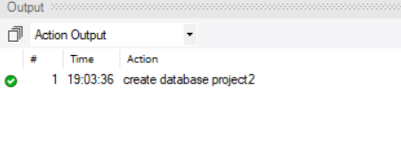
Database Creation:
The create database statement is used to create a new SQL database.
create database project;
Notes:
null

Slide 8
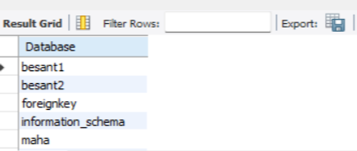
Show database:
lists the databases that are accessible by the MYSQL DBMS .
show databases;
Notes:
null

Slide 9
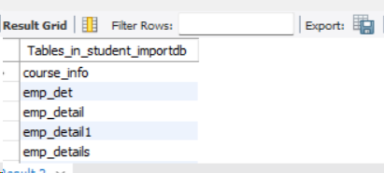
Create Table :-
create table emp_details(emp_id int,emp_name varchar(20),designation_id int,dep_no int,doj date,primary key (emp_id));
Show Tables :-
Show Tables;
Notes:
null

Slide 10
Insert values:-
The SQL insert into statement is used to add new rows of data into a table in the database.
insert into designation values(3001,'Manager'),
(3002, 'Junior Associates'),
(3003, 'Senior Manager'),
(3004, 'HR'),
(3005, 'General Manager'),
(3006, 'Team Lead'),
(3007, 'Senior HR');
Notes:
null

Slide 11
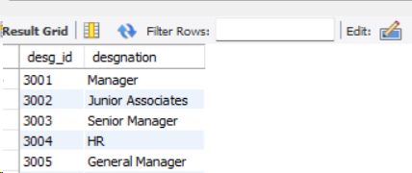
Insert values:-
The SQL insert into statement is used to add new rows of data into a table in the database.
Notes:
null

Slide 12
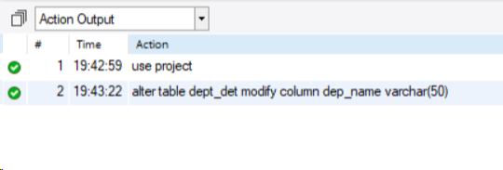
Alter Table:-
The ALTER TABLE statement is used to add, delete, or modify columns in an existing table.
alter table dept_det modify column dep_name varchar(50);
Notes:
null

Slide 13
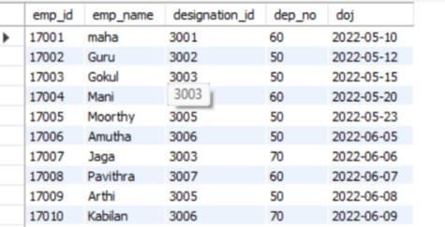
Update Table:-
The UPDATE statement is used to modify the existing records in a table.
update emp_detail set dep_no=60 , emp_name='maha' where emp_id=17001;
Notes:
null

Slide 14
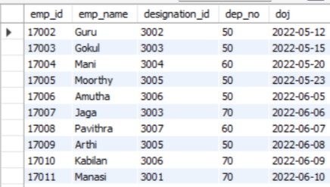
Delete Statement:-
The DELETE statement is used to delete existing records in a table.
delete from emp_detail where emp_id=17001;
Notes:
null

Slide 15
My Sql General Functions:
Where
Or
And
In
Not in
Greater Than
Lesser Than
Not like
Between
Not
Greater than or equal to
Lesser than or equal to
count
Distinct
Order by Asc
Order By Desc
Group By
Limit
Desc Limit
Like (_%)
Notes:
null

Slide 16
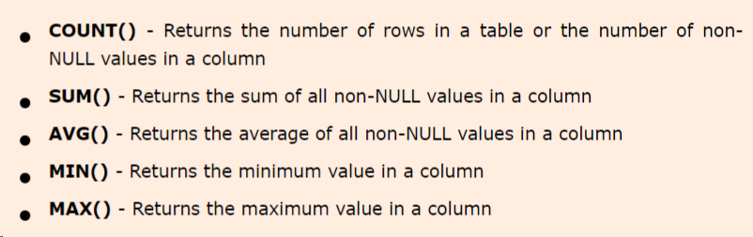
Aggregate Functions:-
Notes:
null

Slide 17
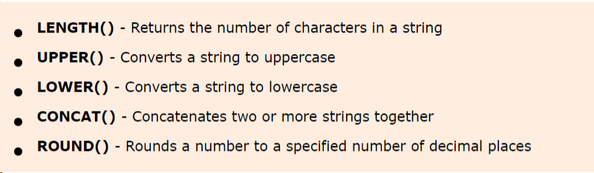
General Functions:-
Notes:
null

Slide 18
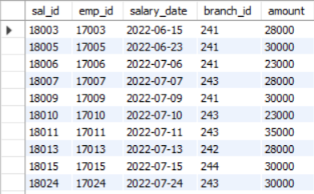
Where Statement:-
Select * from salary_detail where amount <20000 ;
Notes:
null

Slide 19
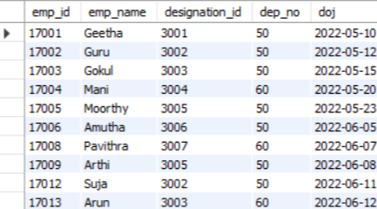
Or Statement:-
select * from employee_det where dep_no=50 or dep_no=60 ;
Notes:
null

Slide 20
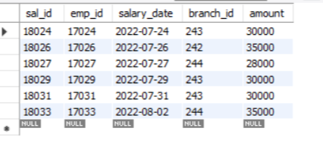
And Statement:-
select * from salary_detail where emp_id >17015 and amount>25000 ;
Notes:
null

Slide 21
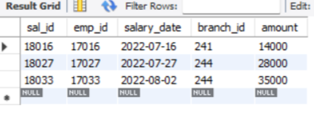
In Statement:-
select * from salary_detail where emp_id in( 17016,17033,17027) ;
Notes:
null

Slide 22
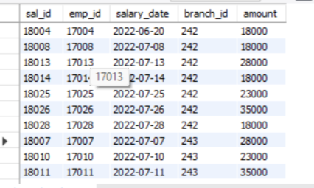
Not In Statement:-
select * from salary_detail where branch_id not in(241,244) ;
Notes:
null

Slide 23
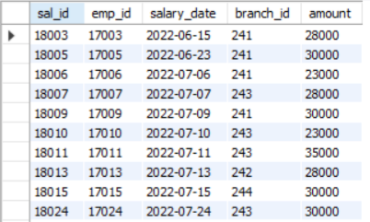
Greater Than Equal To:-
select* from salary_detail where amount >=20000 ;
Notes:
null

Slide 24
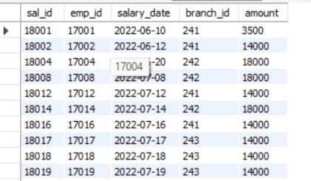
Lesser Than Equal To:-
select* from salary_detail where amount <=20000 ;
Notes:
null

Slide 25
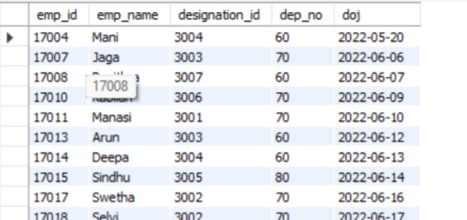
Not Equal To :-
select * from employee_det where dep_no !=50 ;
Notes:
null

Slide 26
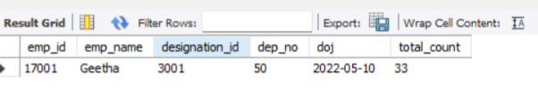
Count :-
COUNT() - Returns the number of rows in a table or the number of non-NULL values in a column
select *, count(emp_id)as total_count from employee_det ;
Notes:
null

Slide 27
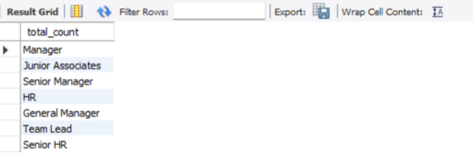
Distinct:-
select distinct desgnation as total_count from designation;
Notes:
null

Slide 28
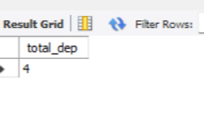
Count with Distinct:-
COUNT() - Returns the number of rows in a table or the number of non-NULL values in a column
select count(distinct dep_no)as total_dep from employee_det;
Notes:
null

Slide 29
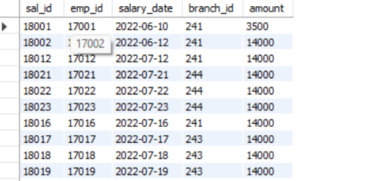
Order by asc:-
The ASC command is used to sort the data returned in ascending order
select * from salary_detail group by emp_id order by amount asc;
Notes:
null

Slide 30
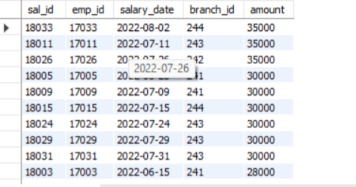
Order by desc:-
select * from salary_detail group by emp_id order by amount desc ;
Notes:
null

Slide 31
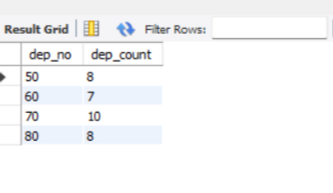
Group by:-
The GROUP BY statement is often used with aggregate functions (COUNT(), MAX(), MIN(), SUM(), AVG()) to group the result-set by one or more columns.
select dep_no,count(*) as dep_count from employee_det group by dep_no ;
Notes:
null

Slide 32
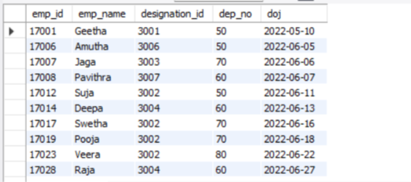
Like:-
The LIKE operator is used in a WHERE clause to search for a specified pattern in a column.
select * from employee_det where emp_name like('%a') ;
Notes:
null

Slide 33
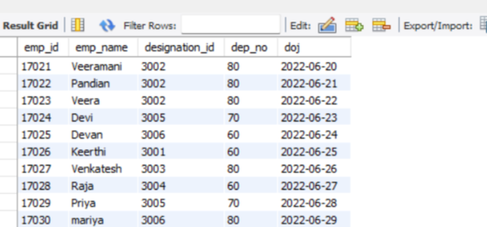
Not Like:-
The NOT LIKE operator in SQL is used on a column which is of type varchar. Usually, it is used with % which is used to represent any string value, including the null character \0.
select * from employee_det where emp_name not like('s%');
Notes:
null

Slide 34
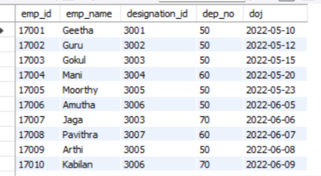
Between:-
The BETWEEN operator selects values within a given range. The values can be numbers, text, or dates.
select * from employee_det where month(doj) between 1 and 7;
Notes:
null

Slide 35
My Sql Calculate Functions:-
Sum
Average
Min
Max
Count
Notes:
null

Slide 36
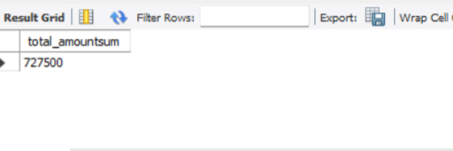
Sum:-
The SUM() function returns the total sum of a numeric column.
select sum(amount) as total_amountsum from salary_detail ;
Notes:
null

Slide 37
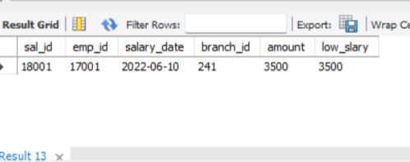
Min:-
The MIN() function returns the smallest value of the selected column.
select*, min(amount) as low_slary from salary_detail; ;
Notes:
null

Slide 38
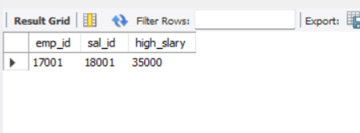
Max:-
The MAX() function returns the largest value of the selected column.
select emp_id, sal_id ,max(amount) as high_slary from salary_detail ;
Notes:
null

Slide 39
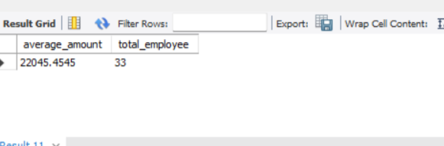
Average:-
AVG() function returns the average value of a numeric column.
select avg(amount) as average_amount,count(emp_id) as total_employee from salary_detail;
Notes:
null

Slide 40
My Sql String Functions:-
Lcase
Ucase
Left
Right
Concat
Trim
Char Length
Mid
Length
Notes:
null

Slide 41
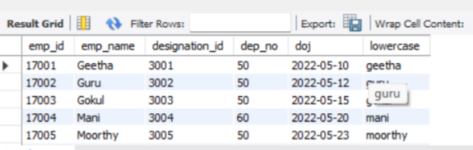
Lcase:-
The LCASE() function converts a string to lower-case..
select * , lower(emp_name) as lowercase from employee_det;
Notes:
null

Slide 42
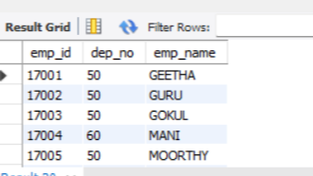
Ucase:-
The UCASE() function converts a string to upper-case.
Select emp_id,dep_no ,upper(emp_name) as emp_name from employee_det;
Notes:
null

Slide 43
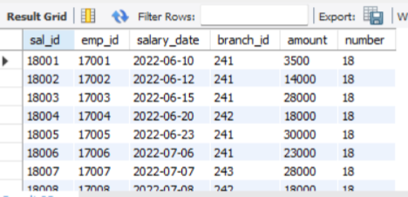
Left:-
The LEFT() function extracts a number of characters from a string (starting from left).
select * ,left(sal_id,2) as number from salary_detail;
Notes:
null

Slide 44
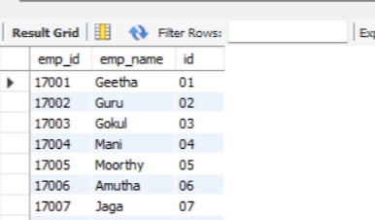
Right:-
The RIGHT() function extracts a number of characters from a string (starting from right).
select emp_id,emp_name,right(emp_id,2)as id from employee_det;
Notes:
null

Slide 45
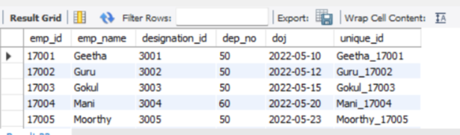
Concat:-
The CONCAT() function adds two or more expressions together.
select * , concat(emp_name,'_',emp_id) as unique_id from employee_det;
Notes:
null

Slide 46
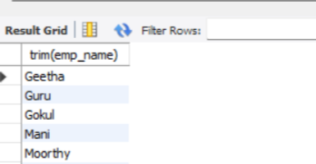
Trim:-
Remove leading and trailing spaces from a string.
select trim(emp_name)from employee_det;
Notes:
null

Slide 47
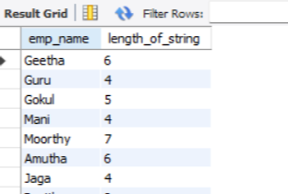
Char Length:-
The CHAR_LENGTH() function return the length of a string (in characters).
select emp_name,char_length(emp_name) as length_of_string from employee_det;
Notes:
null

Slide 48
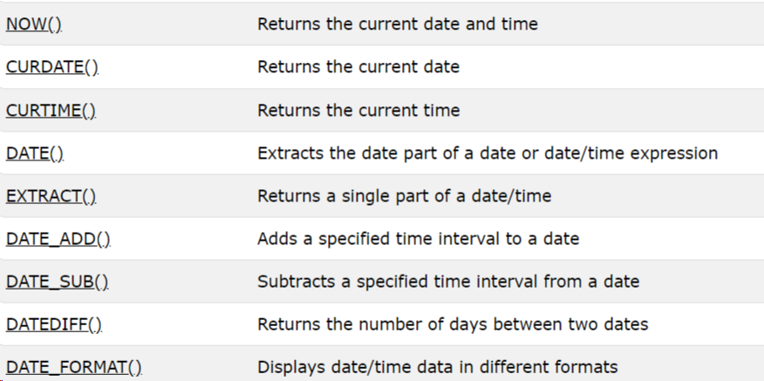
My Sql Date Functions:-
Notes:
null

Slide 49
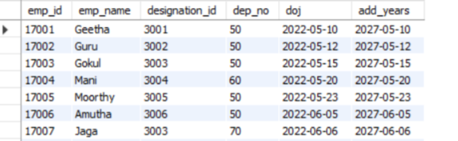
Date Add:-
DATE_ADD() function adds a time/date interval to a date and then returns the date.
SELECT * ,date_add(doj,interval 5 year) as add_years from employee_det;
Notes:
null

Slide 50
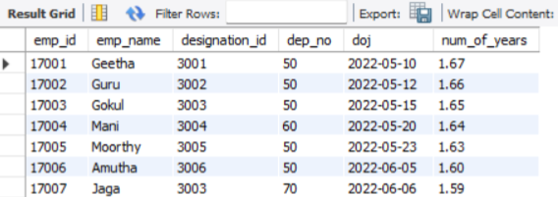
Date Diff:-
The DATEDIFF() function returns the number of days between two date values.
select *,round(datediff(curdate(),doj)/365,2) as num_of_years from employee_det;
Notes:
null

Slide 51
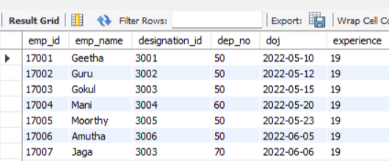
Time Stamp:-
The TIMESTAMP() function returns a datetime value based on a date or datetime value.
select *,timestampdiff(month,doj,curdate()) as experience from employee_det;
Notes:
null

Slide 52
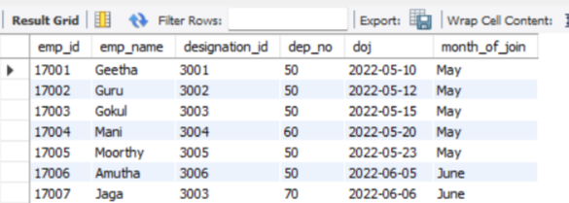
Date Format:-
The DATE_FORMAT() function formats a date as specified.
select*,date_format(doj,'%M') as month_of_join from employee_det;
Notes:
null

Slide 53
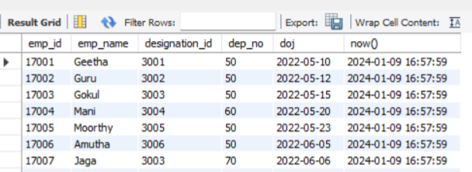
Now:-
The NOW() function returns the current date and time.
select *,now() from employee_det;
Notes:
null

Slide 54
LOGICAL
FUNCTIONS
IF CONDITIONS
IF WITH AND CONDITIONS
IF WITH OR CONDITIONS
Notes:
null

Slide 55
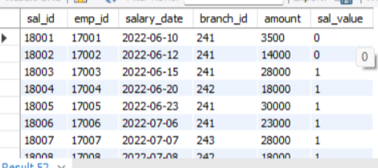
IF Condition:-
The IF() function returns a value if a condition is TRUE, or another value if a condition is FALSE.
select *,if(amount >15000 ,'1','0') as sal_value from salary_detail;
Notes:
null

Slide 56
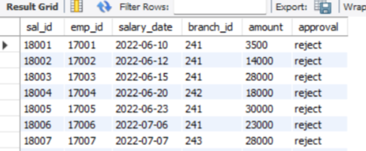
IF with andCondition:-
select *,if ((amount > 15000) and (emp_id > 17015) ,'accept','reject') as approval from salary_detail;
Notes:
null

Slide 57
RDBMS:-
A relational database defines database relationships in the form of tables. The tables are related to each other - based on data common to each.
A relational database is a type of database. It uses a structure that allows us to identify and access data in relation to another piece of data in the database. Often, data in a relational database is organized into tables.
Notes:
null

Slide 58
Two Table Connection:-
Joining two tables in SQL can be done in four major ways:
Inner Join- (returns rows with matching columns)
Left Join -(ALL records in the left table and matching records in the right table)
Right Join- (ALL records in the right table and matching records in the left table)
Union - (removes duplicates).
Notes:
null

Slide 59

Three Table Connection:-
To join three or more tables using a subquery, you can use a nested SELECT statement to retrieve data from one table based on the values in another table, and then join the results of the subquery with the remaining tables in the outer SELECT statement.
Notes:
null

Slide 60
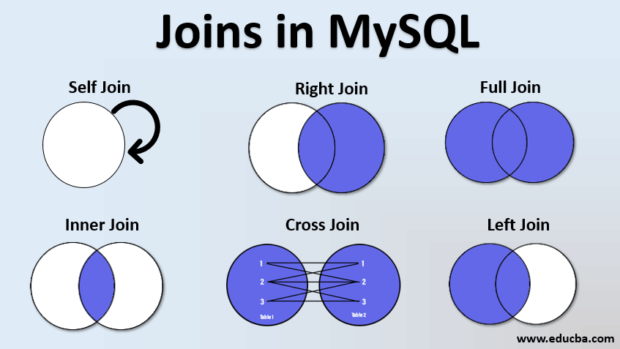
Join Queris:-
Notes:
null

Slide 61
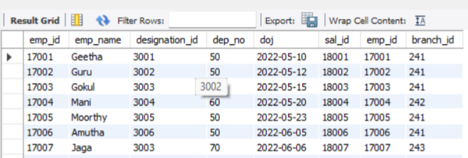
Inner Join:-
The INNER JOIN keyword selects records that have matching values in both tables.
select employee_det.emp_id,employee_det.emp_name,employee_det.designation_id,employee_det.dep_no,employee_det.doj,
salary_detail.sal_id,salary_detail.emp_id,salary_detail.branch_id from employee_det inner join salary_detail on employee_det.emp_id=
salary_detail.emp_id;
Notes:
null

Slide 62
Left Join:-
The LEFT JOIN keyword returns all records from the left table (table1), and the matching records (if any) from the right table (table2).
select * from employee_det left join designation on employee_det.designation_id=designation.desg_id order by employee_det.designation_id;
Notes:
null

Slide 63
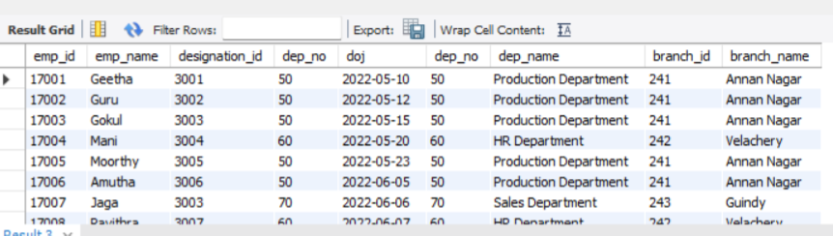
Right Join:-
The RIGHT JOIN keyword returns all records from the right table (table2), and the matching records (if any) from the left table (table1).
select * from employee_det right join dept_det on employee_det.dep_no=dept_det.dep_no order by employee_det.emp_id;
Notes:
null

Slide 64
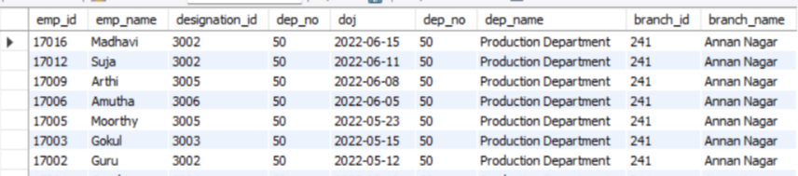
Full Outer Join:-
The FULL OUTER JOIN keyword returns all records when there is a match in left (table1) or right (table2) table records).
(select * from employee_det right join dept_det on employee_det.dep_no=dept_det.dep_no order by employee_det.emp_id) union
(select * from employee_det right join dept_det on employee_det.dep_no=dept_det.dep_no order by employee_det.emp_id);
Notes:
null

Slide 65
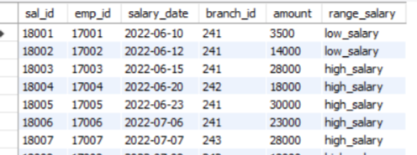
Case:-
The CASE expression goes through conditions and returns a value when the first condition is met (like an if-then-else statement). So, once a condition is true, it will stop reading and return the result. If no conditions are true, it returns the value in the ELSE clause.
select salary_detail . *,
case
when amount>15000 then "high_salary "else "low_salary"
end as range_salary from salary_detail;
Notes:
null

Slide 66


Double case with end statement:-
Notes:
null

Slide 67
Procedure:-
A stored procedure is a prepared SQL code that you can save, so the code can be reused over and over again.
So if you have an SQL query that you write over and over again, save it as a stored procedure, and then just call it to execute it.
You can also pass parameters to a stored procedure, so that the stored procedure can act based on the parameter value(s) that is passed.
Notes:
null

Slide 68

Procedure:-
Notes:
null

Slide 69
Trigger:-
A trigger is a set of actions that are run automatically when a specified change operation (SQL INSERT, UPDATE, or DELETE statement) is performed on a specified table.
Triggers are useful for tasks such as enforcing business rules, validating input data, and keeping an audit trail.
Notes:
null

Slide 70
BEFORE INSERT
AFTER INSERT
TRIGGERS
BEFORE UPDATE
AFTER UPDATE
AFTER DELETE
BEFORE DELETE
Notes:
null

Slide 71

Before Insert:-
Before Insert Trigger in MySQL is invoked automatically whenever an insert operation is executed
Notes:
null

Slide 72

After Insert:-
After Insert Trigger in MySQL is invoked automatically whenever an insert event occurs on the table.
Notes:
null

Slide 73

Before Update:-
BEFORE UPDATE Trigger in MySQL is invoked automatically whenever an update operation is fired on the table associated with the trigger.
Notes:
null

Slide 74
THANK YOU
Notes:
null

