Slide 1
Employee Data Analysis using Excel
STUDENT NAME: Sandhiya.G
REGISTER NO:312217044
DEPARTMENT:B.com general
COLLEGE: Shri Krishna swamy college women

Slide 2
PROJECT TITLE
Employee Performance Analysis using Excel

Slide 3


AGENDA
Problem Statement
Project Overview
End Users
Our Solution and Proposition
Dataset Description
Modelling Approach
Results and Discussion
Conclusion
3/21/2024 Annual Review

Slide 4

PROBLEM STATEMENT
The Human Resources (HR) department of [Company Name] is seeking to enhance its evaluation process for employee performance. The goal is to identify key performance metrics, analyze employee performance trends, and make data-driven decisions to improve overall productivity and employee satisfaction.

Slide 5

PROJECT OVERVIEW
- Collect and integrate employee performance data from various sources - Design and develop an interactive Excel dashboard with visualizations and charts - Include metrics such as: - Job performance ratings - Goal achievement - Training and development participation - Attendance and absenteeism - Employee engagement and satisfaction - Enable filtering and drill-down capabilities for detailed analysis
.

Slide 6

WHO ARE THE END USERS?
HR
Team manager and supervisor
Senior management and executive
Employees
Data analytics

Slide 7

OUR SOLUTION AND ITS VALUE PROPOSITION
To provide an accurate response, could you clarify what specific solutions you're referring to? For example, are you asking about employee performance analysis tools, specific products or services your company offers, or something else? This will help me tailor the value proposition effectively.

Slide 8
Dataset Description
Employee information
Performance Metrics
Training and development
Feedback and reviews
Compensation and rewards
Other variable

Slide 9

THE "WOW" IN OUR SOLUTION
Interactive Dashboard
Custom metrics and kels
Advanced data analytics
Automation
Collaborative Features
3/21/2024 Annual Review
9

Slide 10
MODELLING
Scenario planning
Final presentation
Automation and macros
Reporting and analysis
Bench marking
Trend analysis
10

Slide 11
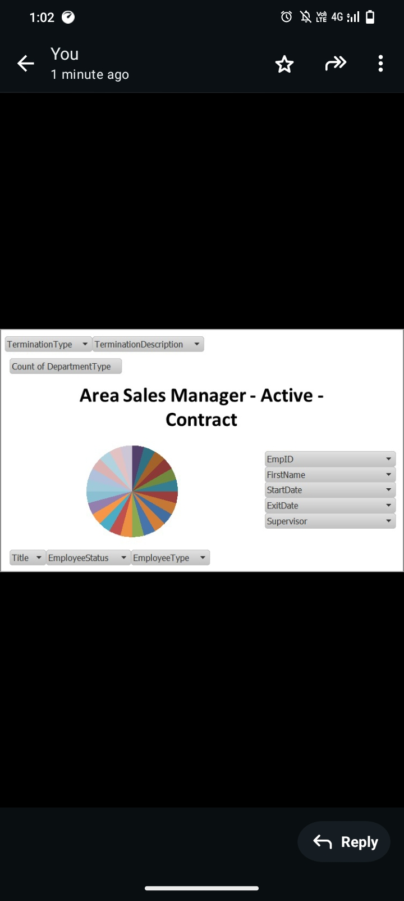
RESULTS
11

Slide 12
conclusion
In conclusion, conducting an employee performance analysis using Excel is a highly effective method for gaining insights into individual and team productivity. By leveraging Excel's features such as formulas, pivot tables, and data visualization tools, you can easily organize, analyze, and present performance data. This process enables management to identify top performers, areas for improvement, and trends over time. Ultimately, this analysis supports data-driven decision-making, helping to enhance overall workforce efficiency and effectiveness.

