Slide 1
AD HOC INSIGHTS
Using
SQL QUERIES
Done by
Sandhiya S

Slide 2
BUSINESS PROBLEM
Atliq Hardwares (imaginary company) is one of the leading computer hardware producers in India and well expanded in other countries too.
However, the management noticed that they do not get enough insights to make quick and smart data-informed decisions.
The company plans to expand the data analytics team by adding junior data analysts.
To assess candidates, Data analytics director, Tony Sharma plans to conduct a SQL challenge to evaluate both tech and soft skills.
The company seeks insights for 10 ad hoc requests using SQL queries

Slide 3
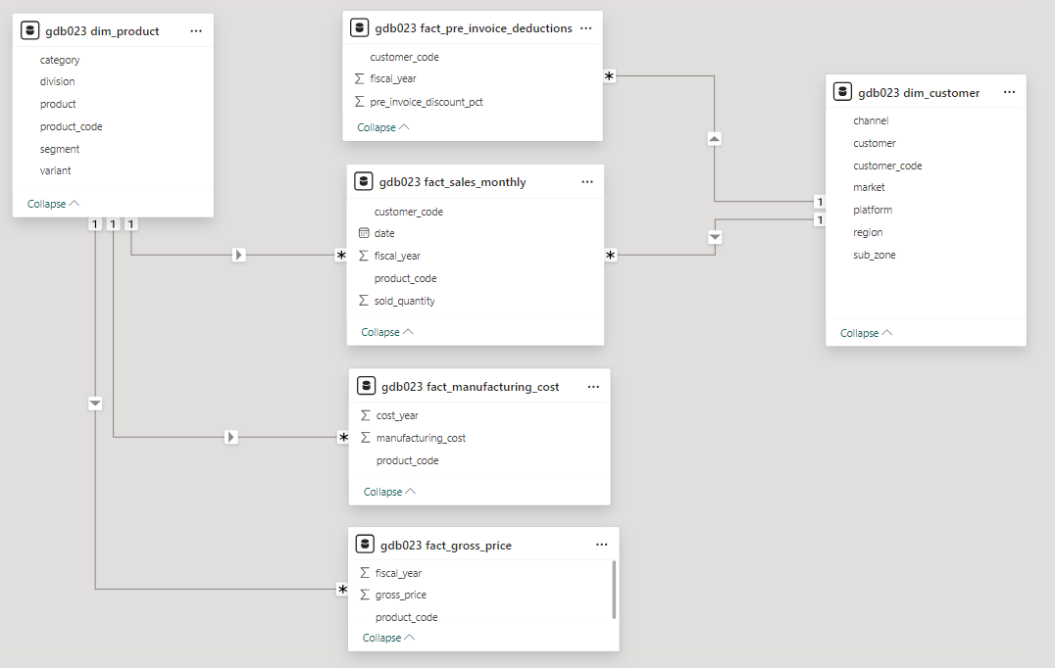
ENTITY RELATIONSHIP DIAGRAM

Slide 4


1. Provide the list of markets in which customer "Atliq Exclusive" operates its business in the APAC region
QUERY
OUTPUT

Slide 5
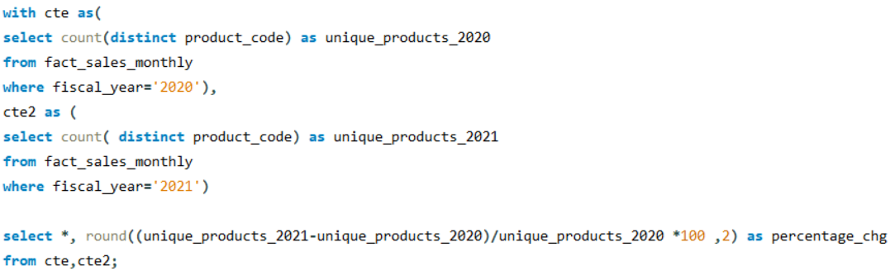

2. What is the percentage of unique product increase in 2021 vs. 2020? The final output contains these fields,unique_products_2020,unique_products_2021,percentage_chg
QUERY
OUTPUT
INSIGHTS
There is a 36.33% increase in unique products in 2021 comparing the previous year 2020

Slide 6
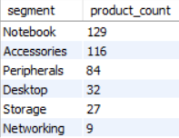
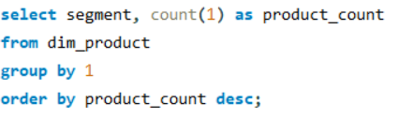
3. Provide a report with all the unique product counts for each segment and sort them in descending order of product counts. The final output contains 2 fields, segment, product_count
OUTPUT
QUERY
INSIGHTS
More than 60% of products is from the segments Notebook and Accessories

Slide 7
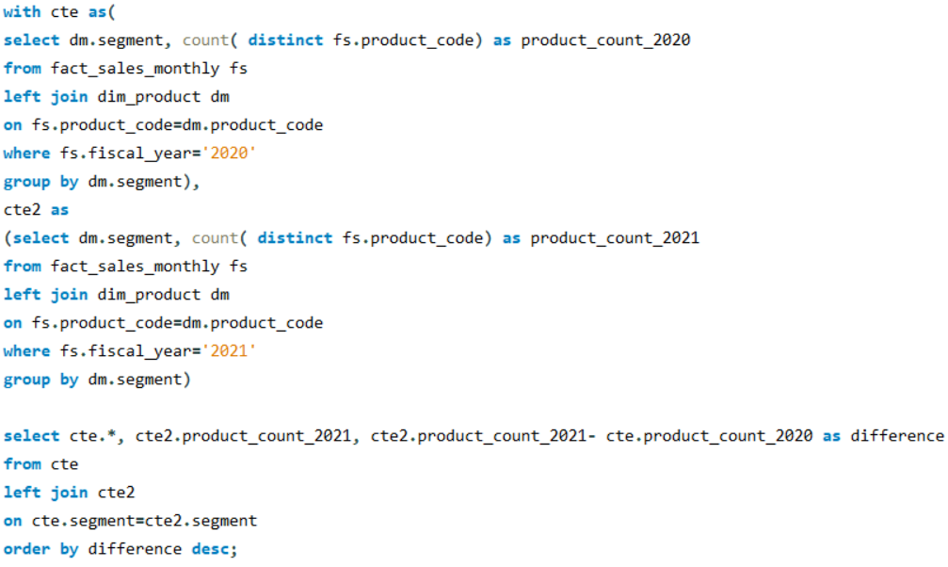
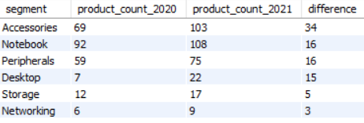
4. Follow-up: Which segment had the most increase in unique products in 2021 vs 2020? The final output contains these fields, segmentproduct_count_2020product_count_2021difference
QUERY
OUTPUT
INSIGHTS
Accessories segment has the most increase in unique products
It is to be noted that Notebook, Peripherals and Desktop had similar increase in product count

Slide 8
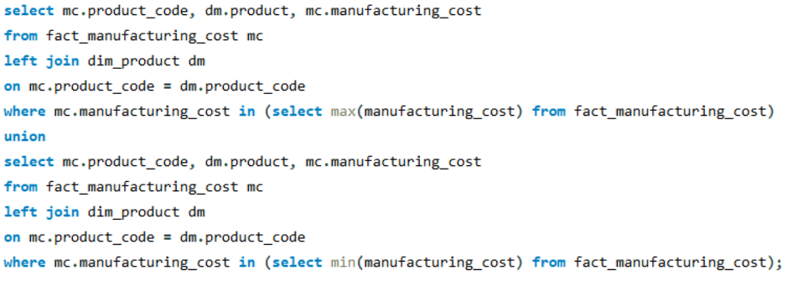

5. Get the products that have the highest and lowest manufacturing costs.The final output should contain these fields,product_code,product,manufacturing_cost
QUERY
OUTPUT
INSIGHTS
AQ Home Allin1 Gen2 (Variant:Plus3) has the highest manufacturing cost
AQ Master wired x1 Ms (Variant:Standard1) has the lowest manufacturing cost.

Slide 9
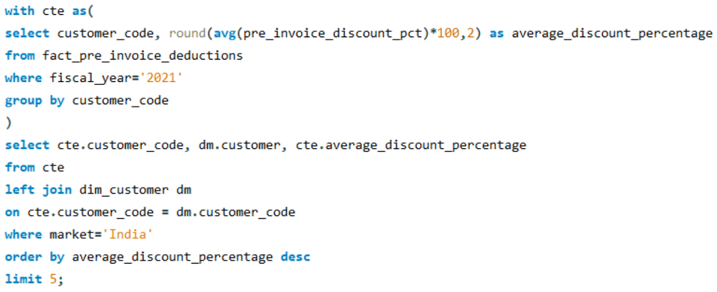
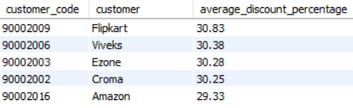
6.Generate a report which contains the top 5 customers who received an average high pre_invoice_discount_pct for the fiscal year 2021 and in the Indian market. The final output contains these fields, customer_code, customer, average_discount_percentage
QUERY
OUTPUT
INSIGHTS
Among the top 5 customers in the fiscal year 2021 in the Indian market,
Flipkart received the highest average discount percentage
Amazon received the lowest average discount percentage

Slide 10
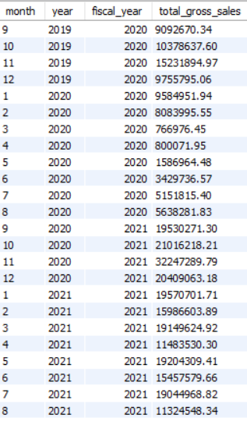
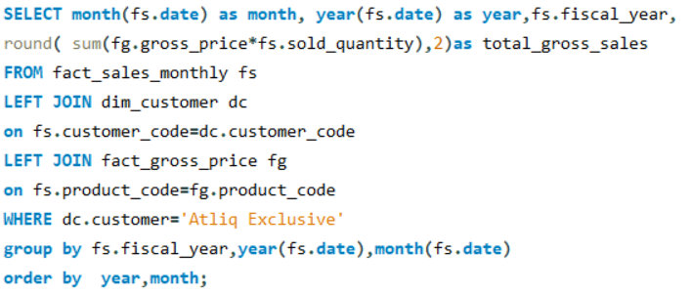
7. Get the complete report of the Gross sales amount for the customer “Atliq Exclusive” for each month. This analysis helps to get an idea of low and high-performing months and take strategic decisions. The final report contains these columns: Month, Year, Gross sales Amount
OUTPUT
QUERY
INSIGHTS
The lowest Gross sales is in March(2020)
The highest Gross sales is in November (2020)

Slide 11
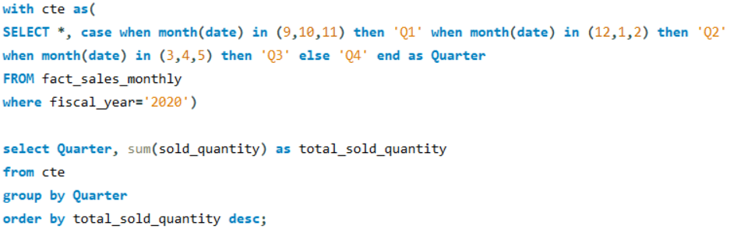
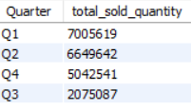
8. In which quarter of 2020, got the maximum total_sold_quantity? The final output contains these fields sorted by the total_sold_quantity, Quarter, total_sold_quantity
QUERY
OUTPUT
INSIGHTS
The maximum sold quantity was in the first quarter of 2020 i.e) in the months of September, October and November

Slide 12
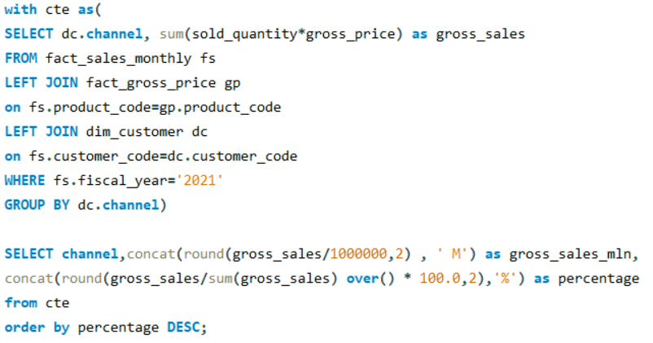

9. Which channel helped to bring more gross sales in the fiscal year 2021and the percentage of contribution? The final output contains these fields, channel, gross_sales_mln, percentage
QUERY
OUTPUT
INSIGHTS
Retailer channel brings more gross sales of 1924.17 M and its percentage contribution is 73.22%

Slide 13
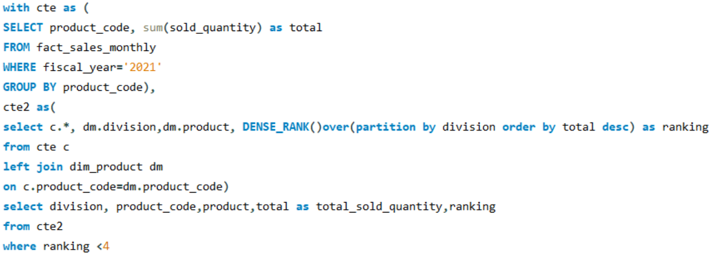
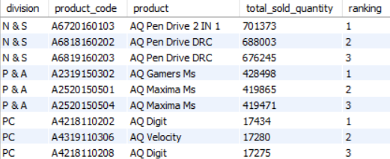
10. Get the Top 3 products in each division that have a high total_sold_quantity in the fiscal_year 2021? The final output contains these fields, division,product_code
QUERY
OUTPUT
INSIGHTS
AQ Pen Drive 2 IN 1 has the highest sold quantity in Networking and Storage Division AQ Gamers Ms has the highest sold quantity in Peripherals and Accessories Division AQ Digit has the highest sold quantity in PC division

