Slide 1


CODE CRACKERS
Final Project

Slide 2
GO CHAT WITH CRACKERS
[CLONE WEBSITE OF JAI KRISHNA CRACKERS]

Slide 3

AGENDA
The Main agenda of this project is to clone the e-commerce website for selling crackers(JAI KRISHNA WEBSITE) using HTML, CSS, JAVASCRIPT languages .
In that Clone Website we can add a additional feature for to attract the customer or to reduce the issues of the customer during shopping.
AGENDA OF THIS PROJECT
CLONE WEBSITE + ADDITIONAL FEATURE

Slide 4

PROBLEM STATEMENT
Now-a-days crackers are ordered in online through e-commerce websites . During this process customers faces many issues . In this project we find solution for lack of communication between admin(or)organizer to customer . During order their crackers customers are unable to communicate with admin in Jai Krishna Crackers website.

Slide 5

PROJECT OVERVIEW
In this project we clone e-commerce website(Jai Krishna Crackers) and add chat bot for that website.
In this website we have home page, product page, pricelist page, brand page, contact page.
This website is used to buy crackers in online through e-commerce website.

Slide 6

WHO ARE THE END USERS?
End users of this project are customers who can buy a crackers in online through e-commerce websites.

Slide 7
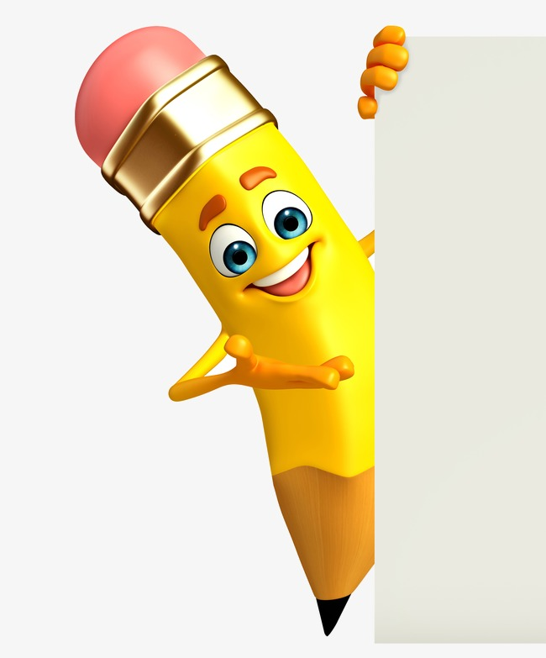
YOUR SOLUTION AND ITS VALUE PROPOSITION
The Solution for the problem is Integrated Chat Bot. Using this chat bot customer can easily communicate with admin. Admin give solution for their customers query. Chat Bot provide relevant information for the users at the request of users. This application also works with different types of browsers in various networks . This Chat bot facilitate interaction with your website. This application enhances the customer care/services.

Slide 8
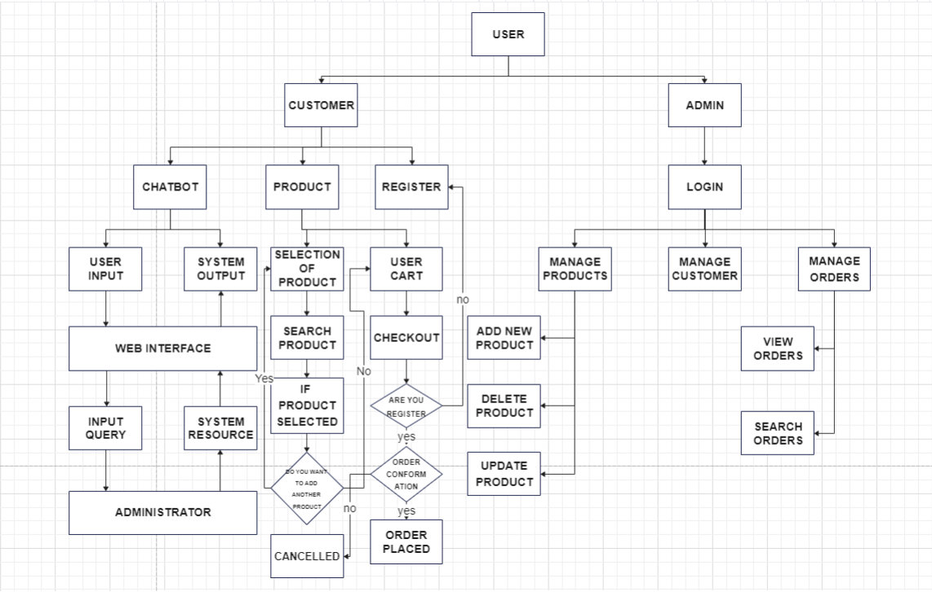

BLOCK DIAGRAM

Slide 9
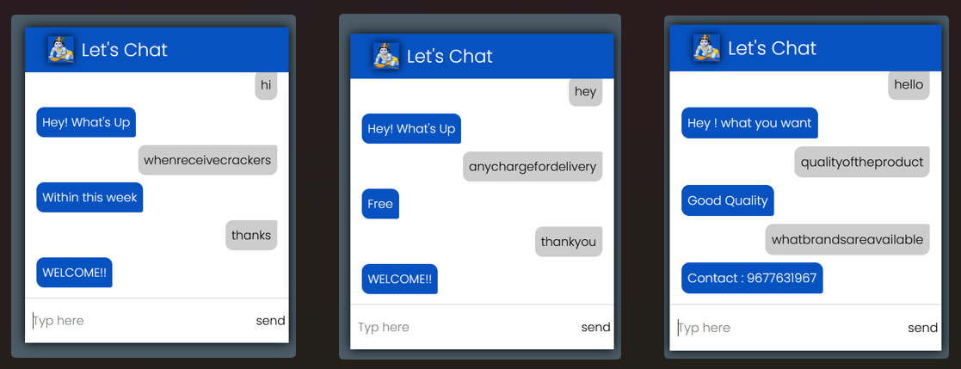
MODELLING
SAMPLE IMAGES – Chat Bot

Slide 10
RESULTS
DEMO VIDEO LINK OF THIS PROJECT
https://drive.google.com/file/d/1tuNH6eiJiH5gzwex7V84zyelXyVfiaq9/view?usp=share_link

Slide 11

.
.
TEAM MEMBER :
SANDHIYA SHANMUGAM

