Slide 1
Employee Data Analysis using Excel
STUDENT NAME: Sandhiya.M
REGISTER NO: 312212856 unm14512022g106
DEPARTMENT: B.COM[GENERAL]
COLLEGE : Mahalashmi Women’s College Of Arts And Science

Slide 2
PROJECT TITLE
Employee Performance Analysis using Excel

Slide 3


AGENDA
Problem Statement
Project Overview
End Users
Our Solution and Proposition
Dataset Description
Modelling Approach
Results and Discussion
Conclusion
3/21/2024 Annual Review

Slide 4

PROBLEM STATEMENT
Employee performance analysis is made to identify the performance level of an employee in each department.
It helps to track the activities and growth of the employees in wholly by department wise.
And it helps to grant remuneration or appreciation for the respected one.

Slide 5

PROJECT OVERVIEW
Analyzing the performance of the employees by considering the various factors like rating,performance level,gender,zone,type etc.
In order to identify the trend and performance on different cateogory in a company or in an organisation.
And it helps to identify which sector’s performance is high,better and low

Slide 6

WHO ARE THE END USERS?
Companies like IT sectors.
Industries.
Banks.
Marketing field.
It helps to analyze the current status of their companies or organisations by hierarchical members.

Slide 7

OUR SOLUTION AND ITS VALUE PROPOSITION
Conditional Formatting
Filtering
Formula used to identify performance level.
Pivot table for summarising
Graph- for data visualization (in units)
Pie Chart- to figure out the overall performance percentage of the each department.

Slide 8
Dataset Description
Employee data downloaded from edunet dashboard.
Features:
Totally 26 features were available. In that 11 features were considered.
Employee ID - in numbers
Names - in text
Employee type.
Performance level.
Gender- male,female.
Employee rating

Slide 9

THE "WOW" IN OUR SOLUTION
To identify the performance level.
=IFS(Z8>=5,”VERY HIGH”,Z8>=4,”HIGH”,Z8>=3,”MED”,TRUE,”LOW”)
3/21/2024 Annual Review
9

Slide 10
MODELLING
Data Collection
Downloaded the data from edunet student’s dashboard.
Feature Collection:
Highlighted data which is required using the fill option.
Data Cleaning:
Identified the missing values using conditional formatting.
Removed / Filtered the missing data using filter-filter by colour.
Performance level:
Performance Analysis is based on Department type is filtered by gender (Male employees)
10

Slide 11
Summary:
Pivot table is created to summarise the data.
Row labels- It is considered as department type.
Column labels-describe the performance level.
Filter- By gender where I prefered the male employees in this data.
Values- To make a count used first name for count of employees in each field.
Visualization:
Used the graph chart to analyze the employees (in units) in the department type category .
Used the pie chart to analyze the employees overall percentage in the department type category.

Slide 12
RESULTS
12

Slide 13
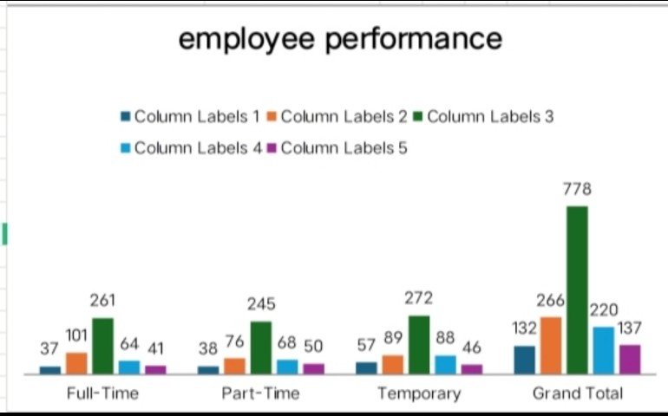
RESULTS

Slide 14
conclusion
Therefore the production department employees performs higher comparing to other department and whereas admin offices performs lower comparing to other department. . Hence the Production department employees works more efficiently and effectively comparing to other departments according to the employee data given.

