Slide 1
CASE STUDY
On Shein

Slide 2
Group Members
Mohammed Swarim Khan
Sandhra Saju
Ch. Jahnavi

Slide 3
ABOUT shein
SHEIN is an international B2C fast fashion e-commerce platform. The company mainly focuses on women's wear, but it also offers men's apparel, children's clothes, accessories, shoes, bags and other fashion items.
SHEIN mainly targets Europe, America, Australia, and the Middle East along with other consumer markets.
SHEIN adheres to the concept that "everyone can enjoy the beauty of fashion."
SHEIN is able to stay on top of the latest fashion trends from around the globe while rapidly bringing these styles to market.
SHEIN is the ultimate one-stop-shop for the modern yet economical fashionista. It aims to promptly offer stylish quality products at appealing prices to every user in the world.

Slide 4
It all starts when an idea, or a thought, is conceived by the designer. The life of a product begins even before the designer's pen hits the paper.
All of our products are created by machinery that emphasizes precision and attention to detail and style. We value quality and sometimes our products are crafted by individuals experienced in hand sewing.
Through creative collaborations with photographers and models, we are able to capture the details of every style for you to preview before you make a purchase decision.
After our products are specially designed and carefully packaged, they are loaded onto a cargo plane for a speedy transcontinental voyage to you.
After rigorous testing and inspection, our products are made into something we can be proud of a fashionable and reliable item!

Slide 5
Shein products

Slide 6
Generating the shein
To enter into SHEIN,
ENTER THE URL www.shein.in

Slide 7
ONLINE PURCHASING

Slide 8
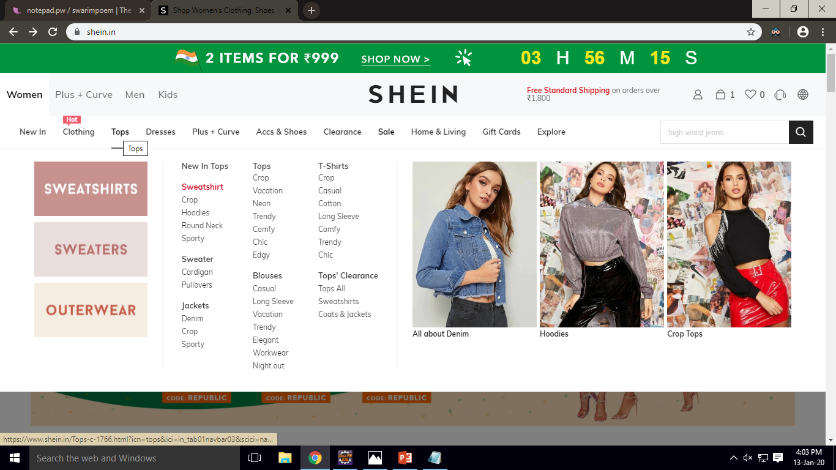
SELECT YOUR DEPARTMENT

Slide 9
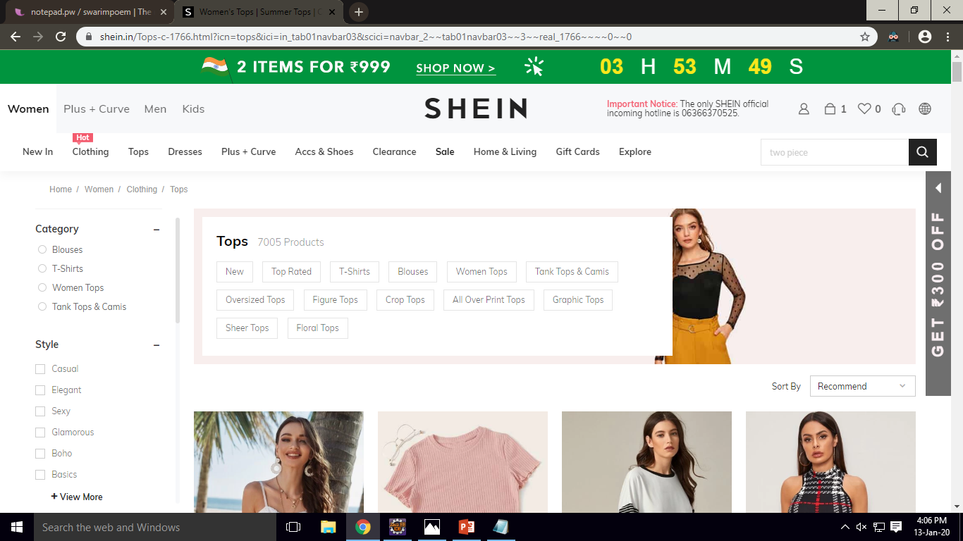
SELECT YOUR CATEGORY

Slide 10
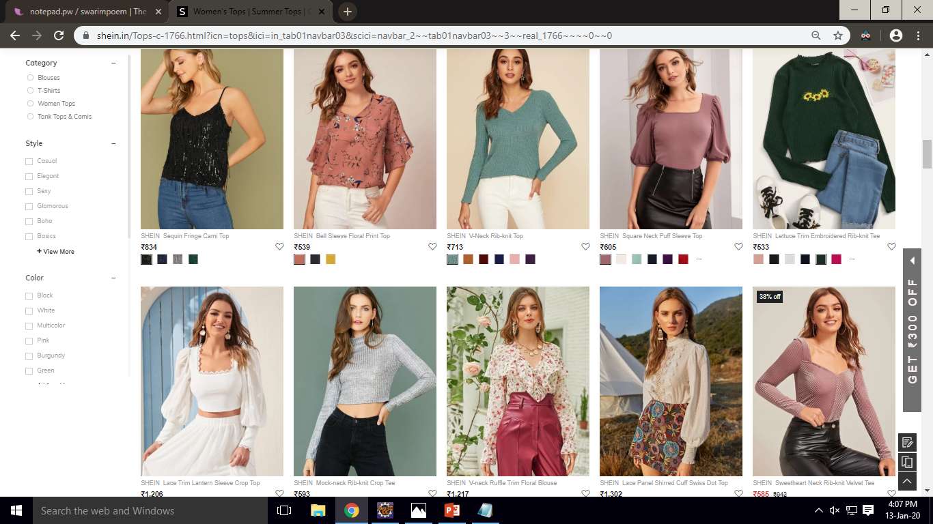
SELECT PRODUCT

Slide 11
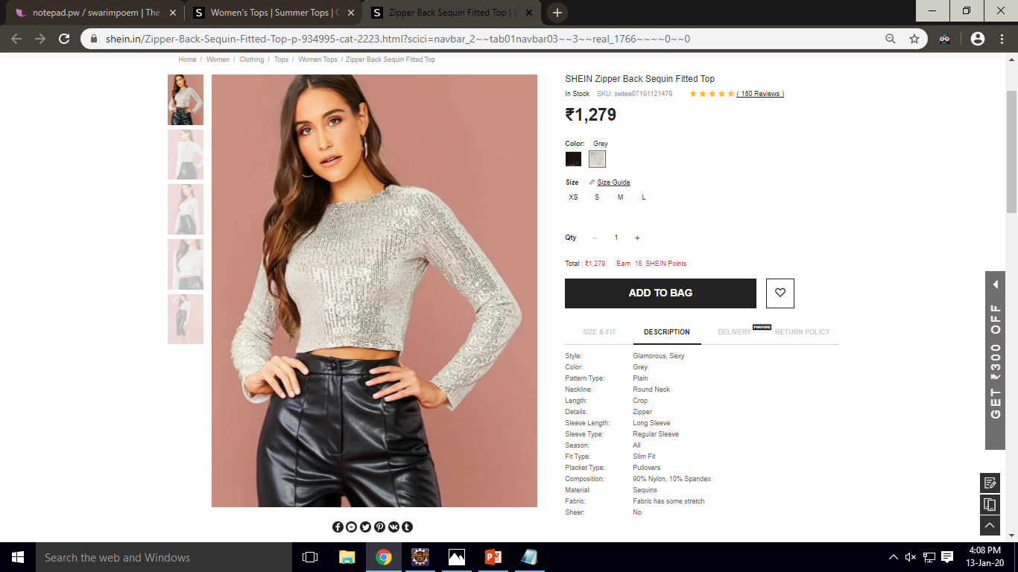
PRODUCT DESCRIPTION

Slide 12
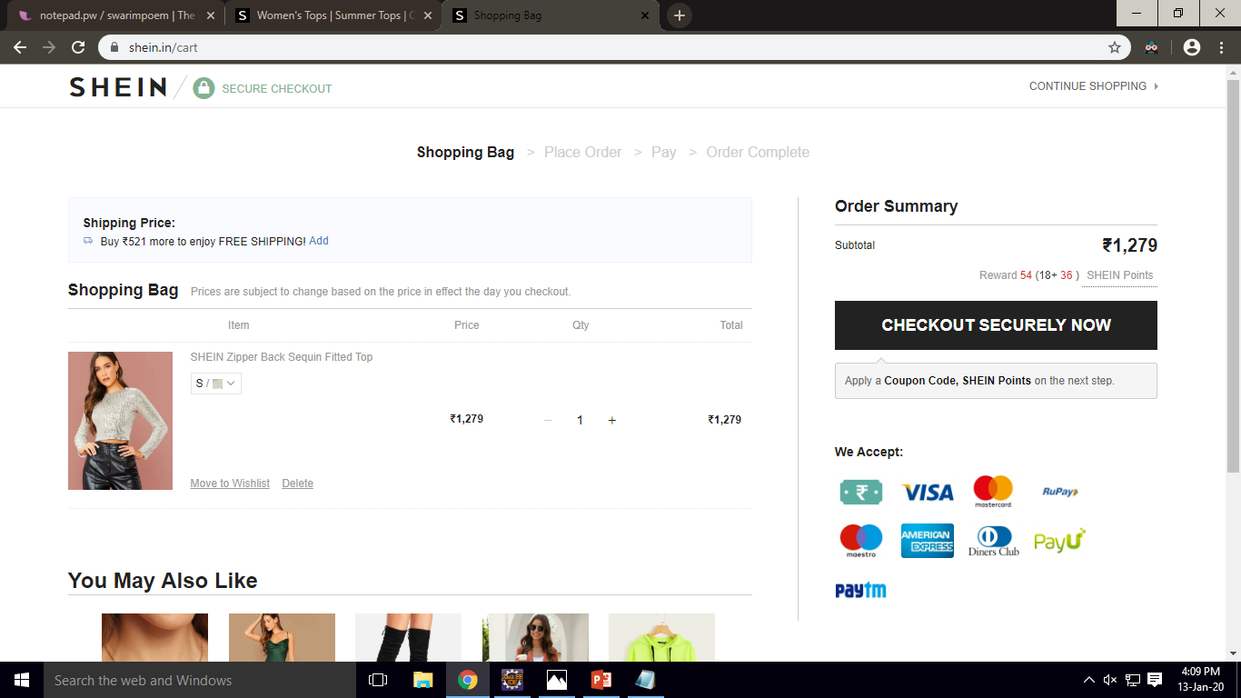
SHOPPING CART

Slide 13
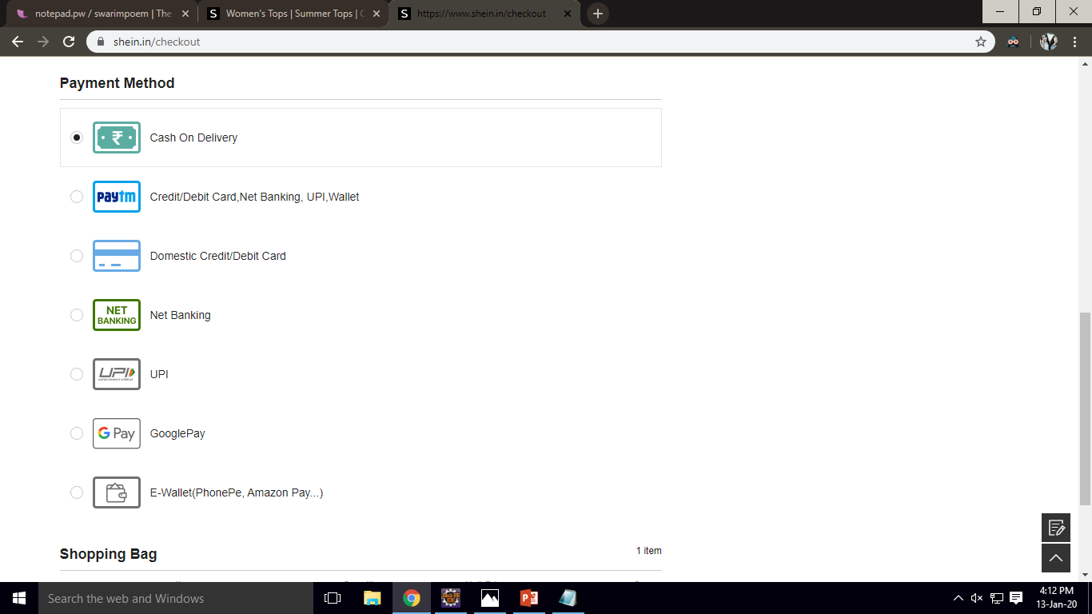
PAYMENT

Slide 14
THANK YOU

