Slide 1
ANOVA: analysis of variance
VCA: variance component analysis

Slide 2
Question
How do environment, replication, genotype, genotype by environment interaction, and error contribute to the observed phenotypic variance?

Slide 3
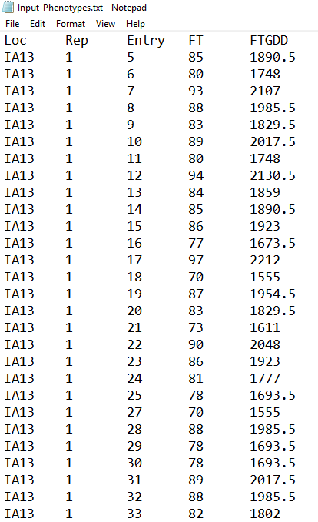
Input
Phenotypic data: collected from multi-environment trials
Experimental design: randomized complete block design (RCBD)
FTGDD: flowering time (growing degree days)
FT: flowering time (days after planting)
Entry: 237 genotypes
Rep: 2 replications
Loc: 7 environments
…..

Slide 4
Method
proc glm data=sasuser.sorghum;
class Loc Rep Entry;
model FTGDD=Loc rep(loc) entry loc*entry;
run;
proc mixed data=sasuser.sorghum;
class loc rep entry;
model FTGDD=/s;
random loc rep(loc) entry loc*entry;
run;
fit_a <-anovaMM(y ~ Loc+Loc/Rep+Entry+Loc*Entry, mydataframe)
fit_r <-remlMM(y ~ (Loc)+(Loc/Rep)+(Entry)+(Loc*Entry), mydataframe)

Slide 5
Output
Source | DF | Sum Square | Mean Square | F Value | Pr > F
Loc | 6 | 403195275.90 | 67199212.60 | 9398.99 | <1E-16
Rep(Loc) | 7 | 6227127.10 | 889589.60 | 124.42 | <1E-16
Entry | 236 | 106978830.70 | 453300.10 | 63.40 | <1E-16
Loc*Entry | 1411 | 137844598.40 | 97692.80 | 13.66 | <1E-16
Error | 1603 | 11460838.60 | 7149.60
Total | 3263 | 665706670.60
Variance Component | Estimate
Loc | 141287.00
Rep(Loc) | 4136.17
Entry | 25788.00
Loc*Entry | 45951.00
Residual | 7150.59
Heritability | 0.78

