Slide 1
Partition G×E variance

Slide 2
Question
What percentages of G×E are due to heterogeneity of slopes/heterogeneity between regressions and remainder?

Slide 3
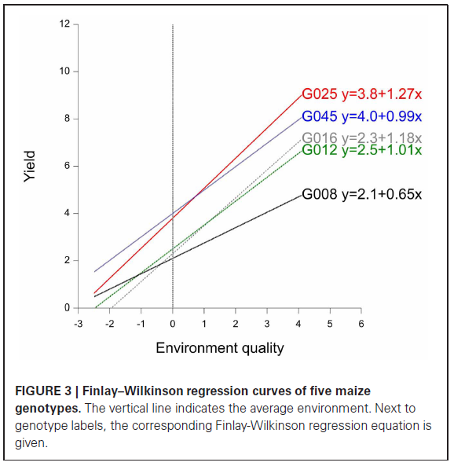
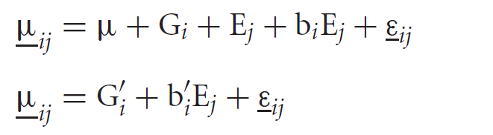
Justification
The magnitudes of the genotype-environmental interactions are a linear function of the environmental quality.

Slide 4
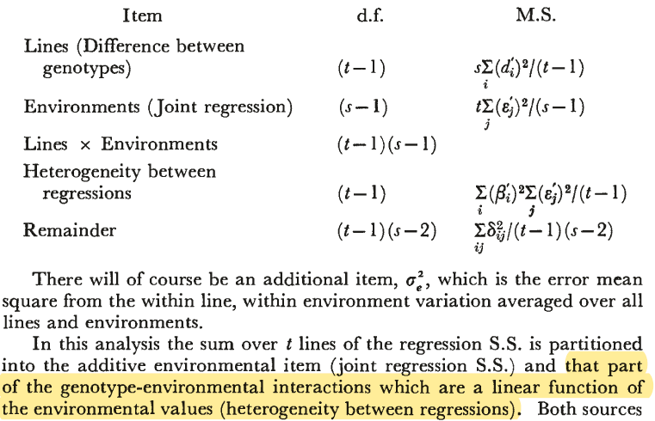
Method

Slide 5
Input
Phenotypic data: collected from multi-environment trials
Experiment design: randomized complete block design (RCBD)
ID | PR11 | PR12 | IA14 | IA13 | PR14S | KS11 | KS12
RIL1 | 1535.44 | 1544.069 | 1594.328 | 1896.731 | 1893.906 | 2281.305 | 2469.962
RIL2 | 1559.544 | 1575.221 | 1579.939 | 1861.281 | 1908.743 | 2340.185 | 2417.467
RIL3 | 1444.95 | 1492.151 | 1634.379 | 2065.41 | 2521.86 | 2886.46 | 3030.63
RIL4 | 1523.586 | 1492.151 | 1643.492 | 1970.44 | 1910.489 | 2580.05 | 2568.77
RIL5 | 1654.772 | 1671.44 | 1654.52 | 1883.226 | 1875.578 | 2139.38 | 2180.77
RIL6 | 1464.711 | 1409.773 | 1634.379 | 2037.96 | 2669.58 | 2928.19 | 3080.69
RIL7 | 1512.522 | 1480.729 | 1594.568 | 1819.405 | 1969.837 | 2269.149 | 2408.022
RIL8 | 1464.711 | 1492.151 | 1704.41 | 2162.02 | 2589.29 | 3055.81 | 2979.69
RIL9 | 1571.003 | 1565.529 | 1565.31 | 1872.316 | 1897.397 | 2153.53 | 2335.45
RIL10 | 1500.273 | 1480.729 | 1581.138 | 1896.438 | 1897.397 | 1915.78 | 2417.685
RIL11 | 1464.711 | 1491.113 | 1450.914 | 1925.102 | 1751.64 | 2024.54 | 2466.966
RIL12 | 1577.602 | 1586.297 | 1501.037 | 1721.85 | 1846.777 | 1833.3 | 1963.74
RIL13 | 1593.921 | 1544.069 | 1786.67 | 2218.27 | 2894.54 | 3307.95 | 3317.58
RIL14 | 1546.899 | 1502.535 | 1450.914 | 1610.03 | 1817.98 | 1823.09 | 1911.92
RIL15 | 1454.83 | 1470.345 | 1601.283 | 1953.765 | 2448.11 | 3272.34 | 3275.3
RIL16 | 1432.31 | 1448.539 | 1463.145 | 1843.59 | 2254.8 | 2647.95 | 2753.43
RIL17 | 1511.337 | 1564.837 | 1475.376 | 1608.01 | 1670.48 | 2015.78 | 2007.83
RIL18 | 1654.772 | 1512.918 | 1538.689 | 2025.62 | 2154.86 | 3184.99 | 3246.84
RIL19 | 1500.273 | 1544.069 | 1645.41 | 1924.23 | 2030.058 | 2354.691 | 2469.986
RIL20 | 1570.607 | 1492.151 | 1594.328 | 1808.88 | 2030.058 | 2286.59 | 2315.11
RIL21 | 1666.63 | 1543.723 | 1552.119 | 1725.13 | 1651.71 | 1929.31 | 2028.82
RIL22 | 1444.95 | 1448.539 | 1426.45 | 1620.78 | 1735.94 | 1901.96 | 2254.48
RIL23 | 1444.95 | 1470.345 | 1701.91 | 1993.48 | 2655.68 | 3162.22 | 2979.69
RIL24 | 1569.817 | 1512.918 | 1382.09 | 1717.29 | 1601.53 | 1686.97 | 1911.92
RIL25 | 1607.75 | 1523.302 | 1463.145 | 1697.14 | 1601.53 | 1901.96 | 2050.85
RIL26 | 1455.74 | 1428.118 | 1565.31 | 1980.95 | 2372.18 | 2939.38 | 2899.17
RIL27 | 1629.878 | 1481.767 | 1552.119 | 1902.26 | 1954.127 | 2211.48 | 2378.501
……

Slide 6


Output
Term | Degrees of freedom | Sum of squares | Mean squares | F | Probability
E | 6 | 203562757.7 | 33927126.3 | 757.46 | <0.001
G | 236 | 49270380.5 | 208772.8 | 4.66 | <0.001
ε | 1416 | 63423815.5 | 44790.8
Total | 1658 | 316256953.7 | 190746.1
 | Estimate
VarG | 23426
VarE | 142963
Varε | 44791
Term | Degrees of freedom | Sum of squares | Mean squares | F | Probability
E | 6 | 203562757.7 | 33927126.3 | 2763.4 | <0.001
G | 236 | 49270380.5 | 208772.8 | 17.0 | <0.001
Heterogeneity of slopes | 236 | 48936515.9 | 207358.1 | 16.9 | <0.001
ε | 1180 | 14487299.6 | 12277.4
Total | 1658 | 316256953.7 | 190746.1
 | Estimate
VarE | 142277.5
VarG | 202.1
VarS | 195080.7
Varε | 12277.4

