Slide 1
Partition G×E variance

Slide 2
Question
What percentages of G×E are due to different principal components?

Slide 3
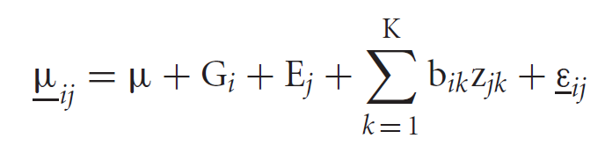
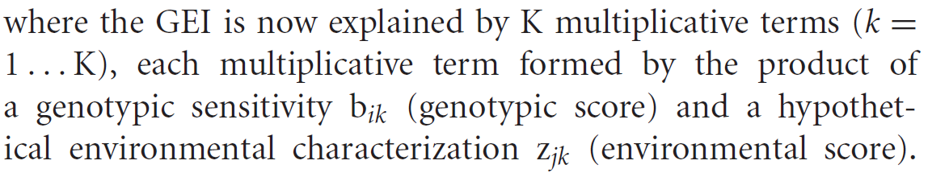
Method
AMMI (Additive Main effect and Multiplicative Interaction) is a combination of ANOVA for the main effects of the genotypes and the environment together with principal components analysis (PCA) of the genotype-environment interaction.

Slide 4
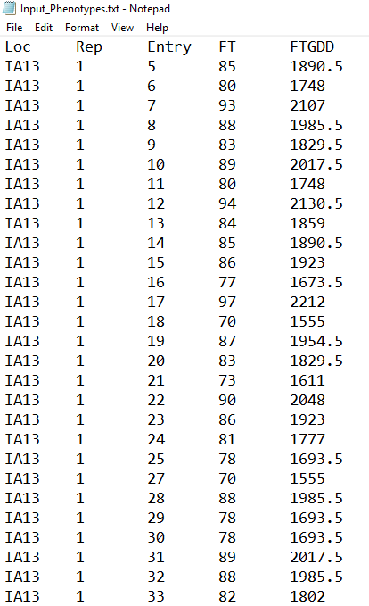
Input
Phenotypic data: collected from multi-environment trials
Experiment design: randomized complete block design (RCBD)
FTGDD: flowering time (growing degree days)
FT: flowering time (days after planting)
Entry: 237 genotypes
Rep: 2 replicates
Loc: 7 environments
…..

Slide 5
Output
PCs | Percent | Accum | Df | Sum.Sq | Mean.Sq | F.value | Pr.F
PC1 | 80.6 | 80.6 | 241 | 1.09E+08 | 452148.2 | 63.24 | 0
PC2 | 8.3 | 88.8 | 239 | 11162944 | 46706.88 | 6.53 | 0
PC3 | 6.7 | 95.5 | 237 | 9007071 | 38004.52 | 5.32 | 0
PC4 | 2.1 | 97.5 | 235 | 2805964 | 11940.27 | 1.67 | 0
PC5 | 1.5 | 99.1 | 233 | 2083804 | 8943.365 | 1.25 | 0.0097
PC6 | 0.9 | 100 | 231 | 1243729 | 5384.11 | 0.75 | 0.9971

