Slide 1
Environmental factors

Slide 2
Question
How do environmental factors, including temperature and photoperiod, influence the final traits?

Slide 3
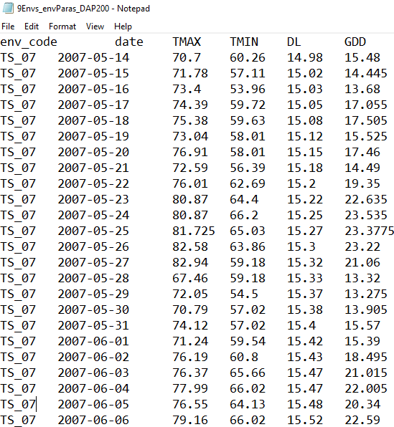
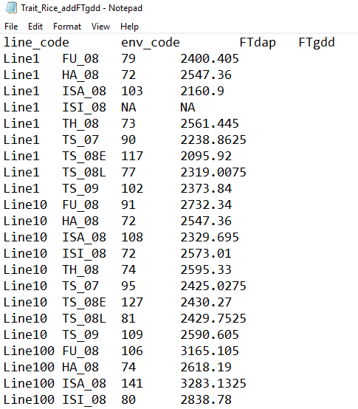
Inputs
Days after planting
9Environment
Environmental factors
Final traits
……
……

Slide 4
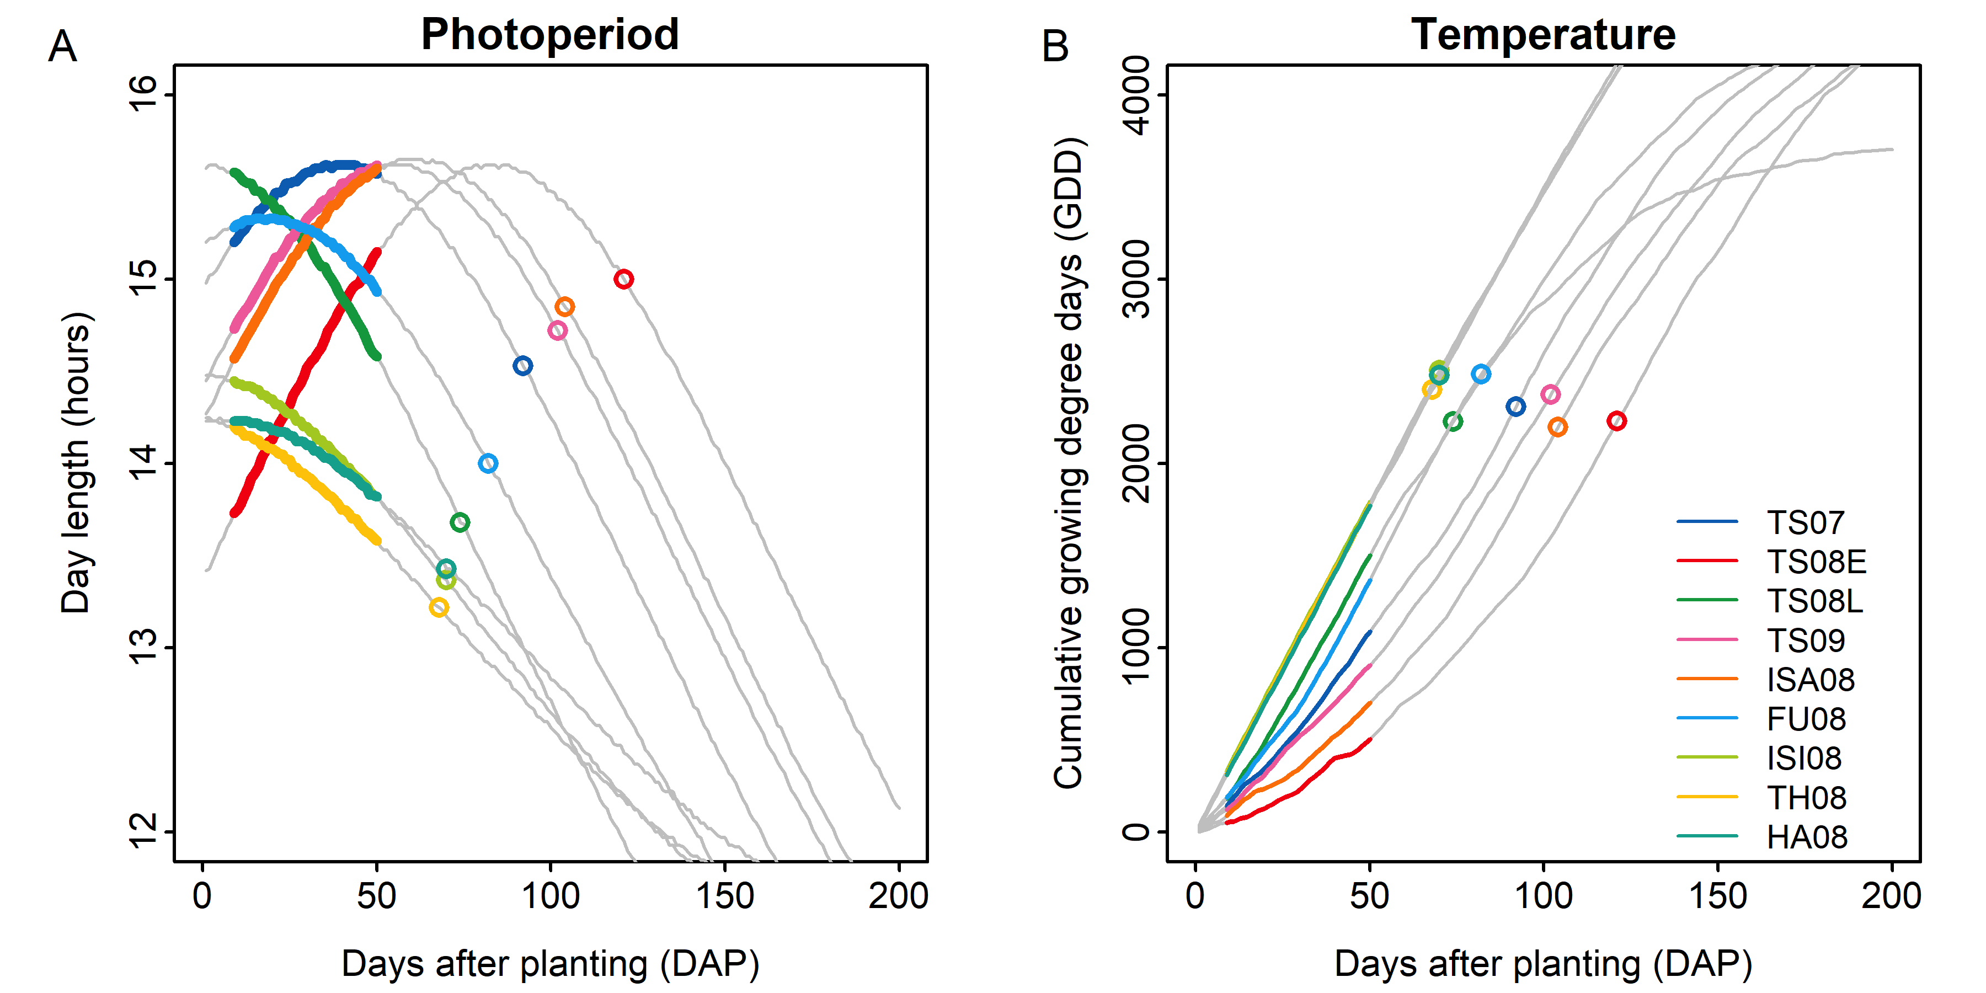
Outputs

