Slide 1
PCA and Clustering

Slide 2
Question
How are environments grouped based on traits and environmental factors?

Slide 3
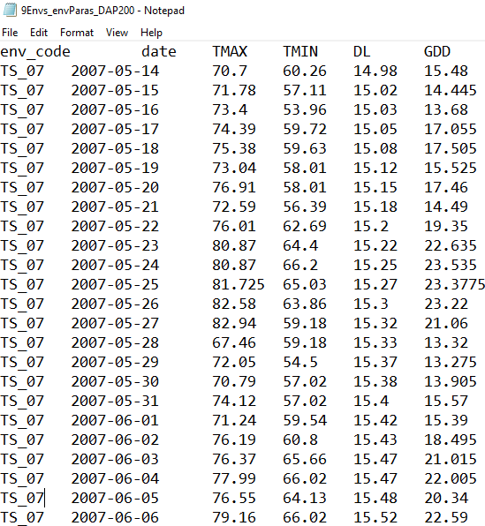
Inputs
Days after planting
LbE table
9Environment
Environmental factors
line_code | TH_08 | ISI_08 | HA_08 | TS_08L | FU_08 | TS_07 | TS_09 | ISA_08 | TS_08E
Line1 | 73 | 74 | 72.5 | 76.5 | 80.5 | 90.5 | 101.5 | 102.5 | 117.5
Line10 | 73.5 | 71.5 | 72 | 81.5 | 91.5 | 95.5 | 109 | 107.5 | 125.5
Line100 | NA | 78 | 73.5 | 92 | 106 | 122 | 138 | 139.5 | 159
Line101 | NA | 68 | 66.5 | 81 | 90.5 | 109 | 119.5 | 121 | 141.5
Line102 | NA | 85 | 79.5 | 92 | 95.5 | 105.5 | 109.5 | 114.5 | 126
Line103 | 65 | 67 | 67.5 | 74.5 | 83.5 | 101 | 112 | 112 | 134
Line104 | 59 | 57.5 | 62.5 | 63 | 71.5 | 87 | 91.5 | 90 | 107
Line105 | 61.5 | 63.5 | 67.5 | 69 | 76 | 91 | 101.5 | 102 | 121.5
Line106 | 71.5 | 75.5 | 76.5 | 87 | 97 | 102.5 | 115.5 | 116 | 132.5
Line107 | 94.5 | 103.5 | 106.5 | 103 | 112 | 108 | 122.5 | 120.5 | 142.5
Line108 | 68 | 71 | 71.5 | 88.5 | 99 | 109.5 | 122 | 119 | 139.5
Line109 | 67.5 | 71 | 71 | 80.5 | 86 | 95 | 103.5 | 103.5 | 123
Line11 | NA | 59 | 55 | 62 | 71 | 84.5 | 93.5 | 90.5 | 108.5
Line110 | 68.5 | 69.5 | 67 | 71.5 | 82 | 91.5 | 100.5 | 100.5 | 119.5
Line111 | NA | 69 | 69.5 | 79 | 85 | 93 | 102 | 103 | 121.5
Line112 | 69 | 69.5 | 66.5 | 76 | 80.5 | 93 | 98.5 | 101 | 120.5
Line113 | 68 | 70 | 72 | 71 | 78.5 | 82.5 | 89 | 90.5 | 105.5
Line114 | 61.5 | 68 | 68 | 73.5 | 81.5 | 93 | 111 | 111 | 129.5
Line115 | 65 | 71.5 | 66.5 | 76.5 | 84.5 | 99.5 | 112 | 114.5 | 132.5
Line116 | 70.5 | 74 | 72 | 83 | 97 | 100 | 108 | 109 | 126
Line117 | 74 | 78 | 76.5 | 95.5 | 107 | 119 | 137.5 | 139 | 160
Line118 | 70 | 69.5 | 72 | 65.5 | 70 | 79.5 | 85 | 86 | 104
……
……

Slide 4
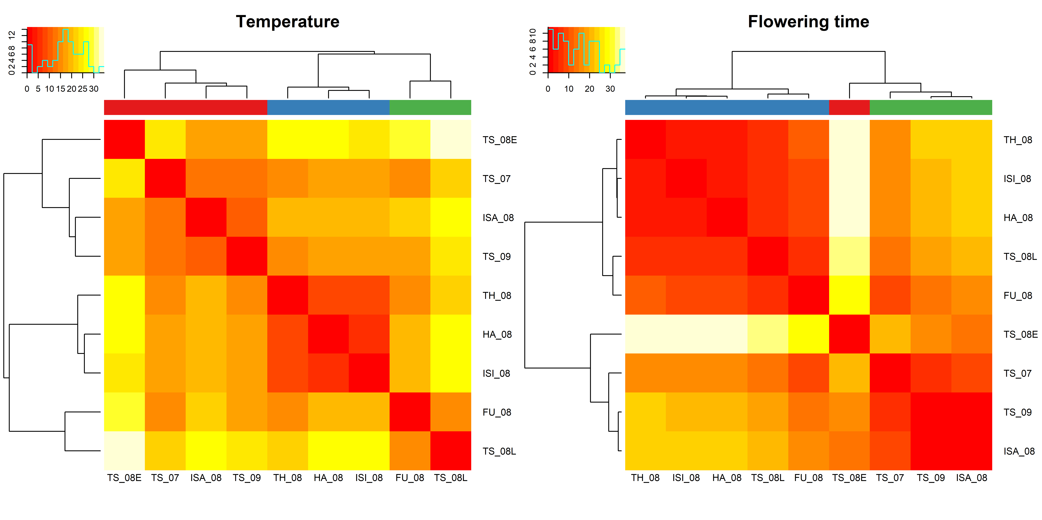
Outputs

Slide 5
Question
How are environments grouped based on genotype by environment interactions (G × E)?

Slide 6
Inputs
GbE table
line_code | TH_08 | ISI_08 | HA_08 | TS_08L | FU_08 | TS_07 | TS_09 | ISA_08 | TS_08E
Line1 | 4.540256 | 3.571022 | 1.785262 | 1.397727 | -2.53574 | -2.53977 | -0.98296 | -1.36932 | -3.86648
Line10 | 0.706923 | -3.26231 | -3.04807 | 2.064393 | 4.130924 | -1.87311 | 2.183712 | -0.70265 | -0.19981
Line100 | -12.6157 | -14.347 | -19.1327 | -5.02028 | 1.04625 | 7.042219 | 13.59904 | 13.71267 | 15.71551
Line101 | -8.81864 | -10.9466 | -12.7324 | -2.61991 | -1.05338 | 7.442589 | 8.499407 | 8.613044 | 11.61588
Line102 | 3.168085 | 3.242544 | -2.54322 | 5.569248 | 1.135779 | 1.131748 | -4.31143 | -0.6978 | -6.69496
Line103 | -6.57085 | -6.54009 | -6.32585 | -3.71338 | -2.64685 | 4.849116 | 6.405934 | 5.01957 | 9.522411
Line104 | 1.595812 | -1.87342 | 2.840818 | -1.04672 | -0.48019 | 5.015782 | 0.0726 | -2.81376 | -3.31092
Line105 | -3.07085 | -3.04009 | 0.674151 | -2.21338 | -3.14685 | 1.849116 | 2.905934 | 2.01957 | 4.022411
Line106 | -6.45974 | -4.42898 | -3.71474 | 2.397727 | 4.464258 | -0.03977 | 3.517045 | 2.630681 | 1.633522
Line107 | 1.095812 | 8.126578 | 10.84082 | 2.953282 | 4.019813 | -9.98422 | -4.9274 | -8.31376 | -3.81092
Line108 | -11.5153 | -10.4845 | -10.2703 | 2.342171 | 4.908702 | 5.404671 | 8.461489 | 4.075126 | 7.077967
Line109 | -2.34863 | -0.81787 | -1.10363 | 4.008838 | 1.575369 | 0.571338 | -0.37184 | -1.75821 | 0.244633
Line11 | -0.47638 | 0.635602 | -3.65016 | -1.03769 | 0.028838 | 3.524807 | 3.081625 | -1.30474 | -0.8019
Line110 | 2.040256 | 1.071022 | -1.71474 | -1.60227 | 0.964258 | 0.460227 | 0.017045 | -1.36932 | 0.133522
Line111 | 0.435928 | -1.72844 | -1.5142 | 3.598268 | 1.664799 | -0.33923 | -0.78241 | -1.16878 | -0.16594
Line112 | 2.095812 | 0.626578 | -2.65918 | 2.453282 | -0.98019 | 1.515782 | -2.4274 | -1.31376 | 0.689078
Line113 | 6.373589 | 6.404355 | 8.118596 | 2.73106 | 2.297591 | -3.70644 | -6.64962 | -6.53599 | -9.03314
Line114 | -7.90419 | -3.37342 | -3.65918 | -2.54672 | -2.48019 | -0.98422 | 7.5726 | 6.186237 | 7.189078
Line115 | -7.23752 | -2.70676 | -7.99252 | -2.38005 | -2.31352 | 2.682449 | 5.739267 | 6.852903 | 7.355744
Line116 | -3.62641 | -2.09564 | -4.3814 | 2.23106 | 8.297591 | 1.29356 | -0.14962 | -0.53599 | -1.03314
Line117 | -16.4597 | -14.429 | -16.2147 | -1.60227 | 1.964258 | 3.960227 | 13.01704 | 13.13068 | 16.63352
Line118 | 11.20692 | 8.737689 | 10.95193 | 0.064393 | -3.36908 | -3.87311 | -7.81629 | -8.20265 | -7.69981
Line119 | -14.9597 | -11.929 | -15.2147 | 1.397727 | 4.464258 | 8.460227 | 9.517045 | 7.130681 | 11.13352
Line12 | -3.86397 | -3.00345 | -0.78921 | -3.17675 | -6.61021 | 4.885755 | 2.942573 | 1.056209 | 8.55905
Line120 | 5.984701 | 6.015467 | 8.229707 | 5.342171 | 0.408702 | -5.09533 | -6.53851 | -5.92487 | -8.42203
Line121 | -6.29308 | -4.26231 | -5.54807 | 4.564393 | 8.130924 | 1.626893 | 3.183712 | 1.797348 | -3.19981
Line122 | 2.484701 | 0.015467 | -0.27029 | -3.65783 | -4.0913 | 0.404671 | 0.461489 | 0.575126 | 4.077967
Line123 | 2.262478 | -1.20676 | -1.99252 | -3.88005 | -4.31352 | 1.682449 | 1.739267 | 1.852903 | 3.855744
……

Slide 7
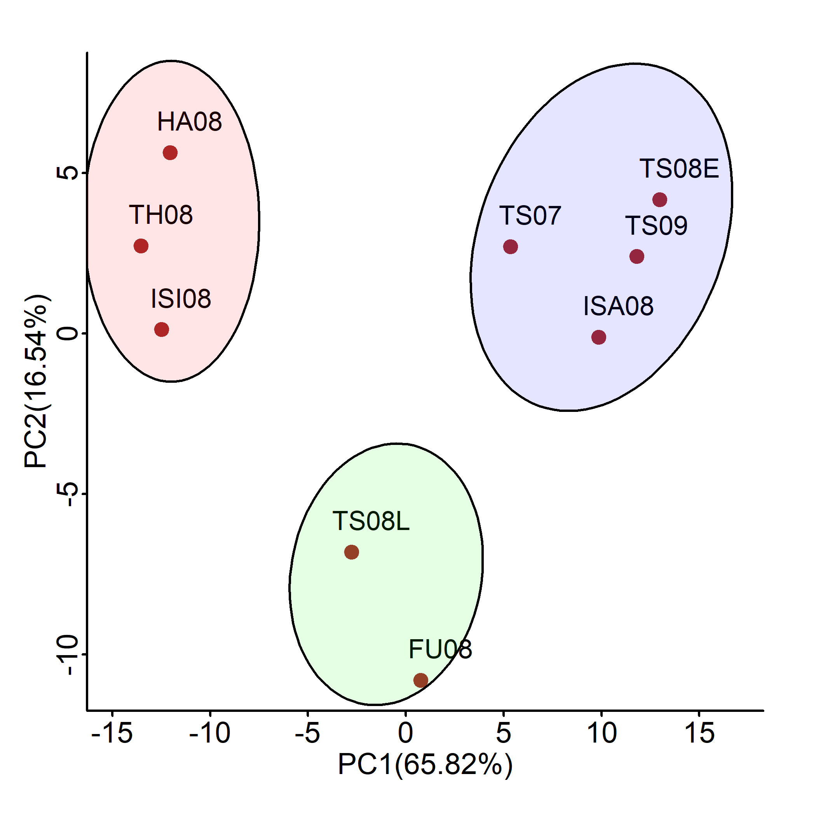
Outputs

