Slide 1
Reaction norm

Slide 2
Question
Reaction norm is the function that relates the environments to which a particular genotype is exposed and the phenotypes that can be produced by the genotype.
How do we find patterns of reaction norm at the phenotypic level?

Slide 3
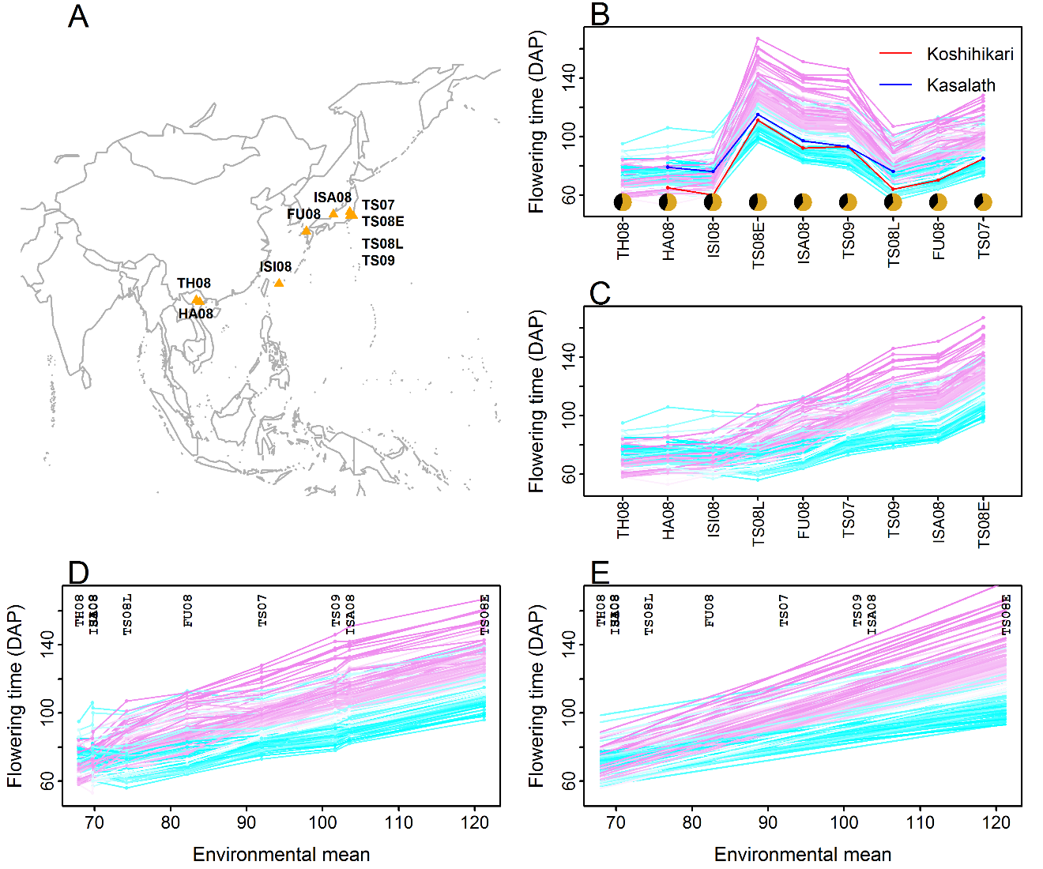
Progress

Slide 4
Input
LbE table
line_code | TH_08 | ISI_08 | HA_08 | TS_08L | FU_08 | TS_07 | TS_09 | ISA_08 | TS_08E
Line1 | 73 | 74 | 72.5 | 76.5 | 80.5 | 90.5 | 101.5 | 102.5 | 117.5
Line10 | 73.5 | 71.5 | 72 | 81.5 | 91.5 | 95.5 | 109 | 107.5 | 125.5
Line100 | NA | 78 | 73.5 | 92 | 106 | 122 | 138 | 139.5 | 159
Line101 | NA | 68 | 66.5 | 81 | 90.5 | 109 | 119.5 | 121 | 141.5
Line102 | NA | 85 | 79.5 | 92 | 95.5 | 105.5 | 109.5 | 114.5 | 126
Line103 | 65 | 67 | 67.5 | 74.5 | 83.5 | 101 | 112 | 112 | 134
Line104 | 59 | 57.5 | 62.5 | 63 | 71.5 | 87 | 91.5 | 90 | 107
Line105 | 61.5 | 63.5 | 67.5 | 69 | 76 | 91 | 101.5 | 102 | 121.5
Line106 | 71.5 | 75.5 | 76.5 | 87 | 97 | 102.5 | 115.5 | 116 | 132.5
Line107 | 94.5 | 103.5 | 106.5 | 103 | 112 | 108 | 122.5 | 120.5 | 142.5
Line108 | 68 | 71 | 71.5 | 88.5 | 99 | 109.5 | 122 | 119 | 139.5
Line109 | 67.5 | 71 | 71 | 80.5 | 86 | 95 | 103.5 | 103.5 | 123
Line11 | NA | 59 | 55 | 62 | 71 | 84.5 | 93.5 | 90.5 | 108.5
Line110 | 68.5 | 69.5 | 67 | 71.5 | 82 | 91.5 | 100.5 | 100.5 | 119.5
Line111 | NA | 69 | 69.5 | 79 | 85 | 93 | 102 | 103 | 121.5
Line112 | 69 | 69.5 | 66.5 | 76 | 80.5 | 93 | 98.5 | 101 | 120.5
Line113 | 68 | 70 | 72 | 71 | 78.5 | 82.5 | 89 | 90.5 | 105.5
Line114 | 61.5 | 68 | 68 | 73.5 | 81.5 | 93 | 111 | 111 | 129.5
Line115 | 65 | 71.5 | 66.5 | 76.5 | 84.5 | 99.5 | 112 | 114.5 | 132.5
Line116 | 70.5 | 74 | 72 | 83 | 97 | 100 | 108 | 109 | 126
Line117 | 74 | 78 | 76.5 | 95.5 | 107 | 119 | 137.5 | 139 | 160
Line118 | 70 | 69.5 | 72 | 65.5 | 70 | 79.5 | 85 | 86 | 104
Line119 | 74 | 79 | 76 | 97 | 108 | 122 | 132.5 | 131.5 | 153
……

Slide 5
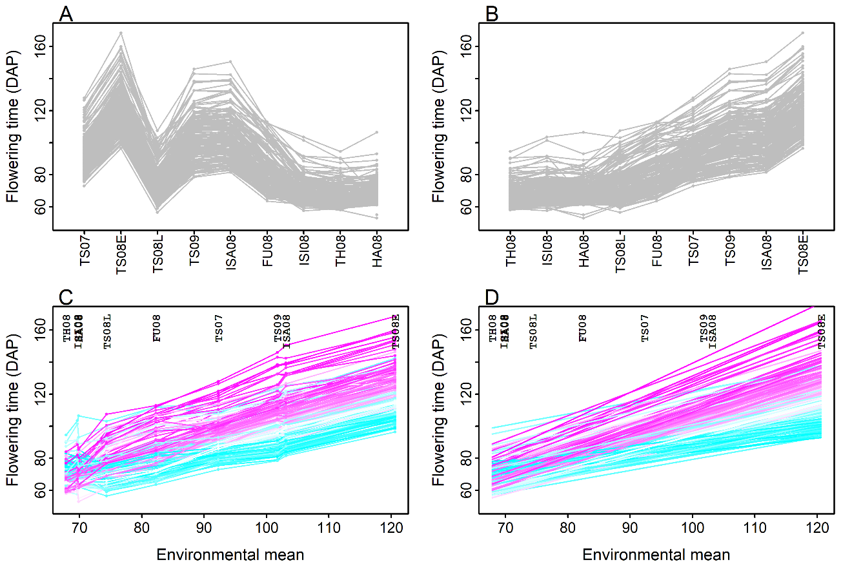
Output

