Slide 1
CERIS or critical environmental regressor through informed search

Slide 2
Question
How do we find an environmental determinant underlying G×E?

Slide 3
Justification
“While the majority of research on G×E interactions has concentrated upon the development of analytical methodologies for quantifying their magnitude, some workers have attempted to define the environmental causes and physiological basis of the G×E interactions.”
“In the absence of explicit environmental information, the biological quality of an environment can be reflected in an average performance of all genotypes in that environment.”

Slide 4
Inputs
File1
File2
env_code | pop_code | line_code | FTdap | FTgdd
PR12 | 1 | E5 | 58.1071 | 1544.069
PR12 | 1 | E6 | 59.2582 | 1575.221
PR12 | 1 | E7 | 56.1885 | 1492.151
PR12 | 1 | E8 | 56.1885 | 1492.151
PR12 | 1 | E9 | 63.0955 | 1671.44
PR12 | 1 | E10 | 53.1187 | 1409.773
PR12 | 1 | E11 | 55.8047 | 1480.729
PR12 | 1 | E12 | 56.1885 | 1492.151
PR12 | 1 | E13 | 58.8745 | 1565.529
PR12 | 1 | E14 | 55.8047 | 1480.729
PR12 | 1 | E15 | 56.1885 | 1491.113
PR12 | 1 | E16 | 59.642 | 1586.297
PR12 | 1 | E17 | 58.1071 | 1544.069
PR12 | 1 | E18 | 56.5722 | 1502.535
PR12 | 1 | E19 | 55.421 | 1470.345
PR12 | 1 | E20 | 54.6536 | 1448.539
PR12 | 1 | E21 | 58.8745 | 1564.837
PR12 | 1 | E22 | 56.9559 | 1512.918
PR12 | 1 | E23 | 58.1071 | 1544.069
PR12 | 1 | E24 | 56.1885 | 1492.151
PR12 | 1 | E25 | 58.1071 | 1543.723
PR12 | 1 | E27 | 54.6536 | 1448.539
env_notes | env_code | lat | lon | PlantingDate | TrialYear | Location
1 | PR11 | 18.037 | -66.796 | 2010-12-04 | 2010 | PR
2 | PR12 | 18.037 | -66.796 | 2011-12-12 | 2011 | PR
3 | KS11 | 39.184 | -96.572 | 2011-06-08 | 2011 | KS
4 | KS12 | 39.184 | -96.572 | 2012-06-07 | 2012 | KS
5 | IA13 | 42.031 | -93.632 | 2013-06-05 | 2013 | IA
6 | IA14 | 42.031 | -93.632 | 2014-06-10 | 2014 | IA
7 | PR14S | 18.037 | -66.796 | 2014-06-05 | 2014 | PR
File3
ftp://ftp.ncdc.noaa.gov/pub/data/ghcn/daily/by_year/
2010.csv.gz, 2011.csv.gz, 2012.csv.gz,
2013.csv.gz, 2014.csv.gz
……

Slide 5
Outputs
env_code | Date | Tmax | Tmin | DL | GDD | DTR | PTT | PTR | PTD1 | PTD2 | PTS
PR11 | 20101204 | 84.2 | 69.8 | 11.88 | 27 | 15.12 | 320.76 | 2.272727 | 171.072 | 1.212121 | 312980
PR11 | 20101205 | 86 | 62.6 | 11.9 | 24.3 | 12.4 | 289.17 | 2.042017 | 278.46 | 1.966387 | 492412
PR11 | 20101206 | 87.8 | 64.4 | 11.88 | 26.1 | 14.22 | 310.068 | 2.19697 | 277.992 | 1.969697 | 502647
PR11 | 20101207 | 84.2 | 71.6 | 11.87 | 27.9 | 16.03 | 331.173 | 2.350463 | 149.562 | 1.0615 | 276592
PR11 | 20101208 | 86 | 73.4 | 11.87 | 29.7 | 17.83 | 352.539 | 2.502106 | 149.562 | 1.0615 | 282983
PR11 | 20101209 | 87.8 | 71.6 | 11.87 | 29.7 | 17.83 | 352.539 | 2.502106 | 192.294 | 1.364785 | 363835
PR11 | 20101210 | 86 | 73.4 | 11.87 | 29.7 | 17.83 | 352.539 | 2.502106 | 149.562 | 1.0615 | 282983
PR11 | 20101211 | 84.2 | 68 | 11.85 | 26.1 | 14.25 | 309.285 | 2.202532 | 191.97 | 1.367089 | 346231
PR11 | 20101212 | 87.8 | 71.6 | 11.87 | 29.7 | 17.83 | 352.539 | 2.502106 | 192.294 | 1.364785 | 363835
PR11 | 20101213 | 87.8 | 69.8 | 11.85 | 28.8 | 16.95 | 341.28 | 2.43038 | 213.3 | 1.518987 | 398351
PR11 | 20101214 | 87.8 | 73.4 | 11.85 | 30.6 | 18.75 | 362.61 | 2.582278 | 170.64 | 1.21519 | 325960
PR11 | 20101215 | 86 | 73.4 | 11.85 | 29.7 | 17.85 | 351.945 | 2.506329 | 149.31 | 1.063291 | 282030
PR11 | 20101216 | 84.2 | 73.4 | 11.83 | 28.8 | 16.97 | 340.704 | 2.434489 | 127.764 | 0.912933 | 238204
PR11 | 20101217 | 84.2 | 69.8 | 11.85 | 27 | 15.15 | 319.95 | 2.278481 | 170.64 | 1.21519 | 311401
PR11 | 20101218 | 84.2 | 64.4 | 11.83 | 24.3 | 12.47 | 287.469 | 2.0541 | 234.234 | 1.673711 | 411769
PR11 | 20101219 | 86 | 69.8 | 11.85 | 27.9 | 16.05 | 330.615 | 2.35443 | 191.97 | 1.367089 | 354421
PR11 | 20101220 | 82.4 | 71.6 | 11.83 | 27 | 15.17 | 319.41 | 2.282333 | 127.764 | 0.912933 | 232763
PR11 | 20101221 | 86 | 66.2 | 11.85 | 26.1 | 14.25 | 309.285 | 2.202532 | 234.63 | 1.670886 | 423172
PR11 | 20101222 | 84.2 | 69.8 | 11.83 | 27 | 15.17 | 319.41 | 2.282333 | 170.352 | 1.217244 | 310351
PR11 | 20101223 | 84.2 | 73.4 | 11.85 | 28.8 | 16.95 | 341.28 | 2.43038 | 127.98 | 0.911392 | 239010
PR11 | 20101224 | 84.2 | 62.6 | 11.83 | 23.4 | 11.57 | 276.822 | 1.978022 | 255.528 | 1.825866 | 443761
PR11 | 20101225 | 86 | 64.4 | 11.85 | 25.2 | 13.35 | 298.62 | 2.126582 | 255.96 | 1.822785 | 456182
PR11 | 20101226 | 84.2 | 66.2 | 11.83 | 25.2 | 13.37 | 298.116 | 2.130178 | 212.94 | 1.521555 | 378870
PR11 | 20101227 | 87.8 | 75.2 | 11.85 | 31.5 | 19.65 | 373.275 | 2.658228 | 149.31 | 1.063291 | 288400
……

Slide 6
Outputs
pop_code | Day_Start | Day_End | window | R_DL | R_GDD | R_DTR | R_PTT | R_PTR | R_PTD | R_PTD2 | R_PTS
1 | 18 | 43 | 25 | 0.563 | 0.8353 | 0.5864 | 0.9965 | 0.2666 | 0.7051 | 0.4145 | 0.8004
1 | 18 | 42 | 24 | 0.563 | 0.8242 | 0.5759 | 0.9963 | 0.2613 | 0.6946 | 0.3999 | 0.7949
1 | 17 | 43 | 26 | 0.563 | 0.8286 | 0.5717 | 0.9962 | 0.2479 | 0.7096 | 0.4274 | 0.8014
1 | 17 | 42 | 25 | 0.563 | 0.8176 | 0.5613 | 0.9961 | 0.2425 | 0.6999 | 0.414 | 0.7962
1 | 20 | 43 | 23 | 0.563 | 0.8359 | 0.5967 | 0.9958 | 0.287 | 0.6972 | 0.4216 | 0.7969
1 | 19 | 43 | 24 | 0.563 | 0.8362 | 0.5901 | 0.9956 | 0.2726 | 0.704 | 0.4288 | 0.7994
1 | 18 | 44 | 26 | 0.563 | 0.84 | 0.5933 | 0.9955 | 0.2727 | 0.7024 | 0.4053 | 0.7987
1 | 19 | 42 | 23 | 0.563 | 0.8249 | 0.5795 | 0.9954 | 0.2673 | 0.6929 | 0.4138 | 0.7936
1 | 16 | 42 | 26 | 0.563 | 0.8126 | 0.5457 | 0.9953 | 0.2237 | 0.7095 | 0.4549 | 0.798
1 | 17 | 44 | 27 | 0.563 | 0.8338 | 0.5792 | 0.9953 | 0.2544 | 0.7068 | 0.4179 | 0.7996
1 | 19 | 29 | 10 | 0.562 | 0.8524 | 0.6148 | 0.9953 | 0.2992 | 0.6977 | 0.3412 | 0.8019
1 | 16 | 43 | 27 | 0.563 | 0.8239 | 0.5564 | 0.9952 | 0.2294 | 0.7184 | 0.4659 | 0.803
1 | 20 | 42 | 22 | 0.563 | 0.8244 | 0.586 | 0.9952 | 0.2818 | 0.6849 | 0.4051 | 0.7906
1 | 17 | 41 | 24 | 0.563 | 0.8116 | 0.5557 | 0.9951 | 0.2396 | 0.7001 | 0.4119 | 0.7972
1 | 18 | 41 | 23 | 0.563 | 0.8183 | 0.5706 | 0.9951 | 0.2589 | 0.6945 | 0.3968 | 0.7959
1 | 19 | 28 | 9 | 0.562 | 0.8498 | 0.6062 | 0.9951 | 0.283 | 0.7029 | 0.3841 | 0.8017
1 | 23 | 29 | 6 | 0.563 | 0.8468 | 0.6433 | 0.9948 | 0.3677 | 0.6619 | 0.2198 | 0.7989
1 | 17 | 45 | 28 | 0.563 | 0.8374 | 0.585 | 0.9947 | 0.2603 | 0.7119 | 0.4264 | 0.8026
1 | 18 | 45 | 27 | 0.563 | 0.8431 | 0.5986 | 0.9947 | 0.2781 | 0.7079 | 0.4149 | 0.8018
……

Slide 7
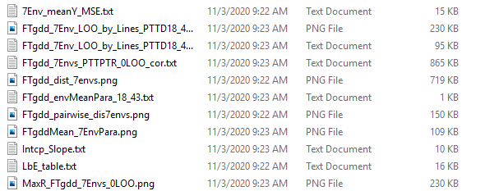
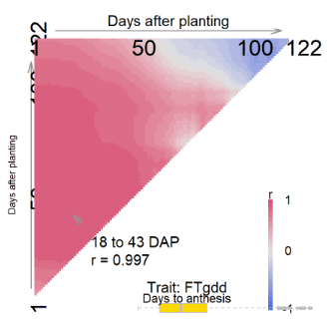
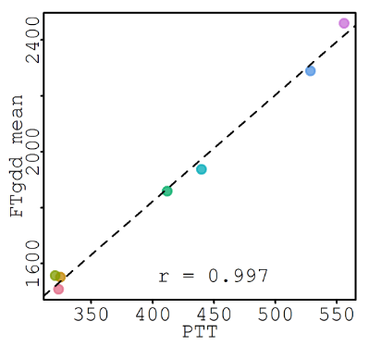
Outputs

