Slide 1
Environment prediction

Slide 2
Question
 |  | Tested environments |  |  | Untested environments
 |  | E1 | E2 | E3 | … | En-1 | En
Tested genotypes | G1
 | G2
 | G3
Untested genotypes | …
 | Gm-1
 | Gm
1
2
3
4
Genotype/Phenotype/Environment

Slide 3
Inputs
File1: 9Env_meta_table.txt is for splitting environments, such as
leave-one-environment out prediction or first-year-predicting-next-year.
File2: FTdap_envMeanPara_9_50.txt is for connecting tested environments and untested environments with environmental index.
File3: LbE_table.txt includes phenotypes in all environments.

Slide 4
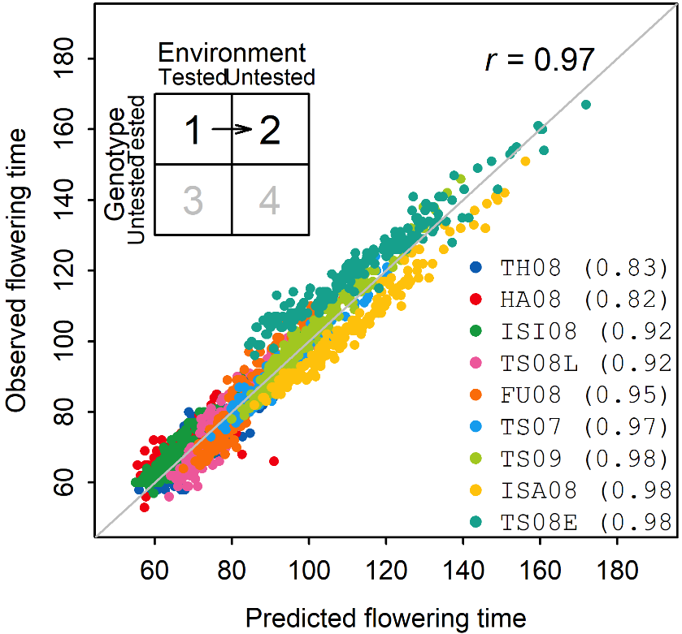
Output
Result_1.2.xlsx
Sheet1: observed and predicted values
Sheet2: within-environment correlations
obs | pre | col | envir
73 | 75.0363044 | #FF0000FF | TH_08
73.5 | 76.9592654 | #FF0000FF | TH_08
 | 75.9540756 | #FF0000FF | TH_08
 | 71.4629566 | #FF0000FF | TH_08
 | 79.8107959 | #FF0000FF | TH_08
65 | 72.039951 | #FF0000FF | TH_08
59 | 60.3089918 | #FF0000FF | TH_08
61.5 | 65.106213 | #FF0000FF | TH_08
71.5 | 74.2217842 | #FF0000FF | TH_08
94.5 | 85.4415673 | #FF0000FF | TH_08
68 | 70.7423609 | #FF0000FF | TH_08
67.5 | 68.7594508 | #FF0000FF | TH_08
 | 61.7986939 | #FF0000FF | TH_08
68.5 | 71.9461731 | #FF0000FF | TH_08
 | 66.4399461 | #FF0000FF | TH_08
69 | 68.4287998 | #FF0000FF | TH_08
68 | 68.2061742 | #FF0000FF | TH_08
cor_within | envir
0.76443666 | TH_08
0.83443023 | ISI_08
0.70705124 | HA_08
0.83329821 | TS_08L
0.85789143 | FU_08
0.88056186 | TS_07
0.90366347 | TS_09
0.9045433 | ISA_08
0.90545575 | TS_08E
Sheet3: cross-environment correlations
0.94327176

