Slide 1
Genomic prediction

Slide 2
Question
 |  | Tested environments |  |  | Untested environments
 |  | E1 | E2 | E3 | … | En-1 | En
Tested genotypes | G1
 | G2
 | G3
Untested genotypes | …
 | Gm-1
 | Gm
1
2
3
4
Genotype/Phenotype/Environment

Slide 3
Inputs
File1: 9Env_meta_table is for splitting environments, such as
leave-one-environment out prediction or first-year-predicting-next-year.
File2: FTdap_envMeanPara_9_50 is for connecting tested environments and untested environments with environmental index.
File3: LbE_table includes phenotypes in all environments.
File4: Genotype includes all the marker information.

Slide 4
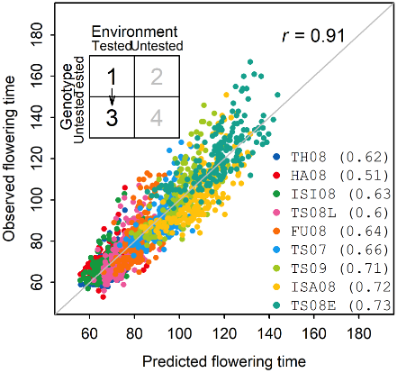
Outputs
Result_Norm_1.3.xlsx
Result_Marker_1.3.xlsx
Sheet1: observed and predicted values
Sheet2: within-environment correlations
obs | pre | col | envir
68 | 67.1531921 | #FF0000FF | TH_08
 | 66.0329745 | #FF0000FF | TH_08
61.5 | 64.1210025 | #FF0000FF | TH_08
65 | 65.8998448 | #FF0000FF | TH_08
81 | 68.8715452 | #FF0000FF | TH_08
63 | 64.9274848 | #FF0000FF | TH_08
59 | 63.2828874 | #FF0000FF | TH_08
60.5 | 61.9519639 | #FF0000FF | TH_08
 | 75.033167 | #FF0000FF | TH_08
60 | 63.0290403 | #FF0000FF | TH_08
 | 69.3529778 | #FF0000FF | TH_08
61.5 | 62.3911136 | #FF0000FF | TH_08
71 | 71.1097683 | #FF0000FF | TH_08
62 | 66.4660182 | #FF0000FF | TH_08
TH_08 | ISI_08 | HA_08 | TS_08L
0.58465456 | 0.60863054 | 0.4930379 | 0.58803919
0.5879116 | 0.59625197 | 0.49295375 | 0.59148198
0.59839995 | 0.61680452 | 0.50422204 | 0.58343983
0.61026471 | 0.62099609 | 0.50550264 | 0.59856801
0.60706563 | 0.62283714 | 0.49938152 | 0.57392418
0.63360587 | 0.64361488 | 0.53015244 | 0.60926163
0.61385206 | 0.62406782 | 0.50938783 | 0.59130455
0.58862493 | 0.60628174 | 0.48157881 | 0.60377245
0.58951268 | 0.59765703 | 0.48124306 | 0.57392931
0.59863377 | 0.6151823 | 0.50121052 | 0.582743
Sheet3: cross-environment correlations
0.91128732
0.90866222
0.90687947
0.90764283
0.9038953
0.9105609
0.90650617
0.9104335
0.90732033
0.90838538

