Slide 1
CERIS-JGRA prediction: site-specific, in-season, on-target, whole-genome, simple-straightforward

Slide 2
Question
How does CERIS-JGRA prediction work for next years?
Are the prediction results in next years accurate and on-target?

Slide 3
Inputs
File1: Envir_Index.txt includes values of environmental index in the training environments and next years environments. The environmental index values in next years environments are collected in seasons.
File2: Phenotype.txt includes phenotypes in training environments.
File3: Observed flowering time_2015.txt
File4: Observed flowering time_2016.txt

Slide 4
Output
Observed flowering time
Predicted flowering time

Slide 5
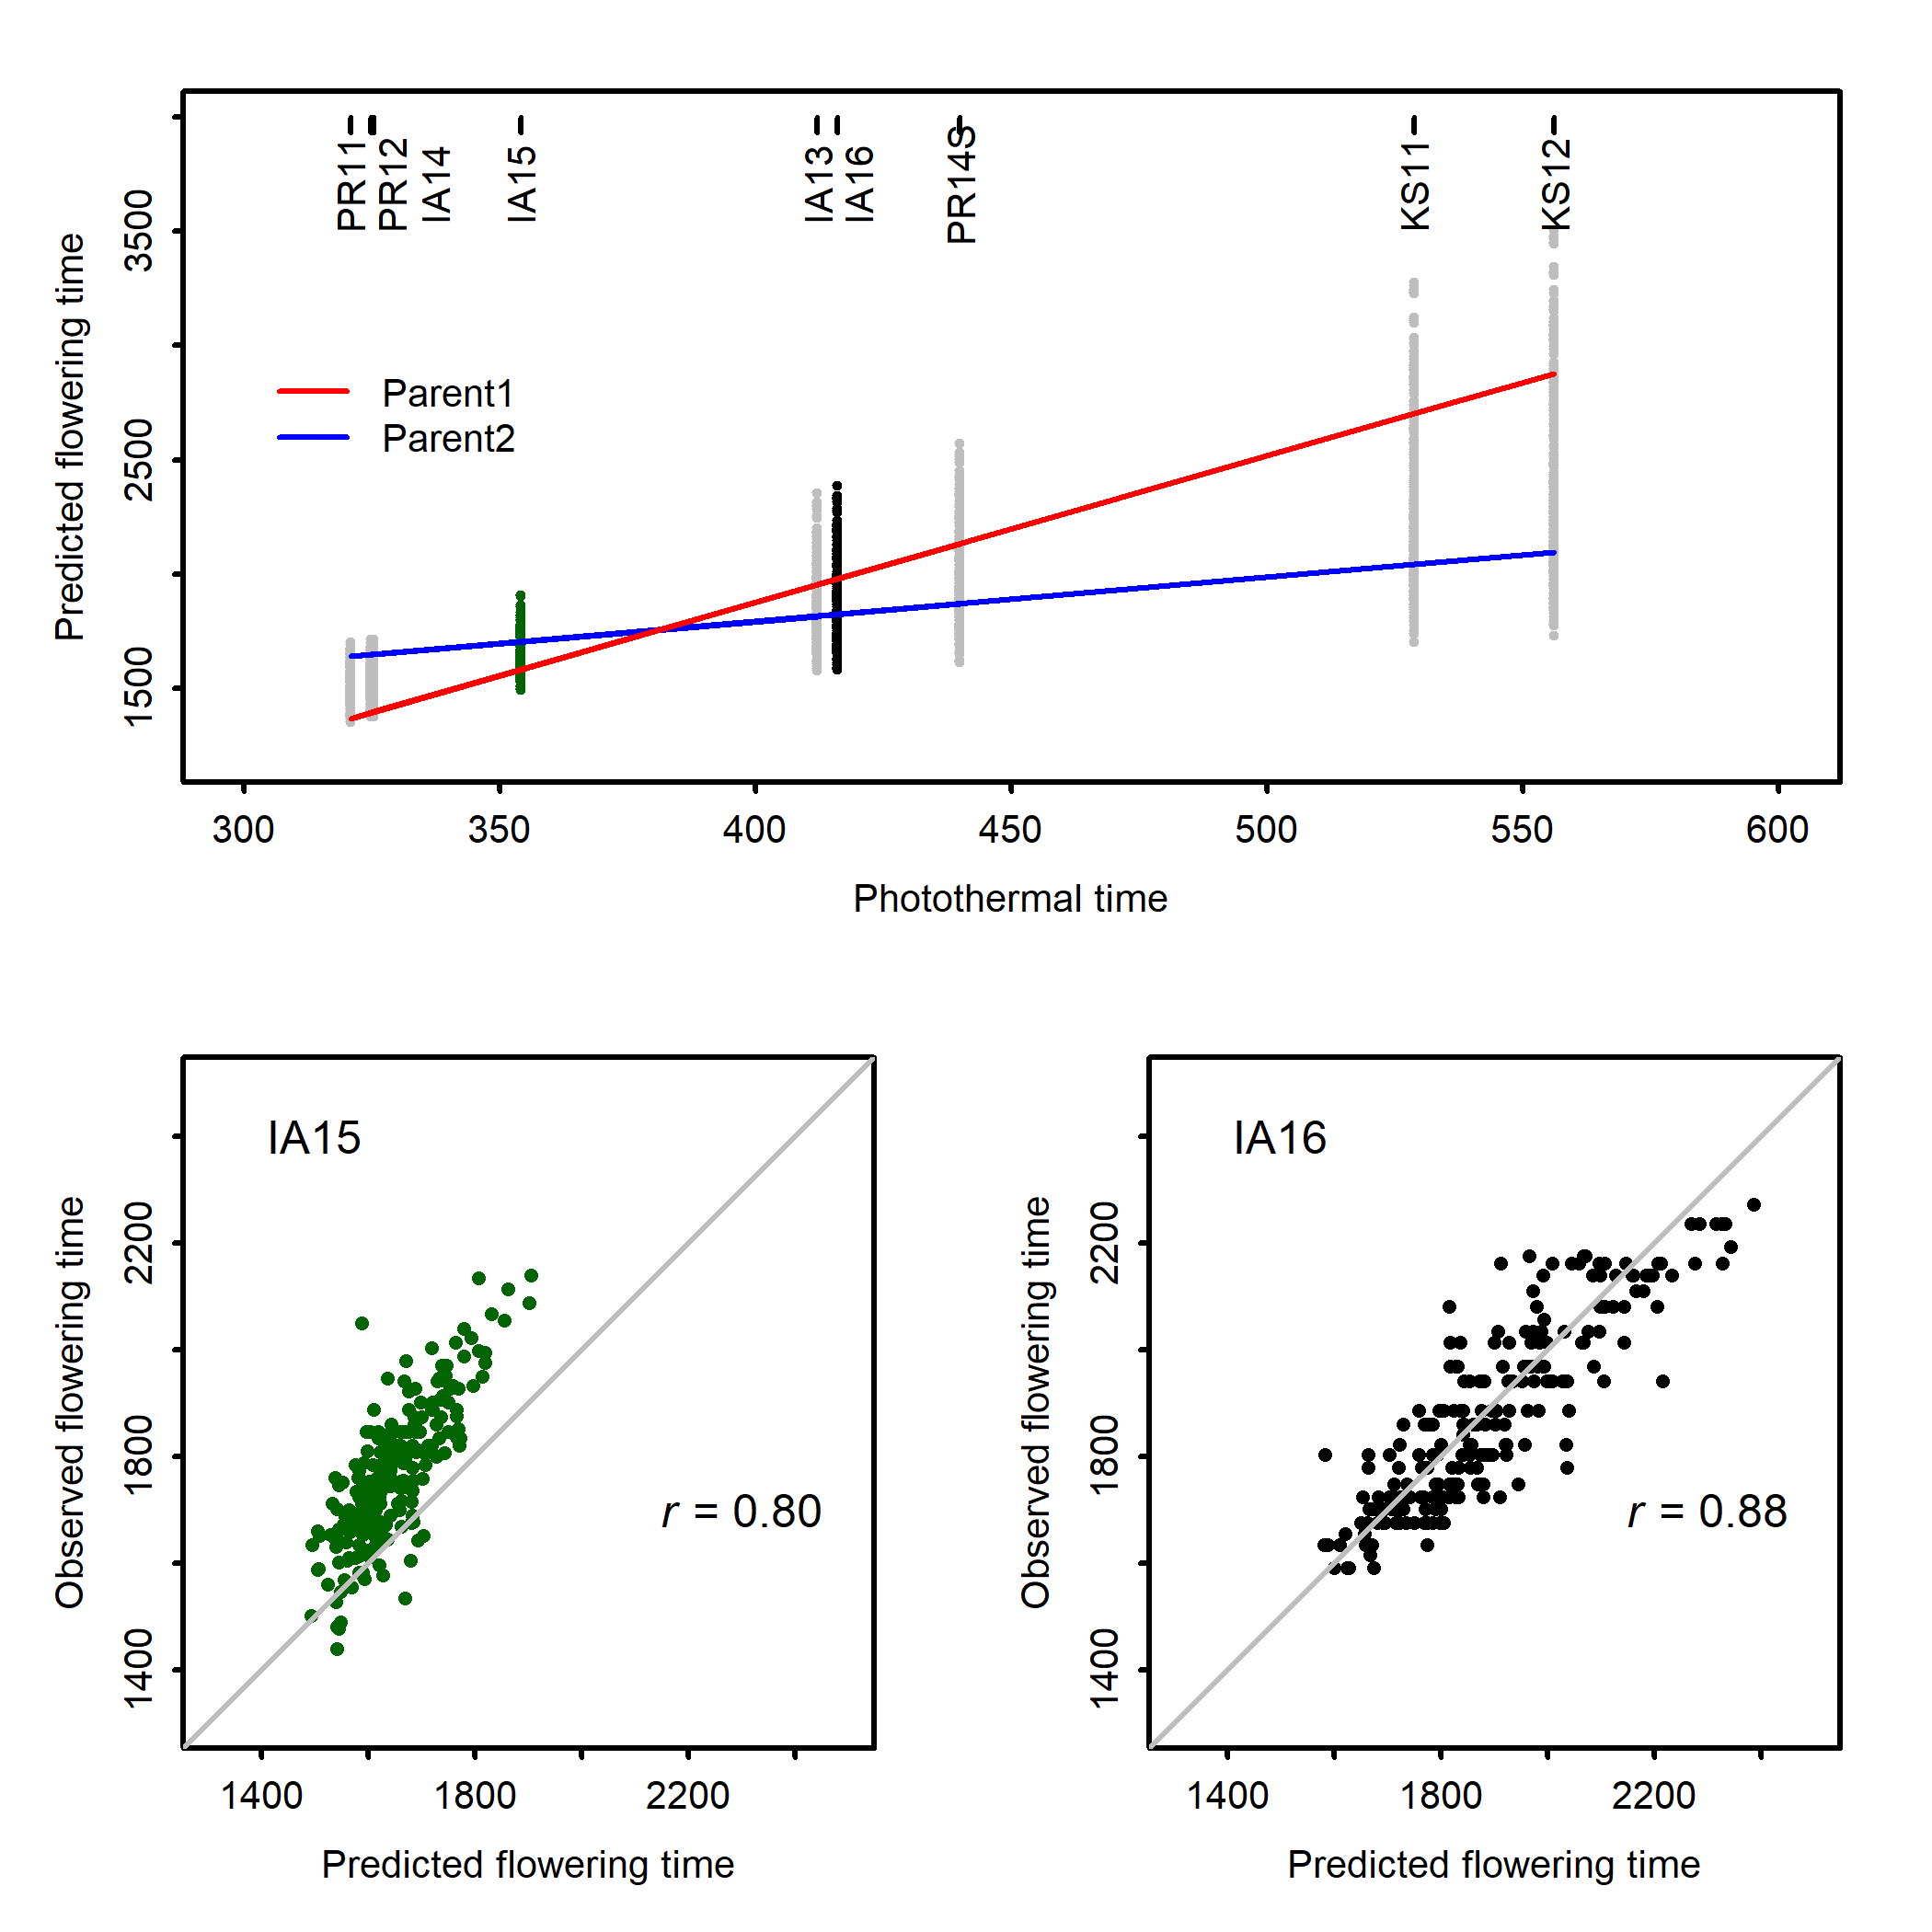
Outputs

Slide 6
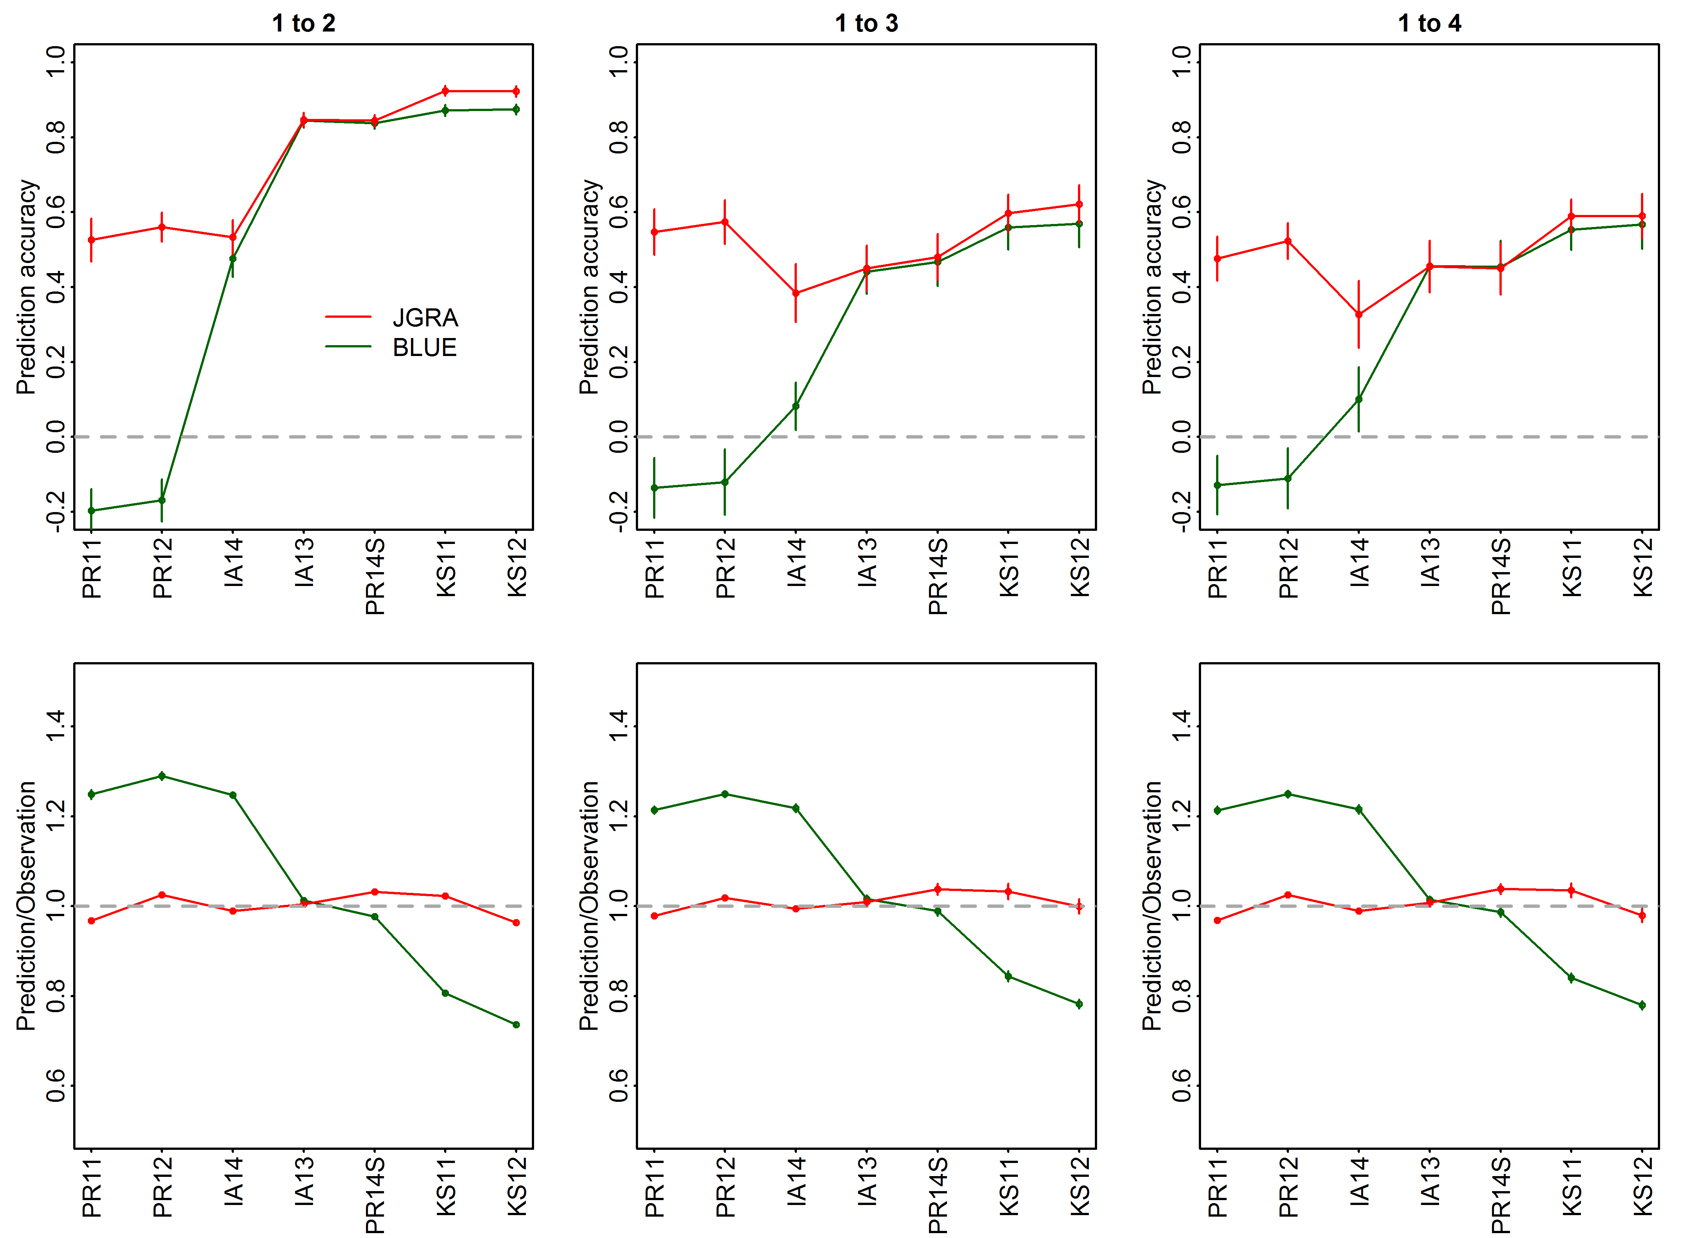
Outputs

