Slide 1
JGRA: Joint genomic regression analysis

Slide 2
Question
 |  | Tested environments |  |  | Untested environments
 |  | E1 | E2 | E3 | … | En-1 | En
Tested genotypes | G1
 | G2
 | G3
Untested genotypes | …
 | Gm-1
 | Gm
1
2
3
4
Genotype/Phenotype/Environment

Slide 3
Inputs
File1: 9Env_meta_table is for splitting environments, such as
leave-one-environment out prediction or first-year-predicting-next-year.
File2: FTdap_envMeanPara_9_50 is for connecting tested environments and untested environments with environmental index.
File3: LbE_table includes phenotypes in all environments.
File4: Genotype includes all the marker information.

Slide 4
Outputs
Result_Norm_1.4.xlsx
Result_Marker_1.4.xlsx
Sheet1: observed and predicted values
Sheet2: within-environment correlations
TH_08 | ISI_08 | HA_08 | TS_08L
0.5922543 | 0.58502262 | 0.49866311 | 0.56156917
0.56937525 | 0.59267775 | 0.49358454 | 0.55625184
0.57859655 | 0.58618999 | 0.50418934 | 0.54753363
0.57343453 | 0.60134387 | 0.51063541 | 0.57551005
0.5597082 | 0.6120975 | 0.48913177 | 0.58538108
0.54013422 | 0.57947093 | 0.46272215 | 0.5806409
0.53807079 | 0.61466729 | 0.49890345 | 0.58467227
0.56321317 | 0.61336951 | 0.49009302 | 0.55965896
0.55737166 | 0.59994184 | 0.48496027 | 0.55898164
0.55227558 | 0.59354457 | 0.47690906 | 0.58583055
obs | pre | col | envir
94.5 | 75.3209255 | #FF0000FF | TH_08
74 | 67.5930014 | #FF0000FF | TH_08
 | 63.686181 | #FF0000FF | TH_08
74.5 | 79.1822116 | #FF0000FF | TH_08
60 | 65.3212178 | #FF0000FF | TH_08
65 | 65.7135997 | #FF0000FF | TH_08
 | 62.3981 | #FF0000FF | TH_08
63.5 | 70.2530136 | #FF0000FF | TH_08
76 | 69.4166379 | #FF0000FF | TH_08
58 | 66.1592338 | #FF0000FF | TH_08
62 | 65.2693687 | #FF0000FF | TH_08
 | 77.7170811 | #FF0000FF | TH_08
67.5 | 68.5139447 | #FF0000FF | TH_08
61.5 | 63.7813 | #FF0000FF | TH_08
60.5 | 62.8496444 | #FF0000FF | TH_08
79.5 | 74.4554519 | #FF0000FF | TH_08
66 | 75.0362063 | #FF0000FF | TH_08
73 | 76.1865975 | #FF0000FF | TH_08
59 | 59.4692132 | #FF0000FF | TH_08
65 | 73.0611287 | #FF0000FF | TH_08
90 | 72.8784189 | #FF0000FF | TH_08
67.5 | 64.6237371 | #FF0000FF | TH_08
73 | 77.946755 | #FF0000FF | TH_08
 | 75.5999944 | #FF0000FF | TH_08
Sheet3: cross-environment correlations
0.89425241
0.89607746
0.89584814
0.89610903
0.8954539
0.89357916
0.89534225
0.89665394
0.89628508
0.89578465

Slide 5
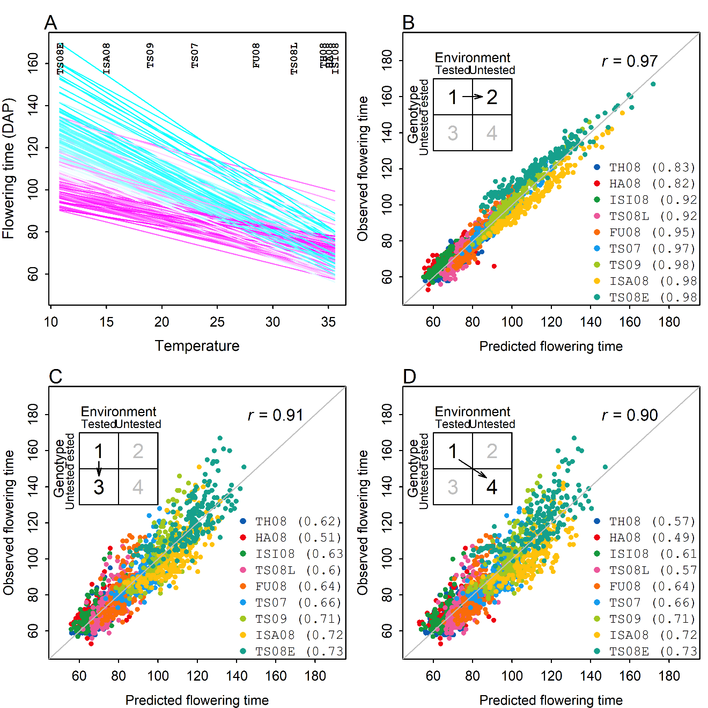
Outputs

Slide 6
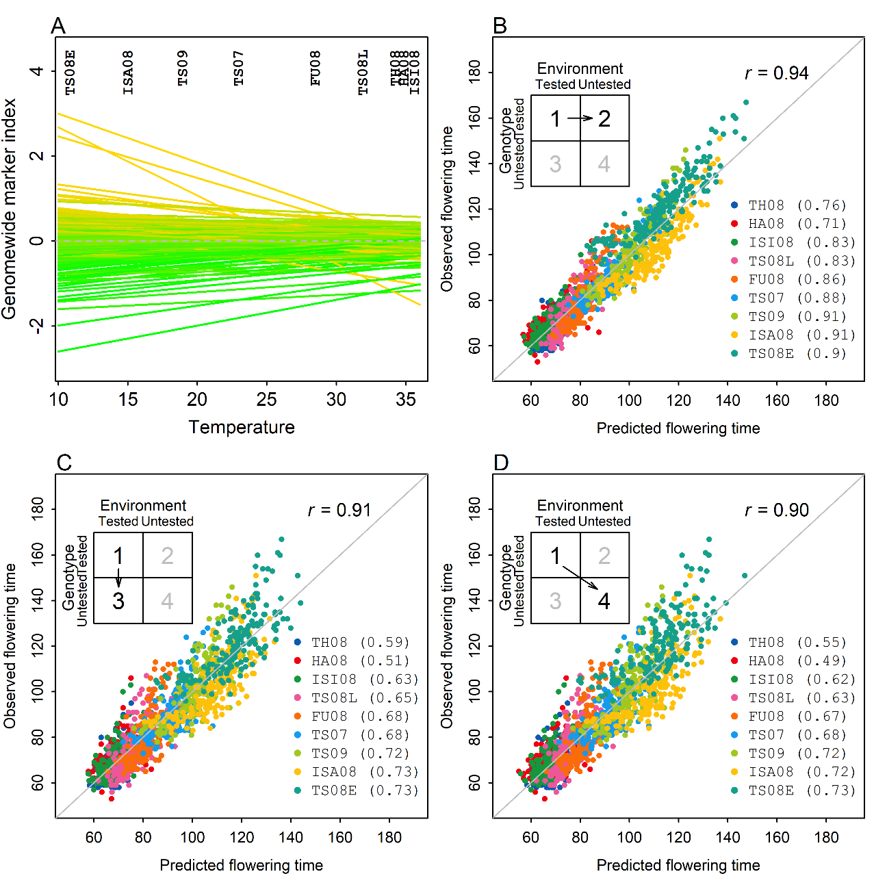
Outputs

