Slide 1
AI-Researcher agent
Presented By : Abhishek Sandhu
Reg. No. : 12200208

Slide 2
Problem Statement
Manual research is time-consuming
Finding papers is difficult
Formatting is complex
No automation in traditional workflow

Slide 3
Project Objective
Automated research system
Paper fetching from arXiv
PDF understanding
Research paper generation
LaTeX to PDF output

Slide 4
System Overview
User inputs topic
AI Agent processes
Papers fetched from arXiv
PDF read and summarized
Final paper generated

Slide 5
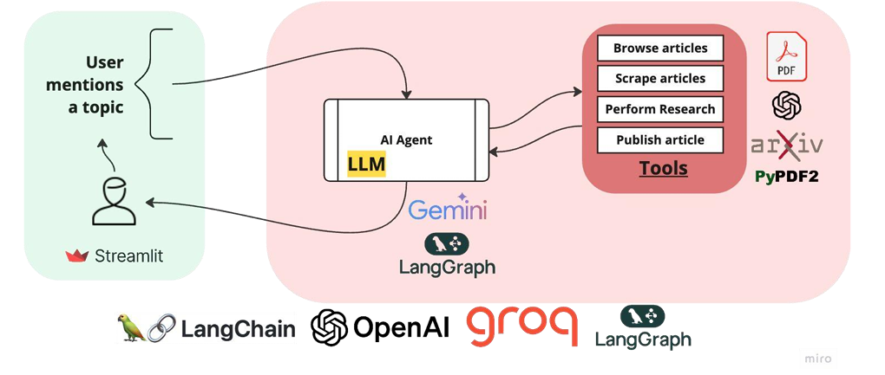
Architecture

Slide 6
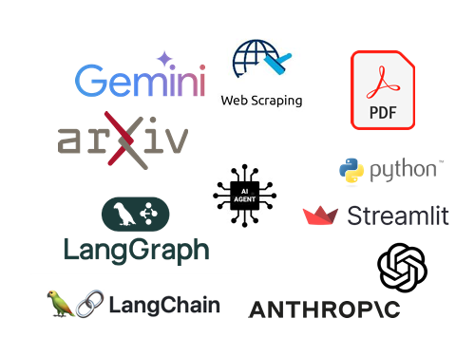
Technologies Used
Python
Streamlit
LangChain
LangGraph
arXiv API
PyPDF2
Tectonic
LLM via OpenRouter

Slide 7
Tools Implemented
arXiv Search Tool
PDF Reader Tool
LaTeX Writer Tool
AI Research Agent

Slide 8
User Interface
Chat system
Topic-based research
Live PDF Preview
Automatic Document Creation

Slide 9
Applications
Students
Researchers
Professors
Literature review
Research automation

Slide 10
Conclusion
Faster research
Better automation
Accurate papers
Improved productivity
Future: Cloud & multi-paper support

