Slide 1
Image Super-Resolution Using Deep Convolutional Networks
Presented by
Bairi Sandhya Rani

Slide 2
Introduction
In this paper, a single image super resolution using deep learning method is proposed.
This method learns an end-to-end mapping between the low/high-resolution images.
The mapping is represented as a deep convolutional neural network (CNN) that takes the low-resolution image as the input and outputs the high-resolution one.
Establishes a relationship between deep-learning-based SR method and traditional sparse-coding-based SR method.

Slide 3
Sparse-Coding based method
One of the representative external example-based SR methods.
First, overlapping patches are densely cropped from the input image and pre-processed (e.g., subtracting mean and normalization).
These patches are then encoded by a low resolution dictionary.
The sparse coefficients are passed into a high-resolution dictionary for reconstructing high resolution image.
The overlapping reconstructed patches are aggregated (e.g., by weighted averaging) to produce the final output.

Slide 4
CNN Method
Doesn’t explicitly learn dictionaries or manifolds for patching space
Implicitly achieved via hidden layers Original / PSNR Bicubic / 24.04 dB
Simple and superiorly accurate
Fully feed-forward network
SRCNN surpasses Bicubic baseline
with few training iterations
Outperforms SC based method with
moderate training
SC / 25.58 dB SRCNN / 27.95 dB

Slide 5
n1 feature maps of low-resolution image, n2 feature maps of high-resolution image
Low resolution High resolution
Image (Input ) image (Output)
Patch extraction Non-linear mapping Reconstruction
and representation
Given an image Y, first convolutional layer of the SRCNN extracts a set of feature maps
The second layer maps these feature maps nonlinearly to high-resolution patch representations.
The last layer combines the predictions within a spatial neighborhood to produce the final high-resolution image F(Y).

Slide 6
Formulation of SRCNN
A single low-resolution image is up scaled to the desired size using bicubic interpolation and denote the interpolated image as Y.
Patch extraction and representation
extracts (overlapping) patches from the low-resolution image Y and represents each patch as a high dimensional vector. These vectors comprise a set of feature maps, of which the number equals to the dimensionality of the vectors.
our first layer is expressed as an operation F1:
F1(Y) = max(0,W1*Y+B1)
where W1 = filters, B1 = biases, * = convolutional operation
W1 corresponds to n1 filters of support cXf1Xf1; c= no. of channels in the input image, f1= spatial size of a filter

Slide 7
Non-linear mapping
nonlinearly maps each high-dimensional vector onto another high dimensional vector. Each mapped vector is conceptually the representation of a high-resolution patch. These vectors comprise another set of feature maps.
The operation of the second layer is:
F2(Y) = max(0,W2*F1(Y)+B12)
Here W2 contains n2 filters of size n1Xf2Xf2, and B2 is n2-dimensional. Each of the output n2-dimensional vectors is conceptually a representation of a high-resolution patch that will be used for reconstruction.

Slide 8
Reconstruction
aggregates the above high-resolution patch-wise representations to generate the final high-resolution image. This image is expected to be similar to the ground truth X.
convolutional layer defined to produce final high-resolution image is,
F(Y) = W3* F2(Y)+B3
Here W3 corresponds to c filters of a size n2Xf3Xf3, and B3 is a c-dimensional vector.

Slide 9
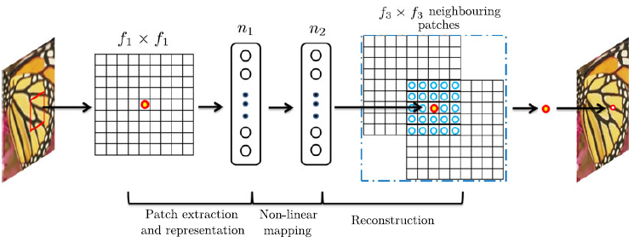
Sparse-Coding-Based method in view of CNN
An f1Xf1 low-resolution patch is extracted from the input image. Then the sparse coding solver will first project the patch onto a (low-resolution) dictionary.
If the dictionary size is n1, this is equivalent to applying n1 linear filters (f1X f1) on the input image ( the left part of above fig )

Slide 10
The sparse coding solver will then iteratively process the n1 coefficients. The outputs of this solver are n2 coefficients, and n2 = n1 in the case of sparse coding.
These n2 coefficients are the representation of the high-resolution patch.
In this sense, the sparse coding solver behaves as a special case of a non-linear mapping operator, whose spatial support is 1 X 1 ( the middle part of figure )
The sparse coding solver is not feed forward, it is an iterative algorithm.
On the contrary, our non-linear operator is fully feed forward and can be computed efficiently.

Slide 11
The above n2 coefficients (after sparse coding) are then projected onto another (high-resolution) dictionary to produce a high-resolution patch.
The overlapping high-resolution patches are then averaged. This is equivalent to linear convolutions on the n2 feature maps.
If the high-resolution patches used for reconstruction are of size f3X f3, then the linear filters have an equivalent spatial support of size f3 Xf3 ( right part of the figure )
In convolutional neural network, the low-resolution dictionary, high-resolution dictionary, non-linear mapping, together with mean subtraction and averaging, are all involved in the filters to be optimized.

Slide 12

Training
Learning the end-to-end mapping function F requires the estimation of network parameters like Θ={W1,W2,W3,B1,B2,B3}.
This is achieved through minimizing the loss between the reconstructed images F(Y;Θ) and the corresponding ground truth high-resolution images X.
Given a set of high-resolution images {Xi} and their corresponding low-resolution images {Yi}, we use mean squared error (MSE) as the loss function:
where n = no. of training samples
The loss is minimized using stochastic gradient descent with the standard backpropagation.

Slide 13

Weight matrices are updated as,
Where l Є {1,2,3} and i are the indices of the layers and iterations, η is the learning rate and finally the derivative.
The learning rate is 10⁻⁴ for the first two layers, and 10⁻⁵ for the last layer.
A smaller learning rate in the last layer is important for the network to converge
fixed image size in training
convolutional neural network can be applied on images of arbitrary sizes during testing.

Slide 14
Training Data
Initially, super-resolution is only applied on the luminance channel (Y channel in YCbCr color space)
A relatively small training set that consists of 91 images, and a large training set that consists of 395,909 images from the ILSVRC 2013 ImageNet detection training partition, are used.
Set5 as the validation set.
Similar trend even for the larger Set14.
The upscaling factor is 3.
Sparse-coding-based method as the baseline, which achieves an average PSNR value of 31.42 dB

Slide 15
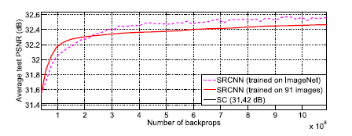
The test convergence curves of using different training sets are shown below
The no. of back props ( 8X10⁸ )and hence training times are same for both sets.
SRCNN+ImageNet achieves 32.52 dB, higher than 32.39 dB yielded by that trained on 91 images.
The results positively indicate that SRCNN performance may be further boosted using a larger training set(sometimes leads to high level vision problems).

Slide 16
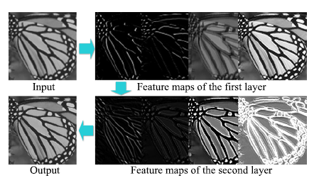
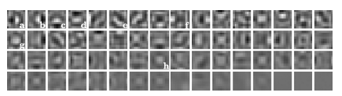
Learned filters for Super-Resolution
The figure (left) shows first-layer filters trained on ImageNet with an upscaling factor 3. The filters organized based on respective variances
Example feature maps of different layers are shown below(right). Obviously, feature maps of the first layer contain different structures (e.g., edges at different directions), while that of the second layer are mainly different on intensities.

Slide 17
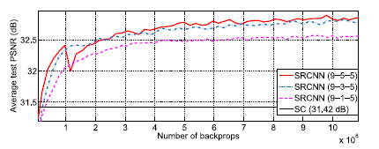
Model Performance and Tradeoffs
Filter number
Adding more filters improves the performance
Filter size
Larger filter size leads to better results
But deployment speed will decrease.
Number of layers
Deeper networks benefit but not always
CNN network here, contains no pooling layer or full-connected layer, thus it is sensitive to the initialization parameters and learning rate.
When we go deeper (e.g., four or five layers), we find it hard to set appropriate learning rates that guarantee convergence.

Slide 18
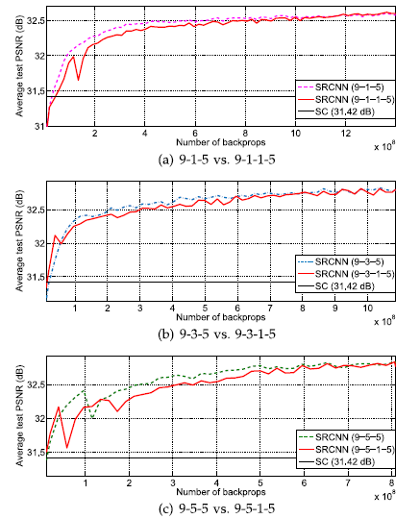
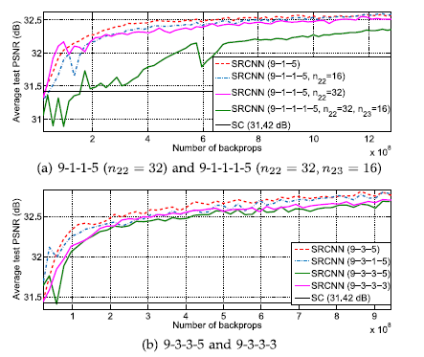
Why “deeper is not better” is still an open question, which requires investigations to better understand gradients and training dynamics in deep architectures.
Deeper structure does not always lead to better results.

Slide 19
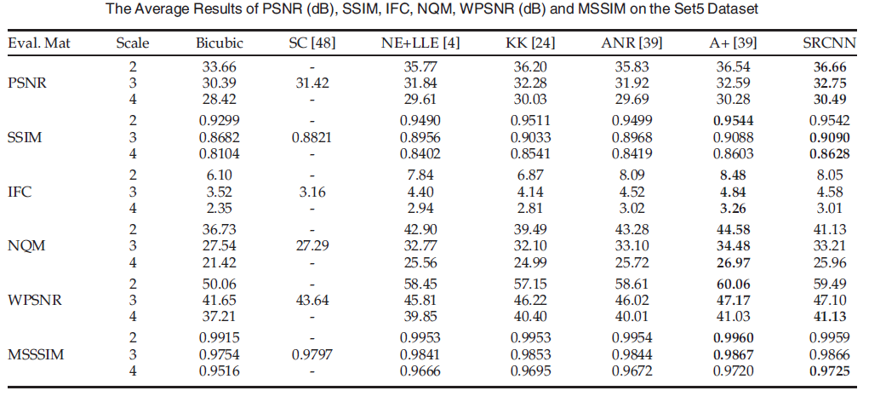
Comparison to state-of-the-arts
The proposed SRCNN yields the highest scores in most evaluation matrices in all experiments

Slide 20
Experiments on color channels
Super-resolution performance can be improved if we jointly consider all three channels in the process.
Y only: This is our baseline method, which is a single-channel (c = 1) network trained only on the luminance channel. The Cb, Cr channels are upscaled using bicubic interpolation.
YCbCr: Training is performed on the three channels of the YCbCr space.
Y pre-train: First, to guarantee the performance on the Y channel, we only use the MSE of the Y channel as the loss to pre-train the network. Then we employ the MSE of all channels to fine-tune the parameters.
CbCr pre-train: We use the MSE of the Cb, Cr channels as the loss to pre-train the network, then fine-tune the parameters on all channels.
RGB: Training is performed on the three channels of the RGB space.

Slide 21
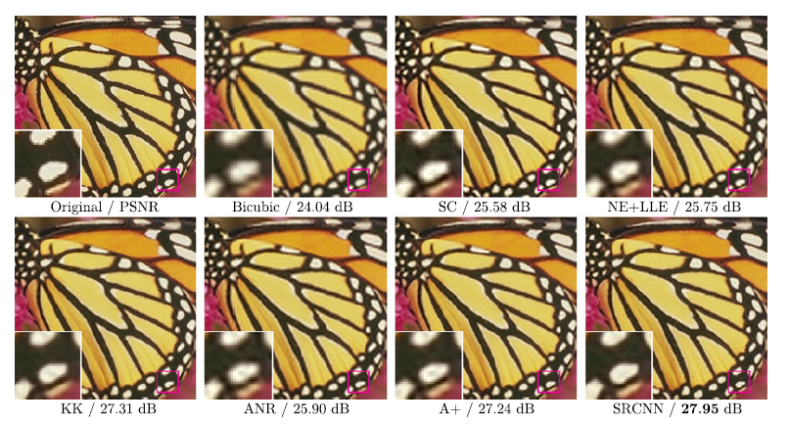
The “butterfly” image from Set5 with an upscaling factor 3.

Slide 22
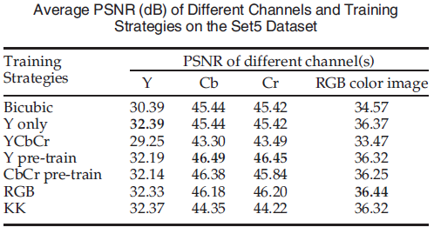
Results
Training on the YCbCr channels leads to worse results than that of bicubic interpolation.
Pre-training on the Y or Cb, Cr channels improves the performance finally, but is still not better than “Y only” on the color image.
Cb, Cr channels have higher PSNR values for “Y pre-train” than for “CbCr pretrain”.
Training on the RGB channels achieves the best result on the color image.

Slide 23
Conclusion
A novel deep learning approach for single image SR.
With a lightweight structure, the SRCNN has achieved superior performance than the state-of-the-art methods.
Additional performance can be further gained by exploring more filters and different training strategies.
Advantages of simplicity and robustness
Can be applied to other low-level vision problems like image deblurring or simultaneous SR+denoising.

Slide 24
THANK YOU

