Slide 1


K.RAMAKRISHNAN COLLEGE OF TECHNOLOGY (AUTONOMOUS), TRICHY
Identification of peninsular herbal plants using CNN
 | PRESENTED BY, BALA VAISHNAVI K (811721001004) FAHMITHA NASRIN S (811721001008) KEERTHANA S (811721001017) SANDHYA SHALINI S.M (811721001035)
GUIDED BY,
Mrs.M.A.REETHA JEYARANI M.E.,
ASSISTANT PROFESSOR/ AI
6/5/24
1

Slide 2
PRESENTATION OVERVIEW
Introduction
Problem Identification
Objective
Abstract
Literature Survey
Existing system
Disadvantages of existing system
Proposed system
Implementation model of proposed system
Explanation of proposed system
Advantages of proposed system
Results and Discussion
Conclusion
6/5/24
2

Slide 3
INTRODUCTION
This framework is mainly designed to identify the common and rare medicinal plants in Southern India to educate and provide correct knowledge .
For preparing Ayurvedic formulation or homemade medicines, the source of rare medicinal plants knowledge is essential.
Thus, a novel Autoencoder architecture using EfficientB4Net and CBAM has been proposed to retrieve and identify medicinal plants with the highest accuracy.
6/5/24
2

Slide 4
PROBLEM IDENTIFICATION
Define the objective
Collection of data
Preprocessing of the collected data
Labelling the data
Model selection and training
Evaluation and optimization
Deployment and continuous improvement
6/5/24
2

Slide 5
OBJECTIVE
The objective is to develop a robust Convolutional Neural Network (CNN) model for accurate identification of peninsular herbal plants. This involves compiling a high-quality, diverse dataset, addressing image variability and class imbalance, and preventing overfitting. By leveraging advanced techniques like transfer learning and model optimization, the goal is to create a reliable, interpretable, and efficient system for real-time plant identification in varying environmental conditions.
6/5/24
2

Slide 6
ABSTRACT
Plant species identification is essential for healthy survival as well as the preservation and protection of biodiversity. Manual identification is time-consuming, hence to address this issue deep learning algorithms for automated plant species identification have been developed. A Novel Architecture comprising of EfficientB4Net, Convolutional Block Attention Module (CBAM) and Residual Block Decoder is proposed to act as Autoencoder for identification and retrieval of twenty distinct groups of medicinal plants, widely available in southern India. When a query image is received, the encoded feature of the query image and the database images are compared using similarity measurement, and the related images are retrieved.
6/5/24
2

Slide 7
LITERATURE SURVEY
S.NO | TITLE | JOURNAL | AUTHOR | DESCRIPTION
1 | Identification of medicinal plant’s and their usage by using deep learning. | Proceedings of the Third International Conference on Trends in Electronics and Informatics (ICOEI 2019) IEEE Xplore Part Number: CFP19J32-ART; ISBN: 978-1-5386-9439-8. | C.Amuthalingeswaran,S.Alexpandi,J.Elamathi, Thiagarajar College Of Engineering Madurai, India. | With the availability of modern computing devices and technology, had built a model (Deep Neural Networks) for the identification of medicinal plants. To train the model, around 8,000 images belonging to four different classes used.
2 | Identification and retrieval of medicinal plants of Southern India using EfficientB4Net. | Journal of Intelligent & Fuzzy Systems 42 (2022) 5097–5112 DOI:10.3233/JIFS-211426 IOS Press | K. Umaa,∗, B. Sathya Bamaa, D. Sabarinathanb and S. Md. Mansoor Roomia aThiagarajar College of Engineering, Thiruparankundram, Madurai, India bCougerInc, Tokyo, Japan | A Novel Architecture comprising of EfficientB4Net, Convolutional Block Attention Module (CBAM) and Residual Block Decoder is proposed to act as Autoencoder for identification and retrieval of twenty distinct groups of medicinal plants, widely available in southern India.
3 | Medicinal Plant identification in the wild by using CNN | 978-1-7281-6758-9/20 ©2020 IEEE | 1st Trung Nguyen Quoc Faculty of Information Technology Ho Chi Minh Open Universty, VietNam trungnq.188i@ou.edu.vn | Vietnamese medicinal plant images in this paper. Different frameworks are evaluated such as: VGG16, Resnet50, InceptionV3, DenseNet121, Xception and MobileNet.
6/5/24
2

Slide 8
EXISTING SYSTEM
Generally, plants are identified by their physical properties such as shape, texture, veins, and color using different texture-based methods.
Conventional methods such as Fuzzy Integral Method [1], Gray Level Co-occurrence Matrix (GLCM) [2], K-Nearest Neighbor (KNN) [3], color Histogram, SHIFT, and Gabor wavelets [4] have been used for plant identification.
But the performance of the methods is affected to a great extent by selecting features.
A large semantic gap exists between the understanding of visual information perceived by computers when compared with humans. The bridging of this semantic gap is still a challenging task
6/5/24
2

Slide 9
DISVANTAGES OF PROPOSED SYSTEM
Computational complexity
Long training period
Overfitting risk
Implementation complexity
Data dependency
Potential redudancy
6/5/24
2

Slide 10
PROPOSED SYSTEM
The proposed Autoencoder model has been designed with EfficientB4Net for retrieving similar images to identify the plant from the medicinal plant database.
The model consists of five layers, in which each layer has an EfficientB4block, Convolutional layer, and pooling layer.
The Autoencoder includes the CBAM block with the EfficientB4Net which sequentially observes the channel and spatial attention maps in both the dimensions and adds them with the input features for adaptive plant feature refinement.
Following the encoding phase the decoder phase consist of a residual block to upsample the compressed features.
Introducing Residual units in the network solves the degradation problem and also helps in extracting the maximum local feature through densely connected convolution layers.
6/5/24
2

Slide 11
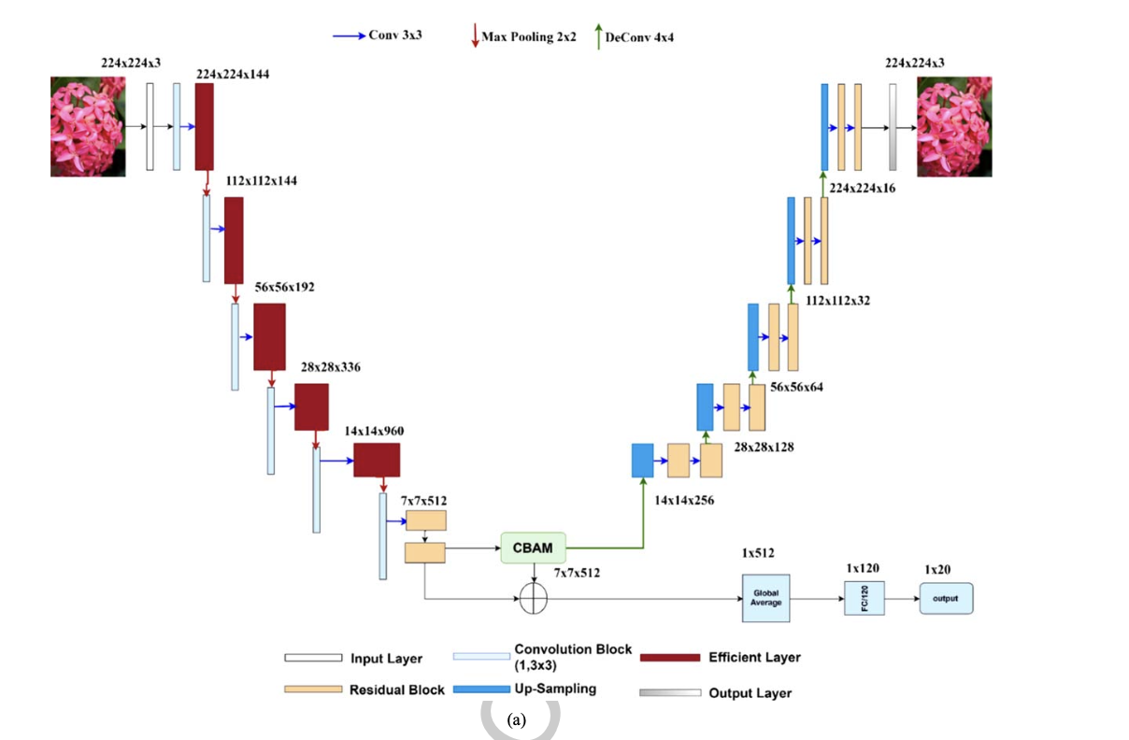
IMPLEMENTATION MODEL
(a) Training Stage
6/5/24
2

Slide 12
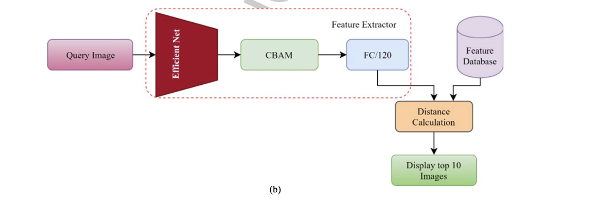
IMPLEMENTATION MODEL
(b) Testing Stage
6/5/24
2

Slide 13
EXPLANATION OF PROPOSED SYSTEM
Proposed Autoencoder model uses EfficientB4Net for image retrieval in medicinal plant database.
Model has 5 layers with EfficientB4block, Convolutional layer, and pooling layer in each.
Utilizes CBAM block for channel and spatial attention maps, enhancing plant feature refinement.
Decoder phase includes residual block for upsampling compressed features.
Residual units tackle degradation problem, extracting maximum local features with densely connected convolution layers.
6/5/24
2

Slide 14
ADVANTAGES OF PROPOSED SYSTEM
Enhanced feature extraction
Improved model performance
Robust image retrieval
Efficient encoding and decoding
Adaptive and scalable
6/5/24
2

Slide 15
RESULTS AND DISCUSSIONS
Improved image retrieval accuracy
Effective feature refinement
Enhanced local feature extraction
Degradation problem mitigation
Robust performance
Future improvements
Potential applications
6/5/24
2

Slide 16
CONCLUSION
Deep learning has emerged as a dominating alternative to hand-designed features to learn the features automatically from the data.
Many researches have been carried out in classifying and retrieving the plant species.
Despite many efforts, plant identification is still a challenging and indeterminate problem.
Thus, a novel Autoencoder architecture using EfficientB4Net and CBAM has been proposed to retrieve and identify medicinal plants with the highest accuracy.
6/5/24
2

Slide 17
THANK YOU
6/5/24
17

