Slide 1

bgs institute of technology department of computer science and engineering a project mini-project on dual window implementation under the guidence of: Mr. Prasanna Kumar M J Mr.Harish .K.V Asst.prof Dept. of CSE Asst.prof Dept. of CSE

Slide 2
Contents
Abstract
Introduction to OpenGL
Overview of this project
System design
Implementation
Flow-chart analysis
Results
Conclusion and future enhancement

Slide 3
abstract
OpenGL is a software interface to a graphic hardware.
It consists of about 150 unique commands for the Implementation of 3D-objects.
The project “Dual window implementation” is implemented on a basic platform of OpenGL which is included in our curriculum.
Our project makes use of a library function called as GLUT.

Slide 4
Introduction
Open Graphics Library is abbreviated as OpenGL.
It is a software interface for graphics hardware.
This interface consists of several hundred functions that allows a graphics programmer produce high-quality color images of 2D-objects and 3D-objects.
OpenGL has many advantage like stable,evolving,well-documented etc.,

Slide 5
Overview
The main objective of this project is to implement the concept of dual window using objects.
Here using the menus , keyboard functions and mouse functions we operate this code’s output.
On running the program, two windows simultaneously appear having operations done in it.
On pressing the right mouse button, the various menu options appear.

Slide 6
design
Create the first window
Register the callback for first window
Create second window
Position the second window
Register the callback for second window
Register (shared)idle callback
Enter the main loop

Slide 7
Implementation
glut
glEnable,glDisable
glTranslatef
glRotatef
glPushMatrix
glutInitWindowSize/position
glutInitDisplayMode
glutCreateWindow
KeyboardFunc/MouseFunc
glAddMenuEntry
glutSwapBuffers
glutIdleFunc
glutPostRedisplay

Slide 8
Flowchart
start
A
Main()
Post_redispaly()
Display()
My_reshape()
Square_plate()
stop
Triangle_plate()
Pyramid()
Polygon()
Spin_cube()
MyMenu()
Mouse()
Keyboard()
A

Slide 9
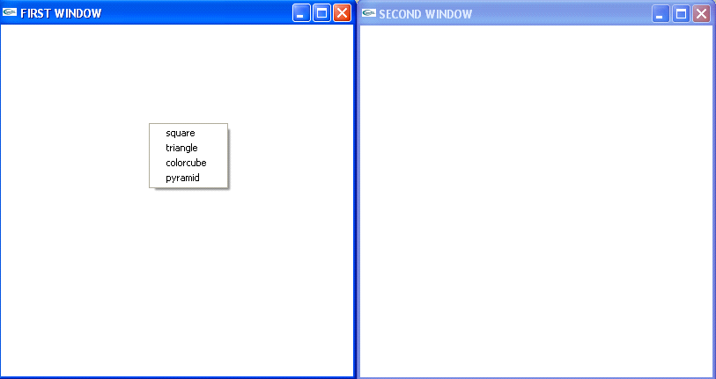
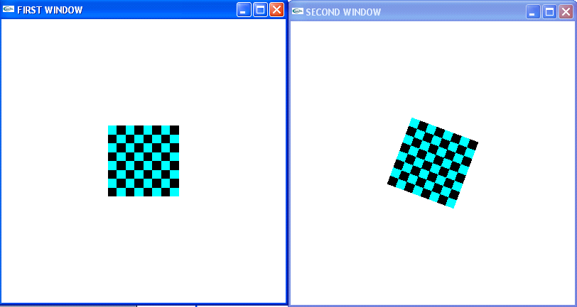
RESULTS AND SNAPSHOTS
Fig1:result options Fig2:Squareplate

Slide 10
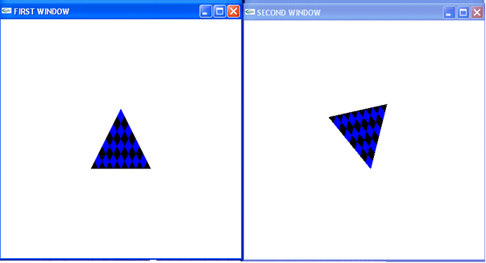
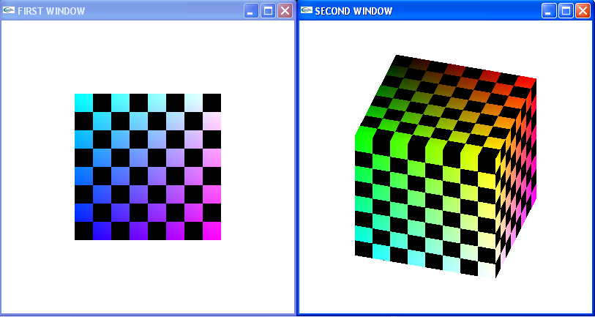
Fig3:triangleplate
Fig4:colorcubefig

Slide 11
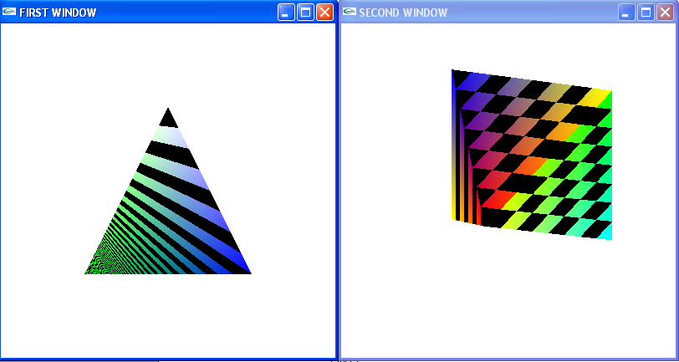
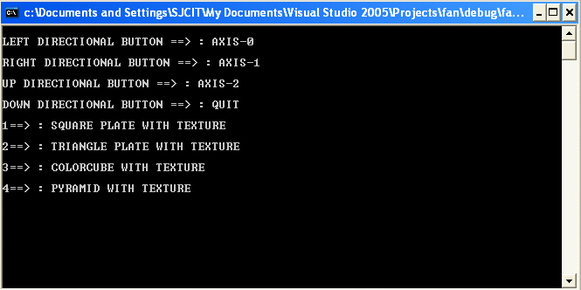
Fig5:pyramid fig6:comment screen

Slide 12
Conclusion
This project is developed using OpenGL.
The designed code incorporates all the basic properties that a simple program must posses.
The main aim of this project is to implement gear wheels by creating the gear wheels and applying rotation to the objects.

Slide 13
future enhancement
This project can be further enhanced in such a way that either both the windows can rotate the object that is chosen or the window selected can make the suitable rotations on the chosen object.
More number of objects can be included as per requirement.
The internal design of the object can also be varied.

Slide 14
REFERENCES
BOOKS
Edward Angel, "Interactive Computer Graphics", 5th edition, Pearson Education.
Jackie. L. Neider, Mark Warhol, Tom. R. Davis, "OpenGL Red Book", Second Revised Edition.
Donald D Hearn and M. Pauline Baker, "Computer Graphics with OpenGL",3rd Edition.
WEBSITES:
http://www.opengl.org
http://www.wikipedia.com
http://basic4gl.wikispaces.com
www.OpenGL.org/documantations
www.pudn.org

Slide 15
Thank you

