Slide 1
Golla Sandhya Rani
Final Project
3/21/2024 Annual Review

Slide 2
PROJECT TITLE
KEYLOGGER AND SECURITY
3/21/2024 Annual Review

Slide 3


AGENDA
Introduction
Problem Statement
Problem Overview
Who are the End users?
Your Solution and its Value Proposition
The Wow in your solution
Modelling
Result
3/21/2024 Annual Review

Slide 4
INTRODUCTION TO KEYLOGGER
Keylogger is a computer program that records every Keystroke made by a computer user, especially to gain fraudulent access to passwords and other confidential information.

Slide 5

PROBLEM STATEMENT
It's challenging to covertly install a hardware keylogger on another person's device
3/21/2024 Annual Review

Slide 6

PROJECT OVERVIEW
The keyloggers can be detected using antiviruses. Installation of hardware keyloggers is difficult without the knowledge of the owner of the system. The solution to the above existing problem is that we can build a software keyloggers instead of hardware keyloggers.
3/21/2024 Annual Review

Slide 7

WHO ARE THE END USERS?
Keyloggers are used in IT organizations to troubleshoot technical problems with computers and business networks. Families and businesspeople use keyloggers legally to monitor network usage without their users' direct knowledge.
3/21/2024 Annual Review

Slide 8

YOUR SOLUTION AND ITS VALUE PROPOSITION
The solution to the above existing problem is that we can build a software keyloggers instead of hardware keyloggers.
3/21/2024 Annual Review

Slide 9

THE WOW IN YOUR SOLUTION
Full Transparency.
Less Risk of Data Theft
Clearer Protection Against Liability
Better Password Access.
More Productivity.
Tougher Deterrent Against Phishing & Viruses.
3/21/2024 Annual Review
9

Slide 10
MODELLING
Before we start, we need to install Python and some libraries of Python in the system which can be installed by the commands in the command prompt(cmd).
pip install pynput
pip install jsons
Pynput helps in reading keystrokes as the user types in stuff Jsons is a later changing format that often exchanges data between a web server and user agent
* Initialization of keylogger :
Set up the main GUI window.
Initialize global variables for keylogging.
* Data Logging into text files :
Continuously update text and JSON log files with captured key events.
* Stop Logging :
Stop capturing key events when the "Stop" button is pressed.
Update the GUI status to indicate that the keylogger is stopped.
3/21/2024 Annual Review
10

Slide 11
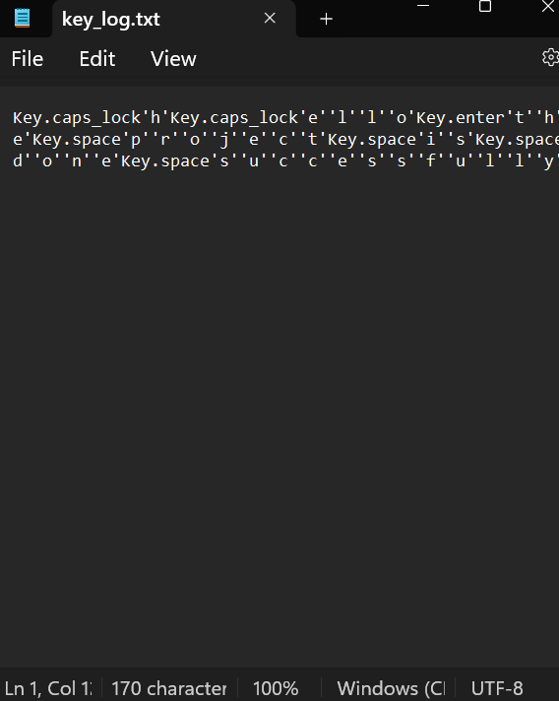
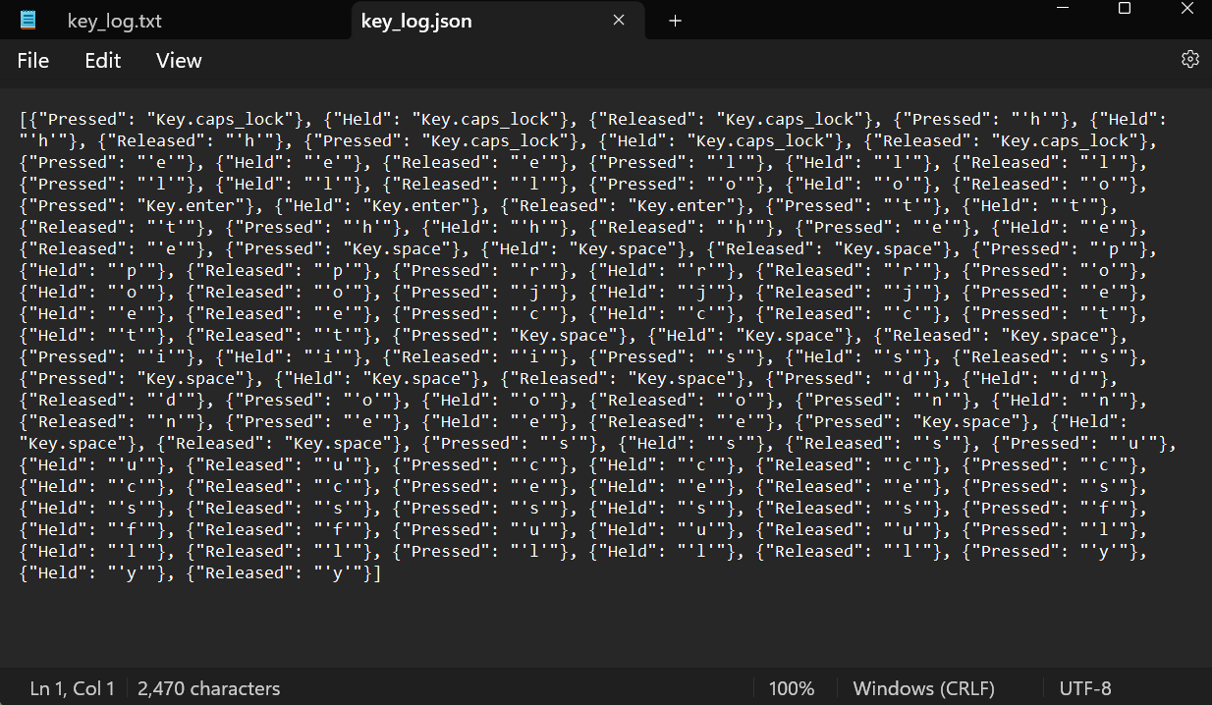
OUTPUTS

Slide 12

RESULTS
  As a result, when a key is pressed, Python will create a keylog.txt file with the list of keys pressed from when the script began running up to the last key pressed.
  If we leave the code like that, it will keep executing constantly. We will define a function consisting of some stop key or a combination of keys that will stop the key logger
  Real-time keylogging with start and stop functionality controlled via a simple GUI.
3/21/2024 Annual Review
12

Slide 13
PROJECY LINK
https://github.com/Sandhya-cs-cmd/Sandhya-project-.git

