Slide 1
Amazon Delivery Time Prediction
A Machine Learning Project
Domain: E-Commerce & Logistics
By: Sandhya Saroj

Slide 2
Problem Statement
Build a model to predict e-commerce delivery time using features like distance, time, and traffic to improve customer satisfaction and operational efficiency.

Slide 3
Project Objectives
- Analyze data
- Engineer features
- Train regression models
- Track with MLflow
- Deploy with Streamlit

Slide 4
Technologies Used
- Python, Pandas, NumPy
- Scikit-learn, XGBoost
- MLflow, Streamlit

Slide 5
Data Transformations
- Converted timestamps
- Calculated durations
- Engineered time-based & distance features
- Categorical encoding

Slide 6
Exploratory Data Analysis
- Found relation between distance & time
- Peak delays in evening hours
- Correlation analysis

Slide 7
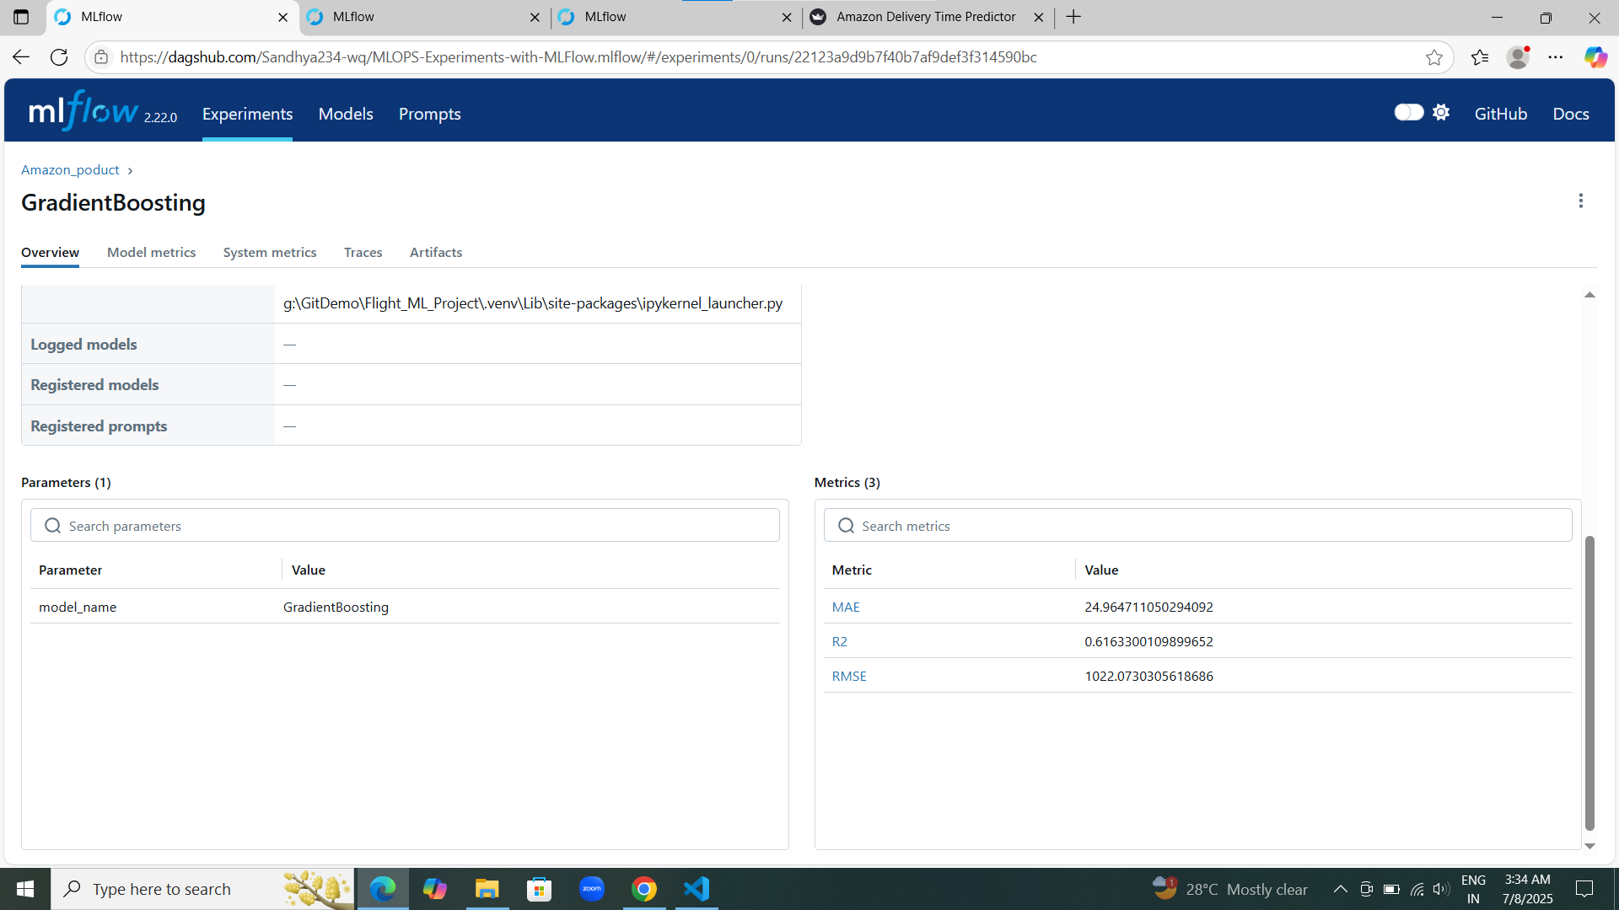
Linear Regression MLflow Metrics

Slide 8
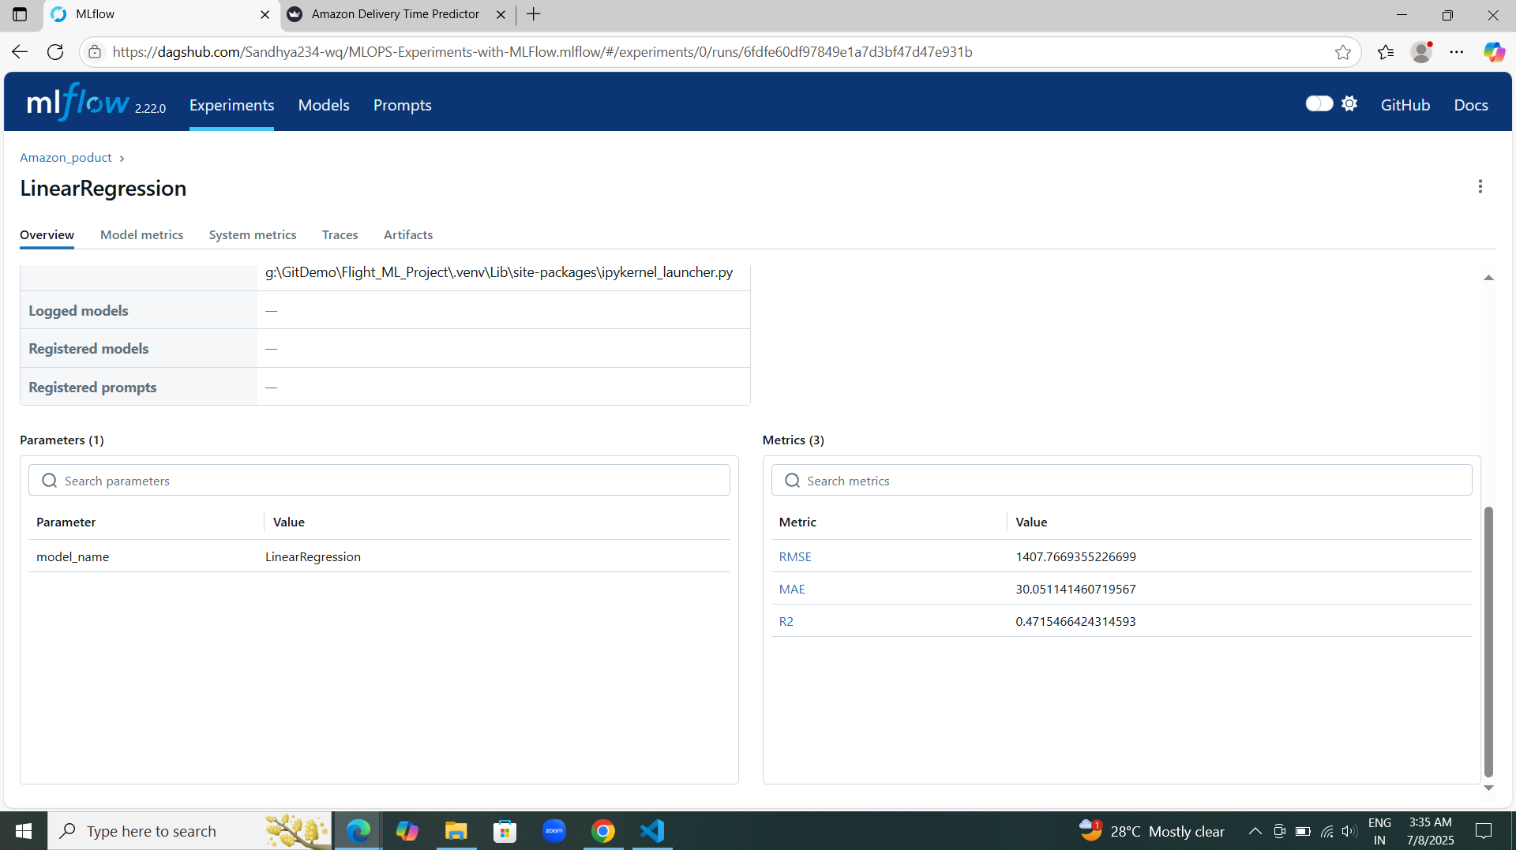
Gradient Boosting MLflow Metrics

Slide 9
MLflow Run Comparison

Slide 10
MLflow Tracking
- Logged models & metrics
- Compared multiple experiments

Slide 11
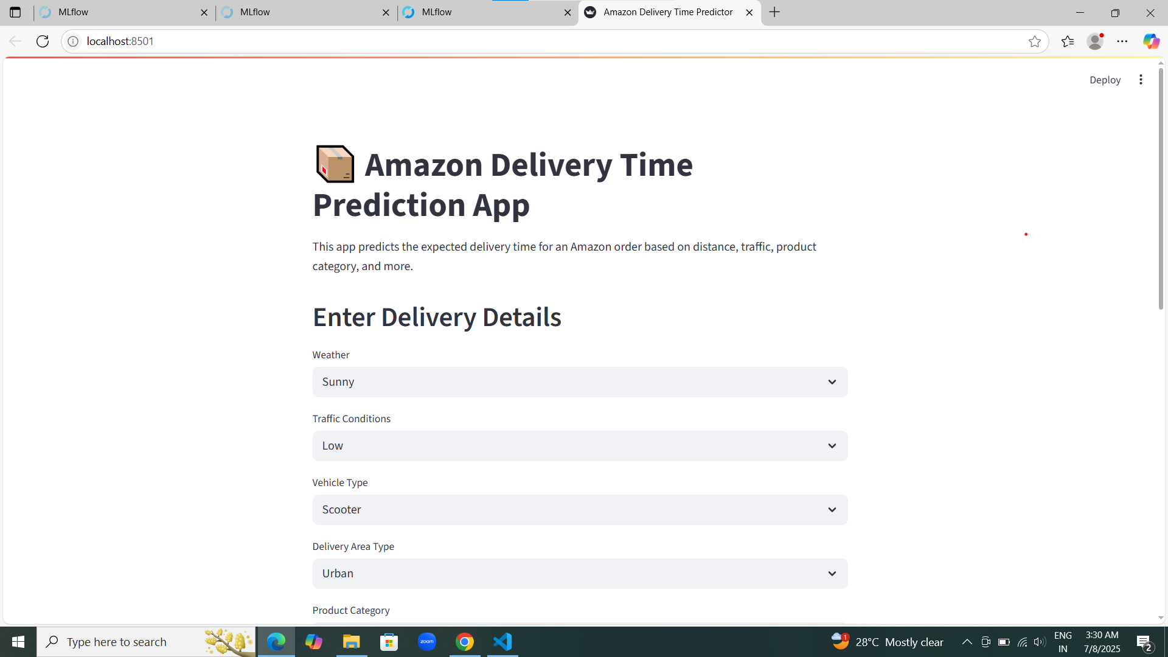
Streamlit App Interface

Slide 12
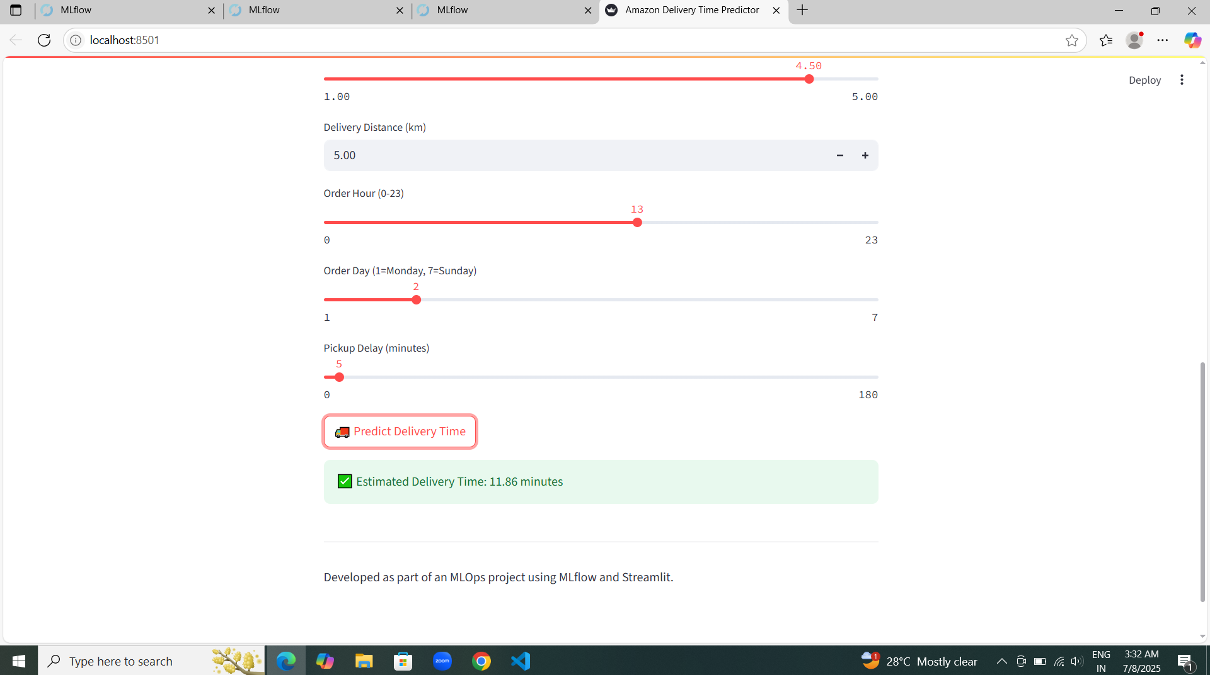
Prediction Output Screenshot

Slide 13
Streamlit App Summary
- User inputs order info
- App predicts delivery time
- Easy to deploy

Slide 14
Key Insights
- Delivery type & time affect results
- Distance strongly correlates with delay

Slide 15
Conclusion
- Accurate delivery prediction helps logistics
- Full ML pipeline implemented

Slide 16
Thank You
GitHub: https://github.com/Sandhya234-wq/Amazon-Delivery
By: Sandhya Saroj

