Slide 1
IMPLEMENTATION OF CENTRALIZED 2 PHASE LOCKING
Sandhya Arumugam Karunanithy

Slide 2
C2PL Short Overview
The 2PL algorithm (locking data items in 2 phases – growing phase for acquiring locks and shrinking phase for releasing locks) can easily be extended to the distributed DBMS environment.
One way of doing this is to delegate lock management responsibility to a single site only.
This means that only one of the sites has a lock manager; the transaction managers at the other sites communicate with it rather than with their own lock managers.
This approach is also known as the primary site 2PL algorithm.

Slide 3
Components in Implementation
COMPONENTS | FUNCTION
DATA SITE | 4 different datasite each with its own individual copies of DB; Data site acts as an orchestrator in our process
CENTRAL SITE | Central site is the one which assigns id to data site and also manages acquirement and release of locks
DATA HANDLER | Makes connection with database and does load and store functions, retrieval and updates to database happens via this
FILE UTIL | This is through which the input set of transactions is read for the data sites
LOCK HANDLER | Lock handler maintains lock table and queue for transactions waiting to acquire lock on data items
DEADLOCK DETECTOR | This is a graph helper through which deadlock is detected. This is implemented using Depth first search and finding cycles in a graph using DFS
REGISTRY | This is required in Java for making communication between data site and central site over a network
LOG FILE | This is where the trace of execution of the whole process is stored for each operation of the transaction.

Slide 4
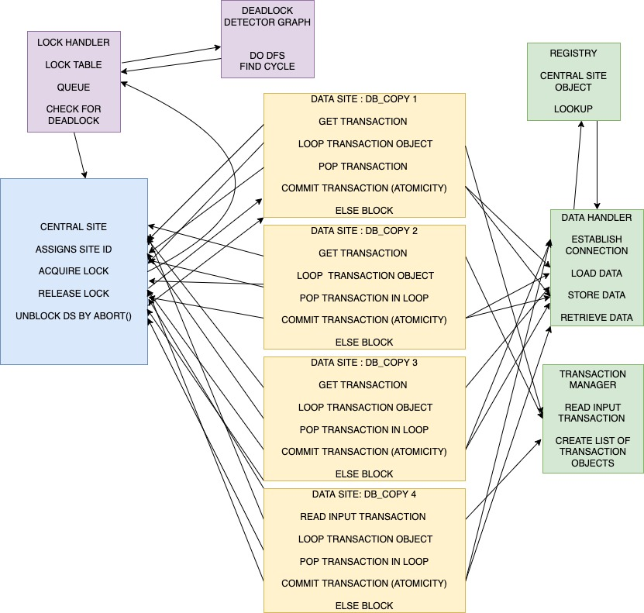
Architecture
Notes:
Deadlock detector: Lock table – Item and list of locks on item x- {t1,t2} Queue table – x, {t1, t3} Edges are made between transactions in lock table and queue table. T1 in queue table is waiting to get a lock on Item I which is locked by t2 in lock table.

Slide 5
Steps of Implementation
Start the registry first to enable communication over the network in Java [Java needs this for any method called over registry, if we want to do RMI in Java, we need this registry service]
Registry will be running as .exe process in the background.
Data site does look up on registry service to get Central site object.
Data site registers itself to registry using bind method while starting
Central Site registers itself to registry using bind method()
DS gets unique id from Central Site using next site id method()
I am implementing 4 different data sites each using its own copy of the database.
It creates a new name for itself - Data site 1 or 2.. and registers using that name.
If the Central Site wants to call the Data Site, it will lookup the name on the registry.
This is the essence RMI for our 2PL process.
Data site reads the input set of transactions which is given as an input text file using file util.

Slide 6
Cntd…
File Util (Transaction manager) will read the input file and convert each transaction to an object
It then creates a list of transactions which the data site will loop through each of the transactions in this list data structure and execute each of them.
Data site will contact the Central site as and when it encounters any read or write operation and the Central Site will contact the lock manager for a lock.
Lock manager checks the lock table and queue table and checks for cycles using DFS in graph and then permits lock access.
Wait for graph is a graph with vertices or nodes as transactions and edges as relation or connection between them.
If a lock is already put on any data item, then any other transaction requesting a lock on that data item will be queued.
Data site will call acquire lock function and does the read or write operation on data item
If two different transactions already have a lock on the same data item and if both transactions try to write that particular data item, then deadlock happens and deadlock is detected. Deadlock is detected by detecting any cycle using DFS in graph helper.
If Deadlock is detected then the transaction is aborted, i.e one of the transactions is aborted in the cycle and the remaining process continues.
At the end of the process the whole execution trace is stored in a log file and the database data items will be updated based on the transaction.
Notes:
Abort – from vertex to vertex

Slide 7
Thank You
Any questions?

