Slide 1

Futurense
Democratizing Tech Talent to deliver impact at scale

Slide 2
Exploratory Data Analysis on
Healthcare Census of India
2011
Ch. Sandhya Rani,
FT656,
FF18.

Slide 3
Overview:
Data Cleaning and Preprocessing
Data Analysis
Data Visualization

Slide 4



Tools and Technologies Used:
Python
Power BI
Jupyter

Slide 5
Libraries/Packages/Features Used:
Pandas
Seaborn
Numpy
Matplotlib
Warnings

Slide 6
Introduction to Healthcare Census
Census is nothing but a process of collecting, compiling, analyzing, evaluating, publishing and disseminating statistical data regarding the population.
It is a reflection of truth and facts as they exist in a country about its people, their diversity of habitation, religion, culture, language, education, health and socio-economic status.
It covers demographic, social and economic data and are provided as of a particular date. Census is useful for formulation of development policies and plans and demarcating constituencies for elections.
The Census of India has been conducted 15 times, As of 2011. It has been conducted every 10 years, beginning in 1871.

Slide 7
EDA Process
The healthcare department wants to process the 2011 census data to find some relevant information about their department.
Importing Libraries
Loading the Data
Data Cleaning
Data Analysis
And Summarizing the Datasets

Slide 8
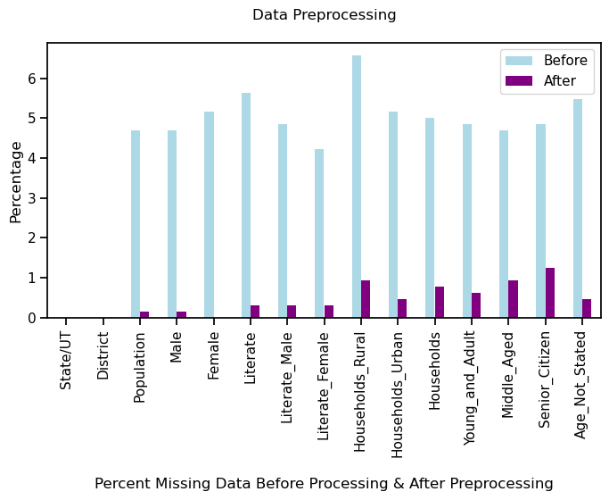
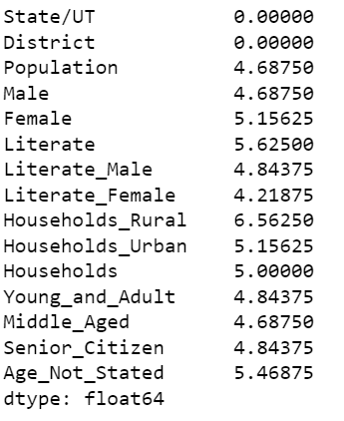
Visualization of Data Preprocessing Plot

Slide 9
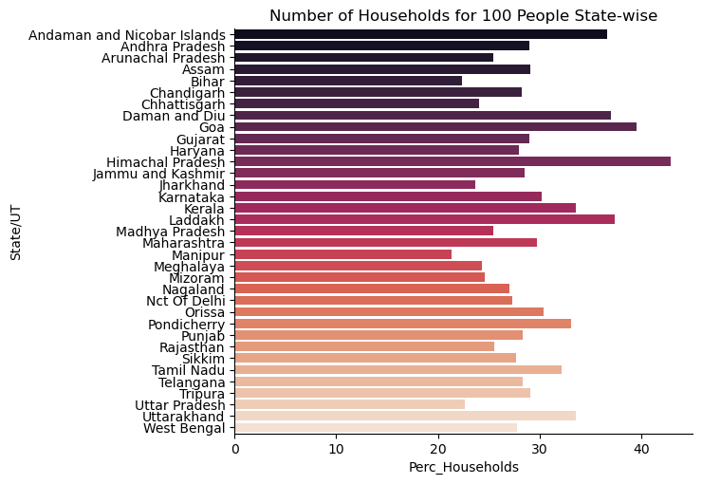
Visualizing Housing Data
Number of hoseholds for 100 people in every State/UT.
Himachal Pradesh has the highest number of households for 100 people.

Slide 10
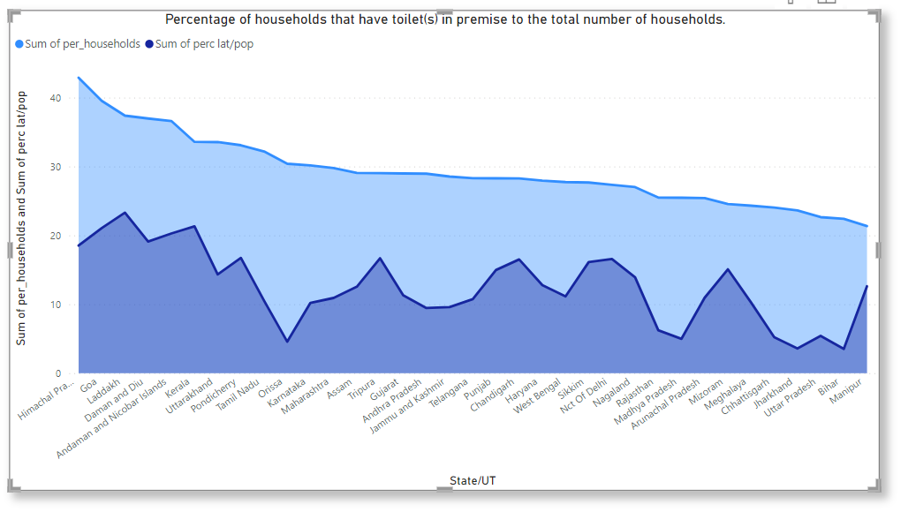
Visualizing Housing Data
Percentage of households that have toilet(s) in premise to the total number of households.
According to the plot, HP, Goa and Laddakh states has the highest facilities to the total number of households.

Slide 11
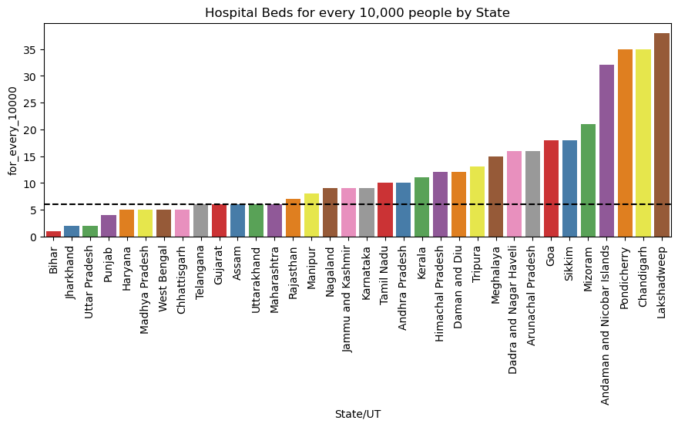
Analyze Healthcare facility disparity
According to the plot, the conclusion is Bihar, Jharkhand, and Uttar Pradesh states has low number of beds for 10000 people.

Slide 12
Inconsistency in different datasets
These districts in both the datasets have major difference.
Aurangabad
Bijapur
Bilaspur
Hamipur
Pratapgarh
Raigarh
The Districts where a major difference is
found in the two datasets of Census and
Housing after Cleaning and
Preprocessing.

Slide 13
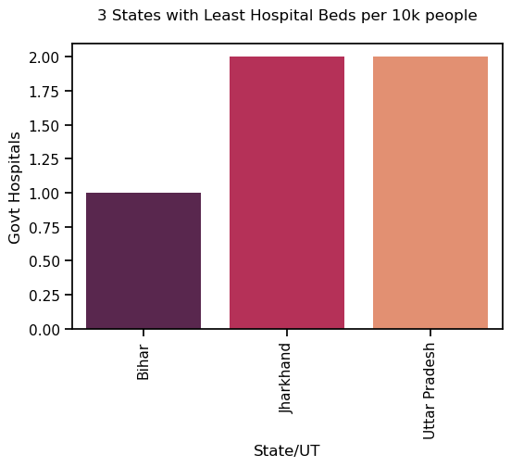
Visualization of States with least number of Hospital beds
Government healthcare facility disparity
These three states which has the least
number of government hospitals and can be
recommended for setting up a new
government hospital.

Slide 14
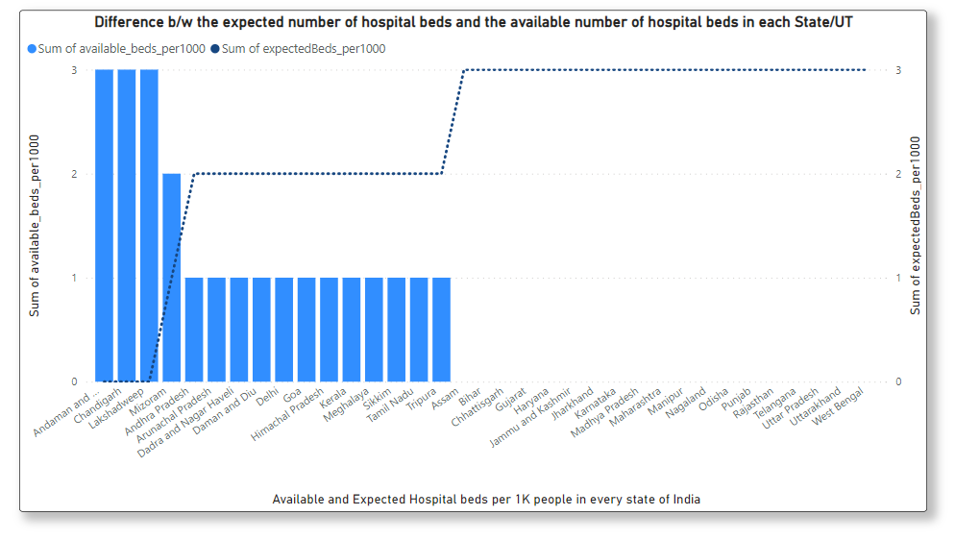
Expected vs Available number of Hospital Beds
According to WHO standards, a minimum of 3 beds per 1000 people is required.
Analyse whether different regions in India as well as the nation as a whole are up to that standard or not
Difference between the expected number of hospital beds and the available number of hospital beds in each State/UT, as well as at the national level.

Slide 15
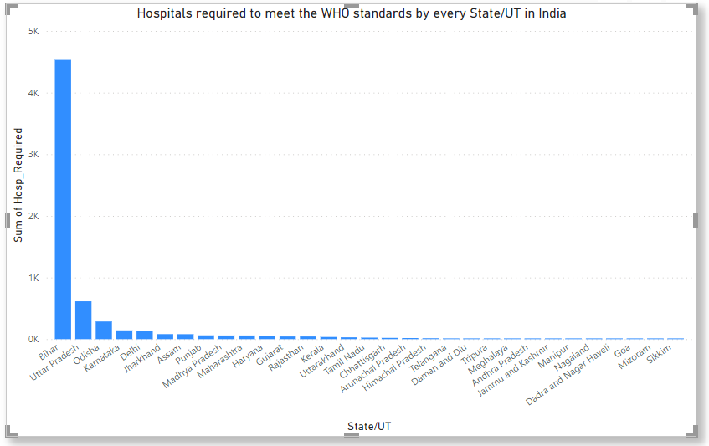
Hospitals required to meet the WHO standards by every State/UT in India
The government have to fill the gap between the available facility and the WHO standards all by itsel.
So, mostly in Bihar State, nearly 5K government hospitals may be required to fill the gap, followed by Uttar Pradesh and Odisha states.

Slide 16
Conclusion:
Bihar, Jharkhand and Uttar Pradesh are states with least number of Hospital Beds.
Himachal Pradesh has the highest number of households for every 100 people.
Mostly in Bihar State, nearly 5K government hospitals may be required to fill the gap, followed by Uttar Pradesh and Odisha states.

Slide 17
Thank You

