Slide 1
SmartBin Project by Team SuperSeven
SmartBin is an application that provides a smart way of doing Waste Management.
Technical stack includes MongoDB, Java, REST framework, Android and JasperReports library.
Simulator has been used to populate the database with data for the “smart” bins.
We have followed Test Driven Development.
The application uses all Open Source thirdparty software.

Slide 2
High Level Design
Android App
REST Service
Object Layer
Report Generator (JasperReports)
DB Service
Mongo

Slide 3
Mongo DB Design
“BinStore” Collection:- This is a collection of bson documents where each document represents a unique bin. Example,
> db.BinStore.find()
{ "_id" : ObjectId("562caa95a456f12ef0b7369c"), "fillLevel" : 2, "humidity" : 52, "binId" : 959, "locality" : "Theegalagutta", "longitude" : 79.12300164794922, "sublocality" : "Hakimpet ", "latitude" : 17.699369430541992, "city" : "Yellamla", "temperature" : 74 }
{ "_id" : ObjectId("562caa95a456f12ef0b7369c"), "fillLevel" : 2, "humidity" : 52, "binId" : 960, "locality" : “Miyapur", "longitude" : 79.13100164794765, "sublocality" : "Hakimpet", "latitude" : 17.697269430541992, "city" : "Yellamla", "temperature" : 75 }
{ "_id" : ObjectId("562caa95a456f12ef0b7369c"), "fillLevel" : 2, "humidity" : 52, "binId" : 961, "locality" : “kondapur", "longitude" : 79.14200164794832, "sublocality" : "Hakimpet ", "latitude" : 17.698269430541992, "city" : "Yellamla", "temperature" : 76 }
“BinHistory” Collection:-This has one bson document corresponding to each bin with latest fill level values for the present day. If any update happens to the same bin on a subsequent day, another document is created for the same.
> db.BinHistory.find({binId : 243})
{ "_id" : ObjectId("562cad03a456f12ef0b73705"), "fillLevel" : 1, "Date" : 20151025, "binId" : 243, "binDate" : "20151025_243" }
{ "_id" : ObjectId("562e773ca456f12da8e8dcec"), "fillLevel" : 1, "Date" : 20151027, "binId" : 243, "binDate" : "20151027_243" }
{ "_id" : ObjectId("563095e95ce60b1344f29628"), "fillLevel" : 1, "Date" : 20151028, "binId" : 243, "binDate" : "20151028_243" }

Slide 4
DB Service
Class MongoDBService in the package com.smartbin.dblayer
Exposes methods for all CRUD (CREATE, READ, UPDATE, DELETE) operations on a Collection and on a Document.
Corresponding test code written in TestNG is TestDBService class in the package com.testng.smartbin.dblayer

Slide 5
Object Layer
Classes Bin and BinHandler in the package com.smartbin.data
Exposes methods for all CRUD operations on a Bin object
Exposes other functionality like getting bins in and around a locality within a radius. Uses HaversineDistance Algorithm for this.
Corresponding test code written in TestNG is TestBinHandler class in the package com.testng.smartbin.data

Slide 6
REST Service
RESTBinService class in com.smartbin.rest package.
Sample REST APIs that are exposed and used by Android client:
GET: http://10.111.6.158:8080/SmartBin/SmartBin/getLocalityBins/17.4968/78.3614/40
GET: http://10.111.6.158:8080/SmartBin/SmartBin/getAllBins
GET: http://10.111.6.158:8080/SmartBin/SmartBin/getReport/20151024/20151031/1,1000
POST: http://10.111.6.158:8080/SmartBin/SmartBin/insertBin
DELETE: http://10.111.6.158:8080/SmartBin/SmartBin/deleteBin/5

Slide 7
Report Generator
JasperReportGenerator class in com.smartbin.reports package
JasperStudio used to design a report template for Fill Trend line chart
The java class uses JasperReports library to compile the report template and run it to generate the HTML report.
Corresponding test code written in TestNG is TestJasperReportGenerator class in the package com.testng.smartbin.data

Slide 8
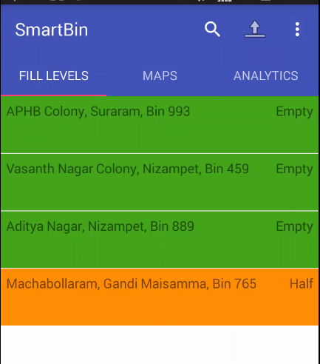
Android Client Features
Search locations. Updates Fill levels and maps tabs on selection of a location
Export Functionality. Gives a facility to write the list of bins to PDF and share. (via mail, Bluetooth etc.)
Fill Levels tab: Shows bins of current location or location selected by search. It shows locality of the bin, bin identifier and fill level.

Slide 9
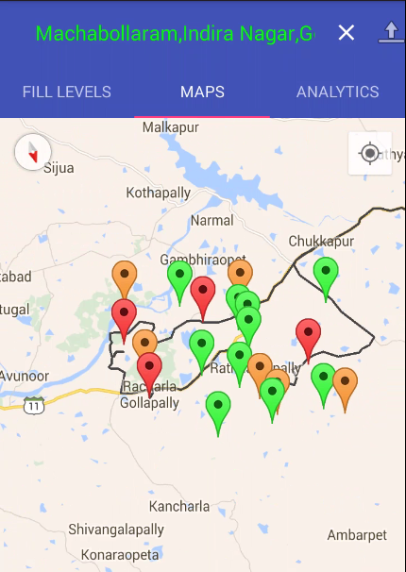
Android Client Features
Maps tab: Shows bins of current location or location selected by search. It shows path of reaching filled bins using travelling sales man algorithm. On clicking on marker, it shows more details.

Slide 10
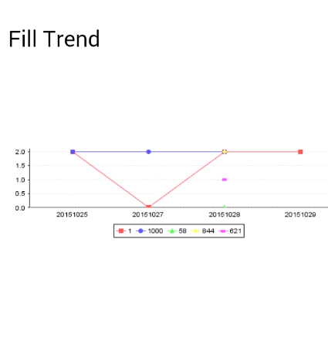
Android Client Features
Analytics tab: On selecting the from and to dates and few bins, it shows fill trend analysis.

