Slide 1

ONTIVUSS
INVESTOR’S
PRESENTATION
Sept 2026

Slide 2





Ontivuss Overview
WIP
AI- Enabled, Tailored processes to ensure we set the process up for success
*Set-up and associated cost to be discussed separately
<<Back to main slide

Slide 3
Mercure at a Glance
WIP
Getting the Foundation Right Wins Half the Battle
Add Mercure Video

Slide 4
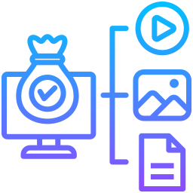



MERCURE
Completed
Built to Solve
What Matters Most.
AUTOMATES IMPLEMENTATION COMPLEXITY
CREATES REPEATABLE MODEL
IMPLEMENTATION COST
COMPRESS TIME TO VALUE
Targets ~50% lower cost versus traditional SI led implementations.
Targets requirements, design & configuration in ~45 days vs. traditional 8-12-month timelines.
Uses AI-driven requirements, design & configuration agents to reduce manual implementation effort.
Reusable orchestration framework designed to scale across CRM, ERP & HRMS platforms.

Slide 5

Road to Commercial Impact
Completed
Strategic capital deployment from technical completion to scalable market readiness
COMPLETE SALESFORCE
VALIDATE WITH EXPERTS
DEPLOY PILOTS
EXPAND CRM
Requirements/design + platform-specific configuration agents
Repeated CRM architecture and question-set validation
Two real customer implementations to validate the model
Begin Dynamics and Oracle CRM end-to-end development
Second-round financing preparation begins by Month 12, well ahead of the initial funding horizon.
<<Back to main slide
Notes:
Could you share your initiatives for employee well-being? Additionally, which wellness models do you utilize out of Employee Assistance Programs (EAP) with in-house support, solely in-house resources, Wellness-as-a-Service (WaaS), or any other approach?

Slide 6



Our Three-Tiered Pilot Framework
Completed
The goal: prove the full operating model in real customer environments before optimizing for revenue.
TECHNICAL
PROOF
OPERATING
PROOF
ECONOMIC PROOF
End-to-End Execution
Validation
Operational Scalability Validation
Cost & Speed
Validation
Can the agents reliably move from SME input to design to configured Salesforce instance?
Can Ontivuss deliver with a repeatable process and manageable
human oversight?
Can the model materially improve implementation time and cost versus the traditional SI approach?
Pilot outputs become the evidence base for pricing, speed claims, customer value, and the next financing round.
<<Back to main slide

Slide 7



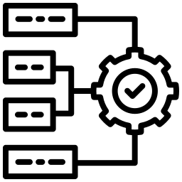
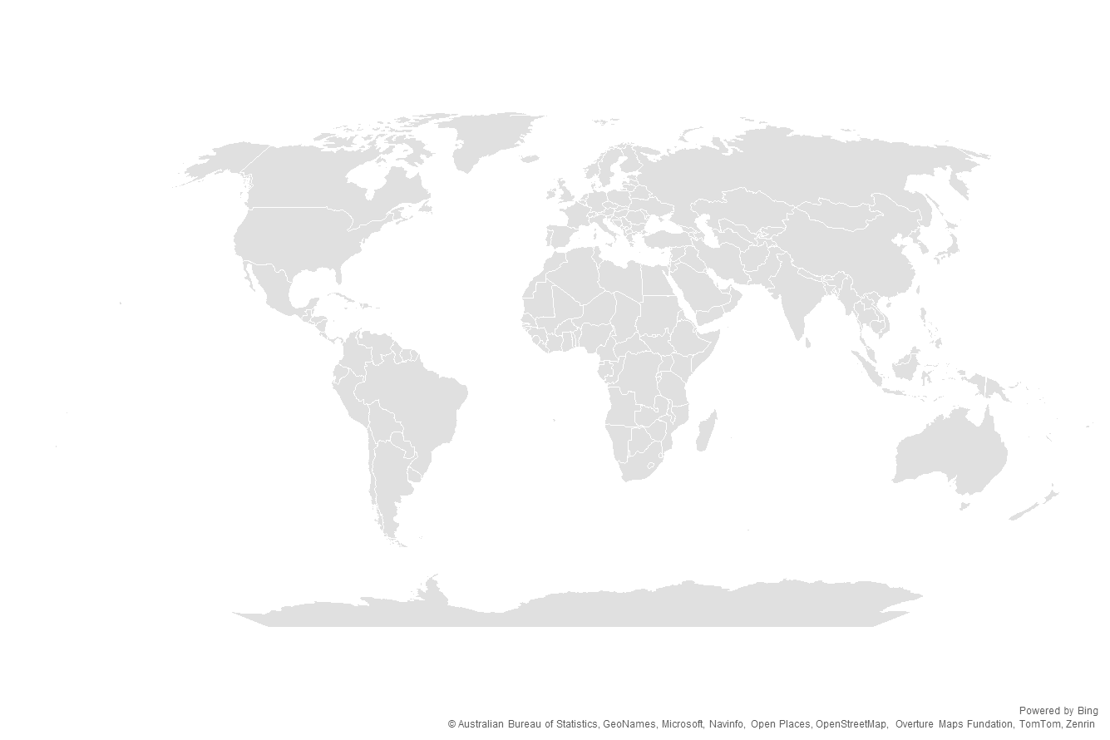













Our Roadmap
WIP
A scalable, people-powered and tech-enabled operating model designed for quality, speed and trust
DELIVERY LOCATIONS
PEOPLE & TEAM
OPERATING SCALE
QUALITY FRAMEWORK
Months 0–3
6 consultants focused on CRM architecture validation & development
6 Experienced Consultants
Planning Allowance : ~$185K–$200K
Months 4–6
Transition resources toward
Build, Configure & Expand
India: Chennai
Strong English Language & IT presence preserving capital efficiency.
Dedicated Leadership
Months 6+
Scale with 3+ Core FTEs
Strategically located.
Globally Connected.
Experienced team.
Built for success.
Structured. Scalable.
Always On.
Quality you can measure.
Outcomes you can measure.

Slide 8












Why Ontivuss as your Preferred Partner?
Completed
01
02
03
04
CURRENT
LEGALLY OWNED
EQUITY EVOLUTION
FINANCIAL FOUNDATION
IP PROTECTION
Planned 50/50 Transition
Upon CTO Onboarding
Banking established,
bookkeeping underway,
zero external liabilities
Consultant confidentiality
& work-product assignments
in place
100% by Founder
05
06
07
08
OWNERSHIP
GOVERNANCE
RECONCILIATION
LEGAL READINESS
BEFORE EX-CAPITAL
Formalize founder ownership & vesting
Define decision rights & departure provisions
Document founder-funded development costs
Secure CTO IP & establish
venture-ready structure.

Slide 9









Commercial Proof Point
Completed
From Automation to Implementation: Making Mercury Salesforce-Ready
CAPITAL NEED
SCALE
PILOT
External Capital Requirement
$1.5 M
Build. Validate. Commercialize
15 Months
From Capability to Proof
2 Pilots
End-to-End
Solution Ready
Customer Environment Test-Ready
Technical Performance Proven
Implementation Model Validated
Customer Value Demonstrated
Advance Mercury from Design Automation to Validated End-to-End Salesforce Implementation

Slide 10


Fueling the Build: Where Capital Creates Value
Completed
Prioritizing product development while maintaining a lean, focused operating model.
01
02
03
AI & software development
CRM architecture validation
Product / QA / Tooling
Core engineering, agent development, platform build
Senior experts validating questions, logic, and outputs
Quality assurance, cloud, AI, API, and software tooling
04
05
06
Legal / IP / Finance
Pilot Execution
Limited GTM preparation
Corporate structure, IP protection, bookkeeping, investor readiness
Customer support, on-site work, testing/UAT assistance
Early business development & commercialization readiness
Development and engineering remain the dominant use of proceeds.

Slide 11
ONTIVUSS
APPENDIX

Slide 12
Compelling economics, delivered by a lean, complementary team
The commercial hypothesis: major cost and cycle-time compression, priced against the value we replace — not like a low-cost point SaaS tool.
~50% lower
~45 days
~50% of SI cost
Implementation cost vs. traditional SI model
Requirements, design, and Salesforce configuration
Working pricing hypothesis, milestone-based payments
LEAN LEADERSHIP WITH COMPLEMENTARY ROLES
CEO / Founder
CTO / AI Partner
Potential CFO / Advisor
Strategy · fundraising · enterprise relationships · go-to-market
AI architecture · platform architecture · agent development
Financial planning · controls · investor readiness
These are working targets — the two pilots must validate them before they are presented as proven results.
Investor Presentation | Step 2
See appendix for full detail

Slide 13
Thank you
ONTIVUSS

