Slide 1
SENTIMENTAL ANALYSIS
CAPSTONE PROJECT
Presented By:
- ADDANKI SANDHYA RANI-VASIREDDY VENKATADRI INSTITUTE OF TECHNOLOGY-INFORMATION TECHNOLOGY

Slide 2
OUTLINE
Problem Statement
Proposed System/Solution
System Development Approach (Technology Used)
Algorithm & Deployment
Result
Conclusion
Future Scope
References

Slide 3
Problem Statement
To develop a sentiment analysis model for restaurant reviews, start by collecting a dataset of reviews labeled as positive or negative. Preprocess the text by cleaning, tokenizing, removing stopwords, and converting words to their base form. Extract features using techniques like TF-IDF or word embeddings. Choose and train a suitable machine learning model such as Naive Bayes or SVM. Evaluate its performance using metrics like accuracy and F1-score, then deploy the model for real-time sentiment analysis of restaurant reviews

Slide 4
Proposed Solution
1. Data Collection and Preparation:
Collecting Data: Obtain a dataset of restaurant reviews along with their corresponding sentiment labels (positive or negative). You can use web scraping tools or access datasets from online repositories.
Preparing Data: Clean the dataset by removing any irrelevant information, handling missing values, and ensuring each review is associated with its sentiment label.Preparing Data: Clean the dataset by removing any irrelevant information, handling missing values, and ensuring each review is associated with its sentiment label.
2. Text Preprocessing:
Tokenization: Split each review into individual words or tokens.
Normalization: Convert text to lowercase to ensure consistency.
Removing Stopwords: Eliminate common words (e.g., "the", "is", "and") that do not contribute to sentiment analysis.
Lemmatization or Stemming: Reduce words to their base form to handle different variations (e.g., "running" to "run").
3. Feature Extraction:
Vectorization: Convert text data into numerical feature vectors. Popular methods include TF-IDF (Term Frequency-Inverse Document Frequency) or word embeddings like Word2Vec or GloVe. These methods capture semantic meaning and relationships between words.
4. Model Selection:
Choose a suitable machine learning model for sentiment analysis. Common choices include:
Naive Bayes: Simple and effective for text classification tasks.
5.Model Training and Evaluation
6.Model Deployment

Slide 5
System Approach
To set up a sentiment analysis project for restaurant reviews, you'll need the following system requirements:
Operating System:Any modern operating system such as Windows, macOS, or Linux.
Python:Version 3.6 or higher. Python is essential for data preprocessing, model training, and deployment.
Python Libraries:
NLTK: For natural language processing tasks like tokenization, stemming, and stopwords removal.
Scikit-learn (sklearn): For machine learning models and evaluation metrics.
Pandas: For data manipulation and analysis.
NumPy: For numerical operations.
Matplotlib or Seaborn: For data visualization (optional but useful for analysis).
Text Processing Tools:NLTK Corpora and Models: Download NLTK resources like stopwords and tokenizers.
WordNet: A lexical database for English that helps with lemmatization.

Slide 6
Algorithm & Deployment
* Naive Bayes Classifier:A probabilistic classifier based on Bayes' theorem with strong independence assumptions between features.
*Support Vector Machines (SVM): SVM constructs a hyperplane or set of hyperplanes in a high-dimensional space, which can be used for classification.
*Logistic Regression:A linear model that predicts the probability of a binary outcome using a logistic function.

Slide 7
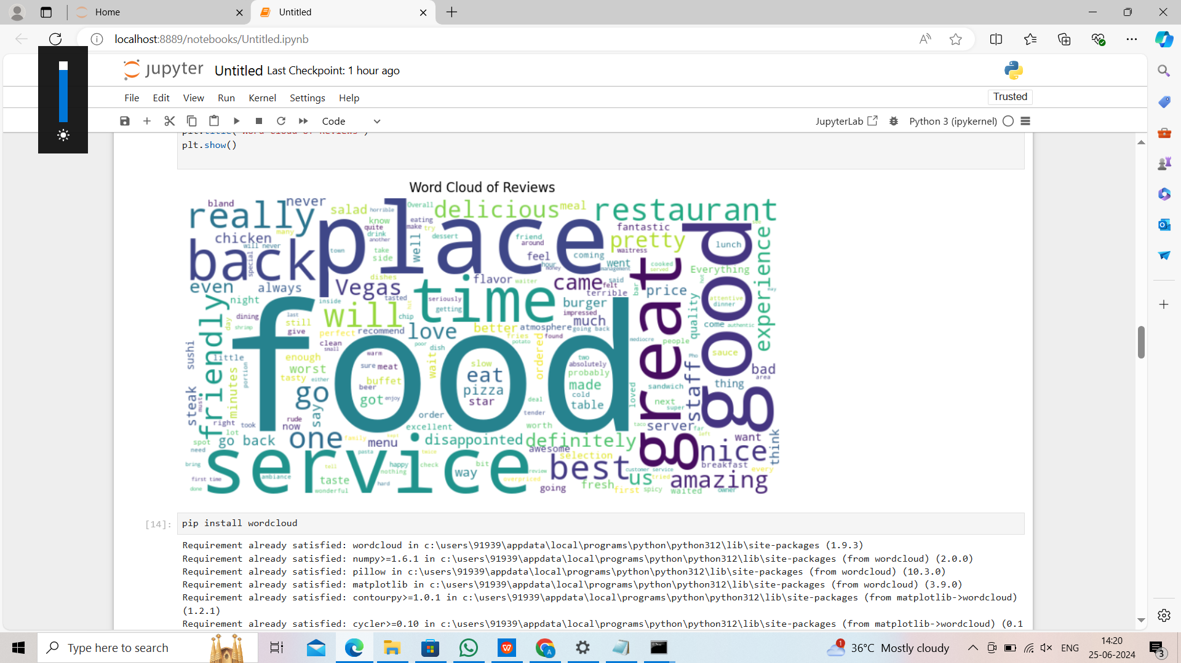
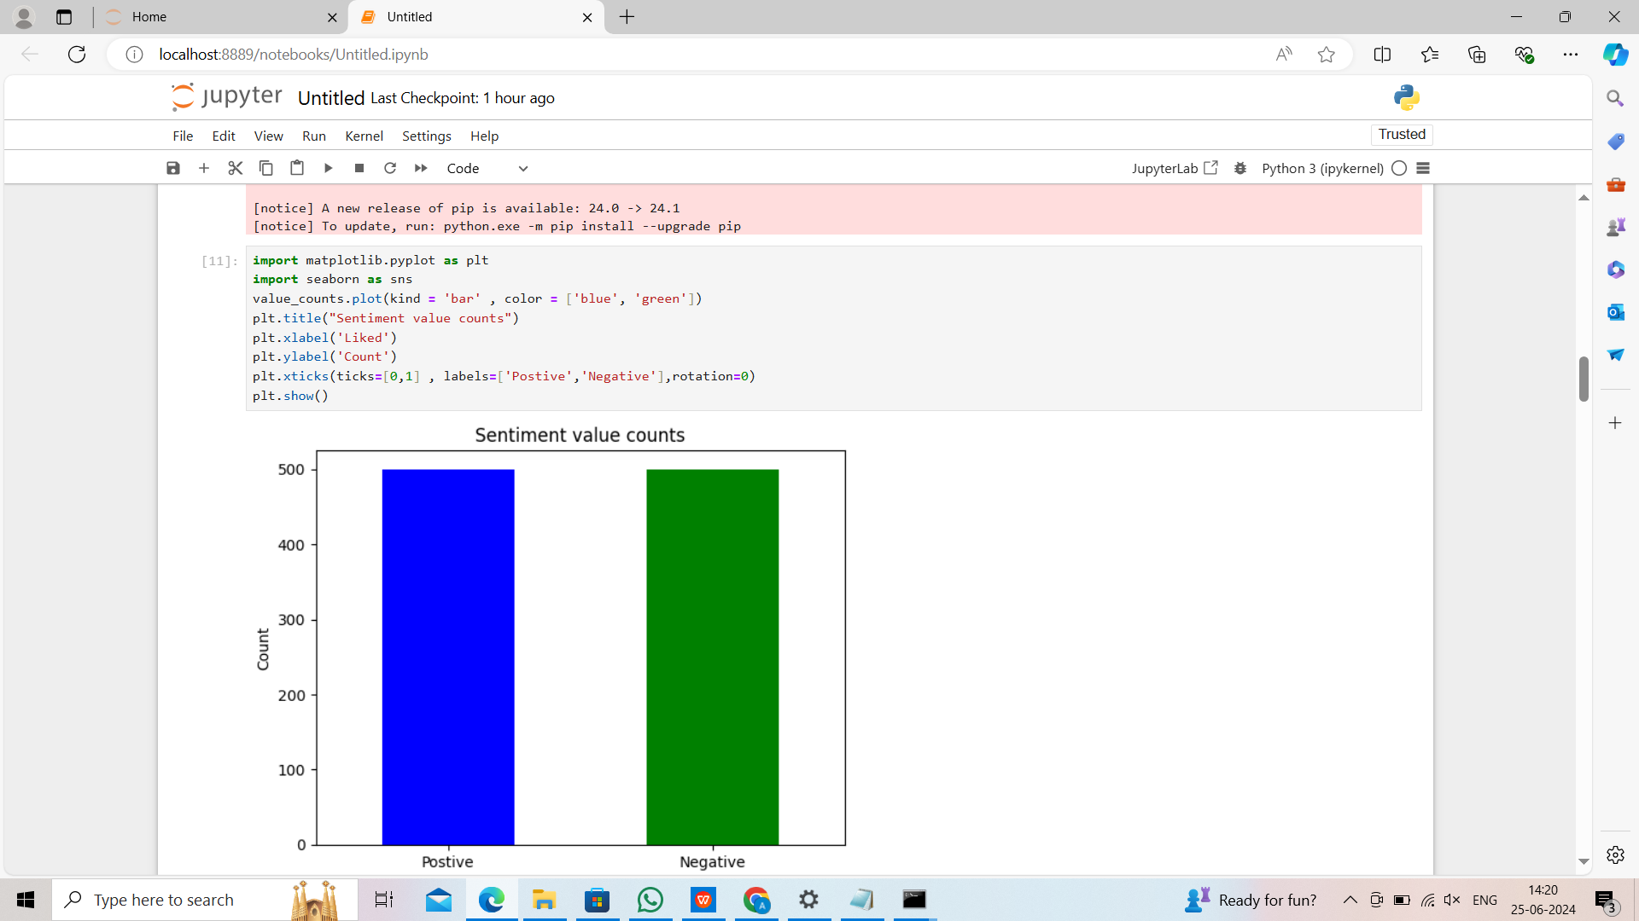

Slide 8
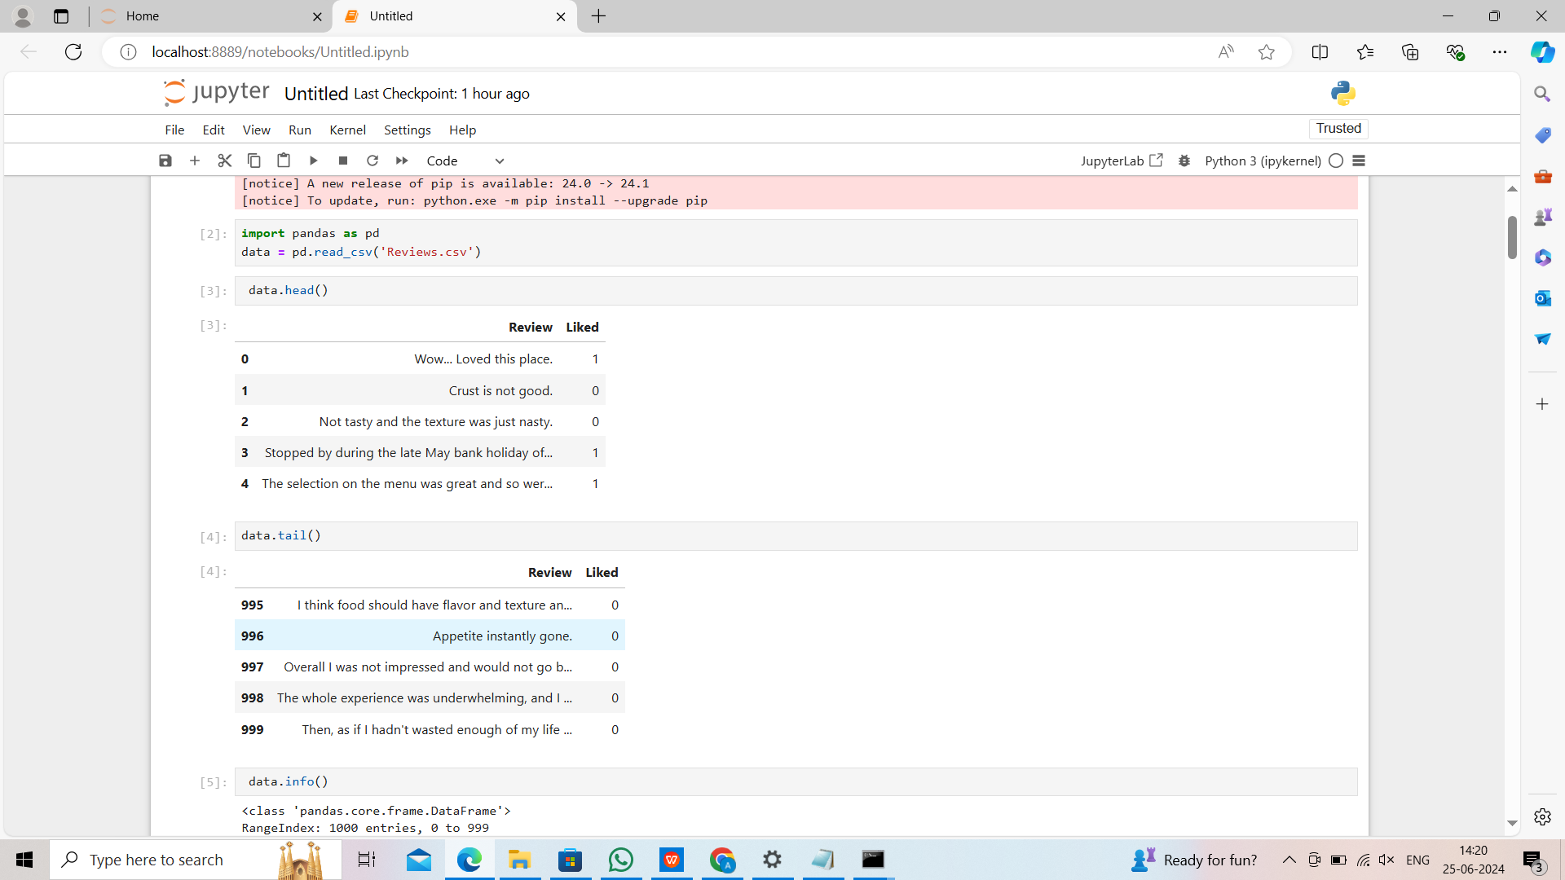

Slide 10
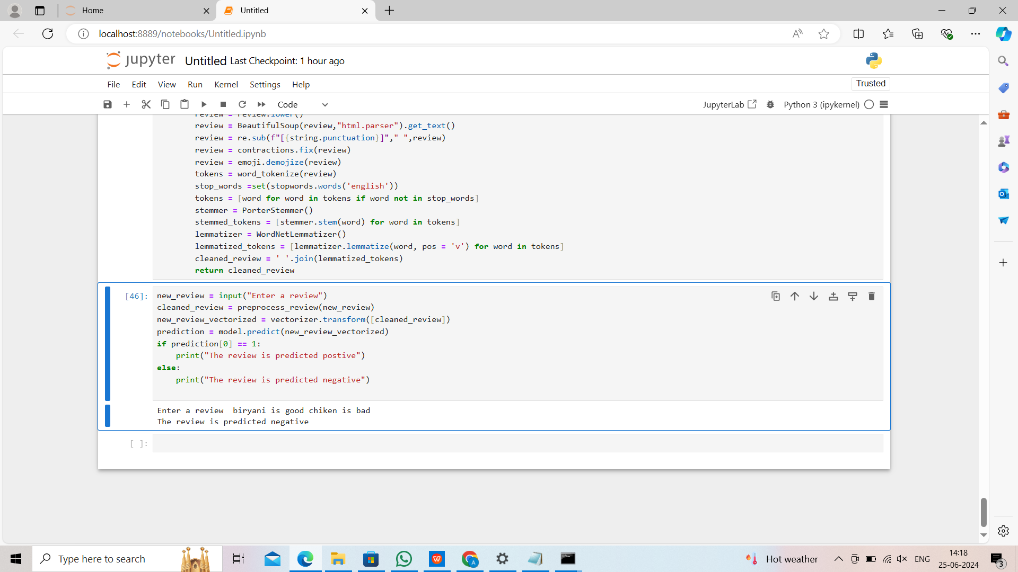

Slide 11
Result
The implemented system successfully automates sentiment analysis of restaurant reviews ,classifyingthem as positive or negative.this unlocks valuable data for businesses,providing insights into customer satisfaction and brand perception

Slide 12
Conclusion
Restaurant review sentiment analysis, using machine learning, automatically classifies reviews as positive or negative. This unlocks valuable insights for businesses, allowing them to:
Understand customer satisfaction
Identify areas for improvement
Track brand reputation
This system automates review analysis, saving time and providing actionable data. By continuously improving the model, restaurants can leverage customer feedback to make data-driven decisions and enhance their business.

Slide 13
Future scope
The future holds exciting possibilities for this sentiment analysis system. We can explore more advanced algorithms like Recurrent Neural Networks to potentially capture a wider range of sentiment beyond just positive or negative. Additionally, integrating the model with review response systems could allow for proactive customer engagement. By analyzing sentiment trends over time, we can identify evolving customer preferences, allowing businesses to adapt and improve their offerings. These advancements can further empower restaurants to leverage customer feedback and make data-driven decisions for success.

Slide 14
References
A Survey of Sentiment Analysis Techniques: Evaluations, Applications and Issues (https://www.researchgate.net/publication/343022813_A_Review_of_Sentiment_Analysis_Techniques)
This research paper provides a comprehensive overview of sentiment analysis techniques, including evaluations, applications, and potential issues.
Sentiment Analysis of Restaurant Reviews: A Review (https://www.irjmets.com/uploadedfiles/paper/volume3/issue_4_april_2021/9088/1628083371.pdf)
This paper specifically focuses on sentiment analysis applied to restaurant reviews.State-of-the-Art in Sentiment Analysis for Social Media (https://www.sciencedirect.com/science/article/pii/S187705091931885X)
This paper explores sentiment analysis techniques used in the context of social media data.

Slide 15
THANK YOU

