Slide 1

Zscaler Networking Virtual Internship
by
S. SANDHYA
Roll No. 224G1A3284
Department of Computer Science and Engineering (Data Science)
Srinivasa Ramanujan Institute of Technology
(Affiliated to JNTUA & Approved by AICTE) (Accredited by NAAC with ‘A’ Grade & Accredited by NBA (EEE, ECE & CSE)
Rotarypuram Village, B K Samudram Mandal, Ananthapuramu – 515701.
2024 - 2025

Slide 2



Contents
Networking Virtual Internship
Course Objective
Introduction
Technology
Modules
Real Time applications
Learning outcomes
GitHub Link
Queries
224G1A3284

Slide 3
Course Objective
Networking Virtual Internship
To provide an understanding of Zscaler’s networking technology, its applications, and real-time implementation in networking environments.
Promote collaboration and critical thinking skills necessary for effective problem-solving in networking and security contexts.
Familiarize participants with Zscaler’s core technologies, including Secure Web Gateway (SWG), Cloud Firewall, and Zscaler Private Access (ZPA).
Develop practical skills in implementing and managing a Zero Trust security model within a cloud-native architecture.
Enhance understanding of real-world applications and best practices for securing remote workforces and cloud environments.
Provide hands-on experience through labs and case studies, enabling participants to apply their knowledge in real-time scenarios.
224G1A3284

Slide 4
Introduction
Networking Virtual Internship
What is Zscaler?
Cloud-based security platform.
Focus on secure internet access and private application access.
Why Zscaler?
Addresses modern networking challenges (remote work, cloud security).
224G1A3284

Slide 5
Technology
Networking Virtual Internship
Zscaler Architecture
Cloud-native architecture.
Zero Trust Security model.
Key Technologies
Secure Web Gateway (SWG)
Cloud Firewall
Private Access (ZPA)
224G1A3284

Slide 6
Different Types Of Technologies:
Networking Virtual Internship
Secure Web Gateway (SWG)
A cloud-based security solution that inspects and controls web traffic to protect users from internet threats and enforce company security policies.
Key Features:
Web Filtering: Controls access to harmful or inappropriate websites.
Threat Prevention: Real-time protection against malware, viruses, and advanced threats.
SSL Inspection: Inspects encrypted traffic for hidden risks.
Data Loss Prevention (DLP): Monitors and blocks unauthorized data transfers.
Application Control: Manages and restricts access to SaaS apps and shadow IT.
Benefits:
Cloud-based security with reduced latency.
Consistent policies across all devices and locations.
Real-time visibility and analytics for compliance and threat monitoring.
Use Cases: Securing remote workers, enforcing compliance, and protecting access to web and SaaS apps.
224G1A3284

Slide 7
Different Types Of Technologies:
Networking Virtual Internship
Cloud Firewall & Private Access
Cloud Firewall:
A cloud-delivered firewall that protects users and devices by inspecting traffic without traditional on-prem appliances.
Key Features:
Layer 3-4 Traffic Filtering: Blocks unauthorized traffic at the network level.
Application-Aware Policies: Granular control over allowed traffic based on applications and services.
Zero Trust Integration: Enforces policies based on user identity and device posture, not IP addresses.
Benefits: Scalable, no hardware needed, real-time threat protection, and policy enforcement globally.
Zscaler Private Access (ZPA):
A Zero Trust solution for secure access to internal applications without exposing the network.
Key Features:
Application-Specific Access: Only grants access to apps, not the full network.
Zero Trust Network Access (ZTNA): Verifies users and devices before allowing connections.
No VPN Required: Simplifies remote access with faster and more secure connections.
Benefits: Reduces attack surface, improves user experience, and enables secure access from any location.
224G1A3284

Slide 8
Modules
Networking Virtual Internship
Network Protocol and Communication.
How does networking works.
Why Companies need Networking.
Benefits of Networking.
Applications of Networking.
224G1A3284

Slide 9
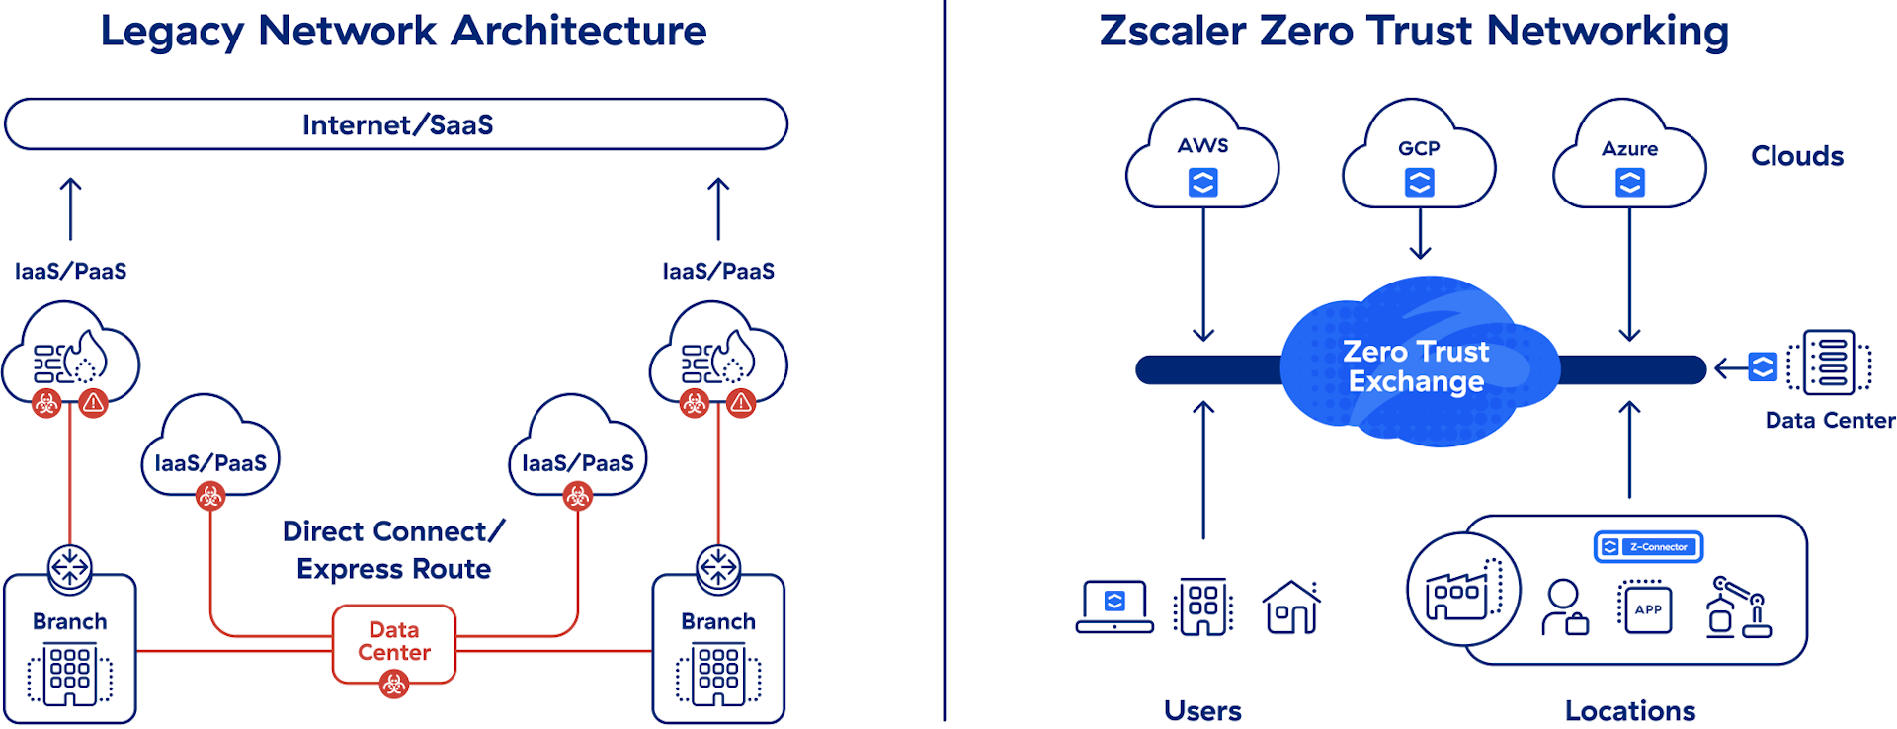
How Does Networking Works?
Networking Virtual Internship
behind everything your organization does: buying, selling, paying, collecting, shipping, and so on. When
224G1A3284

Slide 10
Why Companies need Networking?
Networking Virtual Internship
Unified Security Solution: Zscaler consolidates multiple security functions (like SWG, Cloud Firewall, and ZPA) into one platform, simplifying management and reducing complexity.
Data Protection and Privacy: With features like Data Loss Prevention (DLP) and comprehensive reporting, Zscaler helps organizations meet compliance requirements for regulations such as GDPR and HIPAA.
Flexible Cloud Architecture: Zscaler’s solution scales effortlessly with business growth, accommodating increased traffic and new users without additional hardware investments.
Support for Cloud Applications: As businesses increasingly adopt cloud services, Zscaler ensures secure and efficient access to a wide range of SaaS applications, protecting sensitive data in transit.
224G1A3284

Slide 11
Benefits of Networking?
Networking Virtual Internship
Enhanced Security
Zero Trust Architecture: Ensures that all users and devices are authenticated and authorized before accessing applications, minimizing the risk of data breaches.
Comprehensive Threat Protection: Real-time protection against malware, phishing, and other cyber threats through advanced threat intelligence.
Improved User Experience
Low Latency Access: Direct-to-cloud connections reduce latency for users, enhancing the performance of applications and improving productivity.
Seamless Remote Access: Enables secure access to applications from any location, providing a consistent user experience across devices.
Scalability
Cloud-Native Solution: Easily scales with organizational growth, accommodating increased traffic and user demands without the need for additional hardware.
Global Reach: Zscaler’s extensive cloud infrastructure allows for consistent performance and security across multiple geographic locations.
224G1A3284

Slide 12
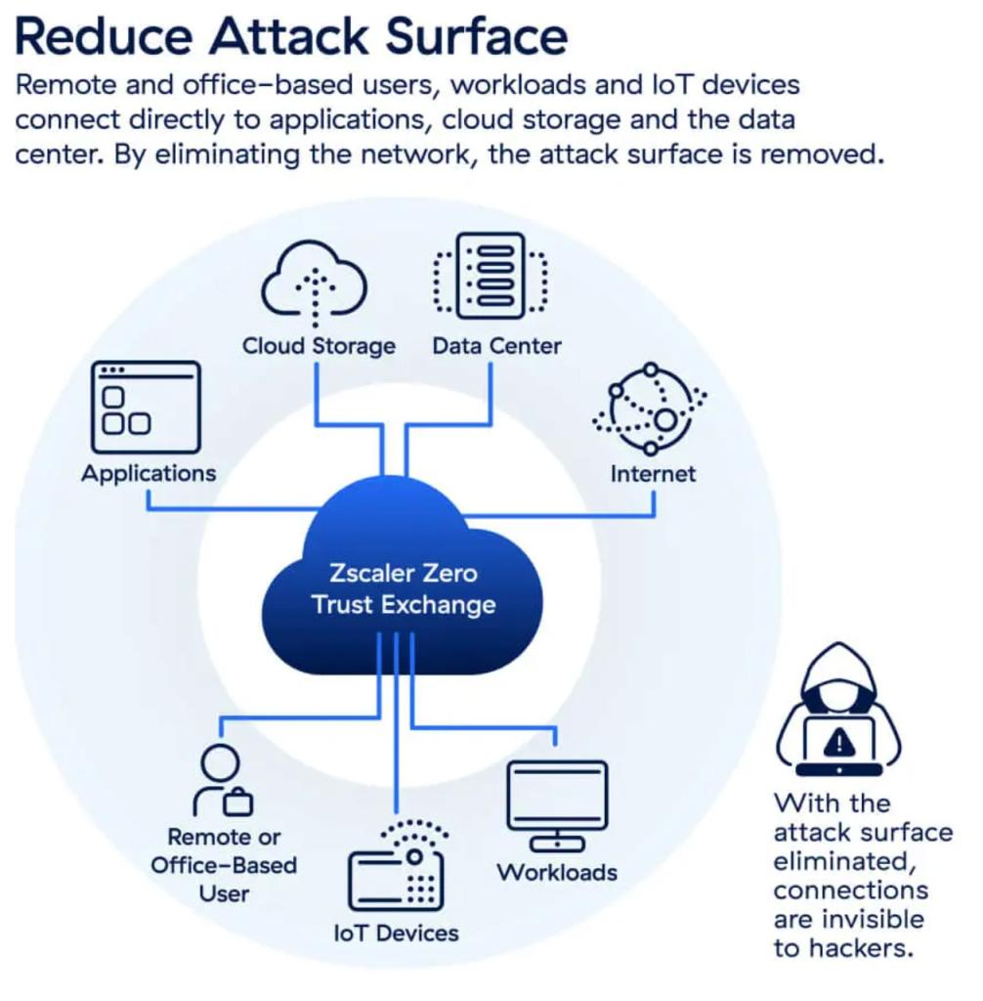
Real Time Applications
Networking Virtual Internship
Remote Workforce Security
Zscaler secures access for remote employees, ensuring they can safely connect to corporate resources from anywhere.
Eliminates the need for traditional VPNs, providing seamless access while enforcing security policies and reducing the risk of data breaches.
224G1A3284

Slide 13

Real Time Applications
Networking Virtual Internship
Malware Protection and Threat Intelligence
The Secure Web Gateway (SWG) component blocks access to malicious websites and inspects web traffic for threats in real time.
Reduces the risk of malware infections and data loss through proactive threat detection and blocking.
Compliance Monitoring and Reporting
Zscaler provides detailed visibility and reporting on user activity and data access, helping organizations maintain compliance.
Facilitates audits and ensures that security policies are being followed effectively.
224G1A3284

Slide 14
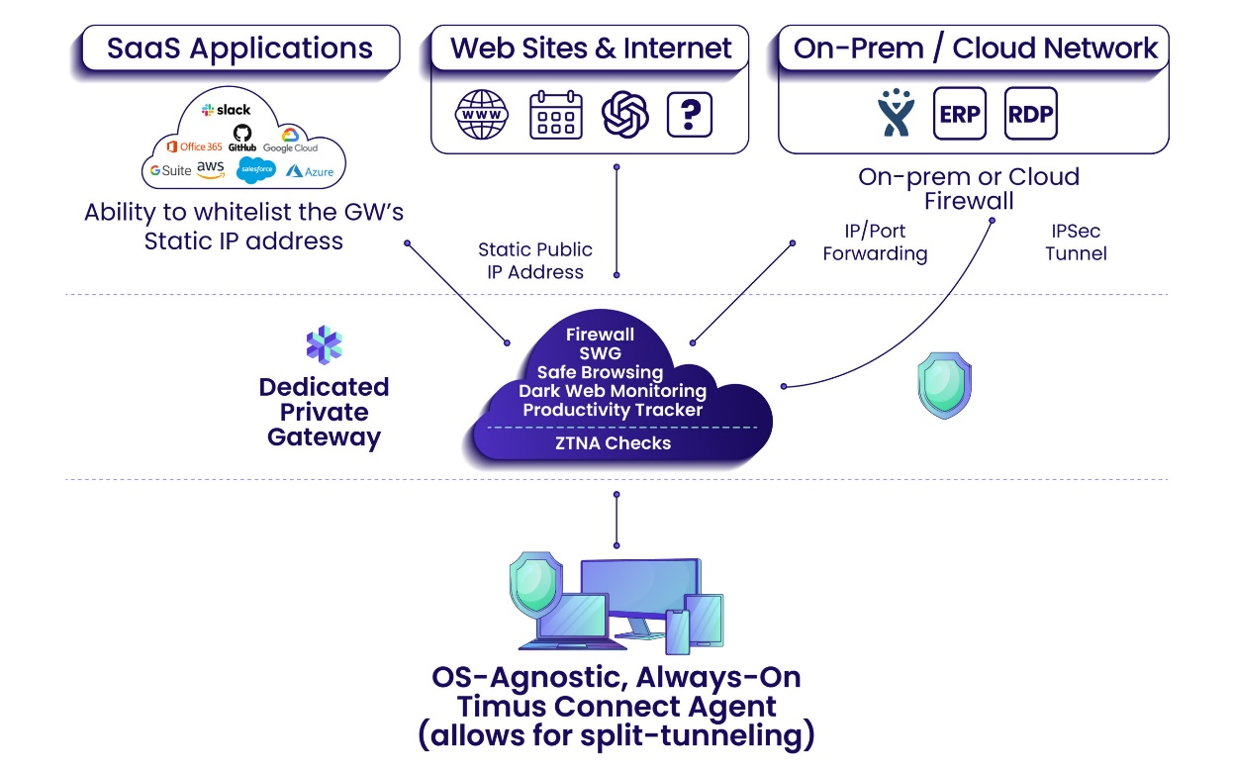
Real Time Applications
Networking Virtual Internship
Application Segmentation and Access Control
Zscaler Private Access (ZPA) allows users to access only specific applications they are authorized to use, minimizing the attack surface.
Reduces risks associated with lateral movement in the network, enhancing overall security.
Business processes are the lifeblood of your company. There’s a process behind everything your organization does: buying, selling, paying, collecting, shipping, and so on. When
224G1A3284

Slide 15
Learning Outcomes
Networking Virtual Internship
Understanding of Cloud Security Concepts.
Proficiency in Zscaler Technologies.
Real-World Application of Networking Skills.
Policy Creation and Management.
Collaboration and Communication.
Critical Thinking and Analytical Skills.
Industry Awareness and Best Practices.
224G1A3284

Slide 16
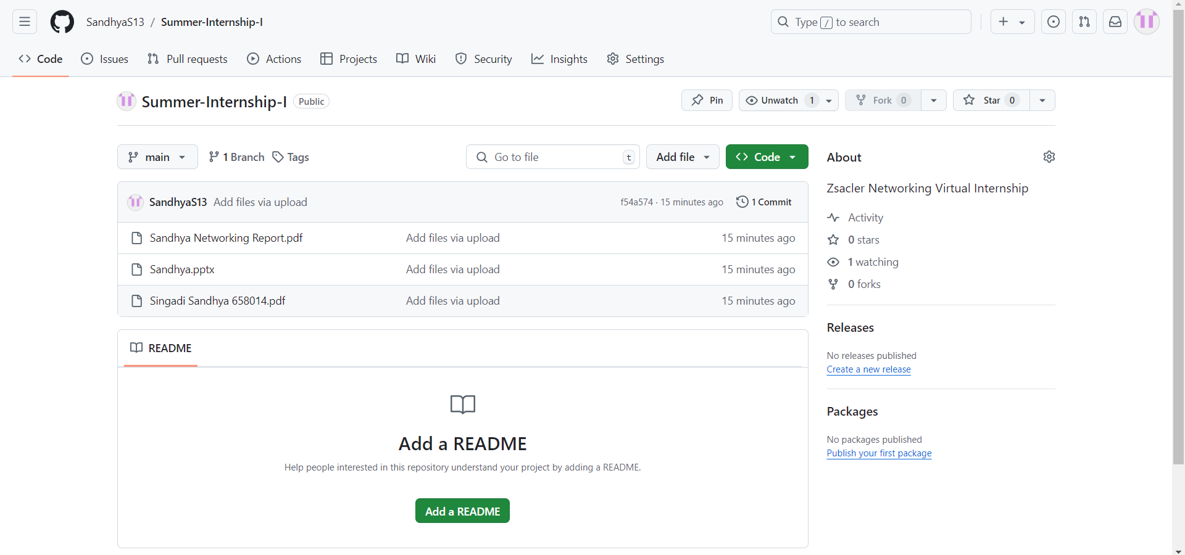
Git Hub Dashboard
Networking Virtual Internship
Repository Name : Summer Internship - I
Git Hub Link: https://github.com/SandhyaS13
224G1A3284

Slide 17
Networking Virtual Internship
Any Queries?
224G1A3284

Slide 18
Networking Virtual Internship
Thank You!!!
224G1A3284

