Slide 1

Capstone Project – 3 Supervised ML – Classification Credit Card Default Prediction
By Sandhya Kumari sah

Slide 2

Presentation Outline
Problem Statement
Introduction
Data Summary
Methodology
Exploratory Data Analysis
Data Processing
Implementing ML algorithms
Challenges
Conclusion

Slide 3

Problem Description
This project is aimed at predicting the case of customers default payments in Taiwan. From the perspective of risk management, the result of predictive accuracy of the estimated probability of default will be more valuable than the binary result of classification - credible or not credible clients. We can use the K-S chart to evaluate which customers will default on their credit card payments

Slide 4

Introduction:
Credit card fraud is an inclusive term for fraud committed using a payment card, such as a credit card or debit card. The purpose may be to obtain goods or services, or to make payment to another account which is controlled by a criminal. In recent times, the number of fraud transactions has increased drastically due to which credit card companies are facing a lot of challenges. For many banks, retaining high profitable customers is the most important business goal. Banking fraud, however, poses a significant threat to this goal. Apart from this, other ways of making fraudulent transactions are as follows:
Manipulation or alteration of genuine cards
Creation of counterfeit cards
Stolen or lost credit cards
Fraudulent telemarketing

Slide 5


Exploring the Dataset

Slide 6

Data Summary:
➢ X1 -Amount of credit(includes individual as well as family credit) ➢ X2 -Gender ➢ X3 -Education ➢ X4 -Marital Status ➢ X5 -Age ➢ X6 to X11 -History of past payments from April to September ➢ X12 to X17 -Amount of bill statement from April to September ➢ X18 to X23 -Amount of previous payment from April to September ➢ Y -Default payment

Slide 7
Features:
ID: ID of each client
LIMIT_BAL: Amount of given credit in NT dollars (includes individual and family/supplementary
credit
SEX: Gender (1=male, 2=female)
EDUCATION: (1=graduate school, 2=university, 3=high school, 4=others, 5=unknown, 6=unknown)
MARRIAGE: Marital status (1=married, 2=single, 3=others)
AGE: Age in year
— —
PAY_0: Repayment status in September, 2005 (-1=pay duly, 1=payment delay for one month,
2=payment delay for two months, … 8=payment delay for eight months, 9=payment delay
for nine months and above)
PAY_2: Repayment status in August, 2005 (scale same as above)
…;
PAY_6: Repayment status in April, 2005 (scale same as above)

Slide 8
Features(Contd.):
BILL_AMT1: Amount of bill statement in September, 2005 (NT dollar)
BILL_AMT2: Amount of bill statement in August, 2005 (NT dollar)
…;
BILL_AMT6: Amount of bill statement in April, 2005 (NT dollar)
— —
PAY_AMT1: Amount of previous payment in September, 2005 (NT dollar)
PAY_AMT2: Amount of previous payment in August, 2005 (NT dollar)
…;
PAY_AMT6: Amount of previous payment in April, 2005 (NT dollar)
— —
Default payment next month: Default payment (1=yes, 0=no)

Slide 9
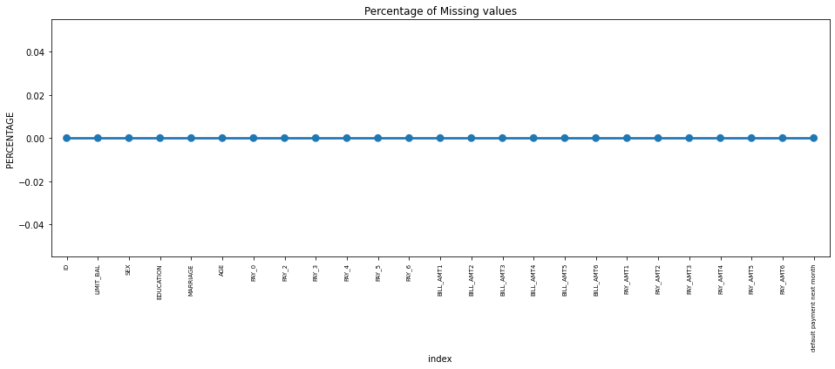
Missing value :
plot the graph to check whether there are any missing value present.
As we can see above there are no missing value presents thankfully.

Slide 10
Methodology

Slide 11
Data preparation and exploratory analysis
Building predictive model using multiple techniques & algorithm
Optimal Model identified through testing and evaluation

Slide 12
EDA AND DATA PROCESSING

Slide 13
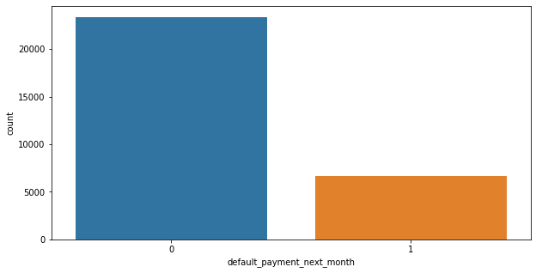
ANALYSIS OF DEPENDENT VARIABLE
As we can see from above graph
that both classes are not in
proportion and we have
imbalanced dataset. We need
to do normalize the data in next step.
0 - Not Default
1 – Default
Defaulters are less than the
Non Defaulters in the given
dataset.

Slide 14
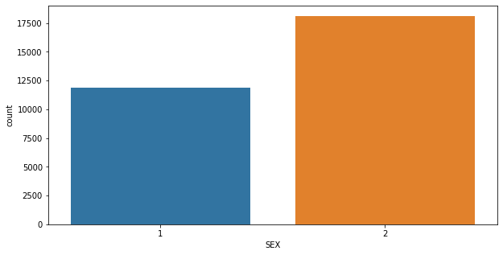
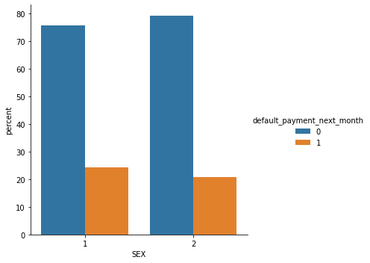
ANALYSIS OF SEX VARIABLE
1 - Male
2 - Female
Number of Male credit holder is less than Female.
It is evident from the above graph that the number of defaulter have high proportion of males

Slide 15
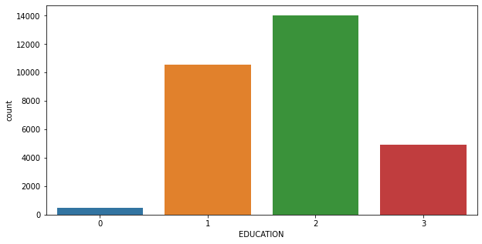
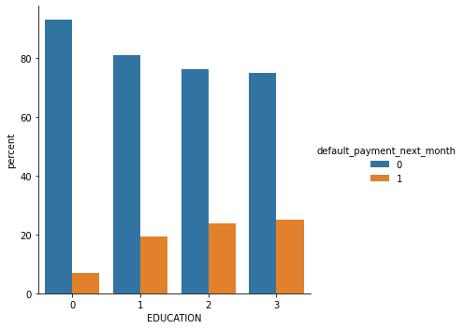
ANALYSIS OF EDUCATION VARIABLE
1=graduate school, 2=university, 3=high school, 0=others
From the above left side plot we can say that more number of credit holders are university students followed by Graduates and then High school students.
From the right side plot it is clear that those people who are other students have higher default payment w.r.t. graduates and university people.

Slide 16
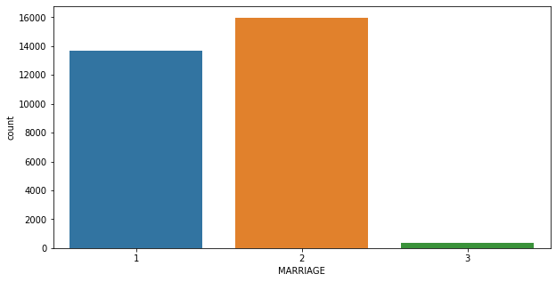
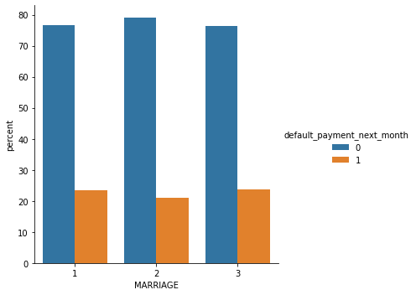
ANALYSIS OF MARRIAGE VARIABLE
1 – married, 2 – single, 3 - others
From the above data analysis we can say that
More number of credit cards holder are Single.
High defaulter rate when it comes to other

Slide 17
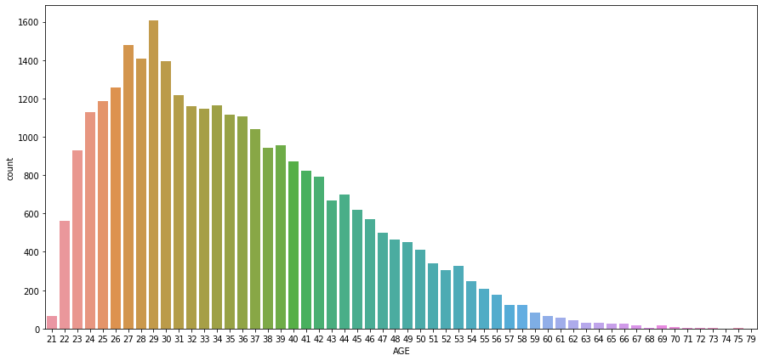
ANALYSIS OF AGE VARIABLE
From the above count plot analysis we can say that
We can see more number of credit cards holder age are between 26-30 years old.
Age above 60 years old rarely uses the credit card.

Slide 18
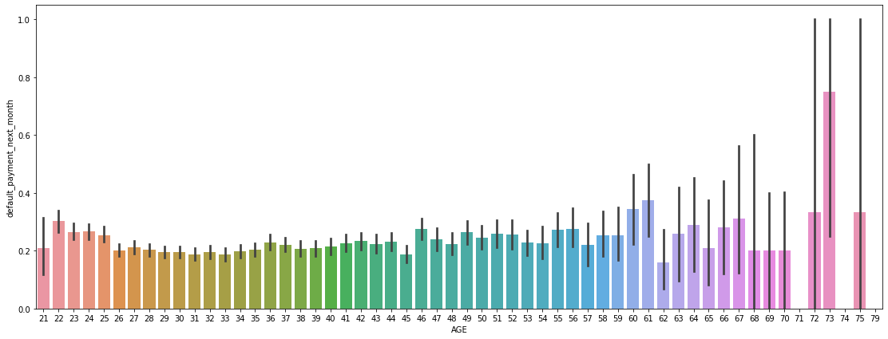
ANALYSIS OF AGE VARIABLE
From the above bar plot which shows the relationship between age and defaulter, we can say that those who default are 60 years and older, that may be they don’t use their card frequently.

Slide 19
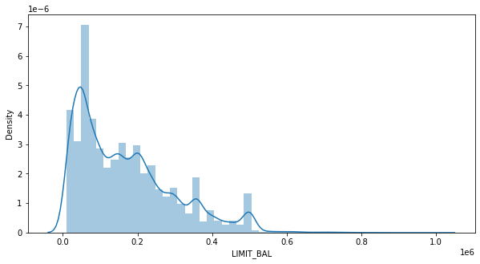
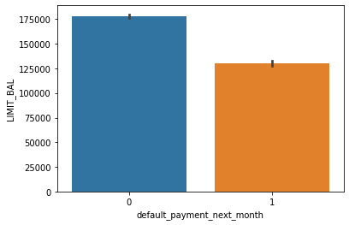
ANALYSIS OF LIMIT BALANCE VARIABLE
From the above plots analysis we can say that maximum amount of given credit in NT dollars is 50,000 followed by 30,000 and 20,000.

Slide 20
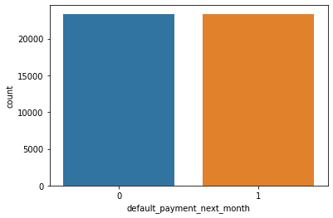
SMOTE
SMOTE (Synthetic Minority Oversampling Technique)- Oversampling is one of the most commonly used oversampling methods to solve the imbalance problem. It aims to balance class distribution by randomly increasing minority class examples by replicating them.
After performing SMOTE operation we get this balance dataset

Slide 21
ONE HOT ENCODING
One hot encoding is a process by which categorical variables are converted into a form that could be provided to ML algorithms to do a better job in prediction.
Here we perform one hot encoding on 'EDUCATION','MARRIAGE','PAY_SEPT',
'PAY_AUG', 'PAY_JUL', 'PAY_JUN', 'PAY_MAY', 'PAY_APR‘.
and label encoding for ‘SEX’
After this we get these features in our dataset:
(['LIMIT_BAL', 'SEX', 'AGE', 'BILL_AMT_SEPT', 'BILL_AMT_AUG','BILL_AMT_JUL', 'BILL_AMT_JUN', 'BILL_AMT_MAY', 'BILL_AMT_APR','PAY_AMT_SEPT', 'PAY_AMT_AUG', 'PAY_AMT_JUL', 'PAY_AMT_JUN','PAY_AMT_MAY', 'PAY_AMT_APR', 'default_payment_next_month','total_Payement_Value', 'Dues', 'EDUCATION_graduate school','EDUCATION_high school', 'EDUCATION_others', 'EDUCATION_university','MARRIAGE_married', 'MARRIAGE_others', 'MARRIAGE_single', 'PAY_SEPT_-1','PAY_SEPT_0', 'PAY_SEPT_1', 'PAY_SEPT_2', 'PAY_SEPT_3', 'PAY_SEPT_4','PAY_SEPT_5', 'PAY_SEPT_6', 'PAY_SEPT_7', 'PAY_SEPT_8', 'PAY_AUG_-1','PAY_AUG_0', 'PAY_AUG_1', 'PAY_AUG_2', 'PAY_AUG_3', 'PAY_AUG_4','PAY_AUG_5', 'PAY_AUG_6', 'PAY_AUG_7', 'PAY_AUG_8', 'PAY_JUL_-1','PAY_JUL_0', 'PAY_JUL_1', 'PAY_JUL_2', 'PAY_JUL_3', 'PAY_JUL_4','PAY_JUL_5', 'PAY_JUL_6', 'PAY_JUL_7', 'PAY_JUL_8', 'PAY_JUN_-1','PAY_JUN_0', 'PAY_JUN_1', 'PAY_JUN_2', 'PAY_JUN_3', 'PAY_JUN_4','PAY_JUN_5', 'PAY_JUN_6', 'PAY_JUN_7', 'PAY_JUN_8', 'PAY_MAY_-1', 'PAY_MAY_0', 'PAY_MAY_1', 'PAY_MAY_2', 'PAY_MAY_3', 'PAY_MAY_4','PAY_MAY_5', 'PAY_MAY_6', 'PAY_MAY_7', 'PAY_MAY_8', 'PAY_APR_-1','PAY_APR_0', 'PAY_APR_1', 'PAY_APR_2', 'PAY_APR_3', 'PAY_APR_4','PAY_APR_5', 'PAY_APR_6', 'PAY_APR_7', 'PAY_APR_8']

Slide 22

Machine Learning Model – Classification

Slide 23

MODEL BUILDING
LOGISTIC REGRESSION
RANDOM FOREST
SVC
XGBOOST

Slide 24
LOGISTIC REGRESSION
Parameeter - {'C': 10, 'penalty': 'l2'}
From this regression model we get the results as below:
* The accuracy on test data is 0.7483301990791777
* The precisiokmn on test data is 0.6782101167315175
* The recall on test data is 0.7888067581837381
* The f1 on test data is 0.7293395634284121
* The roc_score on test data is 0.7533092025677562
We have implemented logistic regression and we getting f1-sore approx 72%. As we have imbalanced dataset, F1- score is better parameter. Let's go ahead with other models and see if they can yield better result.

Slide 25
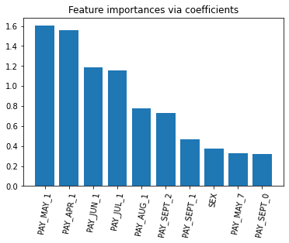
FEATURE IMPORTANCES
From the above feature importance graph we can say that the most important feature that make an impact on dependt variable are PAY_JUL_1,PAY_MAY_1,PAY_APR_1

Slide 26
RANDOM FOREST
PARAMETERS : {'max_depth': 30, 'n_estimators': 200}
From the regression model we get the results as below:
The accuracy on test data is 0.8334738343816873
The precision on test data is 0.7996108949416343
The recall on test data is 0.8576794657762938
The f1 on test data is 0.8276278695126863
The roc_score on test data is 0.8350100231833006
After gridsearch we getting f1-sore approx 82%. As we have imbalanced dataset, F1- score is better parameter. Let's go ahead with other models and see if they can yield better result.

Slide 27
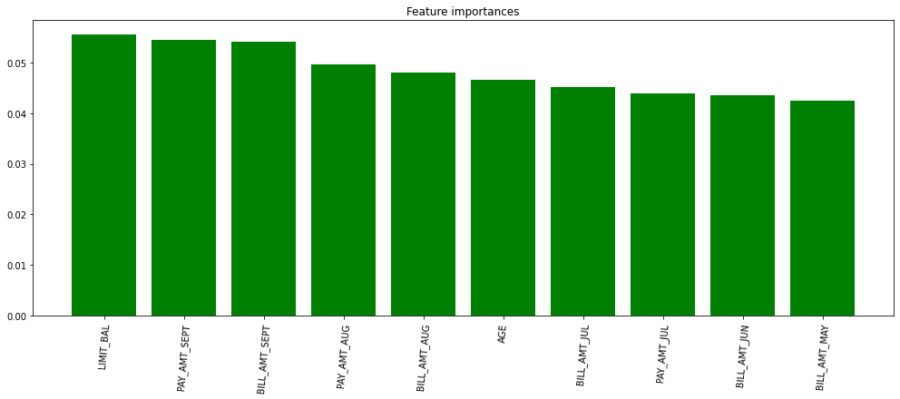
FEATURE IMPORTANCES
from the above feature importance graph we can say that the most important feature that make an impact on dependent variable are LIMIT_BAL,PAY_AMT_SEPT

Slide 28
SUPPORT VECTOR CLASSIFIER (SVC)
PARAMETERS -{'C': 10, 'kernel': 'rbf'}
From the regression model we get theresults as below:
The accuracy on test data is 0.776538486479476
The precision on test data is 0.7045395590142672
The recall on test data is 0.823030303030303
The f1 on test data is 0.7591893780573027
The roc_score on test data is 0.7823914693929431

Slide 29
XGBOOST
PARAMETERS :{‘max_depth’: 15‘min_child_weight’: 8}
From the regression model we get the results as below
The accuracy on test data is 0.7727773814927696 The precision on test data is 0.7058365758754864 The recall on test data is 0.8149146451033243 The f1 on test data is 0.7564637197664721 The roc_score on train data is 0.7777535595412539

Slide 30
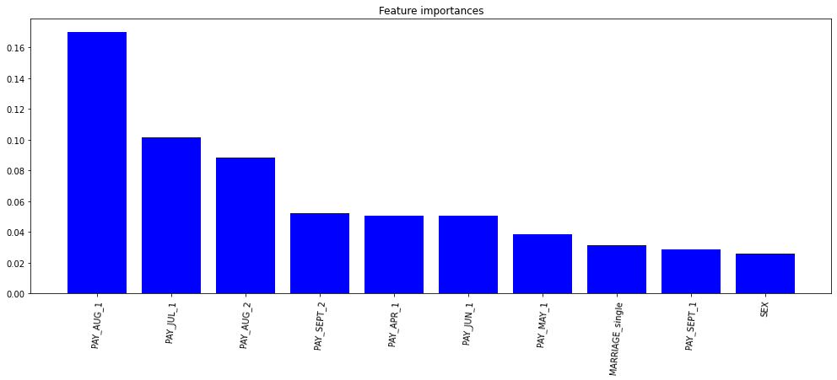
FEATURE IMPORTANCES
from the above feature importance graph we can say that the most important feature that make an impact on dependent variable are PAY_AUG_1

Slide 31
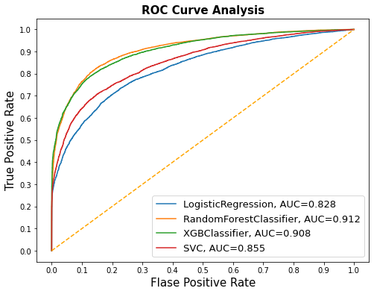
AUC-ROC CURVE COMPARISON
An ROC curve (receiver operating
characteristic curve) is a graph
showing the performance of a
classification model at all
classification thresholds.
This curve plots two parameters:
1. True Positive Rate
2. False Positive Rate
AUC stands for "Area under the
ROC Curve." That is, AUC measures
the entire two-dimensional area
underneath the entire ROC curve.

Slide 32
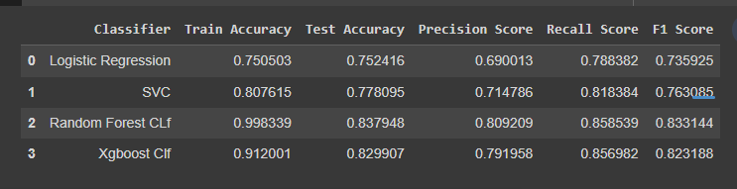
EVALUATING THE MODELS
from the above table we can find that xgboost classifier perform best among those models

Slide 33
CHALLENGES FACED
The data was huge and was to be handled keeping in mind that we do not miss anything which is even of a little relevance.
Computation time.
Getting a higher accuracy on the models.
Carefully handling feature imbalanced data.
Tuning of hyperparameters carefully.
Feature engineering

Slide 34
CONCLUSION
XGBoost model has the highest recall, if the business cares recall the most, then this model is the best candidate. If the balance of recall and precision is the most important metric, then Random Forest is the ideal model. Since Random Forest has slightly lower recall but much higher precision than Logistic Regression, I would recommend Random Forest.
Gradient boost gave the highest accuracy of 82% on test dataset. Repayment in the month of September tended to be the most important feature for our machine learning model.
The best accuracy is obtained for the Random forest and XGBoost classifier.
In general, all models have comparable accuracy. Nevertheless, because the classes are imbalanced (the proportion of non-default credit cards is higher than default) this metric is misleading.
From the table in the previous slide we can see that XGBoost Classifier having Recall, F1-score, and ROC Score values equals 82%, 77%, and 86% and Random forest Classifier having Recall, F1-score, and ROC Score values equals 81%, 75%, and 84%.
XGBoost Classifier and Decision Tree Classifier are giving us the best Recall, F1-score, and ROC Score among other algorithms. We can conclude that these two algorithms are the best to predict whether the credit card is default or not default according to our analysis.

