Slide 1
Student Dropout Prediction
Sandhya Suryanarayana

Slide 2
Topics
Problem Description
Data Wrangling
Data merging
Feature selection
Model Building
Pick Best model using ROC
Conclusion

Slide 3
Objective
Using predictive analytics to identify students at risk of dropping out, and using that knowledge to take steps to improve retention and graduation rates.
Five different types of datasets were provided, each containing different number of data sets.
1) Student Progress Data: Contains student's academic progress over time from Fall 2011 to Summer 2017. These data is collected every term.
2) Student Static Data: Contains static data like Demographics, age, Gender etc, once for each cohert .
3) Student Financial Aid Data: This was a single file with all finance related information from Fall 2011 to Summer 2017.This provided information about Scholarships, work/Study funds, Loans etc.
4) Dropout Train Label: This CSV file contained StudentID's and if that particular student has dropped out or not. This is used to train the models.
5) TestIDs : This file has StudentID's for which we are predicting the Dropouts.

Slide 4
Data Merging
The Student Progress Data contains duplicate ID’s.
Extract latest academic and latest term for each StudentID.
Merge the Static, Progress and financial data sets to get all the information about the student.
Remove all the variables which has all constant or all Null.

Slide 5
Columns that has ALL Null or constant value.
Static Data 2. Progress Data
Campus Complete2
Address2 DegreeTypeSought
FirstGen
DualSummerEnroll

Slide 6
Data Manipulation/Data Wrangling
To get the final data in the required and clean format each of the columns are studied thoroughly and modified appropriately.
1) BirthYear: the only Null value id replaced with the average BirthYear.
2)A new Race column was created to specify a categorical value for each the race
3)A MaritalStatusNew column was created which replaces all the Null value with the most occuring class(i.e Single)
4) The NULL values in FatherHighestGradeLevel and MotherHighestGradLevel is replaced with 'Unknown'.
5)All the NULL values related to Financial columns like Grant, Scholarships are imputed with 0.
6)A new column Funds is created for each year to repesent if the perticular student has been involved in any kind of Loan or fund activity.(1 if YES: 0 if NO)

Slide 7
Data Summary :
StudentID Term AcademicYear LatestYear CompleteDevMath CompleteDevEnglish Major1 Complete1 CompleteCIP1 TermGPA
Min. : 20932 1:3026 Min. :2011 Min. :12.0 -2:7857 -2:8867 Min. :-1.00 0:8814 Min. :-2.00 Min. :0.000
1st Qu.:305164 3:7246 1st Qu.:2014 1st Qu.:15.0 -1: 520 -1: 520 1st Qu.:26.01 7:1122 1st Qu.:-2.00 1st Qu.:1.700
Median :321580 6:1989 Median :2015 Median :16.0 0 :3405 0 :2324 Median :43.04 8:2325 Median :-2.00 Median :3.080
Mean :316079 Mean :2015 Mean :15.7 1 : 479 1 : 550 Mean :38.34 Mean :10.94 Mean :2.583
3rd Qu.:343608 3rd Qu.:2016 3rd Qu.:17.0 3rd Qu.:51.38 3rd Qu.:26.00 3rd Qu.:3.700
Max. :359783 Max. :2016 Max. :17.0 Max. :54.01 Max. :54.00 Max. :4.000
CumGPA State Gender BirthYear Hispanic AmericanIndian Asian Black NativeHawaiian
Min. :0.000 NJ :11972 1:4947 Min. :1945 Min. :-1.0000 Min. :-1.0000 Min. :-1.00000 Min. :-1.0000 Min. :-1.00000
1st Qu.:2.300 NY : 120 2:7314 1st Qu.:1986 1st Qu.: 0.0000 1st Qu.: 0.0000 1st Qu.: 0.00000 1st Qu.: 0.0000 1st Qu.: 0.00000
Median :3.070 FL : 29 Median :1991 Median : 0.0000 Median : 0.0000 Median : 0.00000 Median : 0.0000 Median : 0.00000
Mean :2.778 CA : 16 Mean :1989 Mean : 0.2567 Mean :-0.0668 Mean : 0.01974 Mean : 0.1467 Mean :-0.06696
3rd Qu.:3.580 MD : 15 3rd Qu.:1994 3rd Qu.: 1.0000 3rd Qu.: 0.0000 3rd Qu.: 0.00000 3rd Qu.: 0.0000 3rd Qu.: 0.00000
Max. :4.000 PA : 14 Max. :2000 Max. : 1.0000 Max. : 1.0000 Max. : 1.00000 Max. : 1.0000 Max. : 1.00000
(Other): 95
White HsDip HSDipYr HSGPAUnwtd Enrollmentstatus NumColCredAttemptTransfer NumColCredAcceptTransfer HighDeg MathPlacement
Min. :-1.0000 -1: 842 Min. : -1.0 Min. :-1.0000 1:4952 Min. : -2.00 Min. :-2.00 0:8710 -1: 520
1st Qu.: 0.0000 0 :11205 1st Qu.: -1.0 1st Qu.:-1.0000 2:7309 1st Qu.: -2.00 1st Qu.:-2.00 2:3406 0 :7859
Median : 0.0000 1 : 214 Median : -1.0 Median :-1.0000 Median : 16.00 Median :24.00 3: 143 1 :3882
Mean : 0.1824 Mean : 547.6 Mean : 0.1395 Mean : 37.46 Mean :32.14 4: 2
3rd Qu.: 1.0000 3rd Qu.:2010.0 3rd Qu.: 2.3800 3rd Qu.: 73.00 3rd Qu.:66.00
Max. : 1.0000 Max. :2016.0 Max. : 4.0000 Max. :150.00 Max. :96.00
EngPlacement GatewayMathStatus GatewayEnglishStatus cohort cohortterm MaritalStatus AdjustedGrossIncome ParentAdjustedGrossIncome
-1: 520 0:10794 0:9967 2011-12:2131 Min. :1.000 Divorced : 208 Min. : -24326 Min. :-49406
0 :8966 1: 1467 1:2294 2012-13:2059 1st Qu.:1.000 Married : 924 1st Qu.: 0 1st Qu.: 0
1 :2775 2013-14:1936 Median :1.000 Separated: 185 Median : 0 Median : 0
2014-15:2080 Mean :1.393 Single :9103 Mean : 11271 Mean : 24066
2015-16:2184 3rd Qu.:1.000 NA's :1841 3rd Qu.: 13563 3rd Qu.: 32980
2016-17:1871 Max. :3.000 Max. :2576425 Max. :657631

Slide 8
Data Summary part-2
FatherHighestGradeLevel MotherHighestGradeLevel Housing Loan2012 Scholarship2012 WorkStudy2012 Grant2012
College :2916 College :2896 Off Campus :4846 Min. : 0.0 Min. : 0.00 Min. : 0.00 Min. : 0
High School :4578 High School :4516 On Campus Housing:1430 1st Qu.: 0.0 1st Qu.: 0.00 1st Qu.: 0.00 1st Qu.: 0
Middle School:1201 Middle School:1153 With Parent :4120 Median : 0.0 Median : 0.00 Median : 0.00 Median : 0
Unknown :3566 Unknown :3696 NA's :1865 Mean : 670.3 Mean : 69.89 Mean : 14.58 Mean : 682
3rd Qu.: 0.0 3rd Qu.: 0.00 3rd Qu.: 0.00 3rd Qu.: 0
Max. :55626.0 Max. :27631.90 Max. :3000.00 Max. :13263
Loan2013 Scholarship2013 WorkStudy2013 Grant2013 Loan2014 Scholarship2014 WorkStudy2014 Grant2014 Loan2015
Min. : 0 Min. : 0.0 Min. : 0.0 Min. : 0 Min. : 0 Min. : 0.0 Min. : 0.00 Min. : 0 Min. : 0
1st Qu.: 0 1st Qu.: 0.0 1st Qu.: 0.0 1st Qu.: 0 1st Qu.: 0 1st Qu.: 0.0 1st Qu.: 0.00 1st Qu.: 0 1st Qu.: 0
Median : 0 Median : 0.0 Median : 0.0 Median : 0 Median : 0 Median : 0.0 Median : 0.00 Median : 0 Median : 0
Mean : 1180 Mean : 112.4 Mean : 27.9 Mean : 1215 Mean : 1502 Mean : 157.6 Mean : 35.41 Mean : 1576 Mean : 1673
3rd Qu.: 0 3rd Qu.: 0.0 3rd Qu.: 0.0 3rd Qu.: 0 3rd Qu.: 0 3rd Qu.: 0.0 3rd Qu.: 0.00 3rd Qu.: 0 3rd Qu.: 0
Max. :50555 Max. :28737.1 Max. :4000.0 Max. :13790 Max. :49845 Max. :38850.6 Max. :3300.00 Max. :14001 Max. :47824
Scholarship2015 WorkStudy2015 Grant2015 Loan2016 Scholarship2016 WorkStudy2016 Grant2016 Loan2017 Scholarship2017
Min. : 0.0 Min. : 0.0 Min. : 0 Min. : 0 Min. : 0.0 Min. : 0.00 Min. : 0 Min. : 0 Min. : 0.0
1st Qu.: 0.0 1st Qu.: 0.0 1st Qu.: 0 1st Qu.: 0 1st Qu.: 0.0 1st Qu.: 0.00 1st Qu.: 0 1st Qu.: 0 1st Qu.: 0.0
Median : 0.0 Median : 0.0 Median : 0 Median : 0 Median : 0.0 Median : 0.00 Median : 0 Median : 0 Median : 0.0
Mean : 215.1 Mean : 39.8 Mean : 1876 Mean : 1821 Mean : 254.5 Mean : 40.16 Mean : 2060 Mean : 1987 Mean : 360.4
3rd Qu.: 0.0 3rd Qu.: 0.0 3rd Qu.: 795 3rd Qu.: 0 3rd Qu.: 0.0 3rd Qu.: 0.00 3rd Qu.: 2063 3rd Qu.: 0 3rd Qu.: 0.0
Max. :30477.9 Max. :4600.0 Max. :19038 Max. :52880 Max. :31265.5 Max. :4000.00 Max. :18505 Max. :60118 Max. :33847.9
WorkStudy2017 Grant2017 Race MaritalStatusNew Funds12 Funds13 Funds14 Funds15 Funds16 Funds17 Dropout
Min. : 0.0 Min. : 0 -1:1424 Divorced : 208 0:10553 0:9382 0:8620 0:8035 0:7708 0:7618 0:7527
1st Qu.: 0.0 1st Qu.: 0 1 :3990 Married : 924 1: 1708 1:2879 1:3641 1:4226 1:4553 1:4643 1:4734
Median : 0.0 Median : 0 2 : 23 Separated: 185
Mean : 50.7 Mean : 2280 3 :1084 Single :10944
3rd Qu.: 0.0 3rd Qu.: 2481 4 :2641
Max. :3000.0 Max. :19823 5 : 21
6 :3078

Slide 9
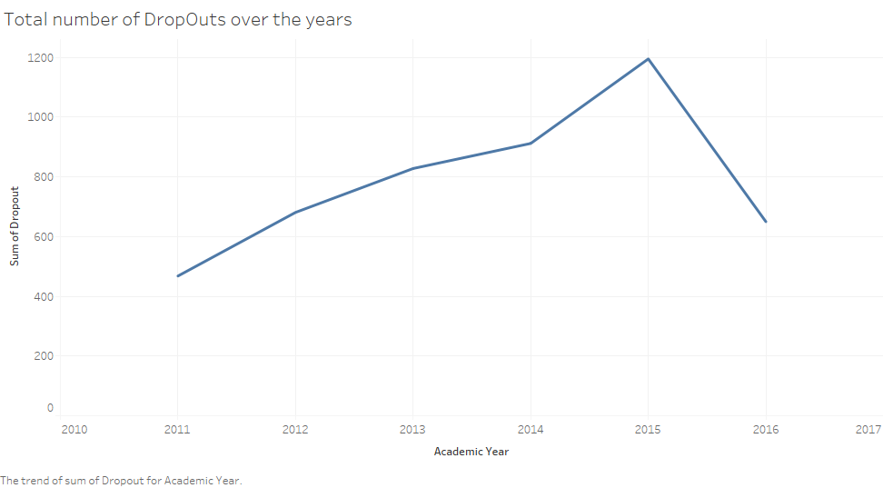
Exploratory Data Analysis
Plot 1: Academic year Over Number of dropouts

Slide 10
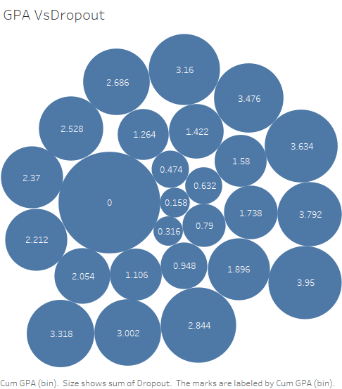
Plot 2: Cumulative GPA Vs Dropouts

Slide 11
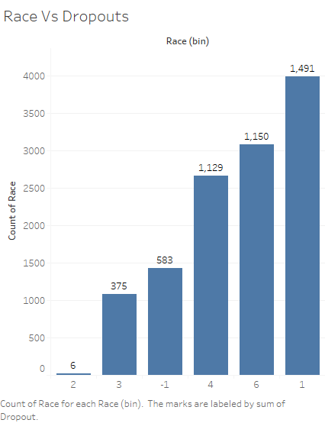
Plot 3: Race Vs Dropouts

Slide 12
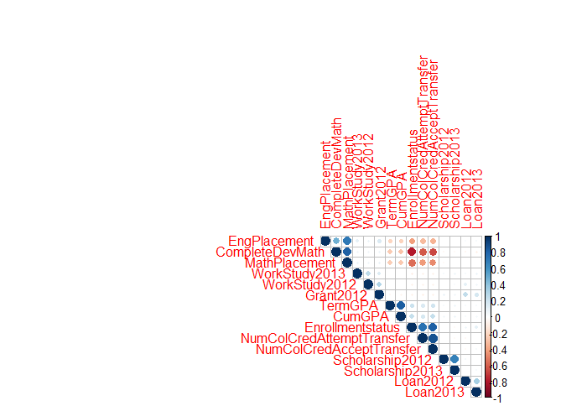
Correlation Plot: Correlation plot to understand the relationship between the variables.

Slide 13
If Correlation between any pair is > 0.75, one of the variables can be removed to reduce linear dependency These are the few variables that was removed to reduce linear dependency
MathPlacement
TermGPA
NumColCredAcceptTransfer
NumColCredAttemptTransfer

Slide 14
Feature Selection
Feature selection is made using Best Subset selection.
Remove all linear dependent Variables
Apply regsubsets on rest of the variables
BIC chose 16 feature variable while Adjusted R2 chose 20.
I have used both 16 and 20 variables in my model to check for highest accuracy

Slide 15
Model Building
Four different models were built using different feature variables and different Resampling technique.
Models | DecisionTree | SVM Radial | Bagging | RandomForest
Accuracy | 90.7% | 91.3% | 91.7% | 92.65%
Kappa | 80.7% | 80.55% | 81.39% | 82.5%
Cp/Cost/Sigma | Cp=0.03 | Sigma:0.03,Cost=1

Slide 16
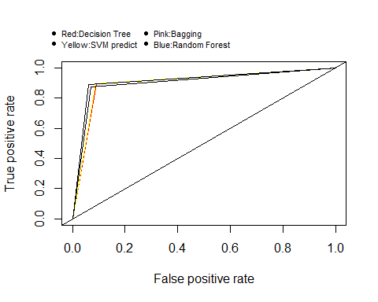
Receiver operating characteristic(ROC): A ROC plot is drawn for all the four models to select the best models. Random forest has the greatest AUC

Slide 17
Conclusion:
Data Wrangling/Data Manipulation is the most important part to get good prediction model.
AUC for ROC curve is highest for Random Forest.
Though Random forest gives the highest accuracy, Decision tree being the simplest can be picked up for the Prediction analysis.

