Slide 1
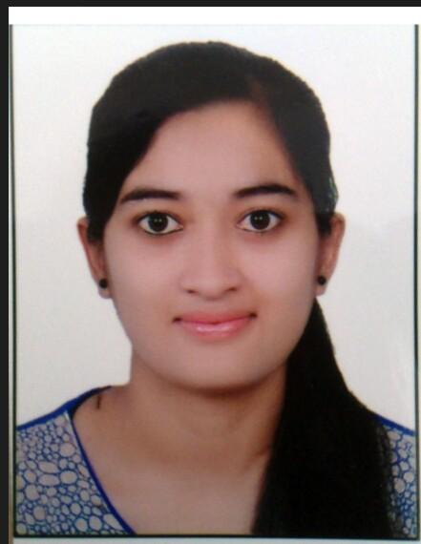
Azure Devops Engineer: Sandhya Avhad
Overall Experience
5+ years of experience in designing & Implement solutions for Azure infrastructure with terraform and azure devops
Created a declarative pipeline to integrate GIT, Maven, Sonarqube, Jfrog tools to download the latest package from Maven and deploy to multiple Tomcat servers using Azure DevOps.
Create & Manage Infrastructure & Configuration with Terraform Docker, PowerShell, and AZDO Pipeline on the Azure Environment, Git Repositories & Branch Policies & Restrictions, and Terraform Modules.
Troubleshoot Any Failures Related to Infrastructure AZDO Pipelines, Agents, Docker, AKS,App Service, AD & IAM, Compute resources & hosted Solutions Logs, Networks & NSGs ETC.
Sync ups with the Clients & DEV Team to understand architecture for Provisioning resources with DevOps Practices & IAAC Tools.
Set up & manages core azure pipelines & YAML def, configuring Agents for Self-hosted CICD VMs & Docker, VK, Networking, etc.
Document & Deploy solutions to higher Environments, while taking the complete handover & ownership of solutions for maintaining sol, with roll-back strategies in place.
Knowledge Transfer to Dev & Internal Members for the tools like Terraform, GIT, and Network Architectures & assist the team to implement DevOps ways.
Tools- Azure DevOps, Terraform, Docker, Ansible, AKS Kubernetes, Grafana, Azure Cloud Services, Bash shell scripting,SonarQube,Git
Education and Certifications:
Bachelors of Engineering (CS)
Microsoft Azure DevOps Expert (Az-400)
Microsoft Administrator (Az-104)
Microsoft Fundamentals (Az-900)

